Slide 1
Address Resolution Protocol
(ARP)

Slide 2
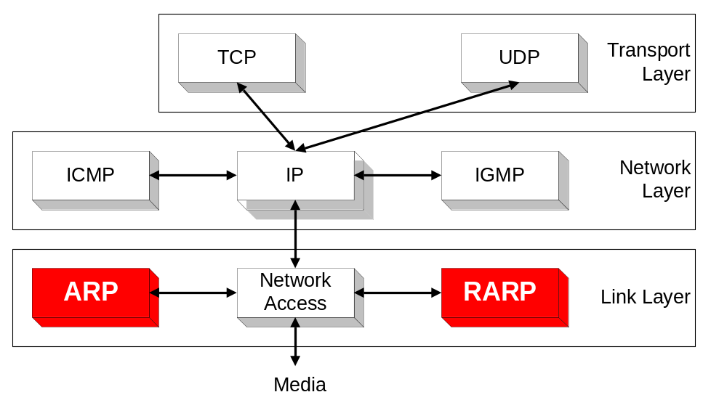
Overview

Slide 3
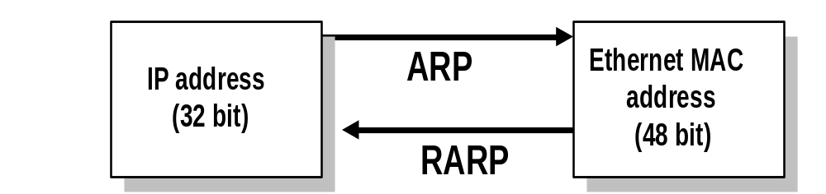
ARP and RARP
Note:
  The Internet is based on IP addresses
  Data link protocols (Ethernet, FDDI, ATM) may have different (MAC) addresses
The ARP and RARP protocols perform the translation between IP addresses and MAC layer addresses
We will discuss ARP for broadcast LANs, particularly Ethernet LANs

Slide 4
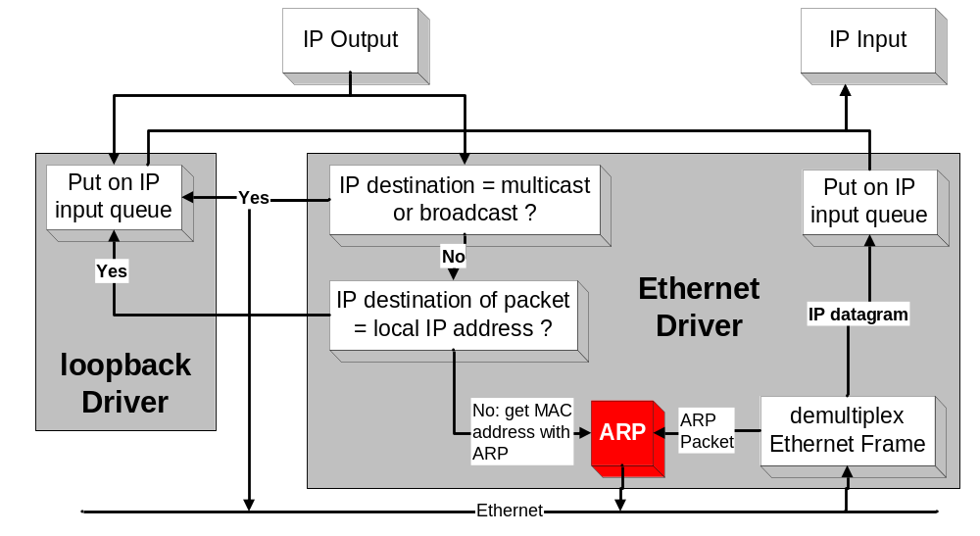
Processing of IP packets by network device drivers

Slide 5
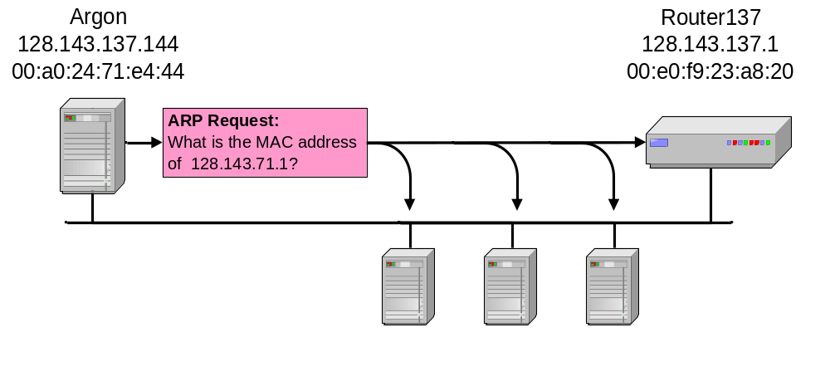
Address Translation with ARP
ARP Request:
Argon broadcasts an ARP request to all stations on the network: “What is the hardware address of 128.143.71.1?”

Slide 6
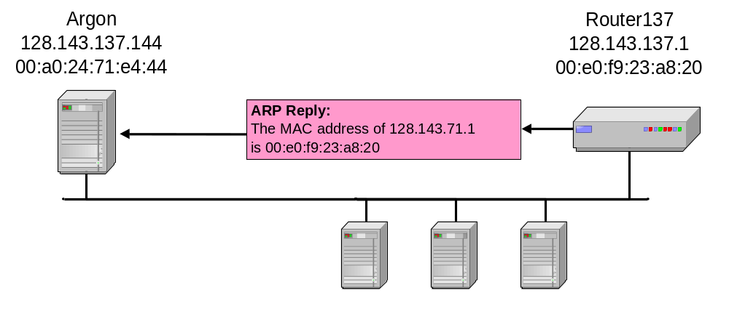
Address Translation with ARP
ARP Reply:
Router 137 responds with an ARP Reply which contains the hardware address

Slide 7
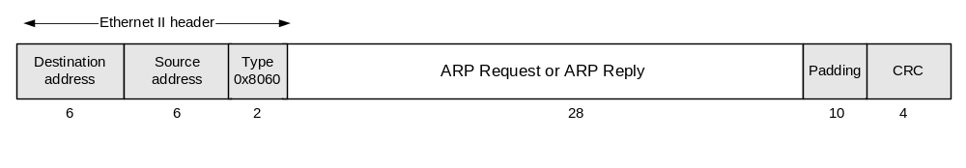
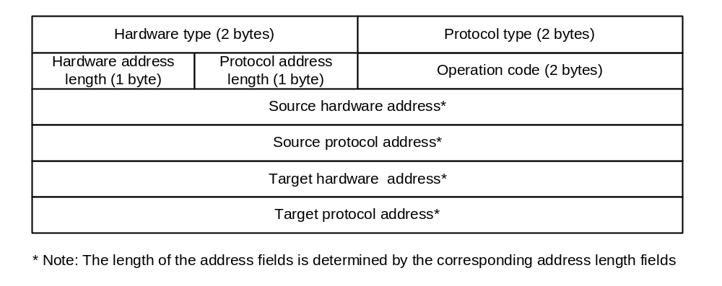
ARP Packet Format

Slide 8
Example
ARP Request from Argon:
Source hardware address: 00:a0:24:71:e4:44
Source protocol address: 128.143.137.144
Target hardware address: 00:00:00:00:00:00
Target protocol address: 128.143.137.1
ARP Reply from Router137:
Source hardware address: 00:e0:f9:23:a8:20
Source protocol address: 128.143.137.1
Target hardware address: 00:a0:24:71:e4:44
Target protocol address: 128.143.137.144

Slide 9
ARP Cache
Since sending an ARP request/reply for each IP datagram is inefficient, hosts maintain a cache (ARP Cache) of current entries. The entries expire after 20 minutes.
Contents of the ARP Cache:
  (128.143.71.37) at 00:10:4B:C5:D1:15 [ether] on eth0
  (128.143.71.36) at 00:B0:D0:E1:17:D5 [ether] on eth0
  (128.143.71.35) at 00:B0:D0:DE:70:E6 [ether] on eth0
  (128.143.136.90) at 00:05:3C:06:27:35 [ether] on eth1
  (128.143.71.34) at 00:B0:D0:E1:17:DB [ether] on eth0
  (128.143.71.33) at 00:B0:D0:E1:17:DF [ether] on eth0

Slide 10
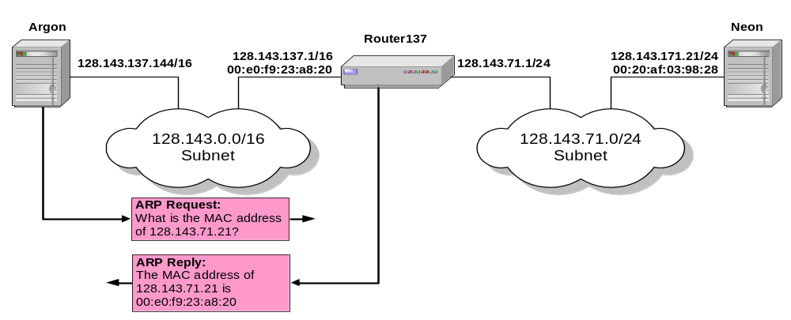
Proxy ARP
Proxy ARP: Host or router responds to ARP Request that arrives from one of its connected networks for a host that is on another of its connected networks.

Slide 11
Things to know about ARP
What happens if an ARP Request is made for a non-existing host?
Several ARP requests are made with increasing time intervals between requests. Eventually, ARP gives up.
On some systems (including Linux) a host periodically sends ARP Requests for all addresses listed in the ARP cache. This refreshes the ARP cache content, but also introduces traffic.
Gratuitous ARP Requests: A host sends an ARP request for its own IP address:
  Useful for detecting if an IP address has already been assigned.

Slide 12
Vulnerabilities of ARP
Since ARP does not authenticate requests or replies, ARP Requests and Replies can be forged
ARP is stateless: ARP Replies can be sent without a corresponding ARP Request
According to the ARP protocol specification, a node receiving an ARP packet (Request or Reply) must update its local ARP cache with the information in the source fields, if the receiving node already has an entry for the IP address of the source in its ARP cache. (This applies for ARP Request packets and for ARP Reply packets)
Typical exploitation of these vulnerabilities:
A forged ARP Request or Reply can be used to update the ARP cache of a remote system with a forged entry (ARP Poisoning)
This can be used to redirect IP traffic to other hosts

