Slide 1

TEAM 2 Digital VR Treadmill
Team Lead: Jiayi He (Louise)
VisD: Shangying Xu (Vivian)
IxDG: Chunqin Cao (Doris)
ID: Yushi Fu (Stella)

Slide 2
Problems? Solution?
During Covid-19 Period, People can’t go out
Running on the treadmill could be a little bit boring
Digital VR Treadmill

Slide 3
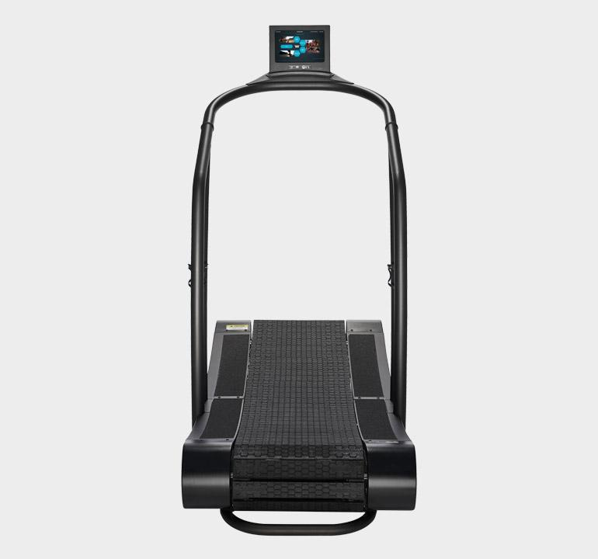
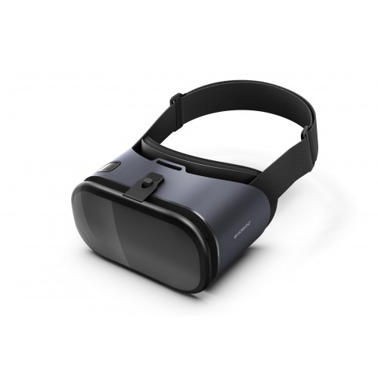
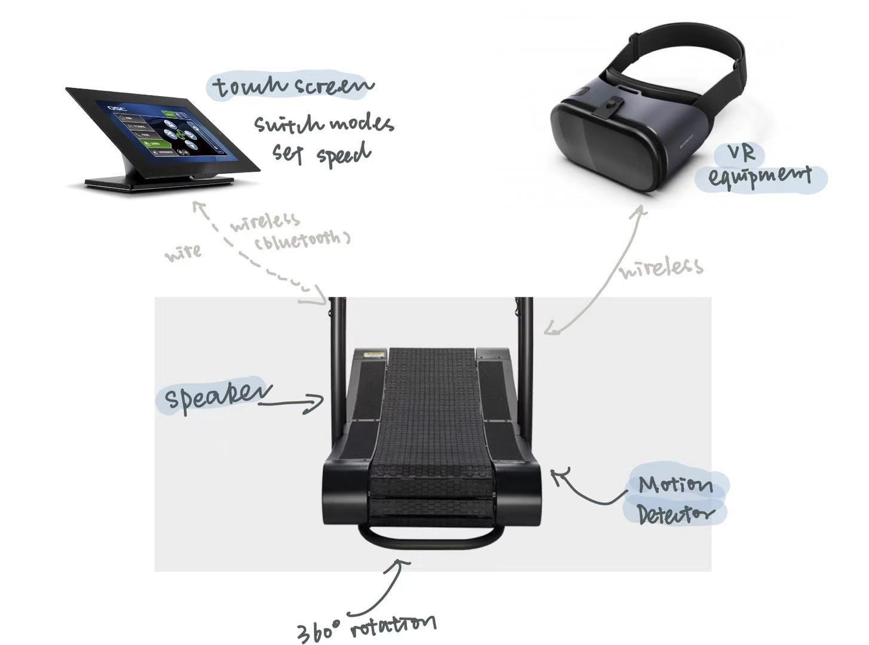
Physical Components
Treadmill
Touchscreen+Speakers
VR Equipments
Immersive Running Experience

Slide 4
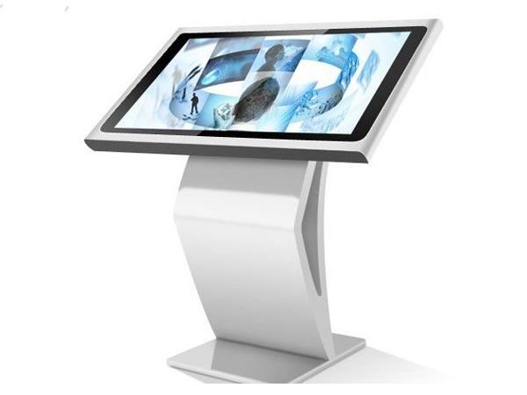
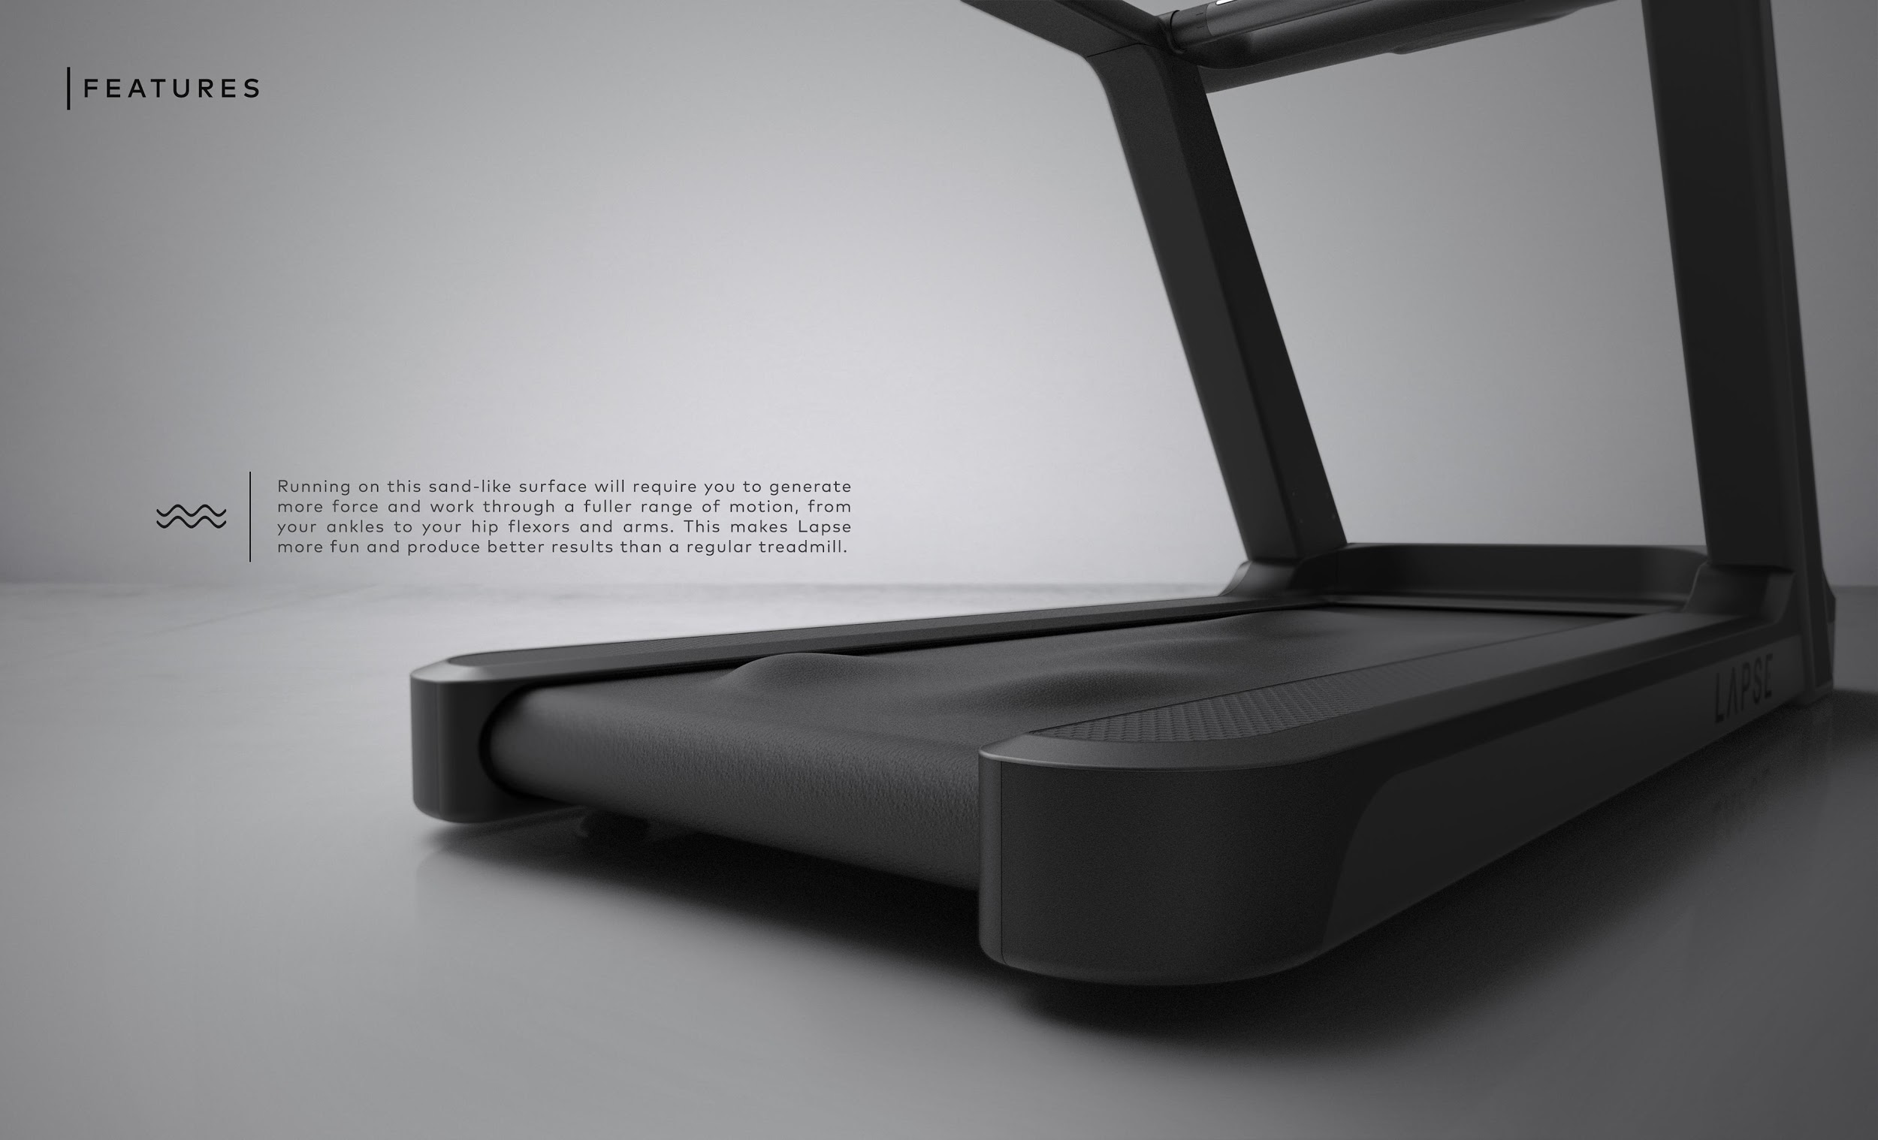
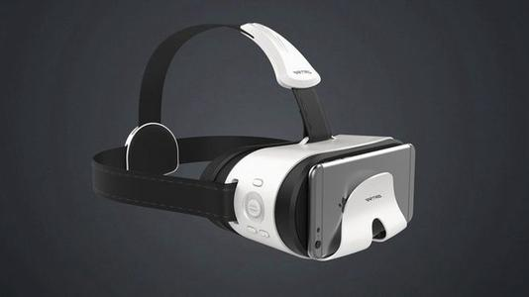
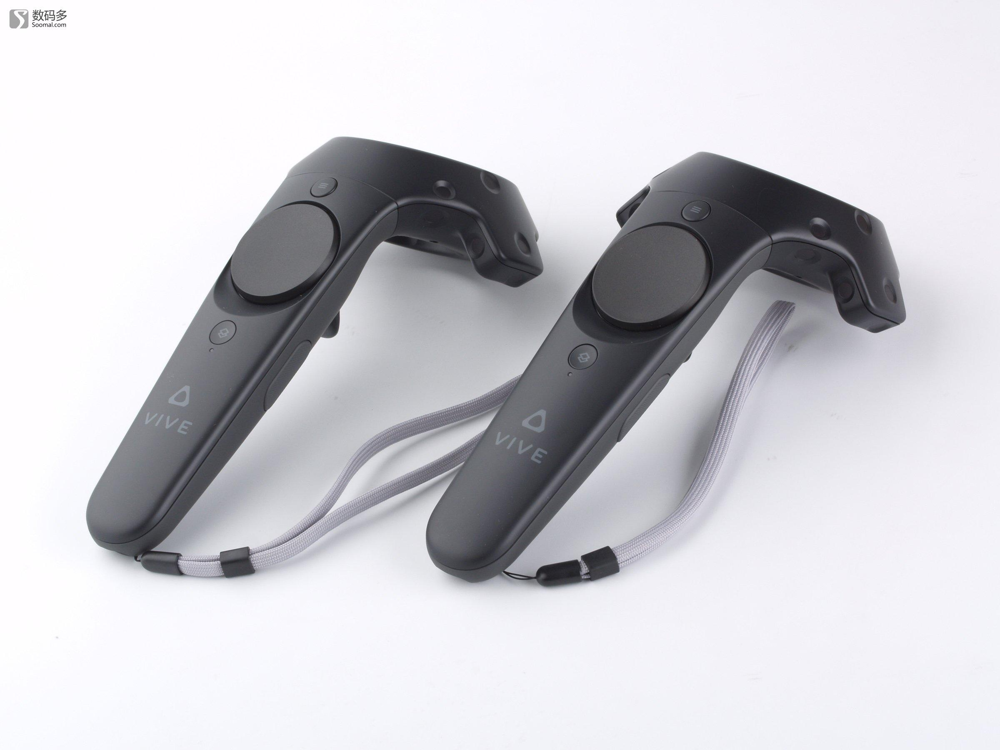
Digital Interface
Touch-sensitive Interface
Motion Detector
86
64
49
VR Equipment

Slide 5


Interactive
Wonderful audio and visual experiences
Travel at home during COVID-19 time
Help users keep fit by doing sports

Slide 6


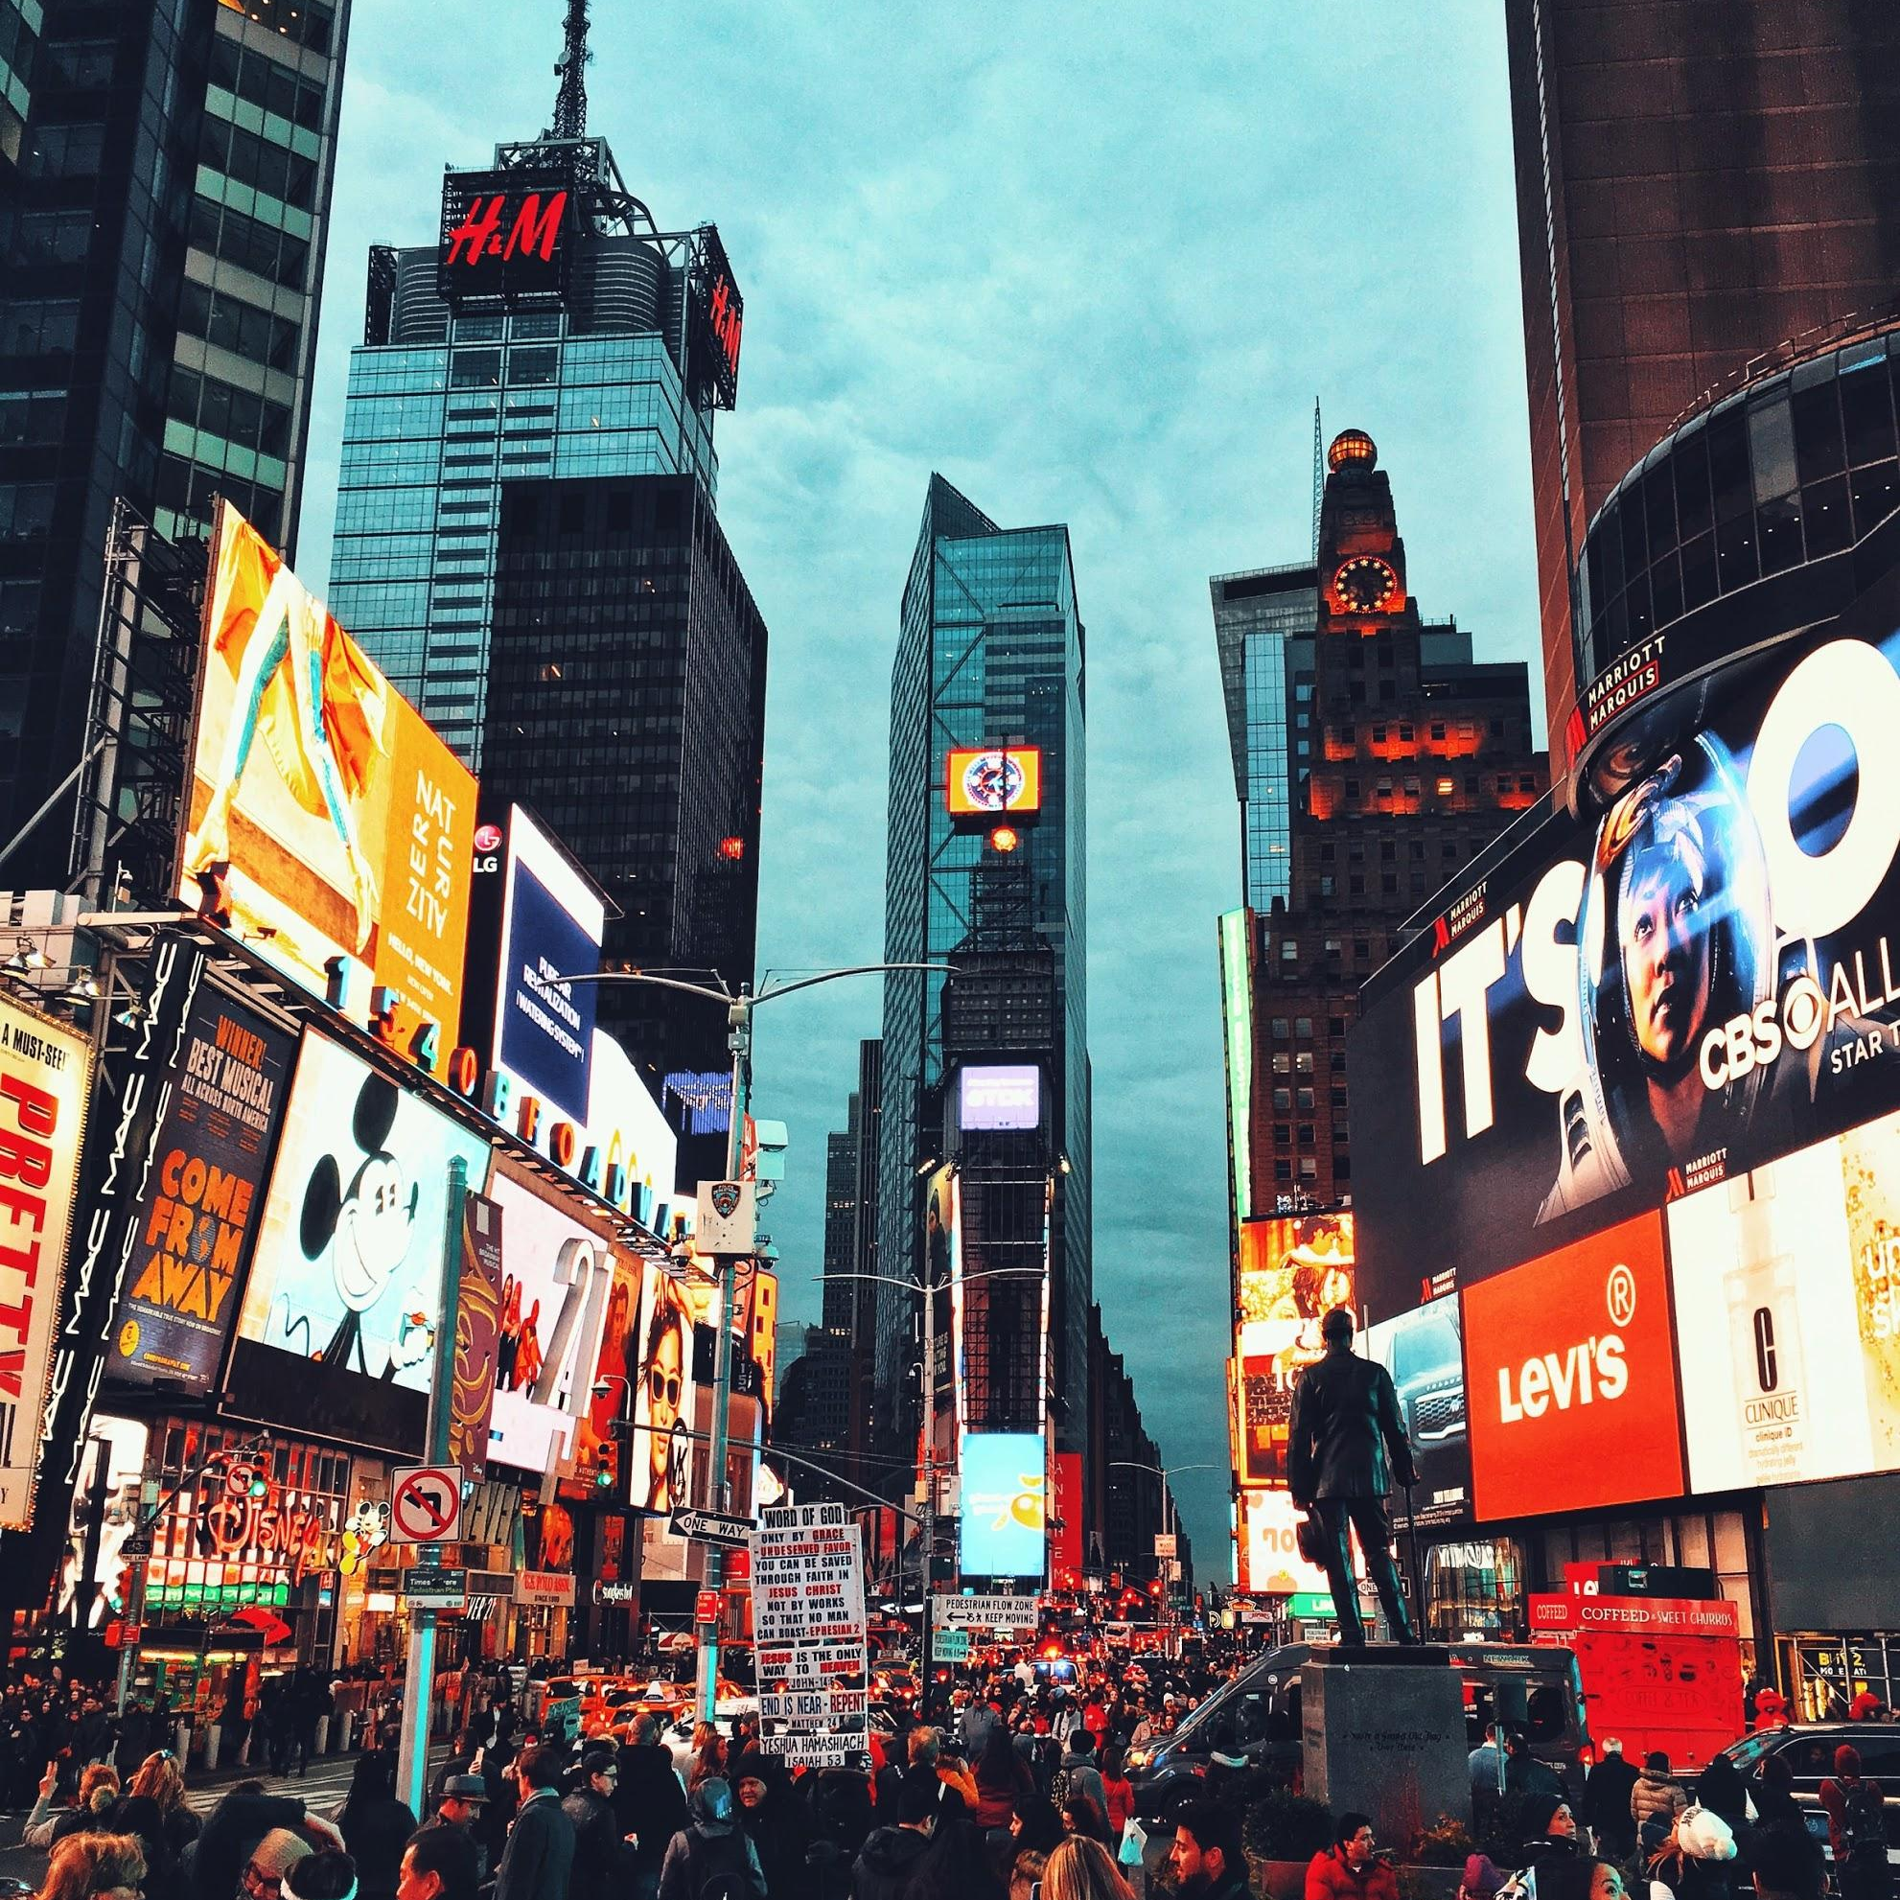

Interactive
Mode Changes
The machine’s mode changes depending on the user’s heart rate, motion and surrounding temperatures accordingly.
The user can also change the machine to any mode they want.
Slope, speed, visual environment, audio and route change in different modes.
Popular Modes listed:
Iceberg
Forest
Rainforest
Park
Beach
Times square
...
Design your own sports space!

Slide 7
Feasibility
Goal
Function
Marketing Strategy
Direct sales channel
Indirect sales channel
Bring more people to have the outdoor sports experience during the quarantine
This equipment mainly serves them and aims to bring them extraordinary hiking experience even at home
the combination of direct sales channel and indirect sales channel
allowing the online and instore purchase; set up a pop-up store
Cooperating with some electronic equipment store and sports equipment store.(ex. Bestbuy, Nordic Track)

Slide 8
THANK YOU!

