Slide 1
Project Ideation
DMS 104-Group 6-Oslo
Jingyan (Jennifer) Yu,
Daniel Freedman,
and Muchen (Skyler) Zhong

Slide 2
Smart Alarm Clock
“Moody” Face Mask
01
02
03
The TeleWindow
A special alarm clock with functions and tasks that helps you to prevent sleep through.
A protective and interactive face mask that helps you to show facial expressions, play games, and a lot more.
A TeleWindow with changeable scenery that brings natural light into your room.

Slide 3
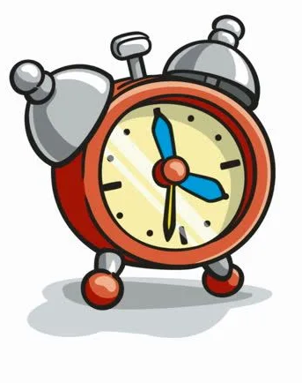
Smart Alarm Clock
Problems like...
Can’t get up every morning?
Sleep through your alarm clock after hitting the snooze button?
Be late for work or school?
NO WORRIES!

Slide 4
Smart Alarm Clock
Physical presentation: an alarm clock with a screen, some buttons and a mic.
Problem: People sleep through their alarm clock is either because the alarm is not loud enough, or for the most of the time, they hit the SNOOZE button.
How to solve it? (human interface)
Louder alarm sound
NO snooze button
Set up different tasks for different users in order to make them wide awake.

Slide 5
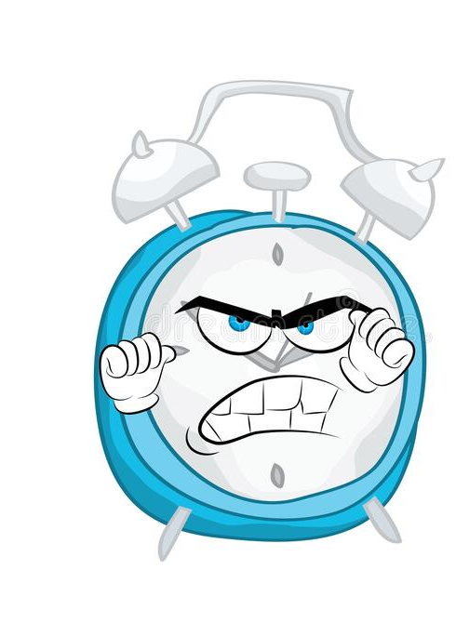
Smart Alarm Clock (Interactivity)
WAKE UP!
The alarm will NOT stop until you pass the task you chose and it will become louder as you take more time to complete. The users will mostly likely be awake after finishing the task. So, it’s easier for them to get out of their bed and have a DELIGHTFUL day.
Tasks include:
Do a list of math questions on the screen correctly.
Or
Spell some long words correctly.
Or
Sing a song that you chose last night, and the system will grade you base on your completion.
Or
Play some simple games with the system and win.
And etc. The users can choose different tasks base on their own condition.

Slide 6
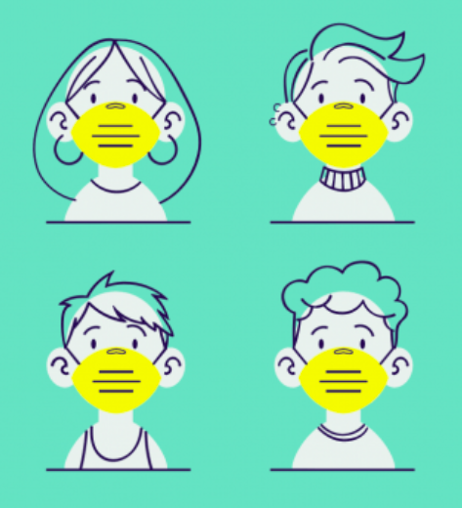
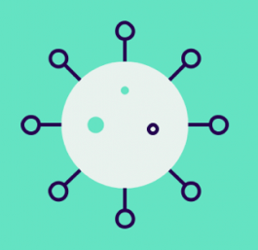

“Moody” Face Mask
Physical presentation: A face mask with a display screen.
Bored with the look of the medical face masks? Hard to express your feelings or hear others through the mask?
The human interface:
Protective
Interactive
Fashionable
Easy to clean (anti-fogging)
Environmental-friendly

Slide 7


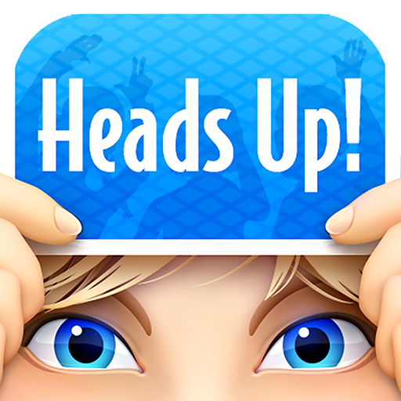
“Moody” Face Mask
The interactivity
Sound Reactive LED Face Mask
Facial expressions
Interactive games
Real-time subtitles/Closed captions
Controllable via mobile app

Slide 8
The TeleWindow
For those in places where it is hard to get outside
The TeleWindow allows for a source of natural light along with changeable scenery while being in a transportable form.

Slide 9
The TeleWindow
Hardware/Interface:
-The TeleWindow is a 2ft x 3ft x 2in smart screen that can use either a plug or batteries
Interactivity:
-It’s purpose is to add natural light to a room while showing different environments to simulate a window (for example, a beach, a rainforest, a city, coral reefs)
-Along with this, it will have buttons to change brightness, on/off/rest, volume of background, change background, display local features (weather, sun rise, calendar). There will be an app where the user can change these settings and add different backgrounds or features
-Rest mode will dim the screen so there is still some natural light being displayed, but it will be significantly more subtle

Slide 10
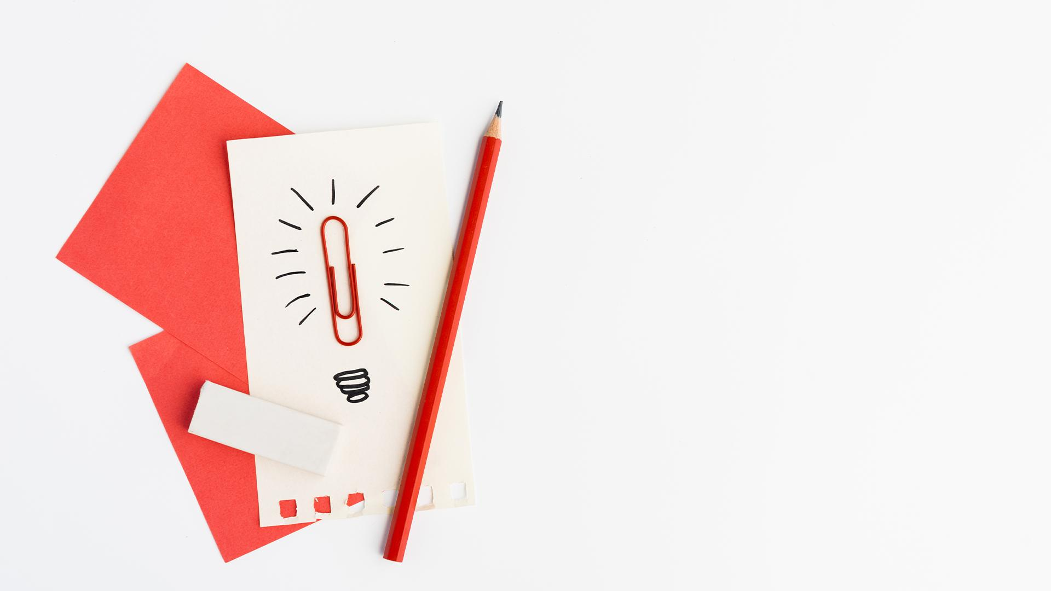
Thanks!

