Slide 1
DeltaDynisma Terrascope
"Development of optimal solutions for land use considering economic and environmental factors"

Slide 2
How?
What?
Why?

Slide 3
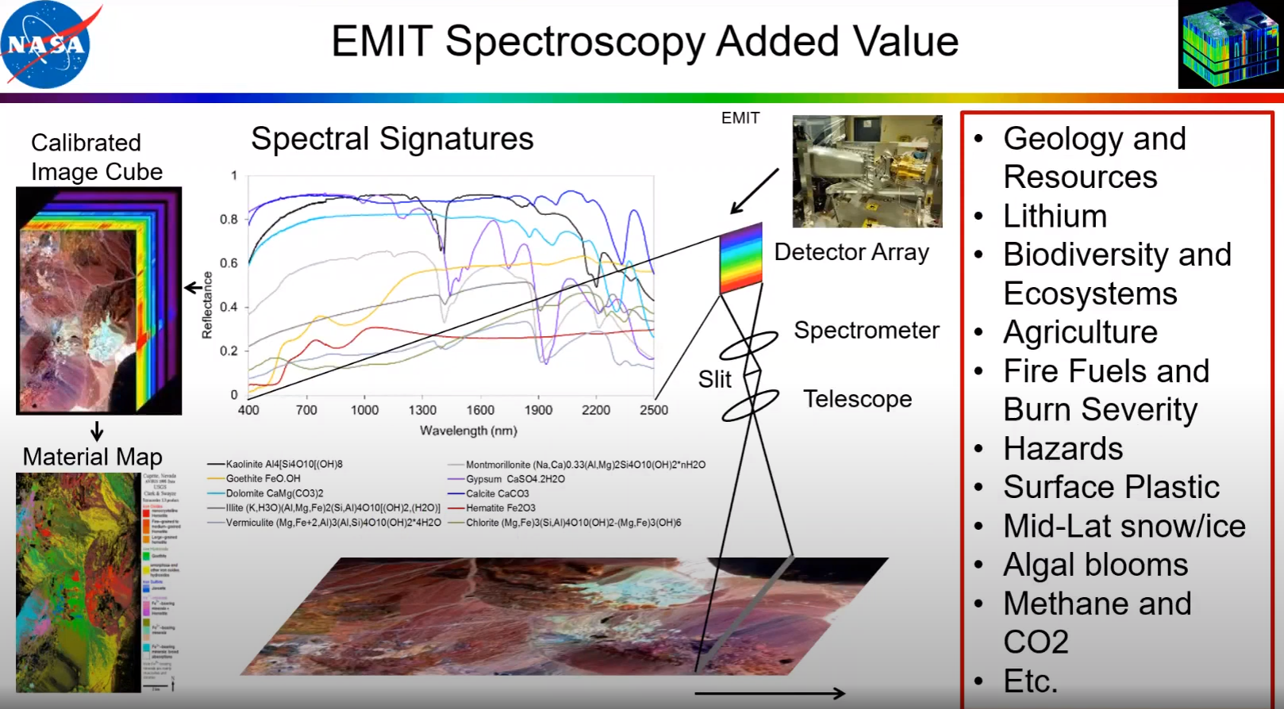
What is EMIT

Slide 4
Terrascope
"Maximizing the Efficient Utilization of Land Considering Economic and Environmental Aspects"

Slide 5
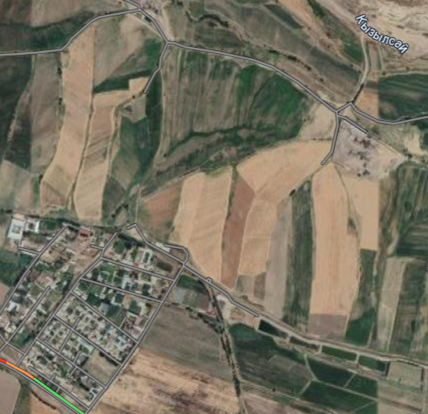
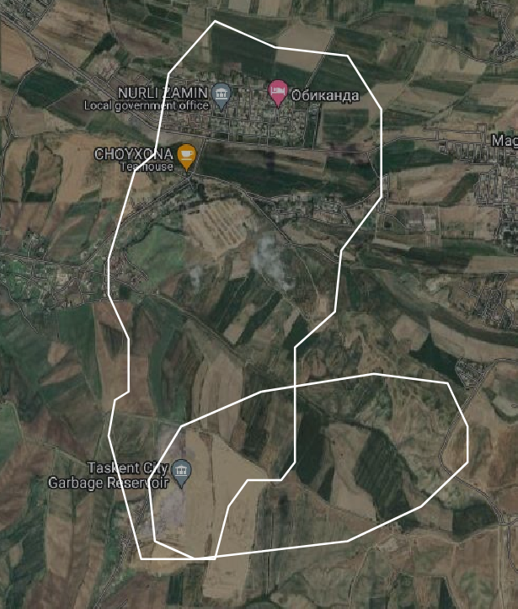
Target
Affect

Slide 6
What is the nature of our project Terrascope?
Our project is capable of detecting and analyzing the presence of valuable minerals in the soil. This can be valuable information for geological exploration and the search for natural resources such as metals, minerals, or even oil and gas. This function can help identify potentially valuable deposits, which can be beneficial for both agriculture and infrastructure projects.

Slide 7
Our project has the capability to tackle several important issues
Site Selection for Construction
Enhancing Agriculture
Mineral Exploration
Our project assists farmers in analyzing soil composition, mineral content, and consistency. This information helps farmers make informed decisions regarding crop selection and cultivation techniques, ultimately optimizing crop yields
It can identify valuable minerals present in the soil, aiding in geological exploration and the search for valuable resources like metals and minerals.
For builders, our project provides data on soil hardness, making it easier to select appropriate locations for construction projects and infrastructure development. This, in turn, helps avoid potential problems associated with unsuitable soil conditions.

Slide 8
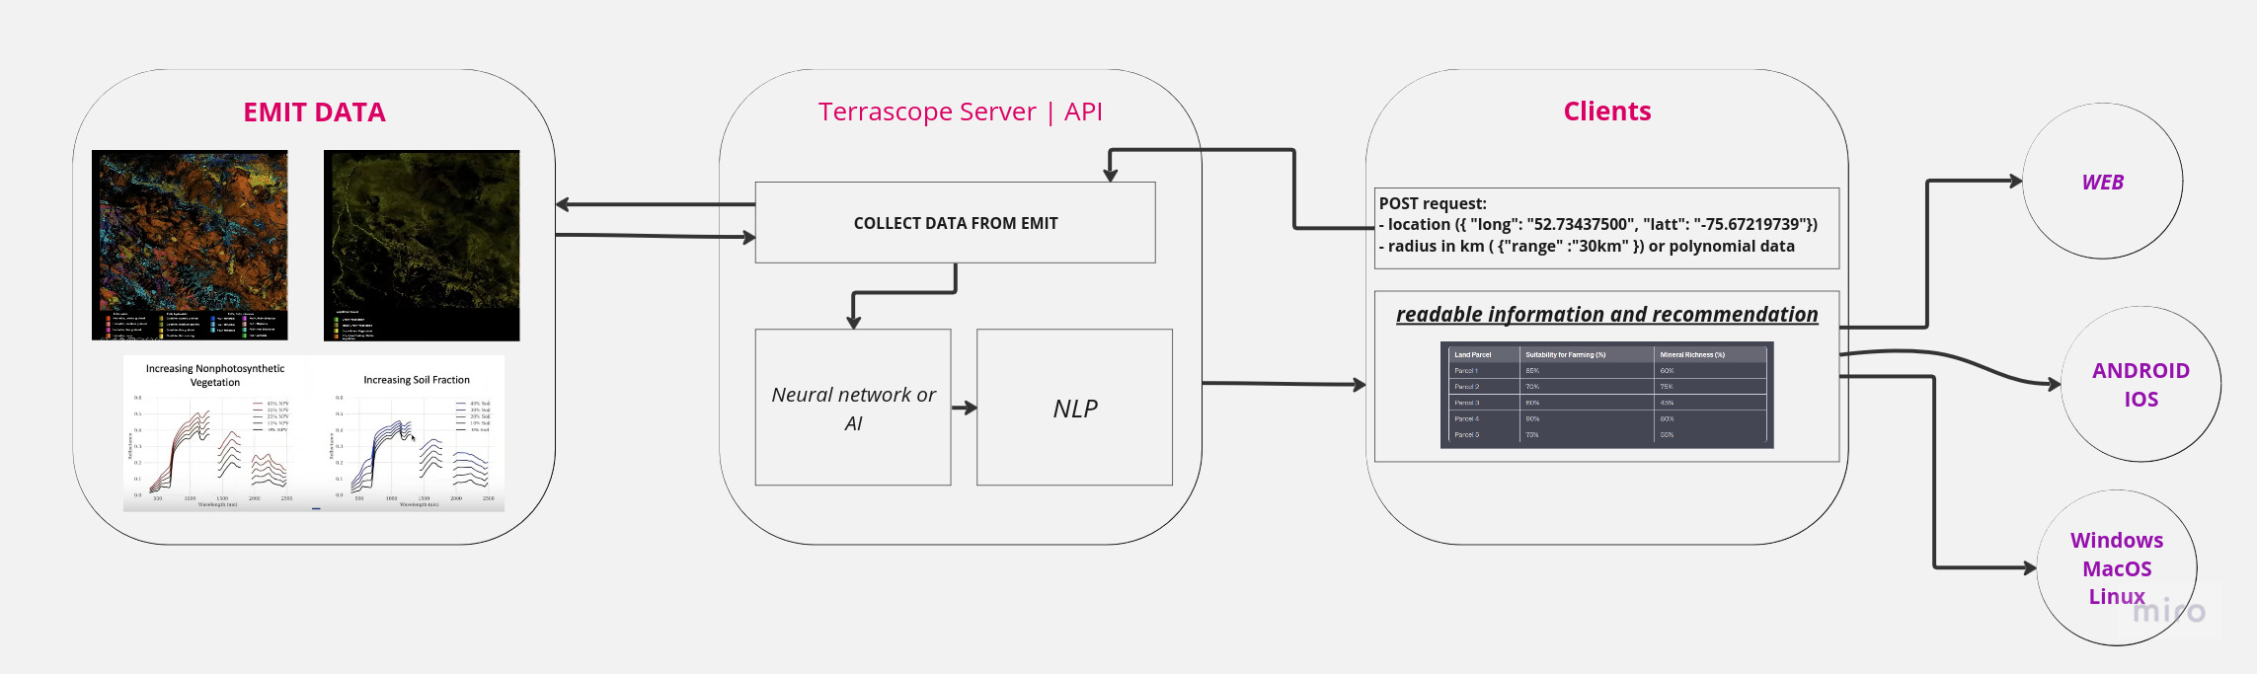
How Terrascope work?
Mars
Saturn
Jupiter
Venus
Mercury
Neptune
Despite being red, Mars is actually a cold place
Saturn is a gas giant and has several rings
It’s the biggest planet in the Solar System

Slide 9
Why Terrascope?
Fast
Accessibility
Economy

Slide 10
Thanks for attention!

