Slide 1
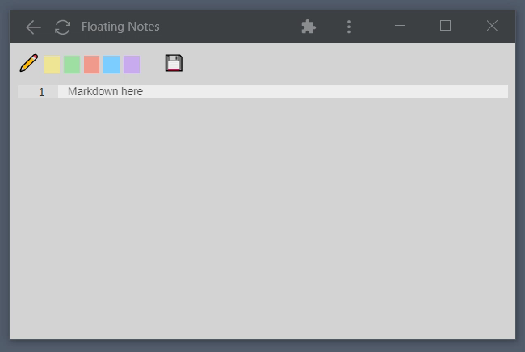
Ctrl-Enter

