Slide 1
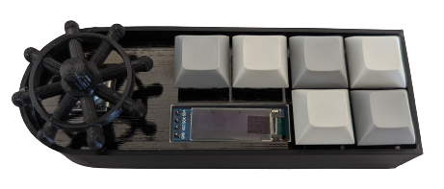
8
7
2
3
4
5
Push: 6
0
1

