Slide 1
GLOBAL VALUE CHAINS
Mert Yazal
Cigdem Ekiz
Ozgen Topcuoglu
Kubra Gurallar

Slide 2
GLOBAL VALUE CHAIN
‘the full range of activities that are required to bring a product from its conception, through its design, its sourced raw materials and intermediate inputs, its marketing, its distribution and its support to the final consumer.’
HS – 8703
HS – 8409
HS – 8708
HS 8703xx group: Vehicles; with both spark-ignition internal combustion reciprocating …
HS 840991: Engines; parts, suitable for use solely or principally with spark-ignition internal combustion piston engines (for other than aircraft)
HS 8708880: Suspension systems and parts for motor vehicles.
HS 870840: Transmission for motor vehicles
Harmonized System (HS): ‘’…internationally standardized system of names and numbers to classify traded products.’’

Slide 3
Classification
SITC (Standard International Trade Classification)
HS (Harmonized System) – HS96 will be used.
BACII data - Data cleansing through methodology of harmonization
Data
References
Feenstra, R. C., et al. (2005). World Trade Flows, 1962–2000. NBER working paper 11040

Slide 4

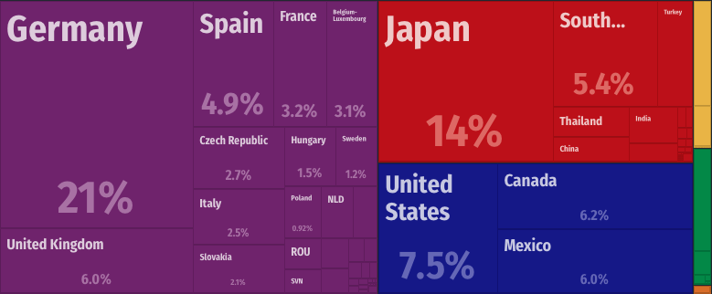
Cars, or HS8703!
Example:
Top exporter - DEU

Slide 5
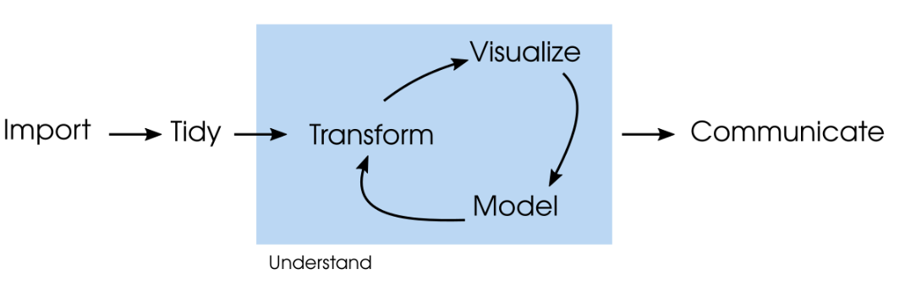
Process
we are here

Slide 6
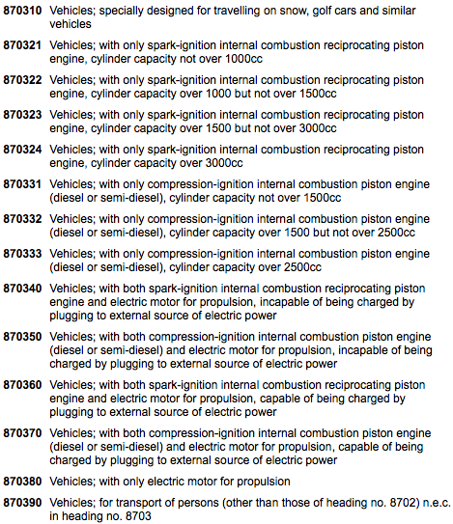
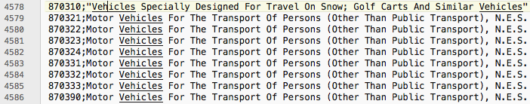
HS 8703
Raw data might be misleading
Check validity and integrity

Slide 7
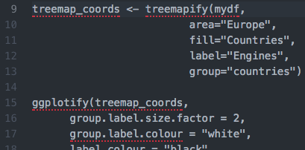
Methods:
Line chart
Bar chart
Bubble chart
Tree map
Scatter plots

