Slide 1
Work on drone radiation detection
Urh Trinko

Slide 2
4.11.2022
Code for measurement of a specified area with a single radiation point source. This simulates flight of a drone over this area. The specifiable parameters are the properties of the source, the height of flight and size of the grid. The code places the point source randomly somewhere on the map. The intensities at certain positions are determined using the inverse square law.
The code for getting the position of the source from measurement data gathers the positions with similar intensities. This points are then fitted to a circle, the centre of which is the estimated position of the source.

Slide 3
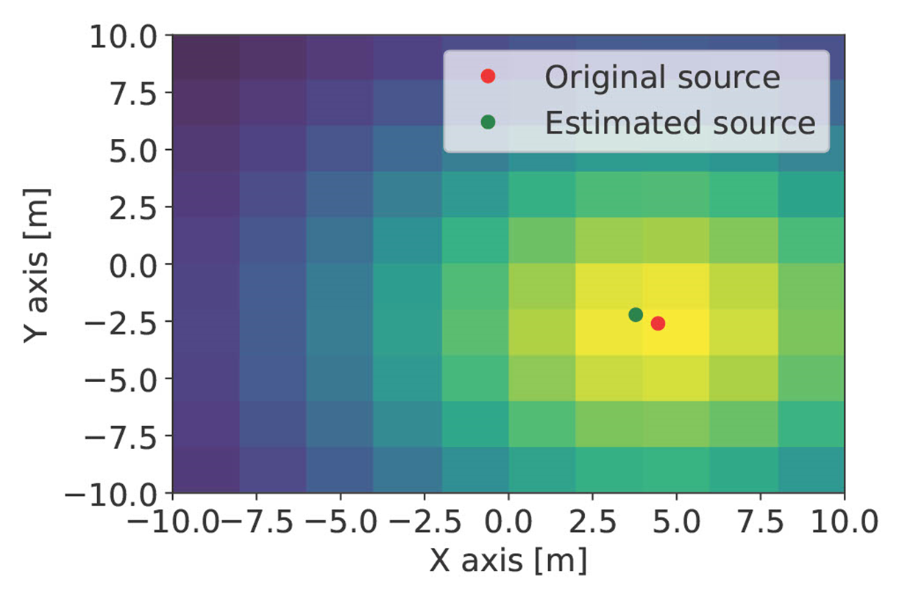
In this example only one set of intensities is used to make a circle and only one centre is calculated. Further improvement could be made by using more circles.

