Slide 1
Work on drone radiation detection
Urh Trinko

Slide 2
4.11.2022
Code for measurement of a specified area with a single radiation point source. This simulates flight of a drone over this area. The specifiable parameters are the properties of the source, the height of flight and size of the grid. The code places the point source randomly somewhere on the map. The intensities at certain positions are determined using the inverse square law.
The code for getting the position of the source from measurement data gathers the positions with similar intensities. This points are then fitted to a circle, the centre of which is the estimated position of the source.

Slide 3
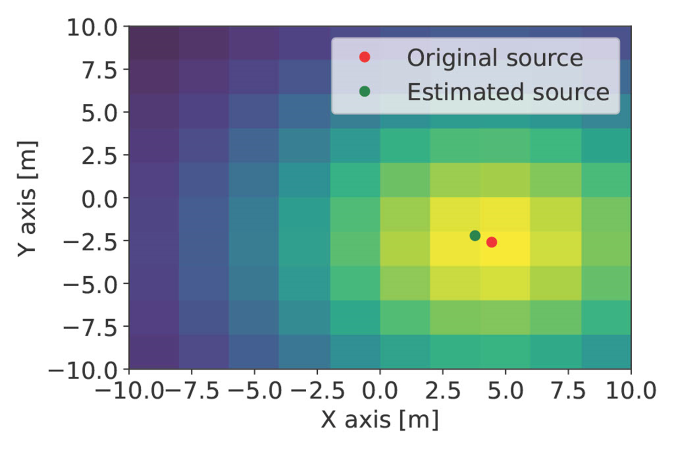
In this example only one set of intensities is used to make a circle and only one centre is calculated. Further improvement could be made by using more circles.

Slide 4
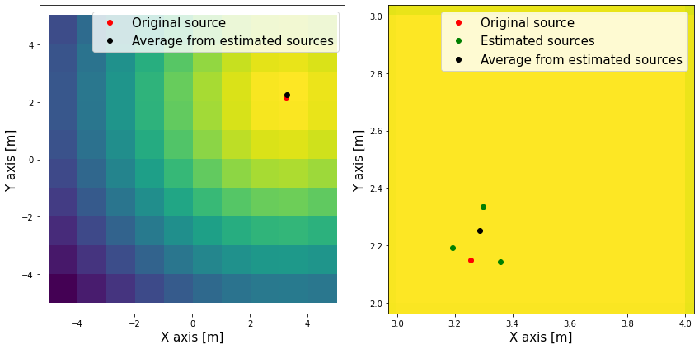
7.11.2022
Improvement of the point source location by using multiple different intensities to get multiple circle centres.
Some of them are then eliminated because they are to far, but the remaining (green points on right image) are averaged to get the estimation of the point source (black dot).
The right image only shows the tile with the largest intensity – “hotspot” tile.

Slide 5
8.11.2022
Improvement of the point source location-finding function. Previously all points outside of the tile with the largest intensity were eliminated. However there are examples in which no points exist inside the “hotspot” tile. This results in an error, because there are no points to average. This is fixed by gradually increasing the acceptable size of the area around the “hotspot” tile until at least one point is collected.

Slide 6
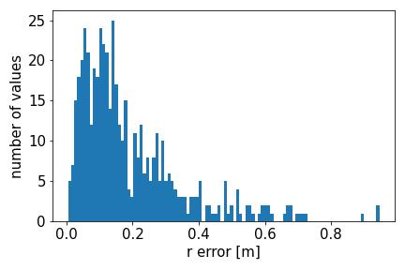
10.11.2022
Simulating entire code multiple times and collecting the distance betweenn the original random source and estimated one. Collecting this data and presentingng it in histogram form – Poisson distribution?
Also trying to calculate the standard distribution from least square method using sum of residuals, effective degrees of freedom and the covariance matrix (?) – PROBLEM: drastically different to the simulation standard deviation.

Slide 7
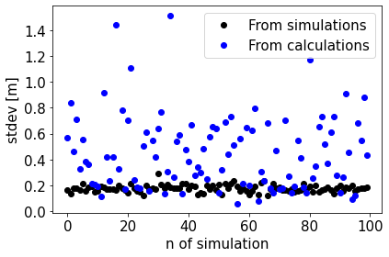
11.11.2022
Comparing the standard deviation for multiple random source positions through calculation and simulation. The simulation results are much less scattered then the calculated ones – possibly not correct yet, further work needed to really understand the covariance matrix.

Slide 8
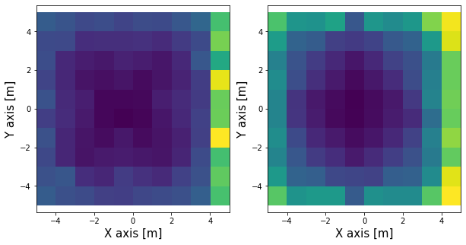
14.11.2022
Comparing the relation between the uncertainty of the estimated source and the position of the original source on the grid. Compering the result between the simulated (left) and calculated (right) results.
Takeaway: We can see that for both images the deviations seem to be larger when the source is positioned at the edge of the grid. Makes sense because there is less data to gather.
Question: Why is the deviation larger on only one side on the left side?
In future: Modify the flight of the detector so it gets the data around the original source.

Slide 9
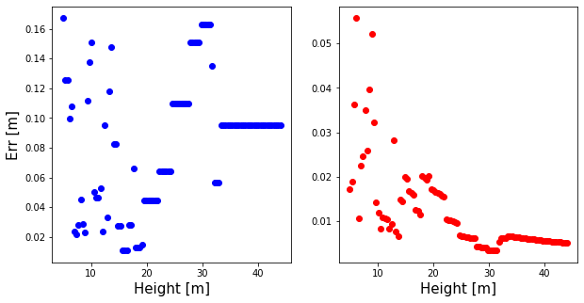
Analysing the error in relation to the height of the fly-over, left – measured, right –calculated err.
At higher levels the error is less (?) but if you go too high the background shades everything.

Slide 10
15.11.2022
Improving the location code by using the Levenberg-Marquardt (page 707) method for least square minimazition.
The model function is the inverse square law, where the adjustable parameters are u (x source coordinate), v (y source coordinate) and A0 (the activity of the source). We have a number of data points of intensities along the grid which gives us a overestimated system of equations.

Slide 11
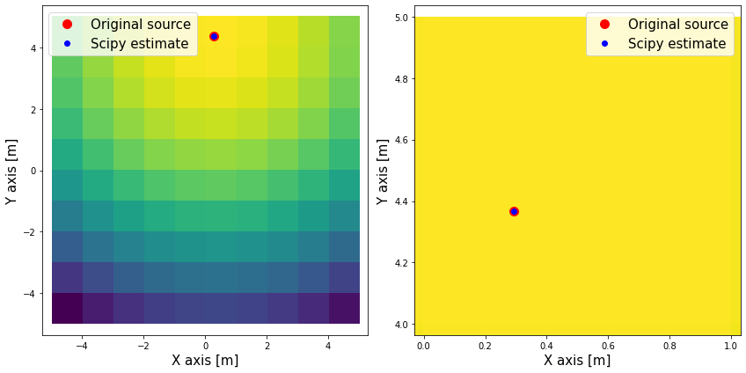
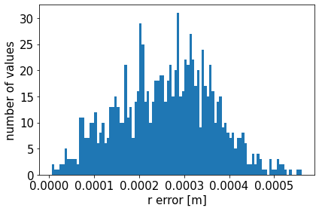
16.11.2022
Successful in making the source locating code using the LM method in scipy. As we can se the accuracy is much higher then with the previous attempts.

Slide 12
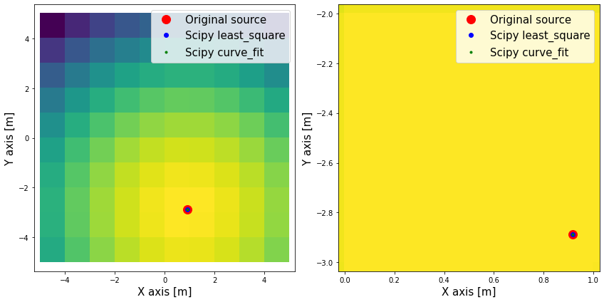
17.11.2022
Implementing source location estimation with the scipy.optimize.curve_fit function, the upside of which is that we can input also the uncertainty of the dependant data.

Slide 13
18.11.2022
Testing the scipy curve_fit sigma absolute error so that it can later be used to specify the uncertainty of the detector for intensities.
FOR NEXT WEEK: Implement a detector constant and see how many measurements you have to make in order to get the same uncertainty for two different quality detectors.

Slide 14
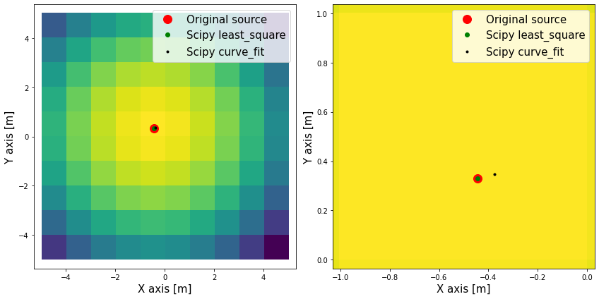
21.11.2022
Adding the variable that contains standard deviation of the x, y coordinates and intensity. The code than adds some gaussian noise to the data. In the picture the sigmas are (0.5, 0.5, 100).
The scipy curve_fit is the point derived from the noisy data.

Slide 15
22.11.2022
In the code implementing factor K, which tells us the information on how many of the possible events we measured and also factor F, which tells us the ratio between the effective dose(for a specific radioactive element and inhalation or ingestion).
The relation F/(1-K) is the factor C, which tells us how good a detector is.
Code written so that this stands: effective_dose = C * activity; relative_error_effective_dose = 1 / \sqrt(effective_dose/C)

Slide 16
23.11.2022
Improving yesterdays code by changing effective_dose_error = 1/ \sqrt((effective_dose*T)/C), where T is the combined time of the flyover of the detector. So the longer we measure the more accurate the results will be. The equation yesterday also didn’t make sense unit wise also.
Comparing how many more grid points you need to get the same error of the effective dose for to different detectors.
Simulating the mentioned error for different girds and trying to find the relation between the two variables.

Slide 17
24.11.2022
CORRECTING code made from 22. and 23.11
Inside the loop pick a point, calculate the activity @ that point, multiply this activity with the number that takes into account detector quality.
Use this number multiplied by the time of measurement at that location as the expected value in a Poission distribution. Use the numpy.random.poisson command to determine the number of events measured by the detector at this location.
Get the measured dose speed by multiplying the number of events with the radioactive dose factor. Calculate the relative error of this by dividing one by the square root of the number of events.
Repat this also for the background radiation, by choosing a constant background expected value for the Poisson distribution.
Do this for each point and then fit the measured data to the inverse square law equation so that you get the searched parameters.

Slide 18
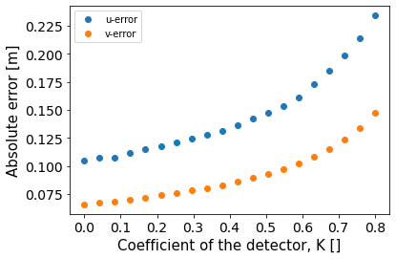
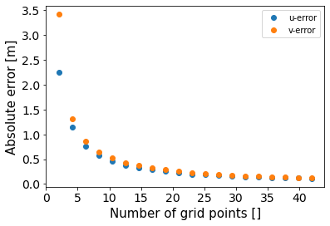
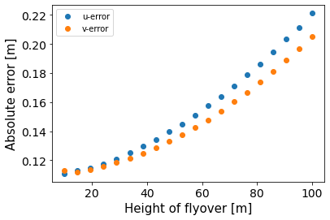
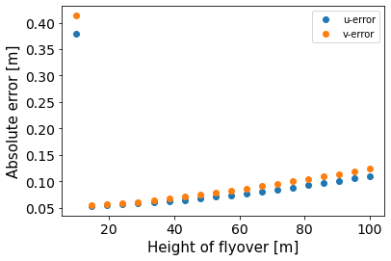
25.11.2022
Comparing the errors of x and y position of the estimated source (u, v parameters) to the different properties of the detector, detector factor K, height of flyover, number of grid points.
Checking if the results are what we expect for our simulation.

Slide 19
Comments on the error analysis (previous slide).
Err(K): Error increases with K – logical because a larger K means an inferior detector. The error seems to increase faster as K becomes larger, similar to some kind of an exponential function. Weird thing happen when approaching 1 for K, that’s why the max value on the graph is 0.8. Further analysis here needed.
Err(h): The error increases with the height – logical because the background is not dependant on the height so it stays the same while the source signal decreases with 1/h**2. For smaller heights the error seems to increase as h**2 but for larger heights the increasing seems linear. EXCEPTION: sometimes for lower heights we get very big uncertainties.
Err(grid): The error decreased with more grid points – logical because this simply means more measurements were made. The decrease is very quick at first and then approaches 0 more slowly. This is reminiscent of the function 1/(n_grids). Err(dt) is similar.

Slide 20
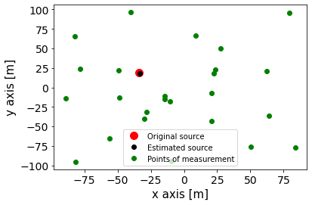
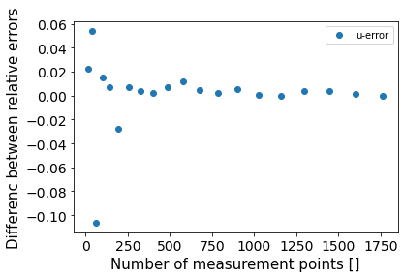
29.11.2022
New flyover, where the detector choose random points in the grid where it measures the intensity
It seems that for smaller numbers of the difference between the errors for random and previously used method is the largest but for larger the numbers are similar (right image shows the the subtraction of the grid error from the random error – negative values therefore mean a lower grid error).

Slide 21
30.11.2022
Trying to fit a function with parameters to the graphs on day 25.11. So that we get some sort of table for how large an error would be for certain detector coefficient, height and number of grid points.
Starting to write an improved flyover for a single point source, where it will first locate the hotspot tile and then fly around that point while gathering information – number of events.

Slide 22
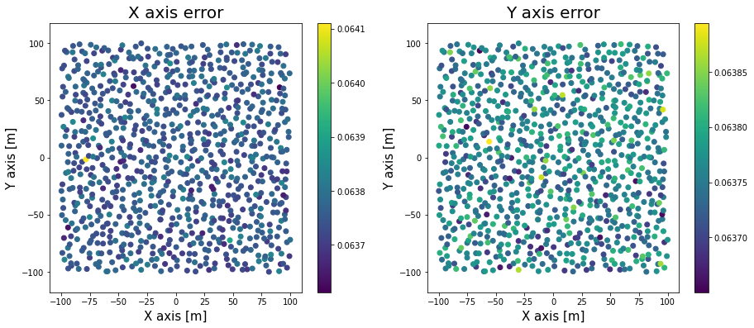
1.12.2022
Continue work on improved flyover.
Testing translation simetry by comparing the x and y errors for source in the middle and somewhere outside. We can see from the picture that there is no noticeable difference (y error larger then x).
MISTAKE!

Slide 23
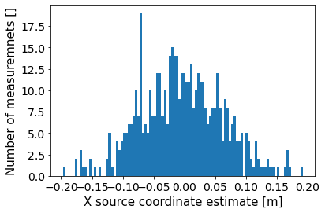
5.12.2022
Simulating finding the source location 500 times for when the source is at the centre of the coordinate system. The values deviate around x = 0 and form a gaussian curve. The deviation of this is similar to the one estimated by the code, so this seems to be working correctly.

Slide 24
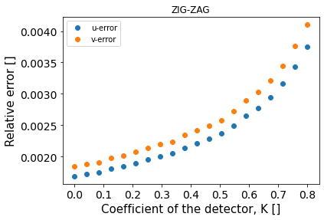

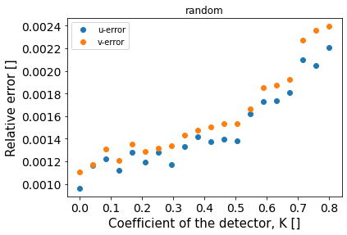
6.12.2022
Comparisson between detector coefficient, height, number of grid points, time of measurement at each grid point and the relative error of the source location. Similar relations as for the ZIG-ZAG flyover (look on slide of 25.11.2022).
I noticed that the relations are much more scattered and you get results similar to the ZIG-ZAG flyover only when you have a lot of random measurements
Left image shows the relation for K to source position error for ZIG-ZAG flyover for 400 measurements. Middle one shows random flyover for 400 measurements and the right one for 1000.

Slide 25
Also the error decreases the fastes with the increase of the number of grid tiles/points of measurement and the increase of the time spent measuring at each point.
Also note that the subsidiary code – simulate_event – didn’t work as intended.
And continue work on improved SPS.

Slide 26
7.12.2022
Completing the improved flyover code.
DESCRIPTION: We divide the area into tiles same as in the ZIG-ZAG. The detector starts at the top left tile. It measures the dose in the tile and comperes it to the neighbouring tiles (measures the right, diagonal and bottom tile to the first tile). If one of the tiles has a larger dose it moves there and continues the described measurement for it’s neighbours. The process is continued until the detector reaches the tile with the highest dose – hotspot tile. It then spirals outward around the centre of the hot spot tile.
PROBLEM: In some situation still questionable paths, but I think this is the result of the Poisson distribution which we use to simulate the measuring of the detector. This brings an uncertainty to the number of measured events. If we put in to many grid points and the source is to week the detector might stop before it reaches the hotspot. It checks the neighbour tiles and sees that non of them have a larger measured dose and so it stops.
FURTHER IMPROVEMENTS: Incorporate the error of the measurement into the movement of the detector.

Slide 27
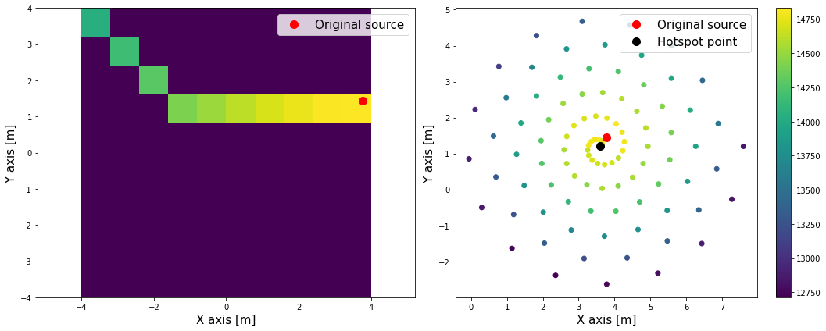
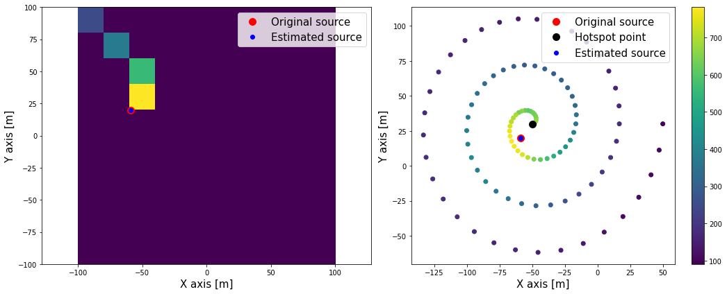
Visual path of the detector.

Slide 28
8.12.2022
Cleaning up the improve flyover code – adding the locatiocating of the source and compering the accuracy to the previous two methods (ZIG ZAG and RANDOM).
Checking if the dependency of the error to the detector constant, height... (check 25.11.2022) is consistent with the dependency from previous methods (some exeptions for time and grid – further analysis).

Slide 29
MISTAKE NOTICED: On the 1.12.2022 I simulated a 2D color graph which showed the x and y error of the estimated source position. I claimed that there is no noticeable difference in the error of the points on the inner side of the grid and outer side of the grid. This is incorrect and was a result of an error code. In the loop where I should have set the parameter of the function to some source outside of the KS centre, I placed the KS centre every time.
The corrected code shows that the error is pretty constant inside of the grid but increases noticeably at the edges. This makes sense because if a source is generated near the edge it can only have measurements made on one side. This idea is supported by the comparison between the graphs for x and y errors. The increase in x error happens at the left end right edge, while for y errors at the top and bottom edge. This supports the idea because in each case there are less measured points for left/right (x error increase) and above/bellow of the source (y error increase).
Also there are no such edge increases for the spiral measurement, because measurements are always done around the source.

Slide 30
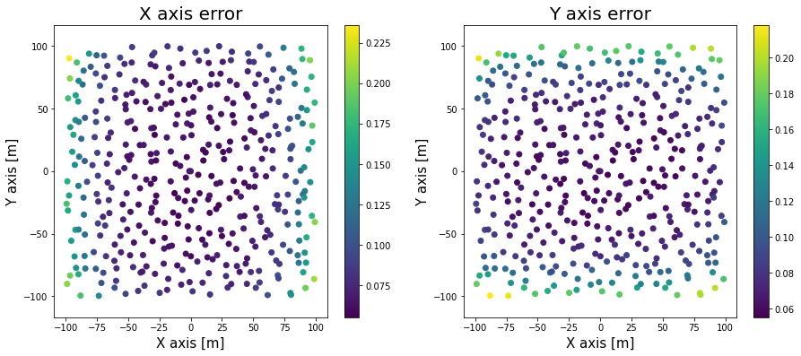
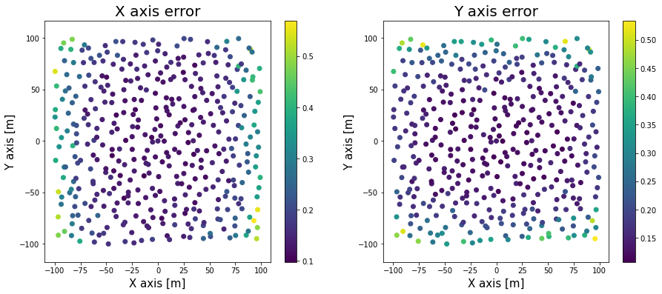
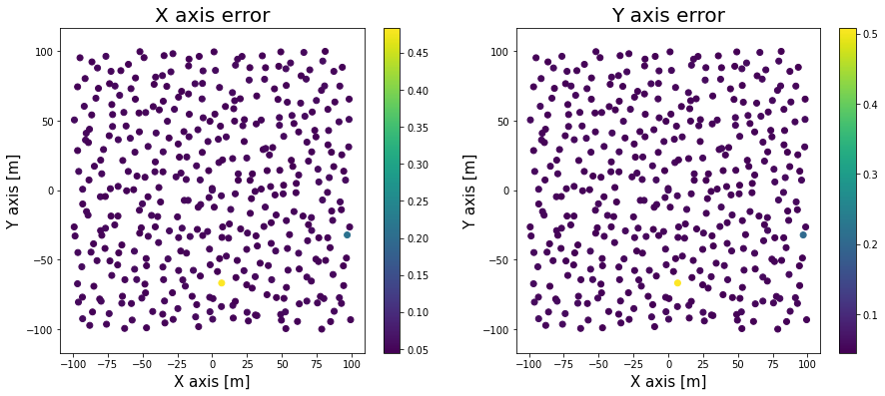
Visual examples for the thought process on the previous slide – from top left: ZIG-ZAG, top right: RANDOM, bottom: SPIRAL.

Slide 31
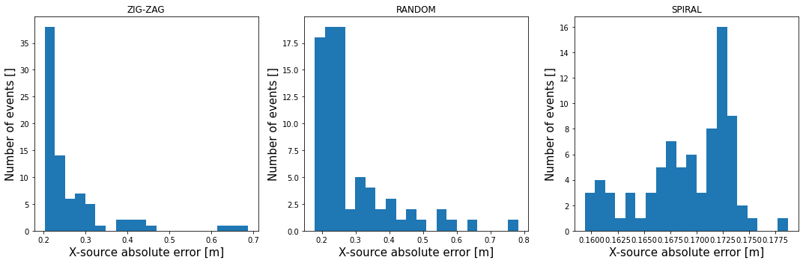
9.12.2022
Simulating different methods (ZIG_ZAG, random and spiral) for random points at each grid tile and then displaying the estimated source error of the x-coordinate in a histogram (for every method)
For spiral an error occurs at the bottom left tile, origin yet UNKNOWN
We se that the error for the spiral method is generally lower (for all simulated methods the number of measurements made is THE SAME).

Slide 32
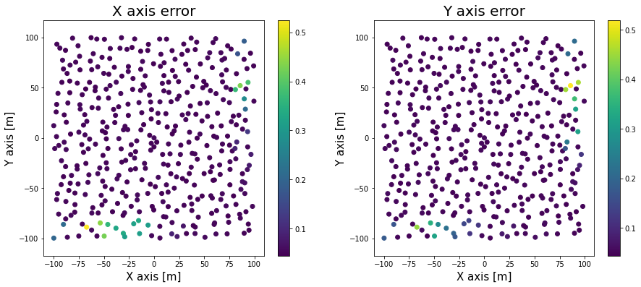
12.12.2022
Found a problem in spiral flyover – we get a IndexError and ValueError when the source is in the bottom right grid corner.
Also the source error position seems to become very high for some large time measurements.
I corrected the index and value errors. There was a unnecessary call for the make_list() function when the detector “was in” the last tile.
New problem -> with the correction above we now don’t get a uniform error distribution for the points on the grid (like on 8.12.2022), but rather there are two areas where the errors seem to always be grater (red circles).

Slide 33
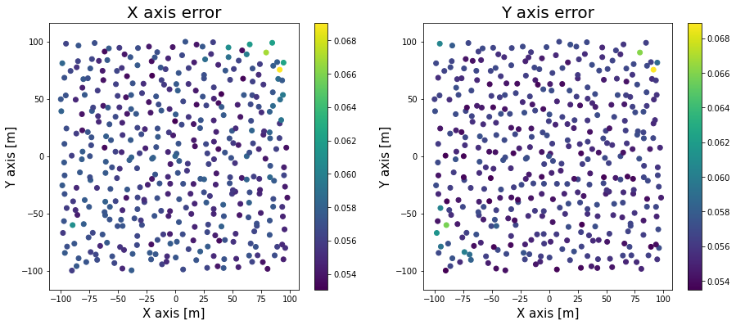
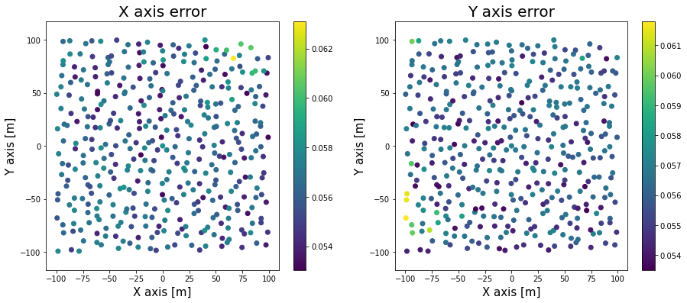
The change that fixed the problem for the bottom right tile source caused this problem. The error caused the while loop to continue going even after it reached the hotspot, stopping only when reaching the bottom right tile. So I fixed the code by adding another break in the while loop.
Now the errors seem to be pretty constant across the grid. There are some hotspots but seem to be random, because they change positions for different simulations. Bottom figures display errors for points on grid for different simulations, where in both cases all the parameters stayed the same. We can se that larger errors appear at different places (is this a sufficient explanation?)

Slide 34
13.12.2022
Analysing and improving the spiral flyover code.
Observing the change in source location uncertainty when the number of grid points, used for location of the hotspot, are used.
At a certain grid number the error drastically increases. This number is however lower when the detector has a higher K factor (less ideal detector). This could indicate that the error jump is due to the know, still present, imperfection of the code. Because the number of measured events is generated randomly through the Poisson distribution, the measurements have a certain error. For less ideal detectors (higher K factor) this error is larger. If the grid is big enough and, a tile that should have a lower measured number of events, can have a higher one than it’s neighbour, which causes a premature stop of the detector.
The detector then spirals around at tile which isn’t the hotspot, resulting in the higher source estimate uncertainty.

Slide 35
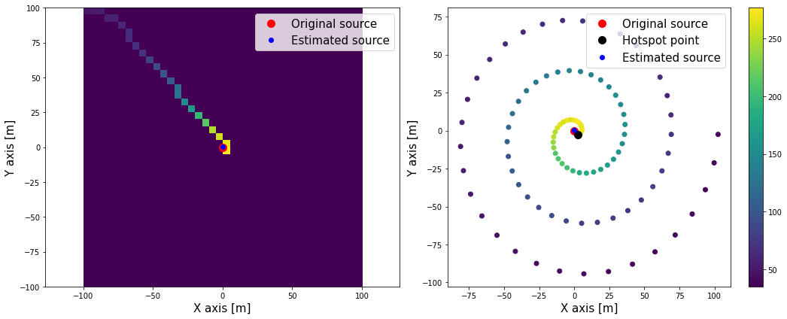
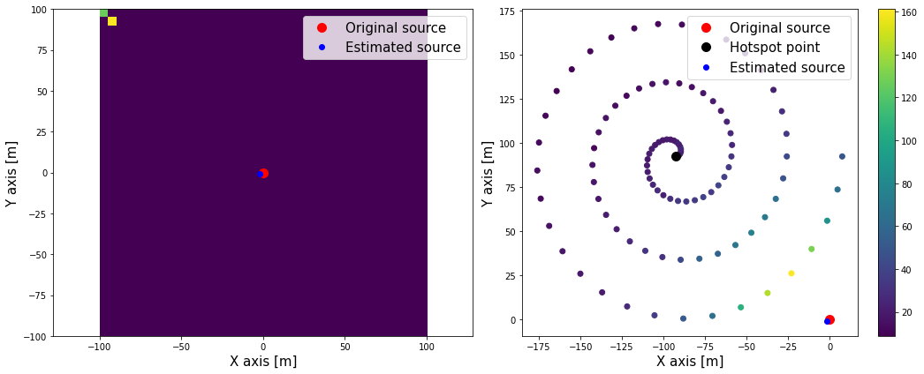
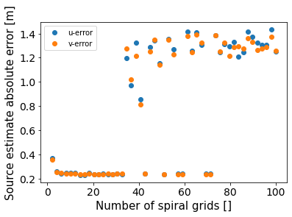
The source estimation error to number of grid points (bottom figure) – for K coefficient 0.8.
Random error due to Poisson uncertainty (for 40 s_grid) – same parameters two different simulations, left correct, right incorrect stopping of the detector.

Slide 36
Change in code so that the maximum dose speed is NOT calculated twice for each step on the grid (only once when checking the neighbours).
Further analysis – size of whole grid to s_grid for s given uncertainty.

Slide 37
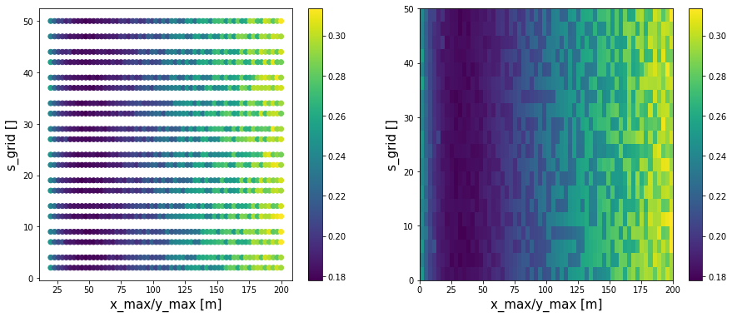
14.12.2022
Trying to figure out how to change the s_grid (the number of tiles along x/y axis which the grid is divided for the detector to locate the “hotspot tile”) so that the estimated source error will remain (roughly) the same for different grid sizes.
We can see that the error dose not seem to change with the s_grid but rather only with the size of the grid (see figure bellow). . Coolormap is th error.

Slide 38
16.12.2022
Calculating the source activity from the constant we get as the fit output.
Some changes to the cod + bug fixes
In the beginning of the new year – measurements on the field to test code accuracy.
Trying to make similar graphs to 25.11.2022, just with added error bars.

Slide 39
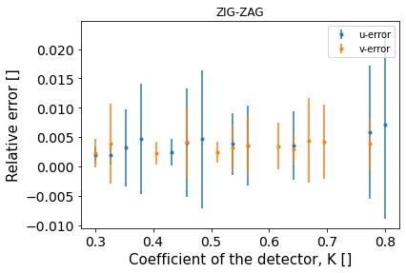
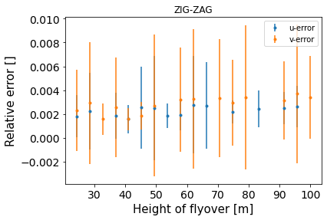
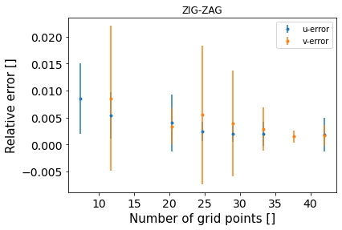
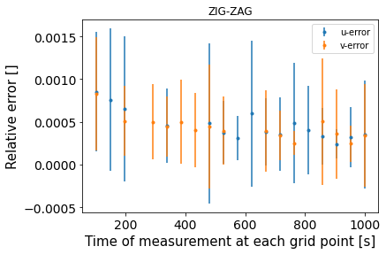
19.12.2022
Trying to make plots of relative error in dependence of K... We get the uncertianty of the error by simulating for different positions on grid and then calculating the standard deviation.
The problem is that the deviation is so large that we can’t clearly see what kind of a dependence we have.

Slide 40
Preparations for field measurements.
PROBLEM -> runtime error for curve fit (for now unsolved).

Slide 41
20.12.2022
Fixed problem from yesterday for field_combination.
Using npyscreen library to create an application for field code analysis.
For now just went through the npyscreen tutorial, haven’t started the main project one yet.

Slide 42
3.1.2023
Trying to make an interactive forum where the user would input the dose and error of the dose measured at a certain tile of the grid.
The problem is how to incorporate the loop through the grid into the forum
FIRST TRY: looping in the create function – works in terms of displaying the values of the position in the forum, but this way we cannot save the values.
REVALATION: we can extract the user input with the self.-.value but IN the on_ok(self) function.
IDEA FOR FUTURE WORK: two forms: the first one will be used for the user to input the radiation and detector parameters and call a separate python file which will manually change the file so that the second forum will have the same amount of widgets as the tiles (where the doses are measured).

Slide 43
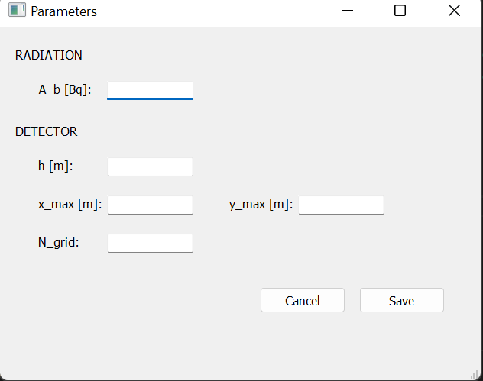
4.1.2023
From now using qt designer to design the GUI.
For now I have managed to make a code that generates a window where the user can input parameters (for the radiation and detector). After you click on the SAVE button this data is saved as a dictionary.

Slide 44
5.1.2023
Editing the python code (generated with Qt_designer) in a new file, new class so that we don’t change the python file made from the .ui file (NOTE: in Qt_designer you have to save the .ui file with SAVE AS for each change otherwise the change is not noted).
For now I have a main window, on which you can press a button that opens a dialog where you can specify the radiation and detector properties.

Slide 45
6.1.2023
Continued work on the app for source location.
YET UNSOLVED PROBLEM: How to save user input in a dialog box.

Slide 46
9.1.2023
Continue work on th GUI.
Starting a new project with an old scintillation detector.
Firs need to gather all the necessary equipment.
I also digitalized the needed documentation.
In future I will write a separate diariy for that.

Slide 47
11.1.2023
Use self.variable to store variable as the attribute of an object.
DIFFERENT APPROACH: Not building a GUI with MainWindow + dialog, just the MainWindow.

Slide 48
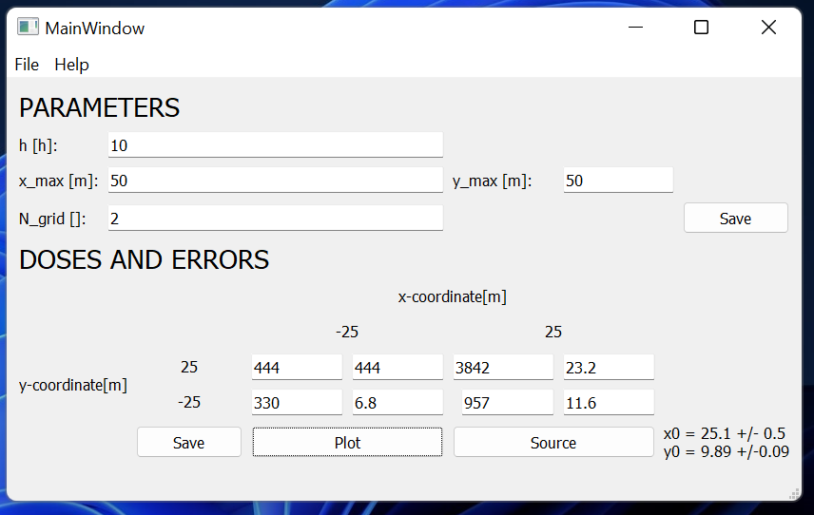
12.1.2023
Finally managed to make a simple GUI, where the user inputs parameters of the detector and then the field measurements of the doses and their errors. The user can then plot the colored grid and display the location of the measured source.
This is version 1.0, because it can only be used for a grid of size x=[-50,50], y = [-50, 50] for 4 doses entries. So the only variable you can change now is the height of the detector. Possibilities for improvement not in short supply.

Slide 49
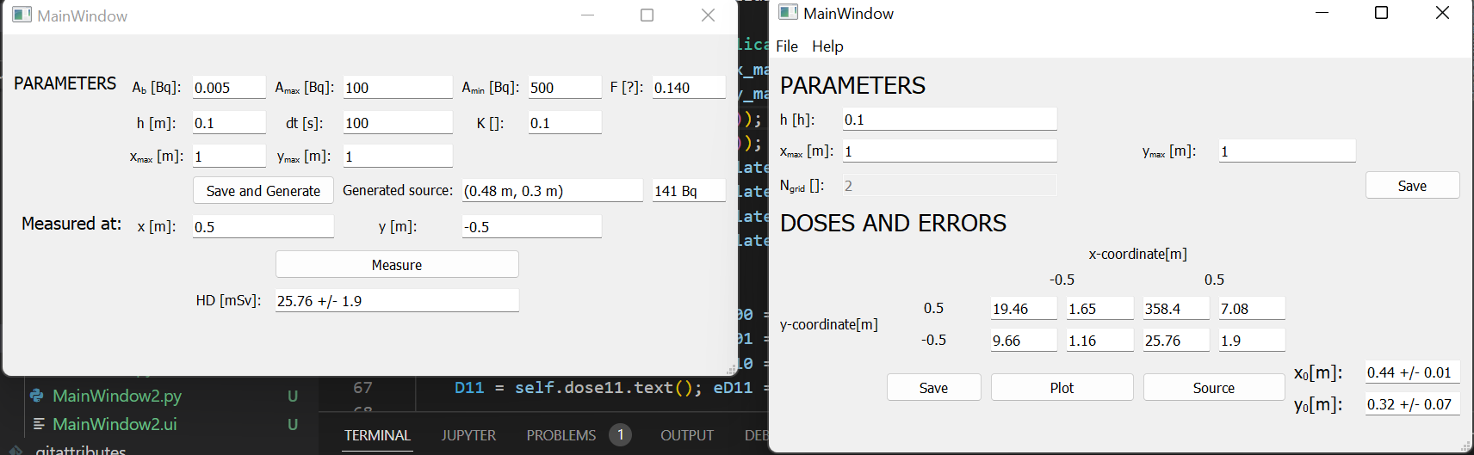
13.1.2023
Developed a GUI that simulates a detector measurements.
The user first saves the parameters of the radiation/detector and generates a random source. After that the user can input a point somewhere on the grid and the code will calculate the dose and its error at that location.
Using this GUI in tandem with the one made on 12.2.2023, which was improved so that the grid size can be changed (only number of grid tiles is constant – improve in future).
Generating measurement for each grid tile and inputting them into the source location code – works mostly.

Slide 50
16.1.2023(?!)
Problem in main_code. When you increase the A_source and A_background parameters scipy dosen’t find optimal parameters, even if the ratio between the two activities stays the same.
VERY problematic!
It seems that the problem occurs when the activities are larger numbers (1e5 Bq <). Maybe the problem is in the random Poisson distribution number generator.
When the \lam in Poisson distribution is larger then 1000 a Gaussian distribution with the mean is equal to \lam and the standard deviation is equal to np.sqrt(\lam).
Changig the random generator didn’t seem to fix the problem ☹

Slide 51
17.1.2023
Fixed the problem from yesterday by coding the function that will divide the source activity until the number is under 1e5 (physically everything is the same – it is like using different units). The background radiation is also appropriately lowered.
When you do this you also have to multiply the fitted source activity to get back the right amount in becquerels.
Is this solution mathematically correct (?)
PROBLEM: For background larger then 10 Bq the stDev from simulation loop (5. 12. 2022) is not similar to the one we get from the fit. What’s more the stDev seems to decrease when the background is raised, while the one from the simulation increases, which is logical (see plot on next slide).

Slide 52
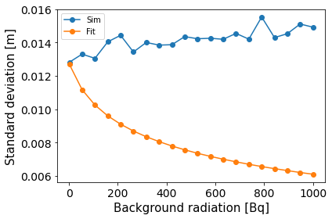

Slide 53
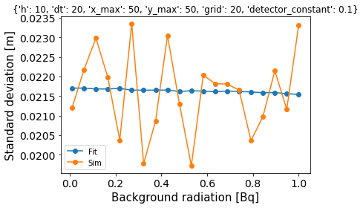
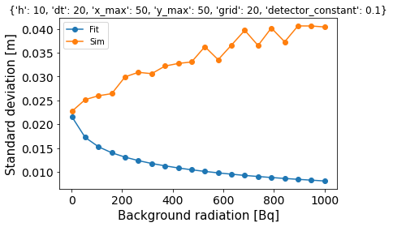
18.1.2023
The solution for bigger source activities proposed yesterday is questionable, so I reverted back to the previous code (I haven’t deleted the previous one completely though).
The comparison between sim and fit, already mentioned yesterday (also figure bellow) still bothers me. Especially the fact that the fit stDev seems to have some kind of functional relation to the background radiation! (?).
Below you can see a graphical comparison sim vs fit for different lower (left) and higher (right) background radiations.

Slide 54
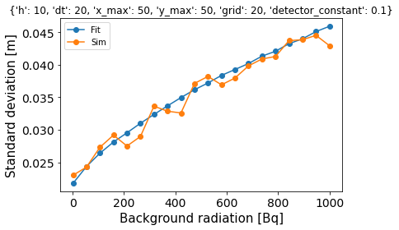
SOLVED the problem with rising background radiation with some help.
The problem was the fit function needed an added parameter to incorporate the background radiation, D = alpha/([x – u]^2 + [y – v]^2 + h^2) + beta
Beta is the added factor.
Code only works if you give an initial estimate of the parameters you are fitting, for alpha beta now works the best if you put in 1e5 – improvement needed.

Slide 55
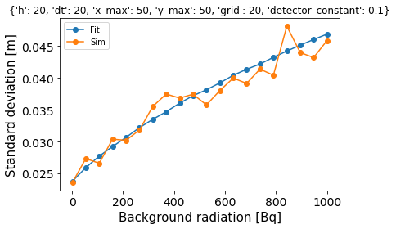
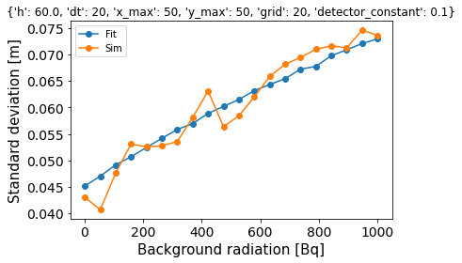
19.1.2023
Guesses for parameter alpha and beta only work at the height of the detector 10 m.
I get a more general guess for the parameters by solving an overdetermined system of equations where the equations come frome the dose function in which I input estimated source locations, from the hotspot tiles. This way I get the correct graph for sim and fit according to the background radiation for heights that are different from 10.

Slide 56
The problem now is that with this code we get the error: parameters could not be estimated for smaller grids – MAKES SENSE? - and at certain points on the grid (example: for x_max = y_max = 50 at -12.5, -12.5 and 7.5, -17.5 – WHAT?

Slide 57
20.1.2023
I managed to write a code, where the values that were last written in the line edits is saved. These values are also displayed the next time you open the GUI.
PROBLEM: With the changes to the fit function on 18.1 the code needs more points to consistently produce a fit. Setting 2 as the value for grid (a 2x2 grid) is not sufficient.
For now the grid 2 is the only option in the GUI.

Slide 58
24.1.2023
Rewriting the ZIG-ZAG flyover code in order to produce a code that takes any desirable amount of measurements not just 4, 9, 25... (previously noted as grid^2).
Made a mix between the ZIG-Zag and random code. By generating a number of random measure points that have to be a certain distance apart.
TOMMOROW: Perfect the curve_fit and visualize parts for this code.

Slide 59
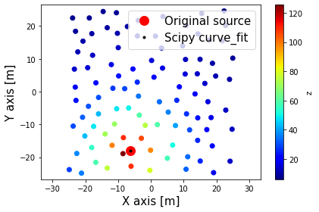
25.1.2023
Finished the ZIGZAG-RANDOM combination code – produces lareger error than just RANDOM?

Slide 60
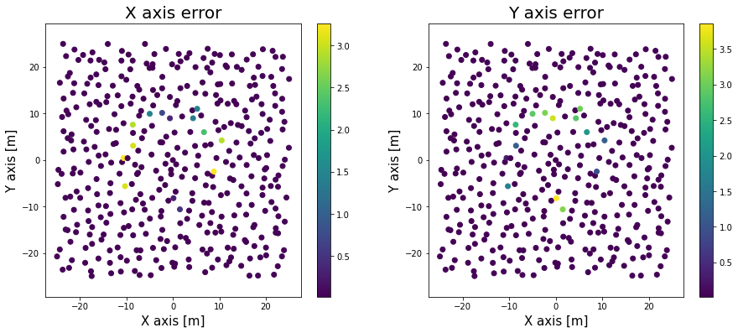
26.1.2023
Managed to get the code from 8.12.2022 to work for the code with 4 fit parameters – u, v, alpha, beta. The problem is I don’t get the logical higher error areas at the side of the grid (as on 8.12.2022), but curtain higher errors closer to the centre.
The figure is for the ZIG-ZAG measurement approach.
??

Slide 61
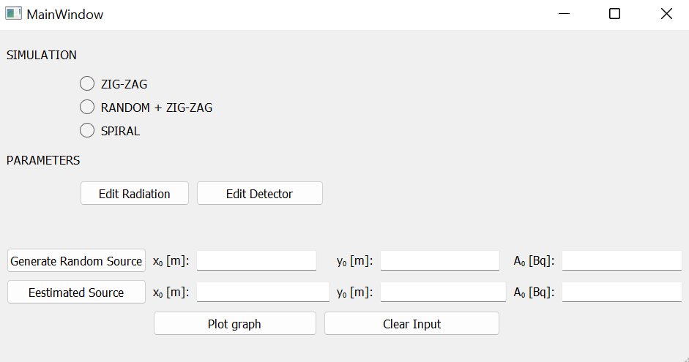
Started working on a GUI, that will more easily run the source finding code for the different methods

Slide 62
27.1.2023
Finished the GUI from yesterday.

Slide 63
30.1.2023
Fixed the code issue where the estimated source activity for ZIG-ZAG and ZIG-ZAG+RANDOM were completely wrong.
Adding more umph to the GUI.
In future add something to prevent the error when converting string to float, maybe use some kind of implemented function that sets float and not text. Add a detailed description.

Slide 64
31.1.2023
Added error messages for radiation and detector dialog boxes. From now the user cannot close these dialogs if some of the lines remain vacant or contan non-float characters.
I also added a detailed description for the different method we can use with the radio button and for the app as a whole.

Slide 65
1.2.2023
Work on th GUI.
Adding the option for the user to enter their own source location and activity.
Trying to add a style to the GUIs with downloadable Qt stylesheets

Slide 66
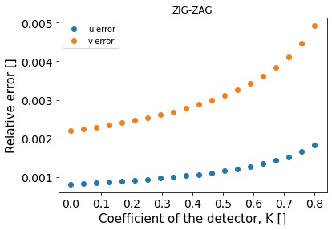


Btw dependency of the error in the source location to the K, h and dt (for the changes made to the code on 18.1.2023).

Slide 67

3.2.2023
I improved the appearance of thr detector simulation GUI and gave it more functionality.

Slide 68
6.2.2023
Making a improved GUI for locating a radioactive source from measurements.
The idea is to have a NEXT and BACK button with which the user can traverse through the positions of measurement in a zig-zag pattern.
Biggest obstacle for now is how exactly to deal with the problem of saving the HDs and dHDs array when the GUI is closed.

Slide 69
7.2.2023
Added some functionality to the GUI from yesterday
Added the progressbar functionality, messages when reaching the end and the findsource function.

Slide 70
9.2.2023
Added the functionality to the findSource GUI, that allows the inputed numbers for HD and dHD to be saved and used again after closing of the main window.
The problem occurred when changing the number of measurements and with that the array for storing them. This problem is now fixed so that everytime we change the number of measurements the loop changes so that it begins the traversal over the new array.
I also changed the functionality of the progress bar, it now shows how many more measurements until the end.
The PROBLEM now is that there is something wrong with the findsource code and the visualization.

Slide 71
10.2.2023
Fixed the code so that the source estimation (only for x and y coordinates) works. Same for visualization.
Tested out for 36 measurements – seems to work.
Also I ran the code at each grid tile – question mark on 26.1.2023, but now the code produces the figure below – which makes sense and is in line with the code/explanation before the added parameter to the fit function, look on 8.12.2023. The spooky thing is I didn’t actively work on improving this since 26.1, so why is it now working properly??

Slide 72


Slide 73
3.8.2023
Preparation to write a report
Created a new directory with separate .py files (subsidiary, zigzag, spiral, combination and example) which will have better comments and will be clearer.

Slide 74
4.8.2023
Finished making zigzag and spiral code cleaner. Also fixed some code
Made a universal location-finding function
For next week: first in report_code directory add code that analyses the simulations. Then write a report for everything except experimental data. Then write to dr Mihovilović and prepare for a possible experimental testing.

Slide 75


8.8.2023
Problem with simulating source at different tiles of the plain with a loop going through the entire grid.
The problem is that you sometimes get the result but other times we get a RuntimeError, which is the result of curve_fit not being able to fit all the parameters. The number of times we don’t get an error decreases with the number of tiles into which we divide the grid (left image: 25 ~ 30% success rate and right image: 100 ~20% success rate).
There also seem to be tiles where the RuntimeError occurs more often the others. This is around the center of the plain.

Slide 76
Starting to write the final report on the project.

Slide 77
9.8.2023
The final version of the activity function.
Final report

Slide 78
10.8.2023
Final report
Add graphs for deviation to changing h, K and dt.

Slide 79
11.8.2023
Continu work on report.
Creating devToParsErrbar.py
Tidying up devToPars.py

Slide 80
16.8.2023
Continue final report
Making 3D graph of deviation, h and dt
Something not 100 percent right fix tomorrow

Slide 81

17.8.2023
Fixed the 3D graph

Slide 82



Plus finally fixed/finished the idea I began working on 19.12.2022. Woorking on fixing the 3D code helped.

Slide 83


18.8.2023
Colour table which displays the uncertainty mean and deviation for an arbitrary source with constants A0 = 15 000 Bq and r0 = 50 m for changing height of flyover and duration of measurement.

Slide 84
21.8.2023
Fixed the scales of the graphs in the report so that the numbers are more visible.
Finished writing the analysis part of the final report, now I just have to write the conclusion.

Slide 85
22.8.2023
Finished writing the report.
Now cleaning the github repository so that it can be included in the report and will be more manageable for others.
Updating the code used in GUIs so that it corresponds to the main_code functions. Already done the detector simulation, tomorrow add the find source and simulations GUIs and then you’re done.

