Slide 1
Power Management
August 2013, Intel Banglor

Slide 2
whoami /all
whoami /fqdn
uril@sela.co.il
http://sela.co.il
http://london.org.il
Skype: uri-london
Material for the course:
http://projects.london.org.il/pmgmt
Lab solutions will be released as we progress

Slide 3
Introduction
Power consumption scenarios:
In general: desktop, servers in data center (energy is major cost).
Mobile: Battery powered laptops
Windows computer can go to sleep or hibernate
Attached device can power down
Without loosing data!
Consideration:
System Activity Level.
System Battery Level.
Current request to shutdown, sleep or hibernate
User Actions such as pressing a button
Control Panel Settings

Slide 4
Scenarios
Customers demands computers to be available at all time, even when turned off!
OS, System, drivers, and devices must work together
Extending batter life
Minimal startup and shutdown delays
Near Silent (e.g. Media)

Slide 5
Industry Initiatives
OnNow
Advanced Configuration and Power Interface (ACPI)
Hardware level interface
Device Class Power Management Reference Specification
For each device class (audio, network, etc.)
http://www.acpi.info/

Slide 6
Support for power management
To support power management, drivers must support PnP
Power Management are associated with installing and removing devices
PnP IRP’s
Two levels: Individual devices and System
Legacy: Fully on or fully off
Drivers can put devices into intermediate steate

Slide 7
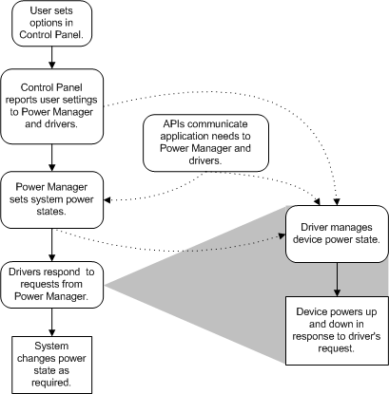
Power Management Overview

Slide 8
Power Manager
Power manager handles scenarios using IRPs
Considered a sub component of the IO manager
Po* routines: PoSetPowerState
WDF (specifically KMDF) makes power management easier.

Slide 9
Power States
System Power States
S0, S1, … , S5
Device Power States
D0, D1, D2, D3
The smaller the number, the greater the power consumption (i.e. S0, D0 – fully on).
See Power Data in device manager

Slide 10
Components
ACPI BIOS
ACPI Driver
Loaded by the HAL
Program components (e.g. WakeUp).
For each device creates Filter DO
Power Manager
Sends IRP_MJ_POWER
Consider: Activity, Battery, Requests from app, User Action, Control Panel Policy
Drivers:
Responds to Power Manager requests
Manage their own device

Slide 11
KMDF Refressher

