Slide 1
Implementing WDM Driver

Slide 2
Reporting Device Power Capabilities
During enumeration:
IRP_MN_QUERY_CAPABILITIES
DEVICE_CAPABILITIES structure
Higher level drivers:
can set IoCompletion routine
May be more restrictive
Flags: DO_POWER_INRUSH, DO_POWER_PAGABLE

Slide 3
DEVICE_CAPABILITIES
Check out now on WDM.H
DeviceD1, DeviceD2
WakeFromD0, WakeFromD1, WakeFromD2, WakeFromd3
DeviceState – mapping between System State and highest possible Device State
SystemWake, DeviceWake (least powered)
D1Latency, D2Latency, D3Latency

Slide 4
Power IRP
IRP_MJ_POWER
IRP_MN_QUERY_POWER
IRP_MN_SET_POWER
IRP_MN_WAIT_WAKE
IRP_MN_POWER_SEQUENCE
Sent only by Power Manager

Slide 5
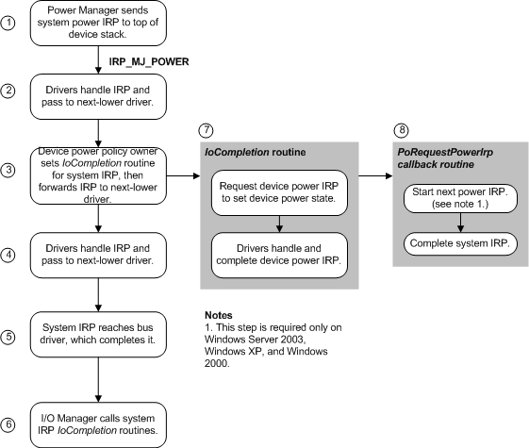
System IRP_MN_SET_POWER

Slide 6
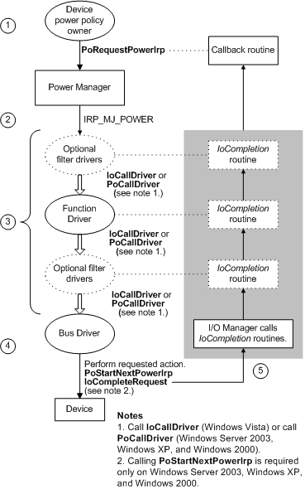

Slide 7
Power Up and Down
IRP_MJ_PNP
No Power IRP for D0 and D3:
Up: IRP_MN_START_DEVICE
Down: IRP_MN_REMOVE_DEVICE
Surprise removal: IRP_MN_SURPRISE_REMOVAL
Call PoSetPowerState
Shutdown: IRP_MN_SET_POWER

Slide 8
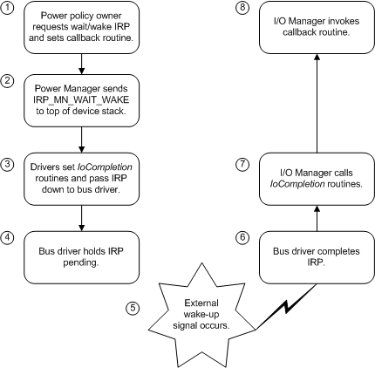
Wake/Wait overview

Slide 9
Enabling Wake Up
Policy Owner calls PoRequestPowerIrp
Sends IRP_MJ_POWER/IRP_MN_WAIT_WAKE

Slide 10
Fast Startup
Preparing Fast Startup in shutdown:
Windows closes all user mode application
Window logout all users
Sends power IRP preparing for hibernate
Save memory in hiberfil.sys

Slide 11
Before and After Vista
IoCallDriver vs. PoCallDriver
Vista and above: use IoCallDriver
2003 and XP: synchronized
PoStartNextPowerIrp
2003 and XP

Slide 12
Passing IRP_MJ_POWER
IoCopyCurrentIrpStackLocationToNext (or Skip)
IoSetCompletionRoutine
IoCallDriver

Slide 13
WDM Power Device

