Slide 1
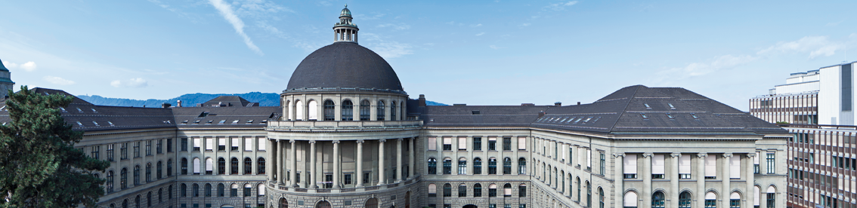
Incremental Verification Uri Juhasz PhD Defence
Examiner: Prof. Dr. Peter Müller
Co-examiners: Prof. Dr. Martin Vechev
Prof. Dr. Clark Barrett
Prof. Dr. Arie Gurfinkel
7.11.2016

Slide 2
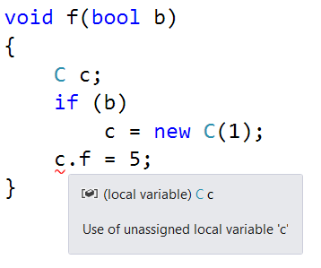


Slide 3
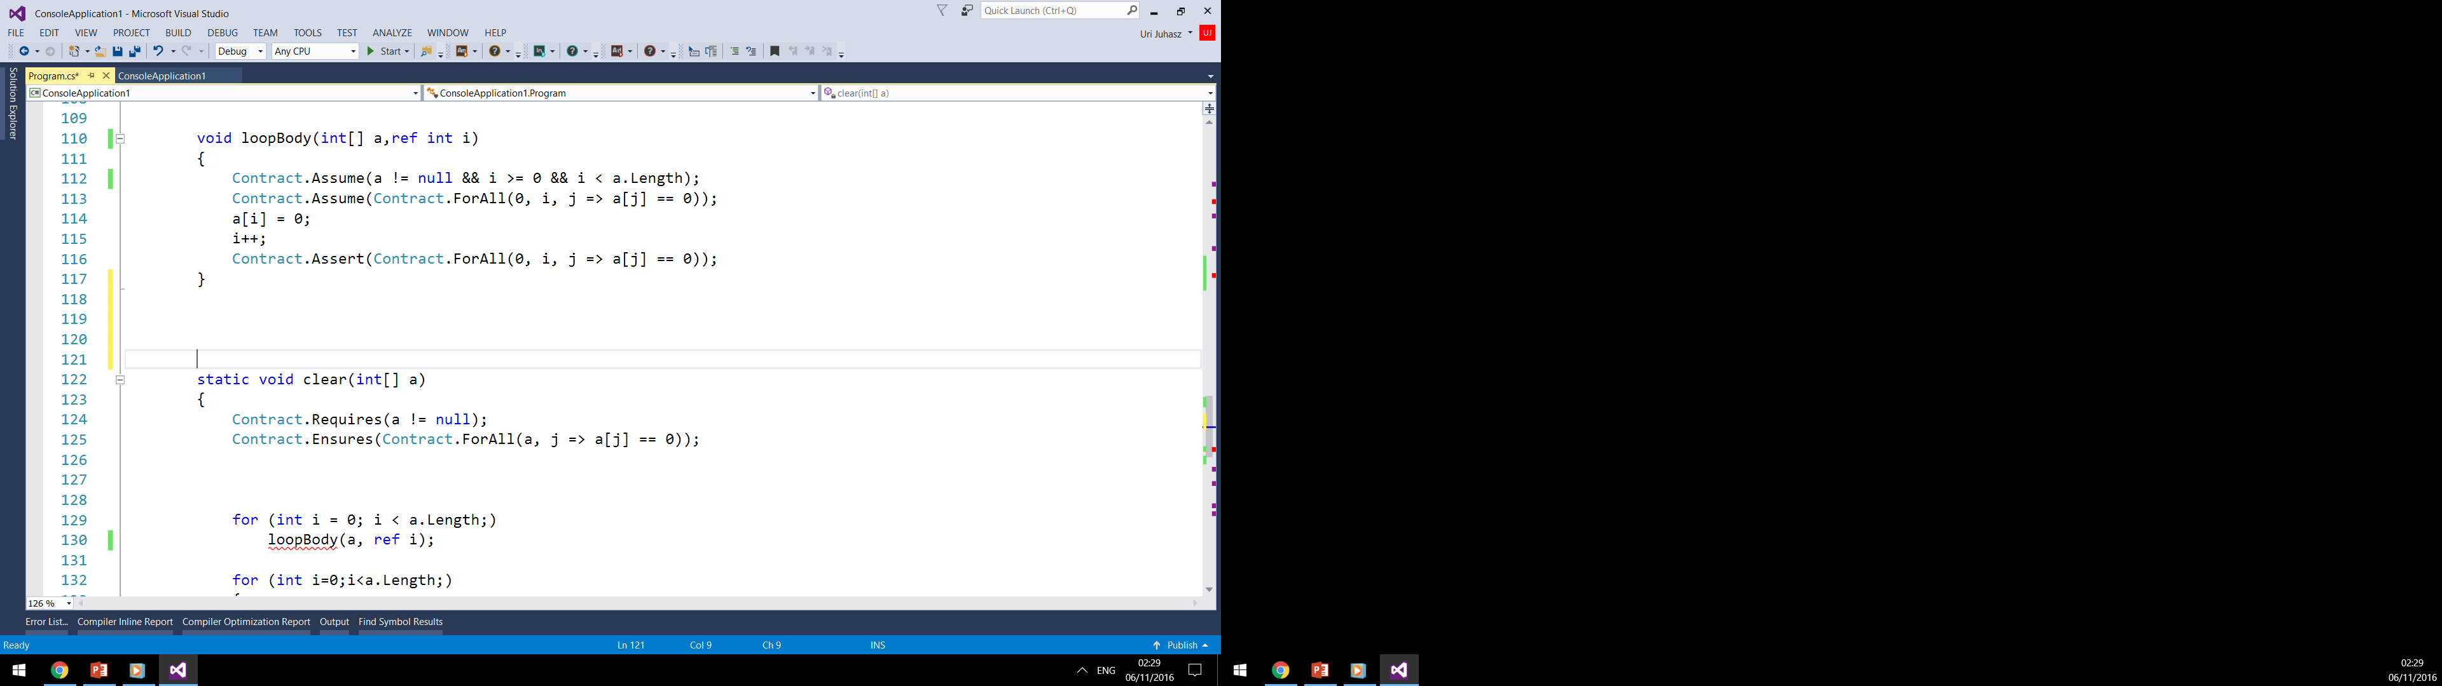
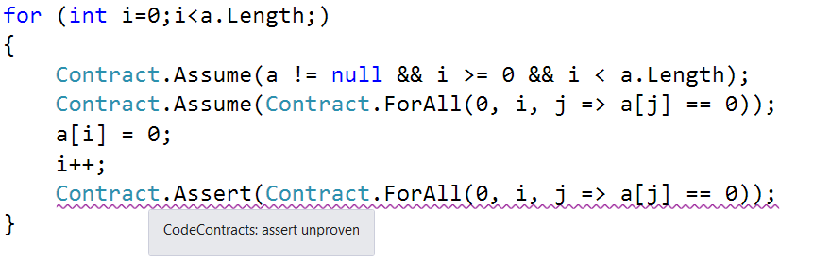
Idea: incremental verification

Slide 4
Verification
method p(x,y : ref)
if (y ≠ null)
if (x = y)
z := x
else
z := y
z.f := 5
true
¬y≠null
y≠null
y≠null
x=y
¬x=y
x=y ∧ y≠null
⊧
x≠null
¬x=y ∧ y≠null
⊧
y≠null
z := x
z := y
z≠null
z≠null
z≠null
z.f:=5
[Floyd67]
[Hoare69]
true

Slide 5
Automation
method p(x,y : ref)
if (y ≠ null)
if (x = y)
z := x
else
z := y
z.f := 5
Convert to formula
(y≠null) → (
( x=y → x≠null)
∧ (¬ x≠y → y≠null))
WP(p) =
Check validity
UNSAT(¬WP(p)) ?
[Dijkstra75]

Slide 6
DPLL
A
¬A
B
¬B
B
¬B
⊥
C
¬C
C
¬C
C
¬C
C
¬C
⊥
⊥
⊥
D
¬D
D
¬D
D
¬D
D
¬D
D
¬D
D
¬D
D
¬D
D
¬D
⊥
⊥
⊥
⊥
⊥
⊥
P(c)
¬P(f(c))
[DavisLogemannLoveland62]
[DavisPutnam60]
P(f(f(c)))
…

Slide 7
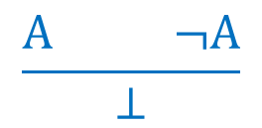
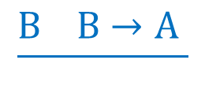
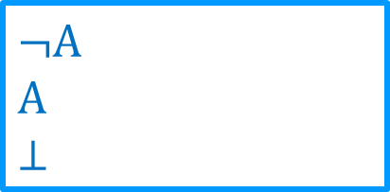
Saturation
0
0
$$\frac{B B→A }{}$$
1
0
$$\frac{A ¬A}{⊥}$$
2
$$¬A$$
$$A$$
$$⊥$$
⊦
Idea: derivation depth

Slide 8
Main contributions
A generic incremental verification algorithm
An instantiation for FOL using superposition
An instantiation for ground equalities using CC graphs
A bounded restriction of the algorithm
A scoped restriction of the algorithm

Slide 9
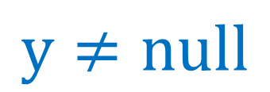
Domain knowledge - CFG
w≠null
Relevance
$$y≠null$$
y:=w
x=y
¬x=y
assert y!=null
z := x
assert y!=null
z := y
Lemma sharing
z.f:=5
Scope

Slide 10
Main contributions
A generic incremental verification algorithm
An instantiation for FOL using superposition
An instantiation for ground equalities using CC graphs
A bounded restriction of the algorithm
A scoped restriction of the algorithm

Slide 11
Preparation
assume x₀=5
x:=5
assert x<10
x:=x+6
assume x₀=5
assert x₀<10
assume x₁=x₀+6
assume ¬ x₀<10
assume x₁=x₀+6

Slide 12
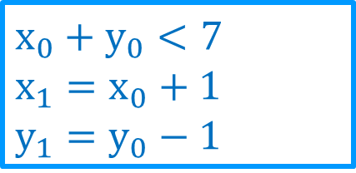
Preparation
assume x₀+y₀<7
assume x₁=x₀+1
assume y₁=y₀-1
$$x_{0}+y_{0}<7$$
$$x_{1}=x_{0}+1$$
$$y_{1}=y_{0}−1$$
⊦

Slide 13
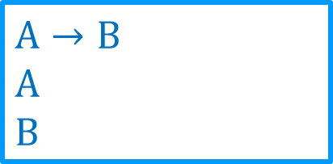
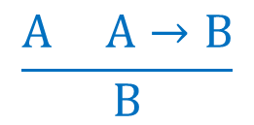
Deduction
$$\frac{A A→B}{B}$$
$$A→B$$
$$A$$
$$B$$
⊦

Slide 14
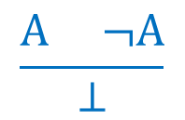
Deduction
$$\frac{A ¬A}{⊥}$$
✓
¬A
A
⊥
⊦

Slide 15
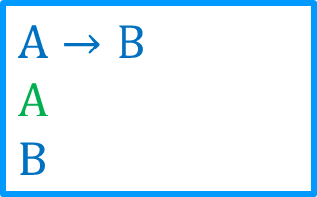
Propagation
$$\frac{A A→B}{B}$$
A
⊦
$$A→B$$
$$A$$
$$B$$
⊦

Slide 16
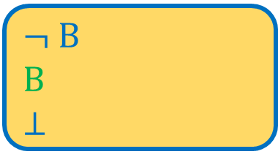



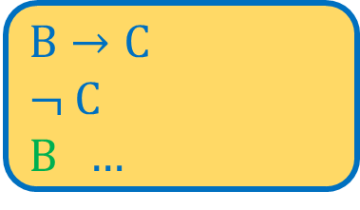
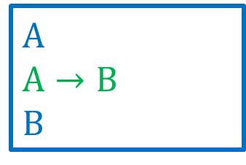
Propagation
$$\frac{\frac{A A→B}{B} \frac{}{¬B}}{⊥}$$
$$A→B$$
⊦
$$\frac{\frac{B B→C}{C} \frac{}{¬C}}{⊥}$$
A
$$A→B$$
B
¬ B
⊦
⊦
¬ B
$$B$$
⊥
⊦
⊦
✓
$$B→C$$
¬ C
$B$ …
✓

Slide 17
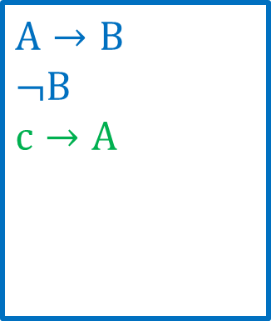

Joins
⊦
c
¬c
$$A$$
⊦
⊦
$$A→B$$
$$¬B$$
$$c→A$$
⊦

Slide 18
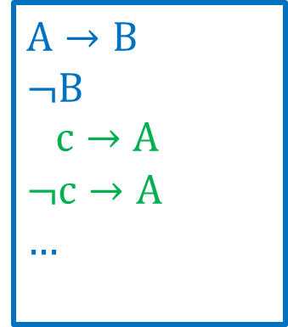
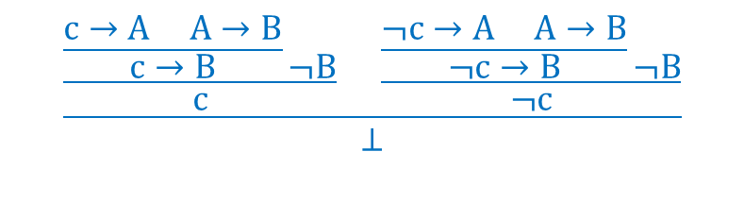
Joins
⊦
c
¬c
$$A$$
A
⊦
⊦
$$\frac{\frac{\frac{c→A A→B}{c→B}\frac{}{¬B}}{c} \frac{\frac{¬c→A A→B}{¬c→B}\frac{}{¬B}}{¬c}}{⊥}$$
$$A→B$$
$$¬B$$
$c→A$
$$¬c→A$$
…
⊦

Slide 19
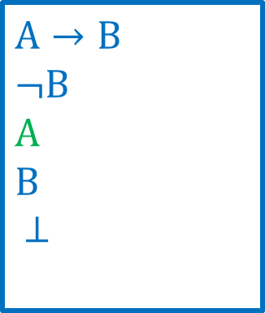
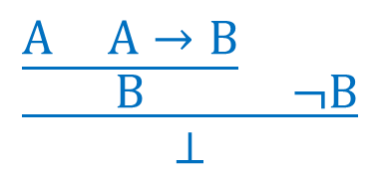
Joins
⊦
c
¬c
$$A$$
A
⊦
⊦
$$\frac{\frac{A A→B}{B} \frac{}{¬B}}{⊥}$$
$$A→B$$
$$¬B$$
$$A$$
$$B$$
$⊥$
⊦

Slide 20
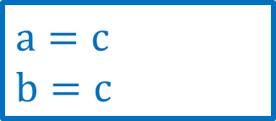
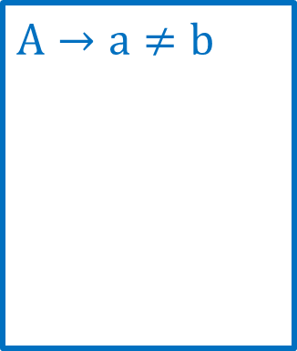
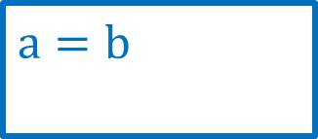
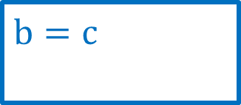
Joins
$$\text{b}=\text{c}$$
⊦
c
¬c
$$a=b$$
$$a=c$$
$$b=c$$
⊦
⊦
$$\text{A}→\text{a}≠\text{b}$$
⊦
[GulwaniTiwariNecula04] (non incremental)

Slide 21
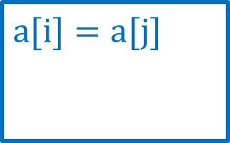
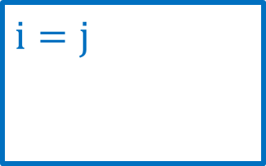
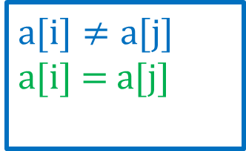
Joins
$$\text{i}=\text{j}$$
$$\text{a}\text{[}\text{i}\text{]}=a[j]$$
⊦
⊦
$$\text{a}\text{[}\text{i}\text{]}≠\text{a}\text{[}\text{j}\text{]}$$
$$\text{a}\text{[}\text{i}\text{] = }\text{a}\text{[}\text{j}\text{]}$$
⊦
[GulwaniTiwariNecula04] (non incremental)

Slide 22
Main contributions
A generic incremental verification algorithm
An instantiation for FOL using superposition
An instantiation for ground equalities using CC graphs
A bounded restriction of the algorithm
A scoped restriction of the algorithm

Slide 23

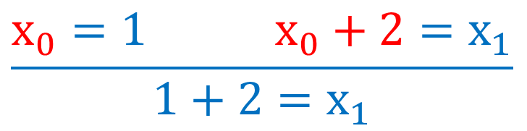
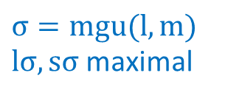
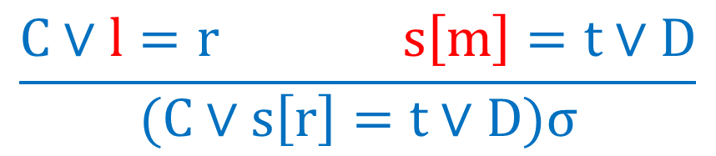

Superposition
$$x_{0}≻1$$
$$x_{0}+2≻x_{1}$$
$$\frac{x_{0}=1{ x}_{0}+2=x_{1}}{1+2=x_{1}}$$
$$\frac{C∨l=r s\left[m\right]=t∨D}{(C∨s\left[r\right]=t∨D)σ}$$
$$σ=mgu(l,m)$$
$lσ,sσ$ maximal
[BachmairGanzinger90]

Slide 24

CFG propagation
a=b
⊦
a,b,c
a=b
b=d
⊦
⊦
a,c
b
...
c=d
a=b
⊦
a,c
$$a≻b≻c≻d$$
a=c
a=b
a≠d
a=b
⊦
⊦
a
a

Slide 25
Term sharing
g(f(b))
g
f(a)
h(a,b)
f(b)
g(b)
f
h₀
h₁
f
g
a
b
Maximal sharing

Slide 26
Main contributions
A generic incremental verification algorithm
An instantiation for FOL using superposition
An instantiation for ground equalities using CC graphs
A bounded restriction of the algorithm
A scoped restriction of the algorithm

Slide 27

Clause width
$$\frac{A∨B∨C∨(a=b) (a=c)∨D∨E∨F}{A∨B∨C∨(b=c)∨D∨E∨F}$$
$$\frac{C∨l=r s\left[m\right]=t∨D}{(C∨s\left[r\right]=t∨D)σ}$$
$$σ=mgu(l,m)$$
$lσ,sσ$ maximal

Slide 28

Term depth
$$\frac{f\left(x_{1},g\left(x_{2}\right),x_{2},g\left(x_{3}\right)…,c\right)=h\left(x_{1}\right) f(g\left(y_{1}\right),y_{1},g\left(y_{2}\right)…,y_{n})=c}{h\left(g\left(g\left(g\left(…c\right)\right)\right)\right)=c}$$
$$\frac{C∨l=r s\left[m\right]=t∨D}{(C∨s\left[r\right]=t∨D)σ}$$
$$σ=mgu(l,m)$$
$lσ,sσ$ maximal

Slide 29
Term depth

Slide 31
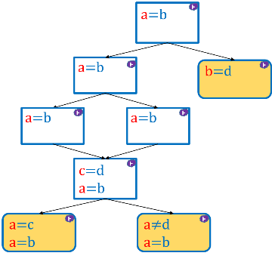

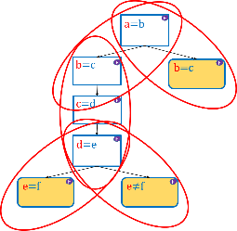
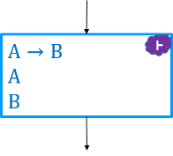
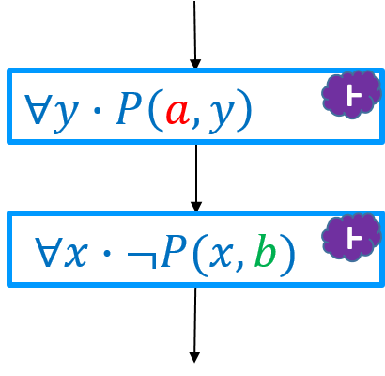


Conclusions:
Incremental verification for FOL
Predictable steps with predictable complexity
Utilizes domain specific knowledge
Size bounds
Scoping – complete for ground clauses
Future work:
Integrate theory (e.g. linear integer, rational) reasoning
Parallelization
Scoping for quantifiers
$$C∨f(a)=b$$
$$\frac{2a>0 a<0}{⊥}$$
||

