Slide 1
Semaphores
“The Little Book on Semaphores”
Allen B. Downey

Slide 2
Definition of Semaphores
A semaphore is like an integer, with three differences:
When you create the semaphore, you can initialize its value to any integer, but after that the only operations you are allowed to perform are increment (increase by one) and decrement (decrease by one). You cannot read the current value of the semaphore.
When a thread decrements the semaphore, if the result is negative, the thread blocks itself and cannot continue until another thread increments the semaphore.
When a thread increments the semaphore, if there are other threads waiting, one of the waiting threads gets unblocked.

Slide 3
Thread blocks
To say that a thread blocks itself (or simply “blocks”) is to say that it notifies the scheduler that it cannot proceed. The scheduler will prevent the thread from running until an event occurs that causes the thread to become unblocked. In the tradition of mixed metaphors in computer science, unblocking is often called
“waking”.

Slide 4
Consequences of the definition
In general, there is no way to know before a thread decrements a semaphore whether it will block or not (in specific cases you might be able to prove that it will or will not).
After a thread increments a semaphore and another thread gets woken up, both threads continue running concurrently. There is no way to know which thread, if either, will continue immediately.
When you signal a semaphore, you don’t necessarily know whether another thread is waiting, so the number of unblocked threads may be zero or one.

Slide 5
What the value of the semaphore means:
If the value is positive, then it represents the number of threads that can decrement without blocking. If it is negative, then it represents the number of threads that have blocked and are waiting. If the value is zero, it means there are no threads waiting, but if a thread tries to decrement, it will block.

Slide 6
Semaphores in Posix threads
See program: http://redux.comp.ncat.edu/carr/comp450/notes/sem.cpp

Slide 7
Chapter 3 Basic synchronization patterns
Signaling: a thread sends a signal to another thread to indicate that something has happened.
Example: Assume that we have a semaphore named sem with initial value 0, and that Threads A and B have shared access to it.
Thread A
1 statement a1
2 sem.signal()
Thread B
1 sem.wait()
2 statement b1
The word statement represents an arbitrary program statement. To make
the example concrete, imagine that a1 reads a line from a file, and b1 displays
the line on the screen. The semaphore in this program guarantees that Thread
A has completed a1 before Thread B begins b1.
Here’s how it works: if thread B gets to the wait statement first, it will find
the initial value, zero, and it will block. Then when Thread A signals, Thread
B proceeds.
Similarly, if Thread A gets to the signal first then the value of the semaphore
will be incremented, and when Thread B gets to the wait, it will proceed immediately.
Either way, the order of a1 and b1 is guaranteed.

Slide 8
Rendezvous
Puzzle: Generalize the signal pattern so that it works both ways. Thread A has to wait for Thread B and vice versa. In other words, given this code
Thread A
1 statement a1
2 sem.signal()
Thread B
1 sem.wait()
2 statement b1
we want to guarantee that a1 happens before b2 and b1
happens before a2. In writing your solution, be sure to
specify the names and initial values of your semaphores.

Slide 9
Rendezvous Solution
Create two semaphores, named aArrived and bArrived, and initialize them both to zero.
As the names suggest, aArrived indicates whether Thread A has arrived at the rendezvous, and bArrived likewise.
Thread A
1 statement a1
2 aArrived.signal()
3 bArrived.wait()
4 statement a2
Thread B
1 statement b1
2 bArrived.signal()
3 aArrived.wait()
4 statement b2

Slide 10
Deadlock #1
Again, while working on the previous problem, you might have tried something like this:
Thread A
1 statement a1
2 bArrived.wait()
3 aArrived.signal()
4 statement a2
Thread B
1 statement b1
2 aArrived.wait()
3 bArrived.signal()
4 statement b2
Assuming that A arrives first, it will block at its wait. When B arrives, it will also
block, since A wasn’t able to signal aArrived. At this point, neither thread can
proceed, and never will.
This situation is called a deadlock and, obviously, it is not a successful
solution of the synchronization problem. In this case, the error is obvious, but
often the possibility of deadlock is more subtle.

Slide 11
Mutual Exclusion (Mutexes)
A Binary semaphore is not a mutex, the maximum value of the semaphore is 1. We will follow Downey’s discussion, but remember we will be using POSIX’s mutex objects for implementation.
A mutex guarantees that only one thread accesses the shared variable at a time.
A mutex is like a token that passes from one thread to another, allowing one thread at a time to proceed. Code: http://redux.comp.ncat.edu/carr/comp450/notes/mutexes.cpp

Slide 12
Mutexes Cont.
In order for a thread to access a shared variable, it has to “get” the mutex; when it is done, it “releases” the mutex. Only one thread can hold the mutex at a time.
Puzzle: Add semaphores to the following example to enforce mutual exclusion to the shared variable count.
Thread A
count = count + 1
Thread B
count = count + 1

Slide 13
Mutual exclusion solution
Since mutex is initially 1, whichever thread gets to the wait first will be able to proceed immediately. Of course, the act of waiting on the semaphore has the effect of decrementing it, so the second thread to arrive will have to wait until the first signals.
Thread A
mutex.wait()
//critical section
count = count + 1
mutex.signal()
Thread B
mutex.wait()
//critical section
count = count + 1
mutex.signal()

Slide 14
P-thread implementation of mutual exclusion objects (mutexes)
Declaration:
pthread_mutex_t mutex1;
pthread_mutex_lock(&mutex1);
// critical section
count = count + 1;
pthread_mutex_unlock(&mutex1);

Slide 15
Few Definitions
Threads are running the same code. This is sometimes called a symmetric solution. If the threads have to run different code, the solution is asymmetric. Symmetric solutions are often easier to generalize. In this case, the mutex solution can handle any number of concurrent threads without modification. As long as every thread waits before performing an update and signals after, then no two threads will access Often the code that needs to be protected is called the critical section, I suppose because it is critically important to prevent concurrent access. Sometimes mutexes are called locks, and a thread is said to lock the mutex before entering and unlock it while exiting.

Slide 16
Multiplex
Puzzle: Generalize the previous solution so that it allows multiple threads to run in the critical section at the same time, but it enforces an upper limit on the number of concurrent threads. In other words, no more than n threads can run in the critical section at the same time. An example of is implemented in the sem.cpp found in the notes.

Slide 17
Multiplex solution
To allow multiple threads to run in the critical section, just initialize the semaphore to n, which is the maximum number of threads that should be allowed. At any time, the value of the semaphore represents the number of additional threads that may enter. If the value is zero, then the next thread will block until one of the threads inside exits and signals. When all threads have exited the value of the semaphore is restored to n.

Slide 18
Barrier
Puzzle: Generalize the rendezvous solution. Every thread should run the following code:
1 rendezvous
2 critical point
The synchronization requirement is that no thread executes critical point
until after all threads have executed rendezvous. You can assume that there
are n threads and that this value is stored in a variable, n, that is accessible
from all threads. When the first n − 1 threads arrive they should block until the nth thread arrives, at which point all the threads may proceed

Slide 19
Incorrect solution to barrier
Listing for Barrier
1 n = the number of threads
2 count = 0
3 mutex = Semaphore(1)
4 barrier = Semaphore(0)
// Incorrect solution
1 rendezvous
2
3 mutex.wait()
4 count = count + 1
5 mutex.signal()
6
7 if count == n: barrier.signal()
8
9 barrier.wait()
10
11 critical point
Puzzle: What is wrong with this solution?
Can cause deadlock. How?

Slide 20
Barrier Deadlock
Examining previous attempt we see for example that if n = 5 and that 4 threads are waiting at the barrier. The value of the semaphore is the number of threads in queue, negated, which is -4.
When the 5th thread signals the barrier, one of the waiting threads is allowed to proceed, and the semaphore is incremented to -3.
But then no one signals the semaphore again and none of the other threads can pass the barrier. This is a second example of a deadlock.

Slide 21
Barrier solution
The only change is another signal after waiting at the barrier. Now as each thread passes, it signals the semaphore so that the next thread can pass. This pattern, a wait and a signal in rapid succession, occurs often enough that it has a name; it’s called a turnstile, because it allows one thread to pass at a time, and it can be locked to bar all threads. In its initial state (zero), the turnstile is locked. The nth thread unlocks it and then all n threads go through.
1 rendezvous
2
3 mutex.wait()
4 count = count + 1
5 mutex.signal()
6
7 if count == n: barrier.signal()
8
9 barrier.wait()
10 barrier.signal()
11
12 critical point
After the nth thread, what state is the turnstile in?

Slide 22
Discussion What’s wrong with this solution???
1 rendezvous
2
3 mutex.wait()
4 count = count + 1
5 if count == n: barrier.signal()
6
7 barrier.wait()
8 barrier.signal()
9 mutex.signal()
10
11 critical point

Slide 23
Answer: Deadlock
Imagine that the first thread enters the mutex and then blocks when it reaches the turnstile. Since the mutex is locked, no other threads can enter, so the condition, count==n, will never be true and no one will ever unlock the turnstile.

Slide 24
Posix Barrier
See http://redux.comp.ncat.edu/carr/comp450/notes/bar2.cpp

Slide 25
Queue
Semaphores can also be used to represent a queue. In this case, the initial value is 0, and usually the code is written so that it is not possible to signal unless there is a thread waiting, so the value of the semaphore is never positive.
So, what is this similar to?

Slide 26
Ballroom Dancers
Imagine that threads represent ballroom dancers and that two kinds of dancers, leaders and followers, wait in two queues before entering the dance floor. When a leader arrives, it checks to see if there is a follower waiting. If so, they can both proceed. Otherwise it waits. Similarly, when a follower arrives, it checks for a leader and either proceeds or waits, accordingly.

Slide 27
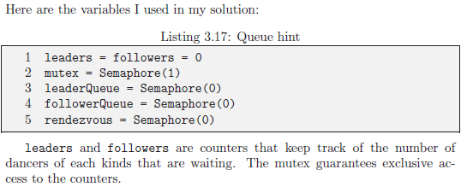
Solution

Slide 28
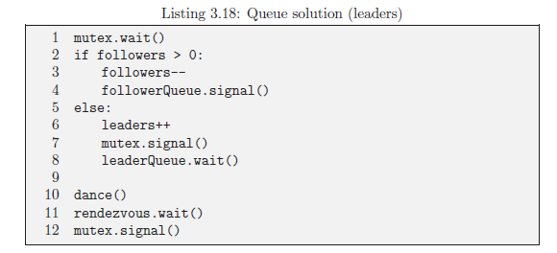
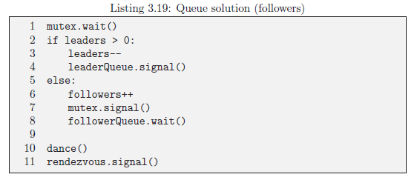
Exclusive queue solution

