Slide 1

Words Abstraction
Ariel Yahalom Yuval Alfassi

Slide 2

Project Theme

Slide 3


Project Theme
Morphological influence
Abstractness
Concreteness

Slide 4
Project Theme
Abstract
racism
autism
feminism
Adventurous
Anonymous
Fabulous

Slide 5
Project Theme
Abstract
אתאיזם
אוטיזם
פמיניזם
עיתונות
מדיניות
פעילות

Slide 6

Project Theme
Hebrew
English

Slide 7
English

Slide 8
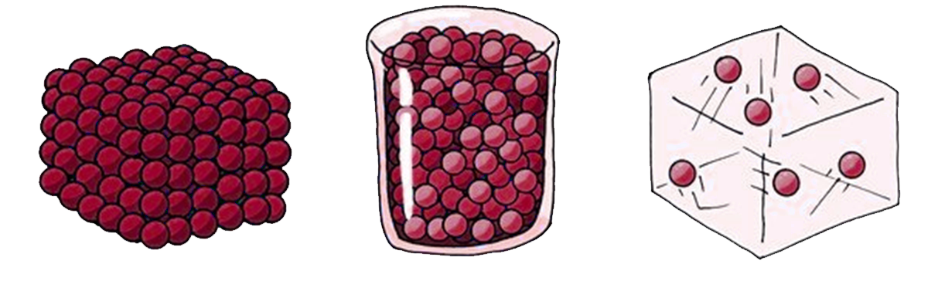
Frequent Nouns
Abstract
-ness
-ism
-ion
-ity
Concrete
Word2Vec
KNN
Classifier

Slide 9
Hebrew

Slide 10
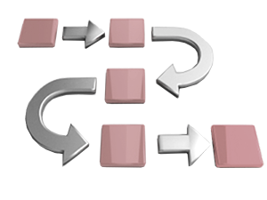
Frequent Nouns
Corpus: Arrutz 7
Nouns
1000 most frequent

