Slide 1
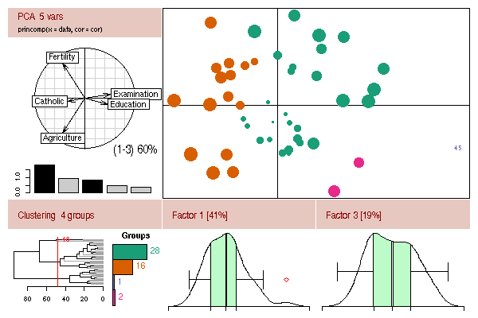

More Complex Graphics in R
FISH 397C
Winter 2009
Evan Girvetz
© R Foundation, from http://www.r-project.org

Slide 2
Hands-on Exercise
Read in the possum.csv dataset to a data frame called possum
Note that the first column of data should be the row names
There are column headings for the other columns

Slide 3
possum Data Frame
Look at data frame
> head(possum)
case site Pop sex age hdlngth skullw totlngth taill footlgth earconch eye chest belly
C3 1 1 Vic m 8 94.1 60.4 89.0 36.0 74.5 54.5 15.2 28.0 36
C5 2 1 Vic f 6 92.5 57.6 91.5 36.5 72.5 51.2 16.0 28.5 33
C10 3 1 Vic f 6 94.0 60.0 95.5 39.0 75.4 51.9 15.5 30.0 34
C15 4 1 Vic f 6 93.2 57.1 92.0 38.0 76.1 52.2 15.2 28.0 34
C23 5 1 Vic f 2 91.5 56.3 85.5 36.0 71.0 53.2 15.1 28.5 33
C24 6 1 Vic f 1 93.1 54.8 90.5 35.5 73.2 53.6 14.2 30.0 32

Slide 4
Plotting Multiple Columns
Plot three columns at one time
> possum[,c(6,8,9)]
> plot(possum[,c(6,8,9)])

Slide 5
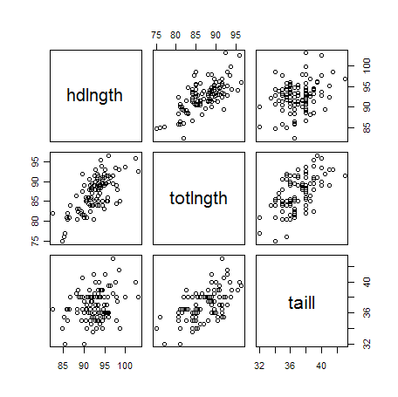

Slide 6
Multiple Graphs on One Layout
Look up mfrow and mfcol under par
> ?par
mfrow: multiple plots on one graph filled by row
mfcol: same but by column

Slide 7
Multiple Graphs on One Layout
The mfrow (or mfcol) command needs to be given to par prior to making the plots
> par(mfrow=c(2,3))
Now draw plots in the order you want them displayed
> plot(possum$hdlngth~possum$totlngth)
> plot(possum$hdlngth~possum$taill)
> plot(possum$totlngth~possum$taill)
> hist(possum$hdlngth)
> hist(possum$totlngth)
> hist(possum$taill)

Slide 8
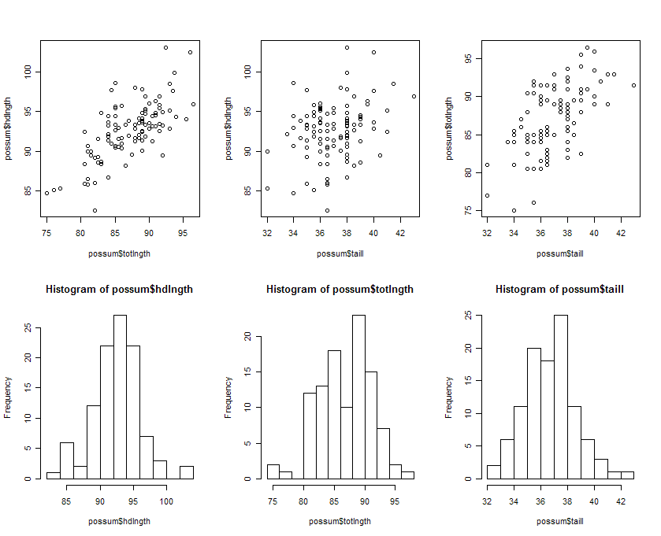

Slide 9
Hands-on Exercise
Create a plot with three graphs across
1: head length vs. total length (x vs y)
2: Histogram of total length
3: Histogram of head length
Add more informative labels and titles
“Head Length”
“Tail Length”
“Total Length”

Slide 10
Making customized layouts
layout(mat, widths = rep(1, ncol(mat)), heights = rep(1, nrow(mat)), respect = FALSE)
mat a matrix object specifying the location of the next N figures on the output device. Each value in the matrix must be 0 or a positive integer. If N is the largest positive integer in the matrix, then the integers {1,...,N-1} must also appear at least once in the matrix.
widths a vector of values for the widths of columns on the device. Relative widths are specified with numeric values. Absolute widths (in centimetres) are specified with the lcm() function (see examples).
heights a vector of values for the heights of rows on the device. Relative and absolute heights can be specified, see widths above.

Slide 11
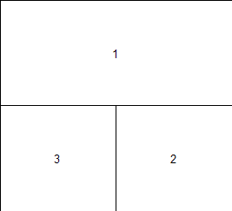
layout: custom layouts
> mat <- matrix(c(1,1,3,2), 2, 2, byrow = TRUE)
> mat
> lay1 <- layout(mat=mat)
> layout.show(lay1)

Slide 12
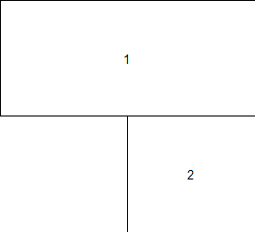
layout: custom layouts
> mat <- matrix(c(1,1,0,2), 2, 2, byrow = TRUE)
> lay1 <- layout(mat=mat)
> layout.show(lay1)

Slide 13
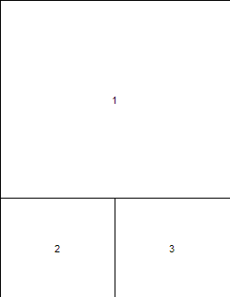
layout: custom layouts
> mat <- matrix(c(1,1,1,1,2,3), 3, 2, byrow = TRUE)
> lay1 <- layout(mat=mat)
> layout.show(lay1)

Slide 14
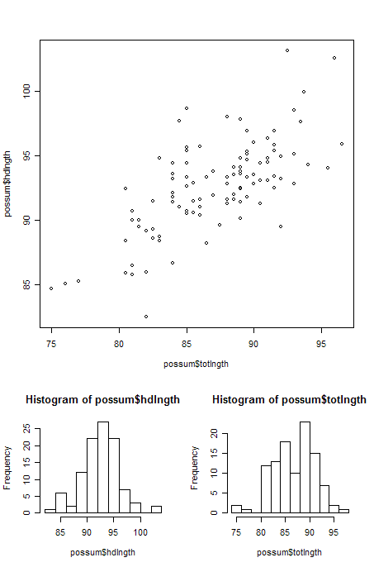
layout: custom layouts
> plot(possum$hdlngth~possum$totlngth)
> hist(possum$hdlngth)
> hist(possum$totlngth)

Slide 15
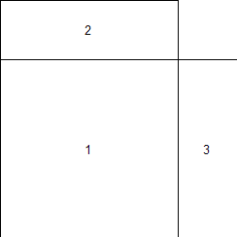
layout: custom layouts
> mat <- matrix(c(2,0,1,3),2,2,byrow=TRUE)
> lay1 <- layout(mat, c(3,1), c(1,3), TRUE)
> layout.show(lay1)

Slide 16
Simple Analyses: hist
> ?hist # look at the help for hist
> hdlngth.hist <- hist(possum$hdlngth)
> totlngth.hist <- hist(possum$totlngth)
> totLngth.hist ## look at totLngth.hist
> plot(hdlngth.hist)

Slide 17
barplot
> ?barplot
> barplot(hdlngth.hist$counts)
> par(mfrow= c(1,2))
> barplot(hdlngth.hist$counts)
> barplot(hdlngth.hist$counts, horiz = T)

Slide 18
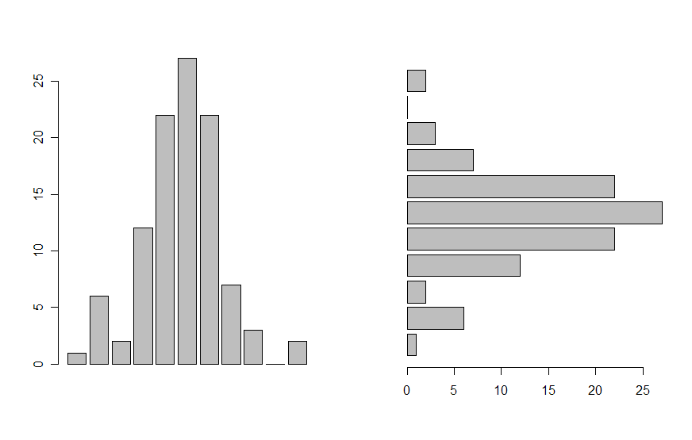
barplot
> par(mfrow= c(1,2))
> barplot(hdlngth.hist$counts)
> barplot(hdlngth.hist$counts, horiz = T)

Slide 19
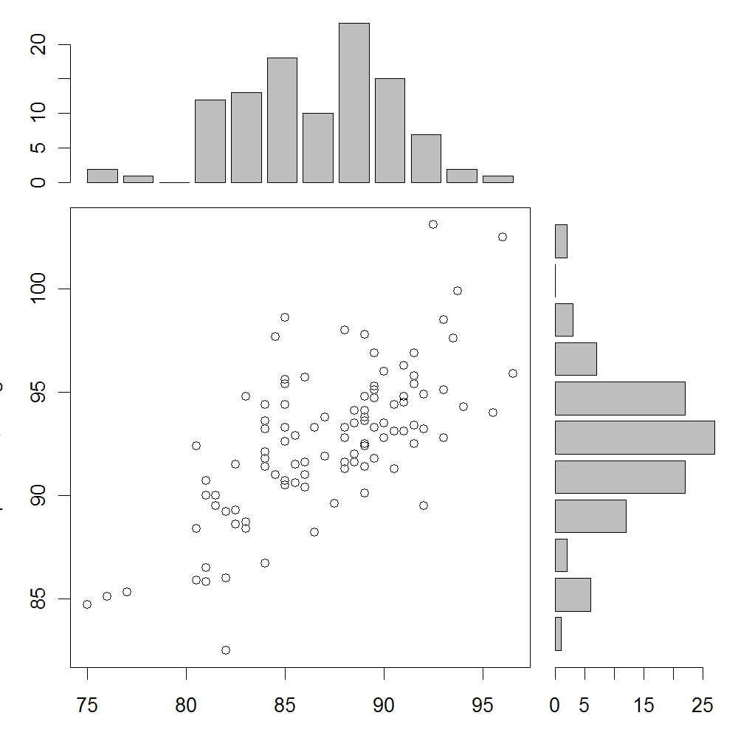
Hands-on Exercise
Add these plots in this order
Scatter plot
totlngth histogram
hdlnth histogram

Slide 20
Changing the Margin Sizes
> ?par # look at help for mar
> par(mar = c(par(mar=c(3,3,1,1)))
> par(mar = c(par(mar=c(0,3,1,1)))
> par(mar = c(par(mar=c(3,0,1,1)))

Slide 21
Hands on Exercise
Redo your layout using these margin sizes for the three plots in this order
> par(mar = c(par(mar=c(3,3,1,1)))
> par(mar = c(par(mar=c(0,3,1,1)))
> par(mar = c(par(mar=c(3,0,1,1)))

Slide 22
Linear Regression : lm
Use linear modeling:
> totHd.lm <- lm(hdlngth ~ totlngth, data = possum)
> summary(totHd.lm)
> totHd.lm$coefficients
> totHd.lm$residuals

Slide 23
Linear Regression : lm
Linear regression diagnostic graphs
> plot(totHd.lm)

Slide 24
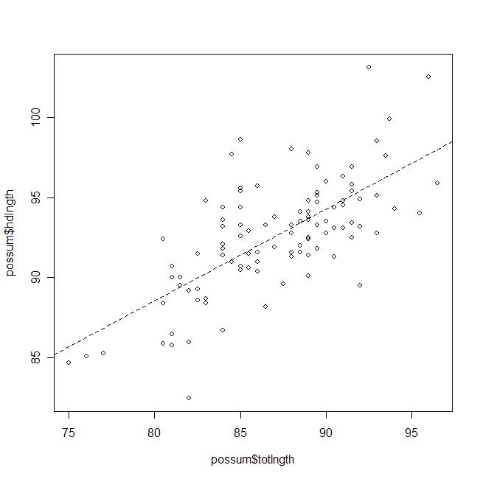
Adding lines to plots: abline
> ?abline # look at the help for abline
> par(mfrow = c(1,1))
> plot(possum$hdlngth~possum$totlngth)
> abline(totHd.lm, lwd = 2, lty = 2)

Slide 25
Hands-on Exercise
Now add a trend line to the scatter plot in your layout

Slide 26
Text Expressions
> coefA <- totHd.lm$coeficients[1,1]
> coefB <-totHd.lm$coeficients[2,1]
> text(x=80,y=101, expression(tailLen == 42.7 + 0.573 * (headLen) ))

Slide 27
Hands On Exercise
Add this equation to the scatter plot in your layout
Write the layout to a .png file and view in a graphics viewer

Slide 28
Lattice Graphics
> library(lattice)
> attach(possum)
The lattice library must be loaded to use the lattice graphical functions

Slide 29
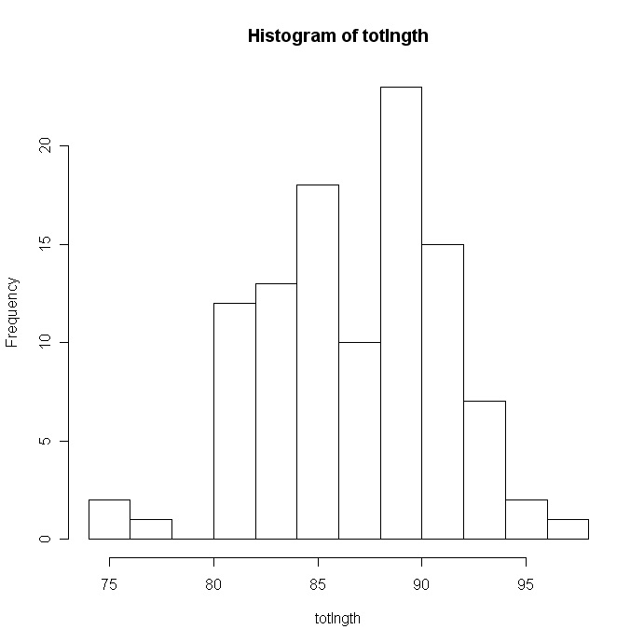
> hist(totlngth) # base graphics

Slide 30
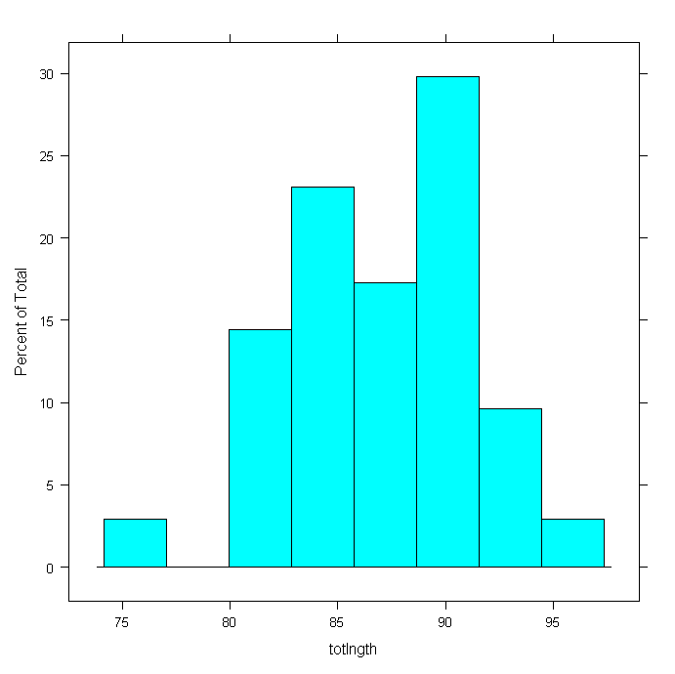
> histogram(totlngth) # lattice graphics

Slide 31
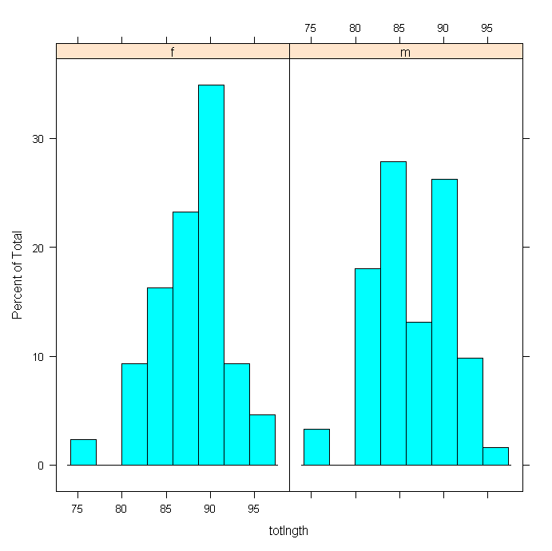
> histogram(~totlngth | sex)

Slide 32
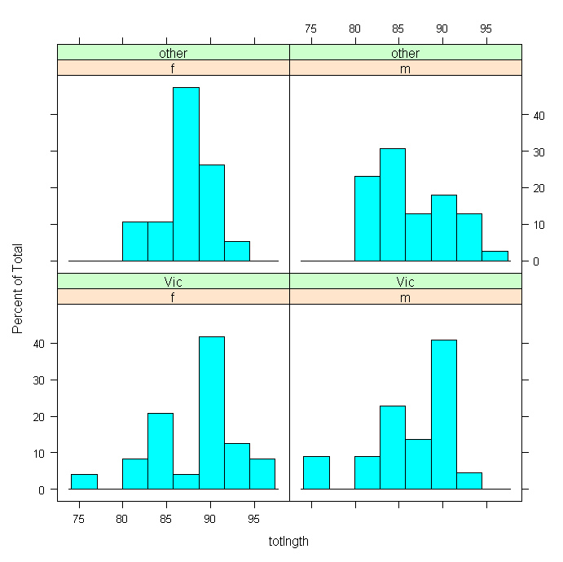
> histogram(~totlngth | sex*Pop)

Slide 33
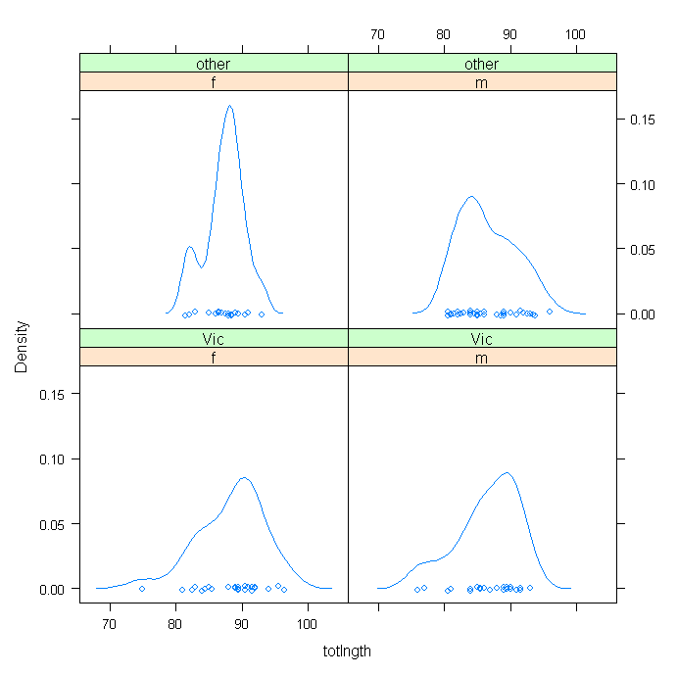
> densityplot(~totlngth | sex*Pop)

Slide 34
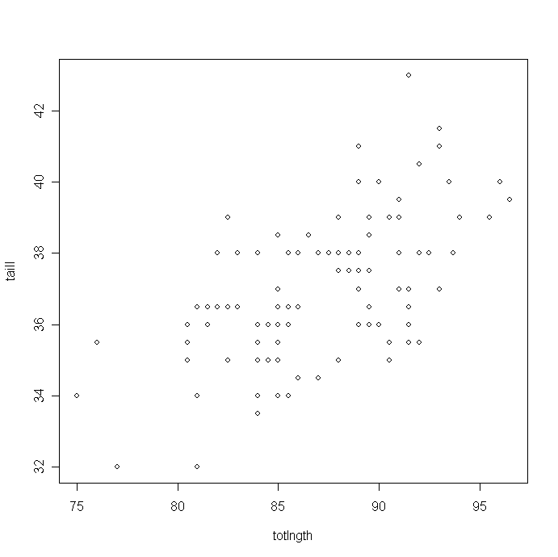
> plot(taill~totlngth) # Base Graphics

Slide 35
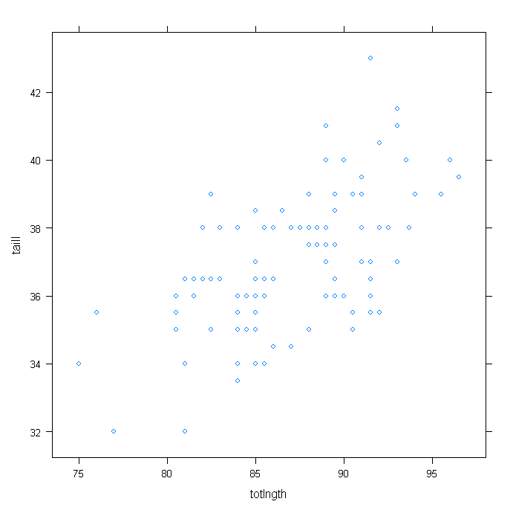
> xyplot(taill~totlngth) # Lattice graphics

Slide 36
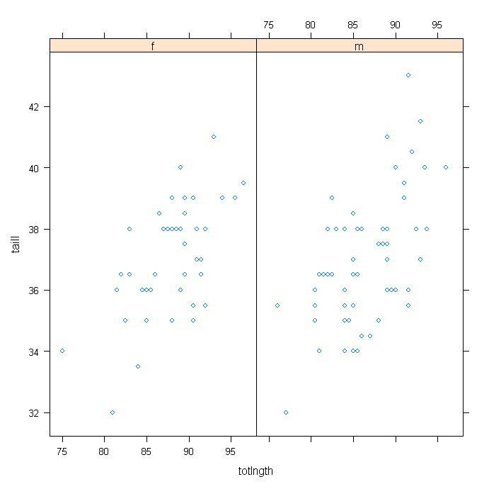
> xyplot(taill~totlngth | sex) # Lattice graphics

Slide 37
Lattice Graphics
dotplot(factor ~ numeric,..) # 1-dim. Display
stripplot(factor ~ numeric,..) # 1-dim. Display
barchart(character ~ numeric,..)
histogram( ~ numeric,..)
densityplot( ~ numeric,..) # Density plot
bwplot(factor ~ numeric,..) # Box and whisker plot
qqmath(factor ~ numeric,..) # normal probability plots
splom( ~ dataframe,..) # Scatterplot matrix
parallel( ~ dataframe,..) # Parallel coordinate plots
cloud(numeric ~ numeric * numeric, ...) # 3D surface
wireframe(numeric ~ numeric * numeric, ...) # 3D scatterplot

Slide 38
Detach the possum data set
> detach(possum)

Slide 39
Other Graphics and Expressions
> symbols(0,0,circles=0.95,bg="gray",
xlim=c(-1,2.25),ylim=c(1,1),inches=FALSE)

Slide 40
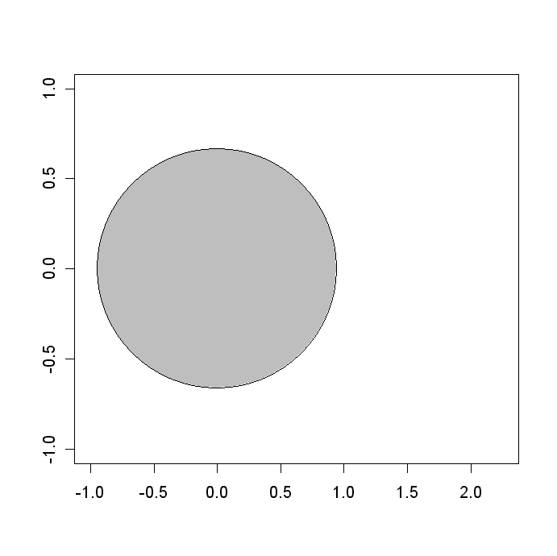

Slide 41
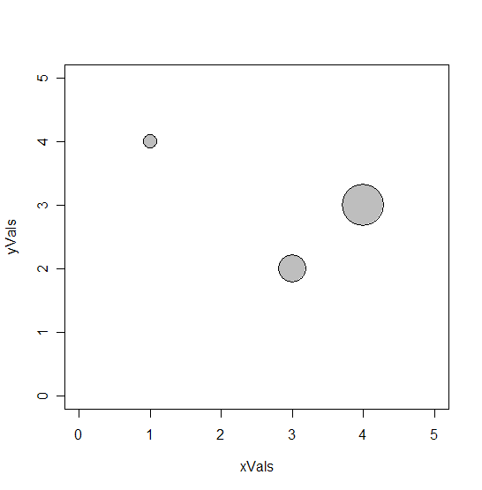
Other Graphics and Expressions
> xVals <- c(1,3,4)
> yVals <- c(4,2,3)
> circleSizes <- c(.1, .2, .3)
> symbols(xVals , yVals ,circles= circleSizes,
bg="gray”, xlim = c(0,5),
ylim = c(0,5),inches=FALSE)

Slide 42
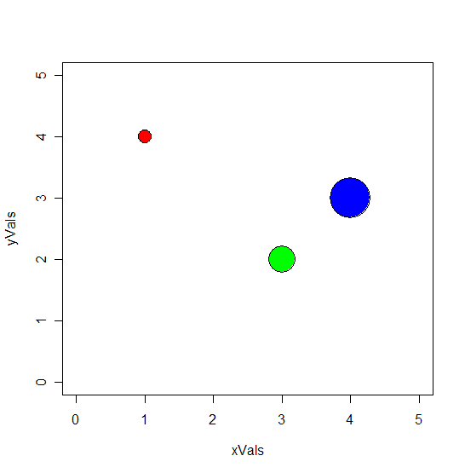
Other Graphics and Expressions
> symbols(xVals , yVals ,circles= circleSizes,
bg=c(“red”, “green”, “blue”), xlim = c(0,5),
ylim = c(0,5),inches=FALSE)

Slide 43
Other Graphics and Expressions
> symbols(0,0,circles=0.95,bg="gray",
xlim=c(-1,2.25),ylim=c(1,1),inches=FALSE)
> text(1.75,0,expression("Area" ==pi*phantom("'")
*italic(r)^2))

Slide 44
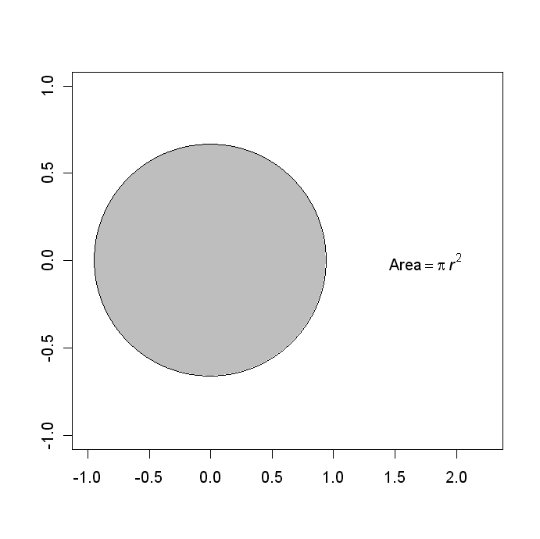

Slide 45
Other Graphics and Expressions
> symbols(0,0,circles=0.95,bg="gray",
xlim=c(-1,2.25),ylim=c(1,1),inches=FALSE)
> text(1.75,0,expression("Area" ==pi*phantom("'")
*italic(r)^2))
> arrows(0,0,-.95,0,length=.1,code=3)

Slide 46
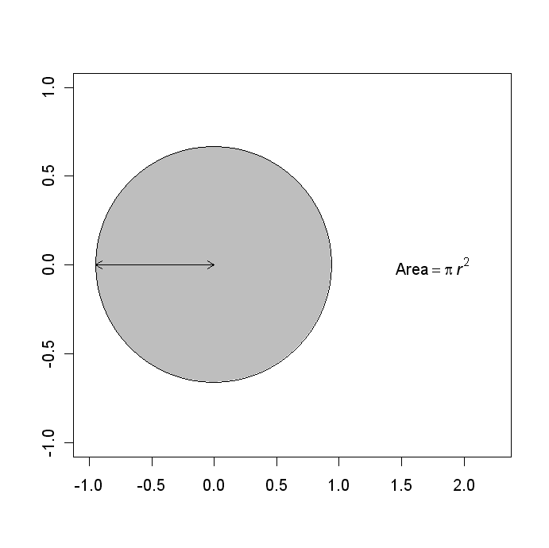

Slide 47
Other Graphics and Expressions
> symbols(0,0,circles=0.95,bg="gray",
xlim=c(-1,2.25),ylim=c(1,1),inches=FALSE)
> text(1.75,0,expression("Area" ==pi*phantom("'")
*italic(r)^2))
> arrows(0,0,-.95,0,length=.1,code=3)
> text(-0.45,-strheight("R"),
expression(italic(r) == 0.95))

Slide 48


Slide 49
Finding Locations: locator()
> location <- locator(n=1)
Now click on the graphic where you’d like the label
> text(location$x,location$y,
expression("Area"==pi*phantom("'")*italic(r)^2))

Slide 50
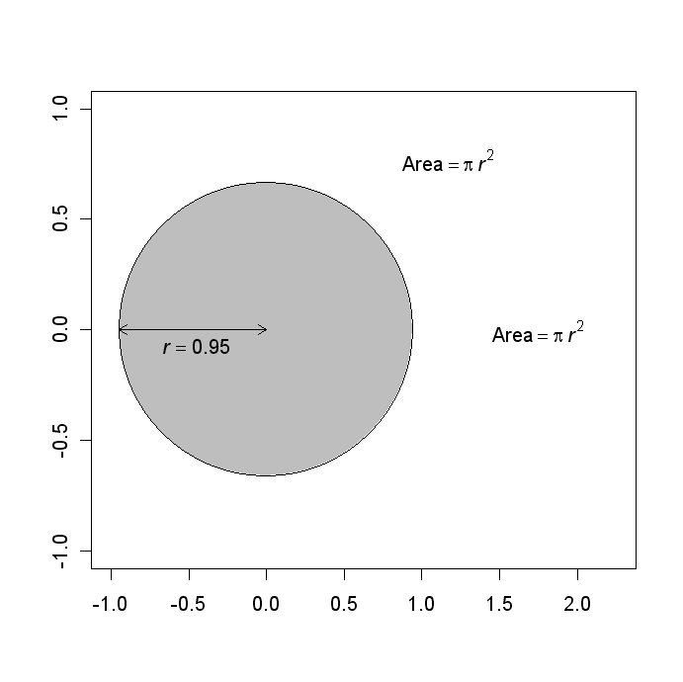

Slide 51
Drawing on graphics: locator()
> locator(n=2, type = "l")
Now click on the two points where you’d like to draw a line
> locator(n=4, type = "p")
Now click on the four locations where you’d like to place points

Slide 52
