Slide 1
Molecules & Joints
Uri Avron, Amnon Catav, Ori Yoran
08/01/2019
14:57

Slide 2
Bioinformatics 101

Slide 3
Goal
(FILL ME: generate printable 3D model which capable of simulating the transformation from one conformation to another etc bla bla bla…)

Slide 4
The model
We first find the best virtual bonds between each pair of chains
For each virtual bond, we add a cylinder (such that the protein is fully connected as one-piece)
In every cylinder, we place a ball-and-socket joint in the middle
Each joint is constrained to certain angles which corresponds to the transformation
We assume that there is no constraints on relative rotations between chains

Slide 5
Finding the best virtual bonds

Slide 6
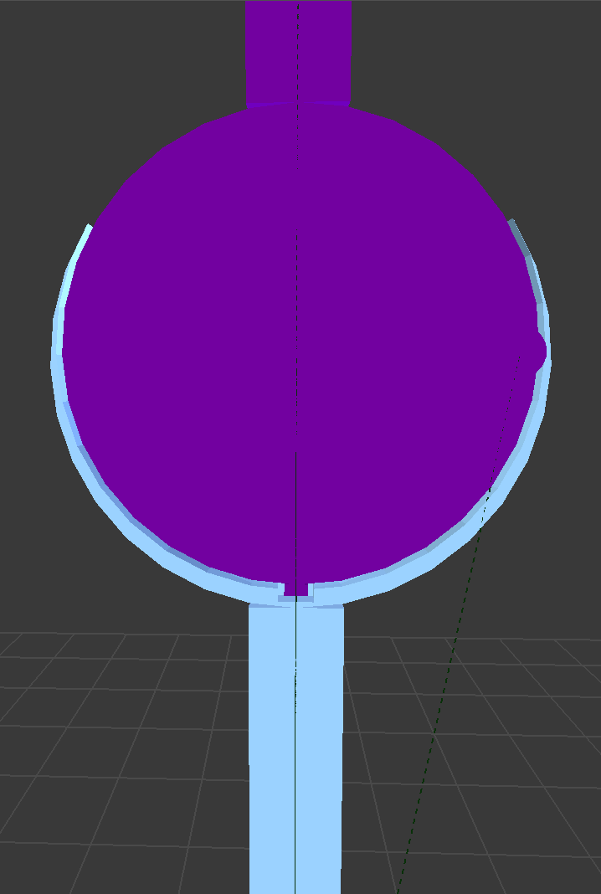
Joint structure
Ball cylinder
Ball
The dimensions of the constraints box are determined by the angles of the transformation, and the safety dimensions
The ”snap” should hold the protein model in conformation A
The angles are relatively small
“Snap”
Socket
Pin/safety +
constraints box
Socket cylinder

Slide 7
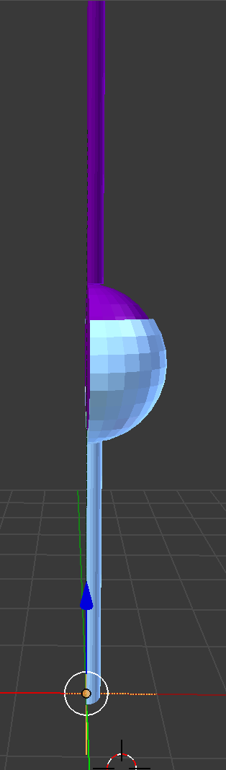
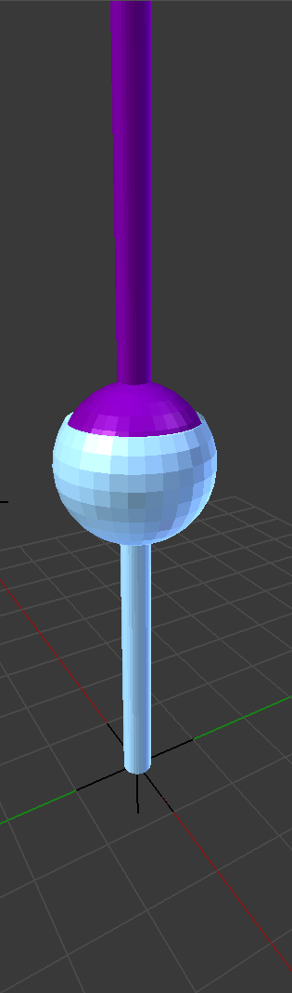
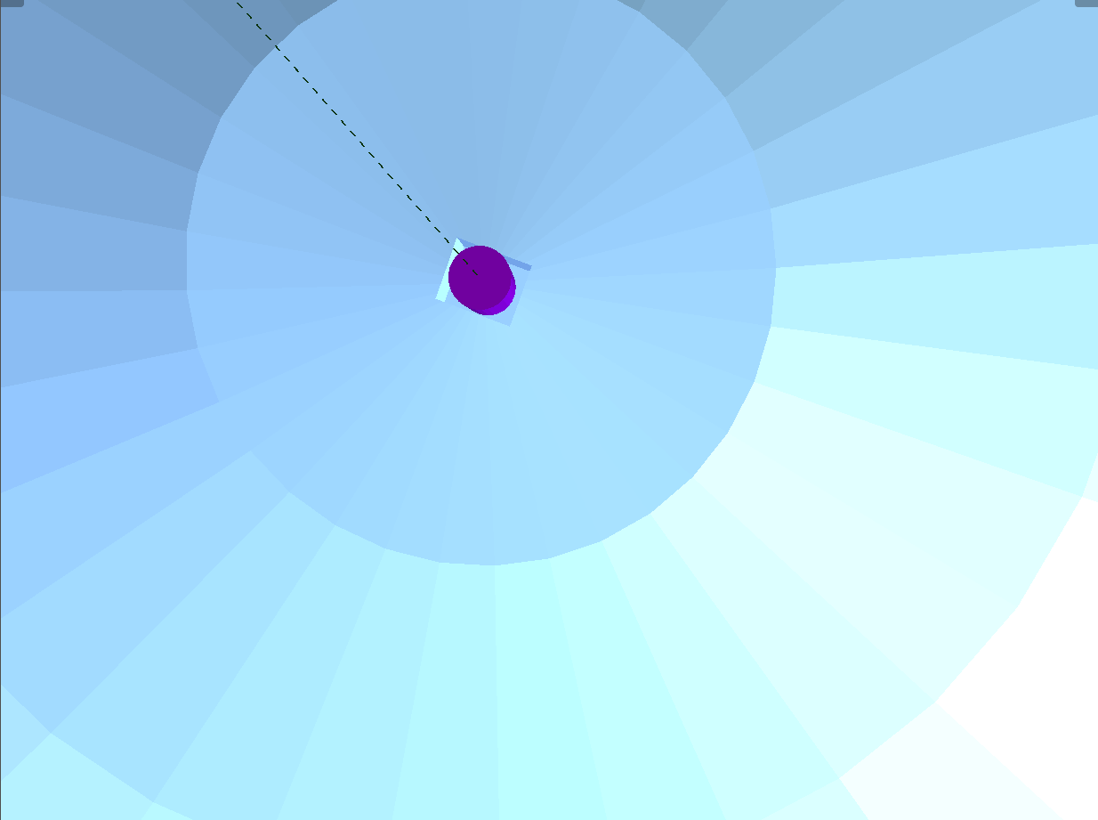
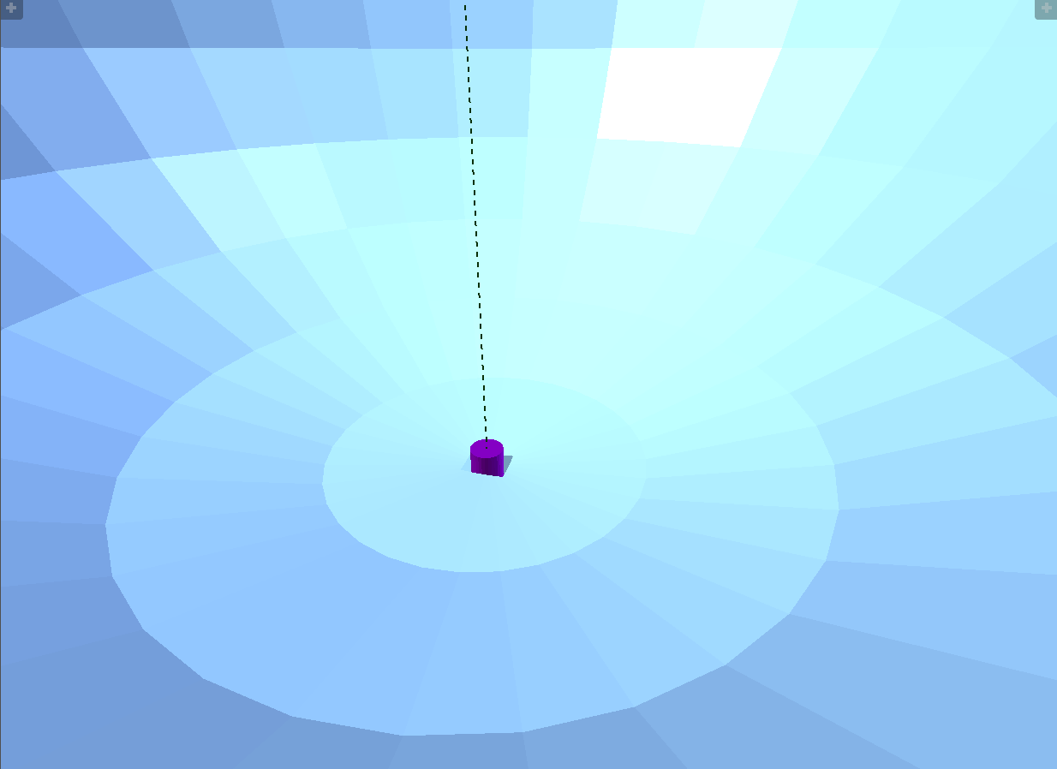
Joint structure

Slide 8
Results
We had experiments we several proteins
For some, the joints were added perfectly
For others, the bonds were intersecting with atoms such that the joints passes through the chains
Thus, as further research, we suggest exploring different methods for finding the best bonds, which won’t intersect but still have a nice approximation of the transformation (a more bioinformatics-related task)

Slide 9
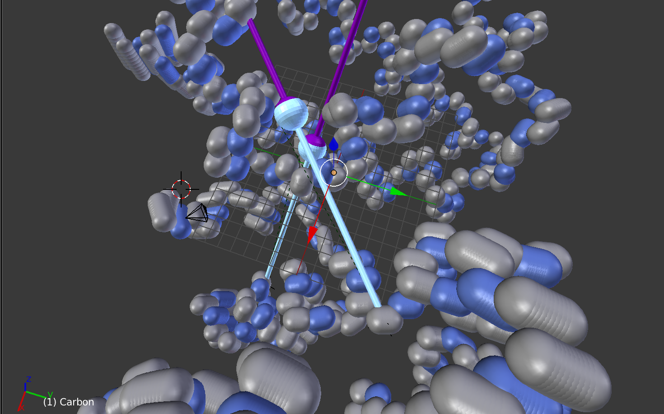

Slide 10
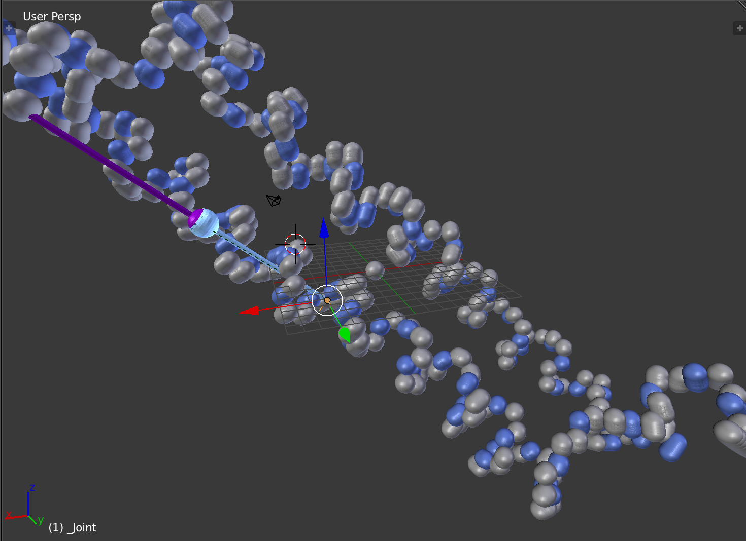

Slide 11
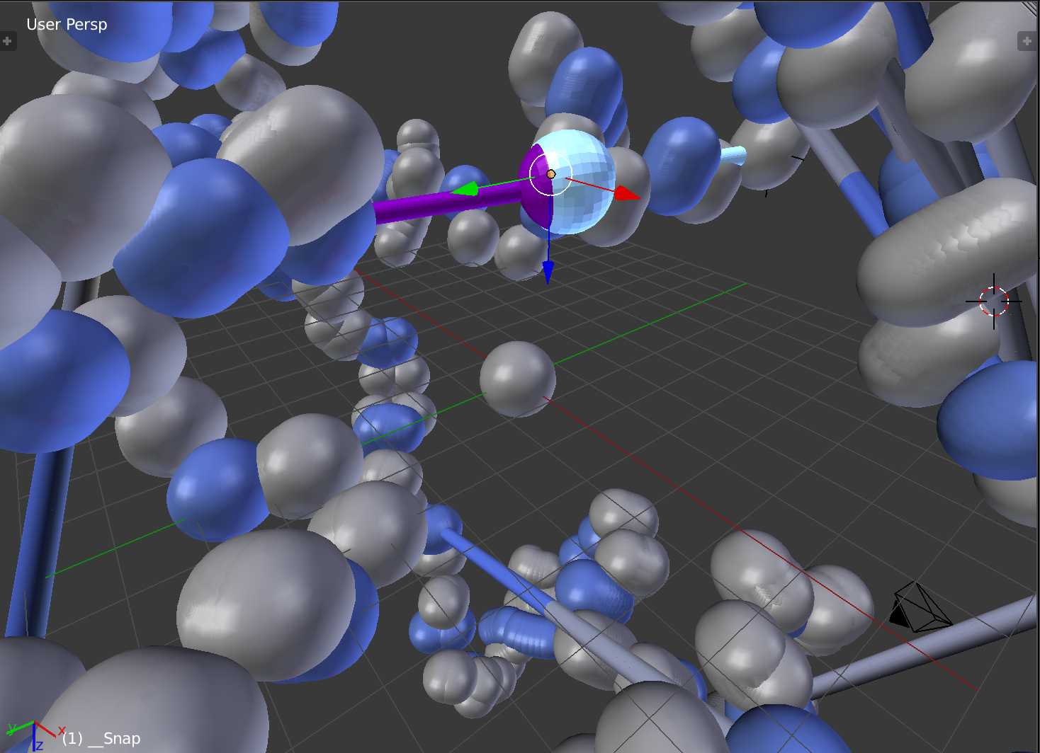

Slide 12
Technologies
Blender
Python
PyMOL
PDB (Protein Data Bank)

