Slide 1
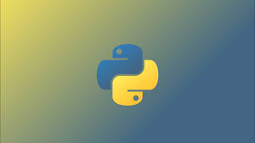
Introduction to Game Development Using PyGame
Hackathon by the Sea 3.0
Uri Mann

Slide 2
Let’s get to know each other
About me
My mane is Uri Mann (Ooree if you want to pronounce it correctly)
Live in Oak Park
Professionally developing software since 1985
My second involvement with Ventura County Hackathon
About you
Did you write any programs in the past?
Which language?
Do you know Python?
Did you try to write any games? What language? Framework?

Slide 3
Agenda
Why Python and PyGame
Setup
Basic Python coding
Basic game development
Demo
Build Your Game
Adding sounds

Slide 4
Why Python and PyGame
Python is a general-purpose programming language
Invented by Guido van Rossum
Free to use by everyone (open source), continuously improved
Easy to learn, widely used, portable
Interpreted language facilitating interactive development
Many modules (libraries) for almost any purpose
PyGame is cross-platform game library (also open source)
Written by Pete Shinners
Based on SDL (Simple DirectMedia Library)

Slide 5
Let’s Get Started
Get Python
Open browser
Navigate to https://www.python.org/
Click Downloads Python 3.8.0
Click Run (IE) or Save to file and then Open
In Python installer check mark Add Python to PATH
Click Install now
Close python installer and python.org browser tab

Slide 6

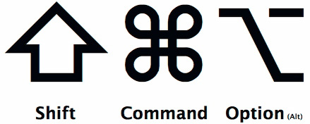
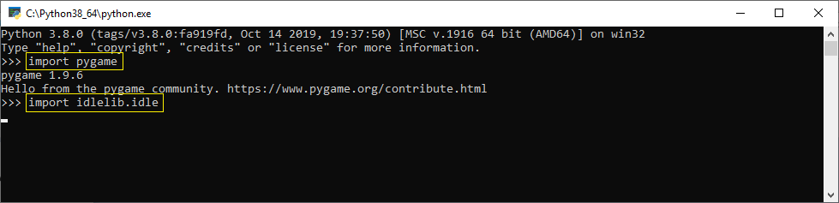
Let’s Get Started (Cont’d)
Setup Python with PyGame
Windows + R / Mac + T
Type cmd /k pip install pygame (Windows) / pip3 install pygame (Mac)
See progress bar
When done type python

Slide 7

Python IDLE
IDLE (Interactive Development and Learning Environment) is simple but powerful tools to start having fun with Python
Allows writing code and run it and debug it interactively
Two main windows
Editor to write and save your work
Python Shell to display program execution and experiment with code snippets

Slide 8
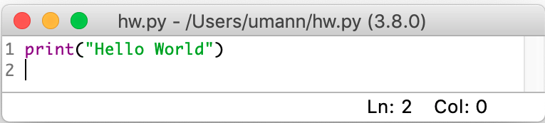
Your first program
Traditionally the first program is “Hello World!”
Hit F5 key
It’s that simple!

Slide 9
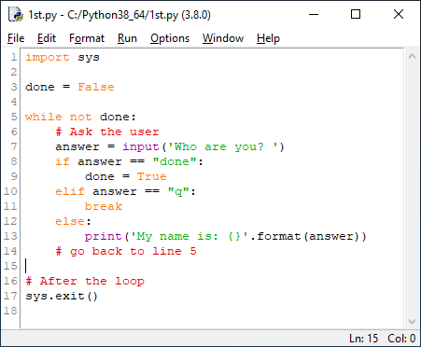
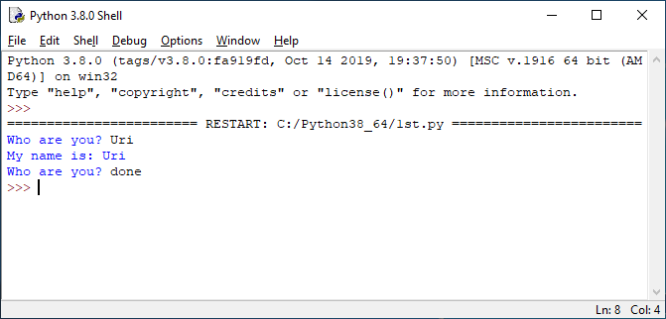
Python programming primer
imported module
boolean variable
while loop
comment
built-in function
control block indentation
(required)
loop break (exit)
sys module function called
literal string

Slide 10
Collections (tuple, list, dict)
Lists may hold any type of objects (may be non-homogenous)
Lists may be inserted into, appended or shrunk
Accessed by index
Tuple – read-only array of items
Delimited by parenthesis (e.g. (1,’2’,3))
List - Modifiable
Delimited by square braces (e.g. [‘this’, ’is’, ’a’, ‘list’, ‘of’, 5, (‘i ’, ‘t ’, ‘ e ’, ‘ m ’, ‘ s’)])
Dict – modifiable list
Key, value, collection delimited by curly braces (e.g. {1: “one”, 2: [1,2,3]})
Keys must be “hashable”
Values may be modified but not the keys

Slide 11
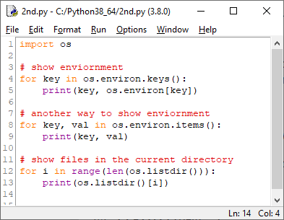
For Loops
Lists may be accessed sequentially (by iteration)
get list of keys from the os.environ dict(ionary)
use the key as index for the value
get key, value pair
get list of files in the current directory
(len() returns the number of items)
access list using index

Slide 12
Anatomy of PyGame Game
Game has three parts
Game initialization
Importing required modules (one of them being import pygame)
Initializing PyGame framework
Acquiring game assets (graphics, sounds, etc.)
Processing main game loop
Processing events (Window events, keyboard, mouse, etc.)
Repainting the screen to show game progress
Game teardown
Releasing assets
PyGame framework shutdown
Terminating python game script

Slide 13
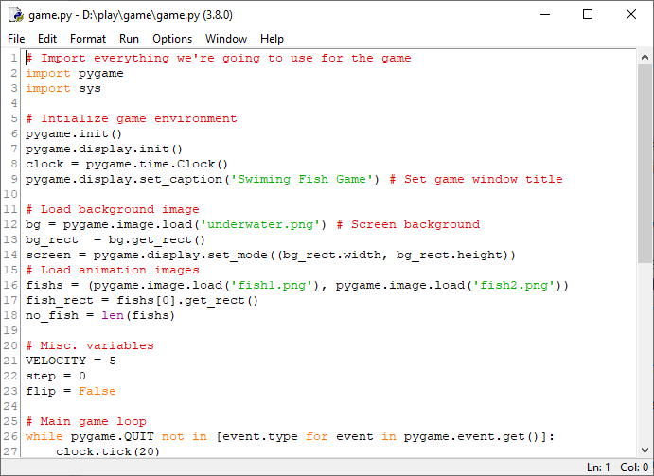

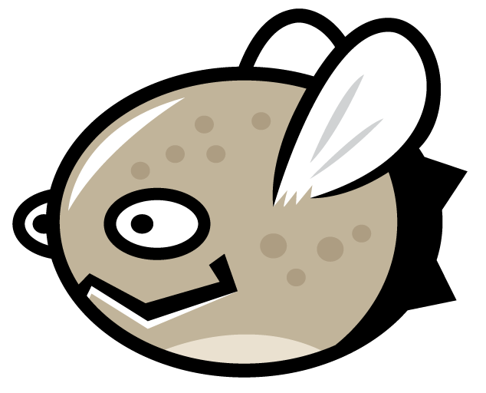
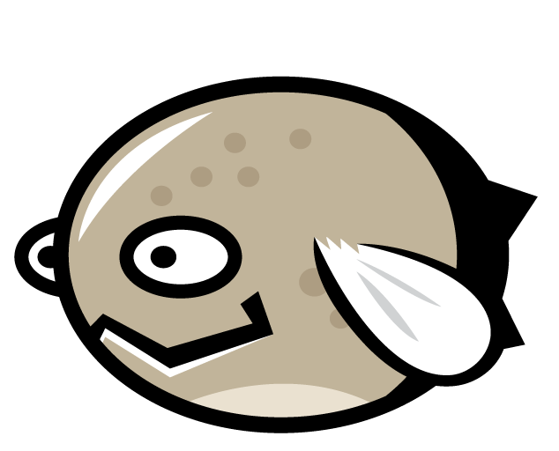
PyGame Game Initialization
imports section
PyGame framework setup
graphical assets
miscellaneous other stuff

Slide 14
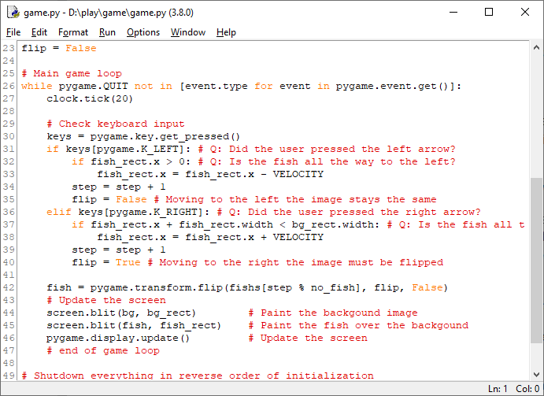
Game Loop
check if player wants to exit the game
process keyboard input from player
repaint the screen
rinse and repeat

Slide 15
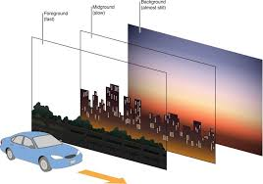
Painting the Screen
Compose the scene form back to front. Far background to closer background to game characters
Same rules apply to animation (parallax scrolling)
Step one sprite image at a time
PyGame compose each step into a buffer
After all composition is finished, screen
is updated at once

Slide 16
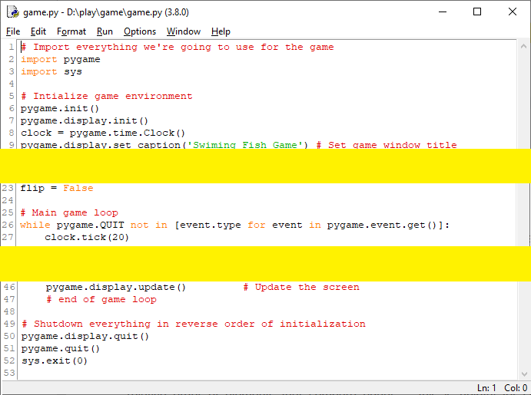
Game Shutdown Sequence
reverse the order of initialization

Slide 17
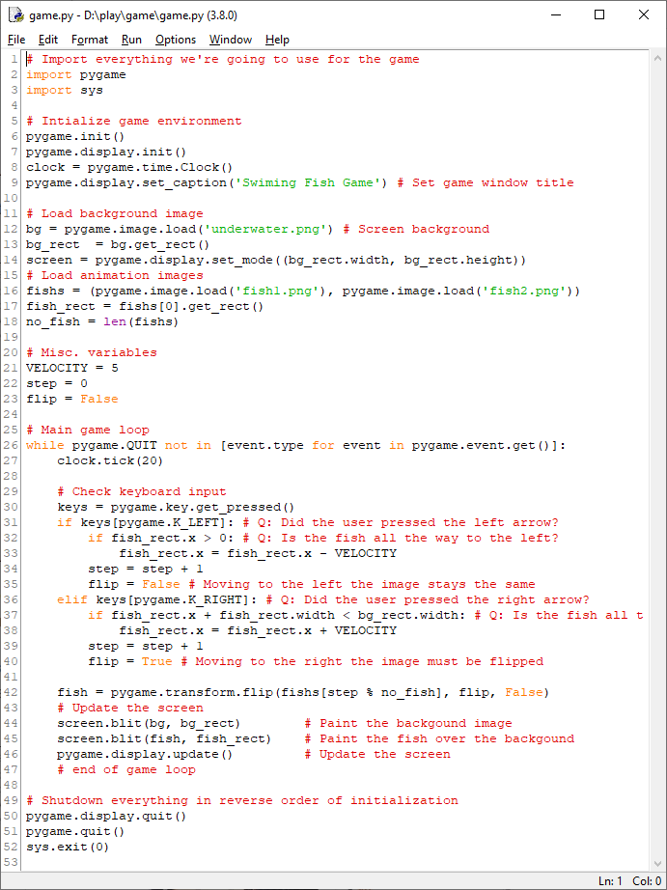
Game Demo

Slide 18
It’s Now Your Turn
Download game code and assets (https://github.com/urielmann/game)
Select Clone or download button to get .zip file
Find replacement assets (background image and sprites)
Recommended: https://opengameart.org/ and https://images.google.com/
Search background according to your game theme (race trace, hunted castle, magic city, etc.)
Search for sprites (race car, vampire, worrier, etc.)
Open game.py in IDLE
Replace underwater.png and fish1.png, fish2.png with path to your images
Hit F5 and enjoy

Slide 19
PyGame Game Initialization

Slide 20
Additional Resources
Python https://www.python.org/: use Download tab to install
PyGame https://www.pygame.org/: use Getting Started, Projects and Docs tabs
Open Game Art https://opengameart.org/: use Browse tab
Stack Overflow https://stackoverflow.com/: search for answers and post questions
Advance tutorial https://techwithtim.net/tutorials/game-development-with-python/pygame-tutorial/
My email: abba.mann@gmail.com

