Slide 1
Man-made Natural
Fixation 1000ms
Man-made Natural
Mask 270ms
Man-made Natural
Mask 30ms
Man-made Natural
RADIO
Prime 30ms
Man-made Natural
Mask 30ms
Man-made Natural
Time
radio
Target + Categorization 500ms
RADIO PHONE
Recognition
How well did you see the first stimulus?
On a scale of 1-4
PAS
1 2 3 4

Slide 2
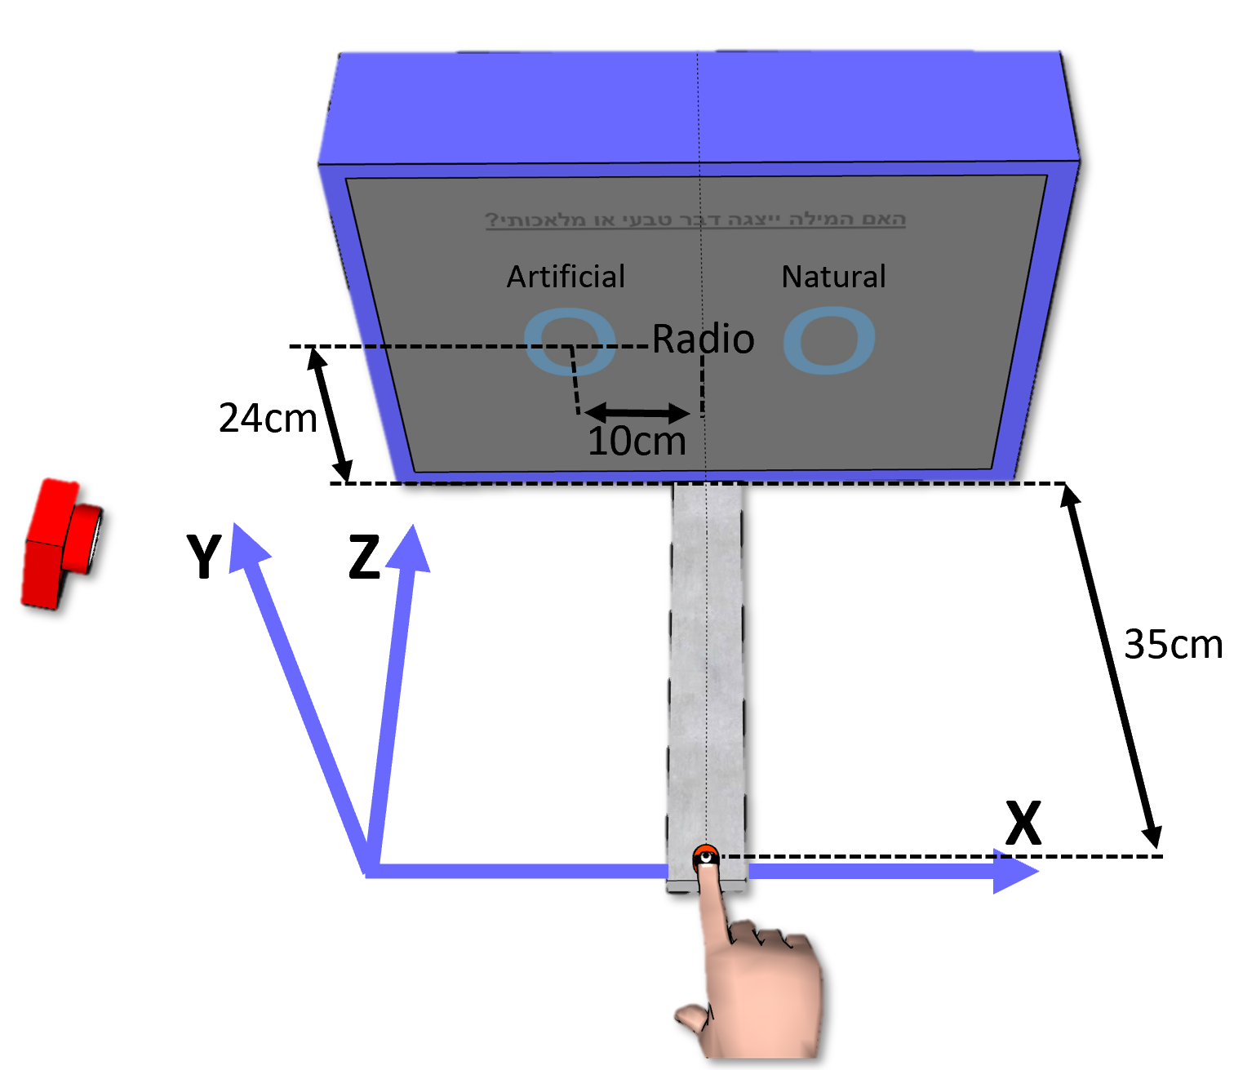
Man-made Natural
Fixation 1000ms
Man-made Natural
Mask 270ms
Man-made Natural
Mask 30ms
Man-made Natural
RADIO
Prime 30ms
Man-made Natural
Mask 30ms
Man-made Natural
Time
radio
Target + Categorization 500ms
RADIO PHONE
Recognition
How well did you see the first stimulus?
On a scale of 1-4
PAS
1 2 3 4

