Slide 1
OLD FIGURE
*
*
*
*
*
(h)
(i)
(j)
(k)

Slide 2
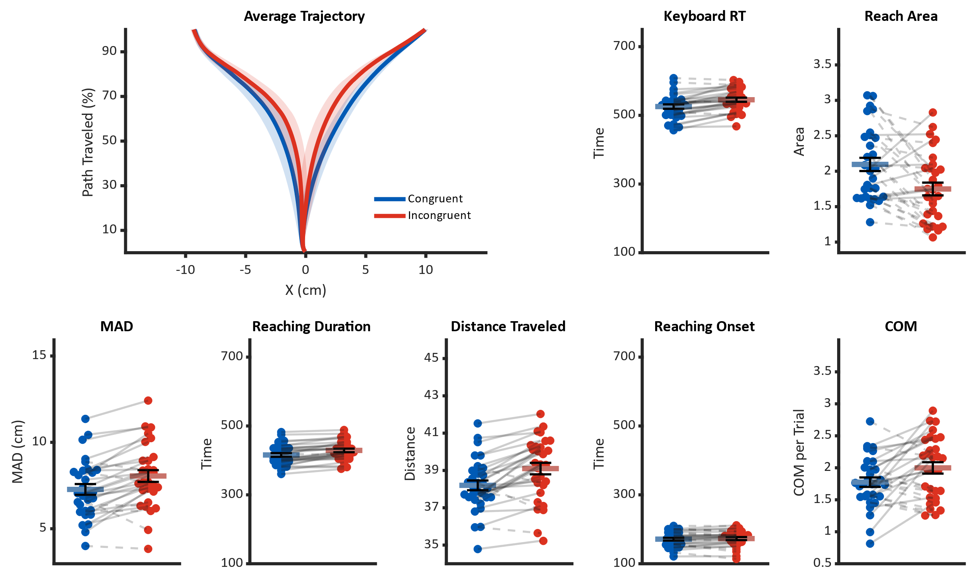
Enlarged to keep high resolution on paper
(a)
(b)
*
(c)
*
(d)
(e)
(f)
(g)
(h)
*
*
*
*
(i)
(j)
(k)
(l)

Slide 3
Reaching Session

Slide 5
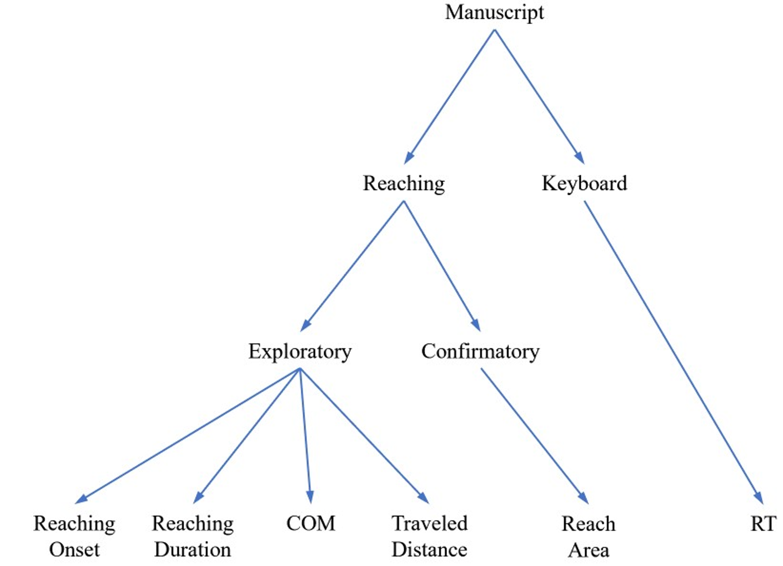
Manuscript
Reaching
Keyboard
Exploratory
Confirmatory
Reaching
Onset
Reaching
Duration
COM
Traveled
Distance
Reach
Area
RT

Slide 6
Manuscript
Reaching
Keyboard
Exploratory
Confirmatory
Reaching
Onset
Reaching
Duration
COM
Traveled
Distance
MAD
Reach
Area
RT

