Slide 1
Introspection Lab Session #2
2020/11/23

Slide 2
Outline
Runtime Interposition Example
Reviewing of Implementation of functions
Organizing Linked lists

Slide 3
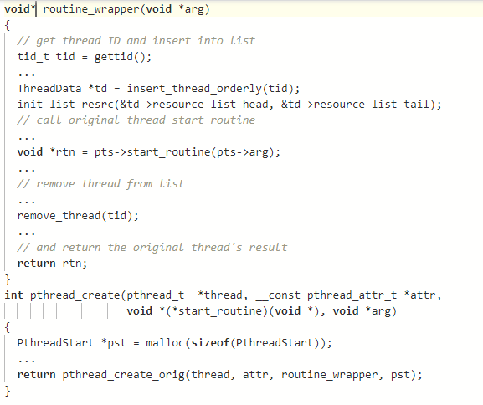
Implementation of functions
wrapping start_routine

Slide 4
Implementation of functions
wrapping start_routine

Slide 5
Implementation of functions
wrapping start_routine
Thread list is shared

Slide 6
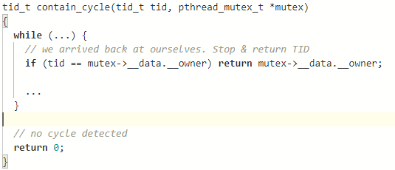
Implementation of functions
Investigating Circular Wait Condition

Slide 7
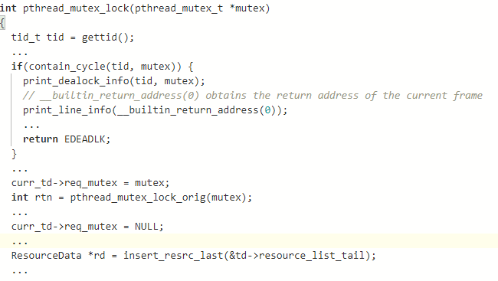
Implementation of functions
Deadlock Detect
Thread list is shared

Slide 8
Implementation of functions
Deadlock Detect

Slide 9
Implementation of functions
Deadlock Detect

Slide 10
Implementation of functions
Deadlock Detect
Thread list is shared

Slide 11
Implementation of functions
Deadlock Detect
Thread list is shared
Resource list is shared ?

Slide 12
Organizing a Linked list
ThreadData* insert_thread_orderly(tid_t tid)
HEAD
1000
2000
HEAD
4000
TAIL
3000

Slide 13
Organizing a Linked list
void remove_thread(tid_t tid)
HEAD
1000
2000
HEAD
4000
TAIL
3000

Slide 14
Organizing a Linked list
void init_list_resrc(Node *head, Node *tail)
HEAD
TAIL

Slide 15
Organizing a Linked list
ResourceData* insert_resrc_last(Node *tail)
HEAD
0x00x
0x00x
HEAD
TAIL
0x00x

Slide 16
Organizing a Linked list
void remove_resrc(Node *head, pthread_mutex_t *mutex)
HEAD
0x00x
0x00x
HEAD
0x00x
TAIL
0x00x

Slide 17
Organizing a Linked list
void remove_thread(tid_t tid)
HEAD
1000
2000
HEAD
4000
TAIL
3000

