Slide 2
Ph.D. Dissertation Title
Model-Based Error Localization and Mutation-Based Error Correction Algorithms and their Implementation for C Designs

Slide 3


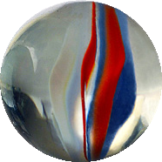

Ph.D. Supervisors
prof. Tanel Tammet
Department of Computer Science, Tallinn University of Technology
dots. Juhan-Peep Ernits
Department of Computer Science, Tallinn University of Technology
prof. Jaan Raik
Department of Computer Engineering, Tallinn University of Technology

Slide 4
Ph.D. Opponents
prof. Erik G. Larsson
Department of Department of Electrical Engineering, Linköping University
prof. Varmo Vene
Institute of Mathematics and Statistics, University of Tartu

Slide 5
List of Publications (1)
Raik, Jaan; Repinski, Urmas; Hantson, Hanno; Jenihhin, Maksim; Di Guglielmo, Giuseppe; Pravadelli, Graziano; Fummi, Franco (2012). Combining Dynamic Slicing and Mutation Operators for ESL Correction. 17th IEEE European Test Symposium (1−6). IEEE.
Repinski, Urmas; Raik, Jaan (2012). Comparison of Model-Based Error Localization Algorithms for C Designs. Proc. of 10th East-West Design & Test Symposium, Kharkov, Ukraine, September 14-17, 2012 (1−4). IEEE Computer Society Press.
Hantson, H.; Repinski, U.; Raik, J.; Jenihhin, M.; Ubar, R. (2012). Diagnosis and Correction of Multiple Design Errors Using Critical Path Tracing and Mutation Analysis. In: 13th IEEE Latin-American Test Workshop Proceedings (27−32). IEEE Computer Society Press.

Slide 6

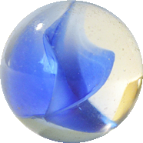
List of Publications (2)
Raik, Jaan; Repinski, Urmas; Jenihhin, Maksim; Chepurov, Anton (2011). High-Level Decision Diagram Simulation for Diagnosis and Soft-Error Analysis. Design and Test Technology for Dependable Systems-on-Chip (294−309). IGI Publishing.
Raik, Jaan; Repinski, Urmas; Ubar, Raimund; Jenihhin, Maksim; Chepurov, Anton (2010). High-level design error diagnosis using backtrace on decision diagrams. 28th Norchip Conference 15-16 November 2010, Tampere, Finland, IEEE.

Slide 7
Other Related Publications
Урмас Репинский (2012), Верификация на основе симуляции с нахождением и исправлением ошибок для с-дизайнов, Програмные продукты и системы, № 100, 2012 год, стр. 229-237
Urmas Repinski (2012). Model-based Verification with Error Localization and Error Correction for C Designs, Програмные продукты и системы (international journal Software and Systems), № 100, 2012, pp. 221-229.
Bloem, Roderick; Drechsler, Rolf; Fey, Goerschwin; Finder, Alexander; Hofferek, Georg; Koenighofer, Robert; Raik, Jaan; Repinski, Urmas; Suelflow, Andre (2012). FoREnSiC - An Automatic Debugging Environment for C Programs, Haifa Verification Conference (HVC'2012), pp 1-6, IBM Research Labs, Haifa, Israel: IBM.

Slide 8
Outline
Introduction
Model-Based
Error
Localization
Algorithm
Mutation-Based
Error
Correction
Algorithm
Experimental
Results
Conclusion
Problem Formulation
Requirements for the tool
Contributions
The Model
Animation and Simulation
Algorithm
Rankings
Dynamic Slicing Algorithm
Related Work
The Model
Error Classes
Algorithm
Properties
Siemens Benchmarks
Error Localization
Dynamic Slicing
Error Correction
Contributions and Novel Approaches
Experimental Results
Future Extensions

Slide 9
Problem Formulation
“Black Box” → “White Box”
The Model
Algorithms ( and Mutation-Based Error Correction)
  Model-Based Error Localization
  Mutation-Based Error Correction
Specification Format
  Vera
  E
  Java
  C/C++

Slide 10
Outline
Introduction
Model-Based
Error
Localization
Algorithm
Mutation-Based
Error
Correction
Algorithm
Experimental
Results
Conclusion
Problem Formulation
Requirements for the tool
Contributions
The Model
Animation and Simulation
Algorithm
Rankings
Dynamic Slicing Algorithm
Related Work
The Model
Error Classes
Algorithm
Properties
Siemens Benchmarks
Error Localization
Dynamic Slicing
Error Correction
Contributions and Novel Approaches
Experimental Results
Future Extensions

Slide 11
Requirements for the Tool
Organized and Structured
  Documentation:
    Specification
    Flow Graphs
    Publications
  Tutorial
Should Process any kind of Design
Inputs and Outputs in Clear Format
Should have a name - “FORENSIC” tool

Slide 12
Outline
Introduction
Model-Based
Error
Localization
Algorithm
Mutation-Based
Error
Correction
Algorithm
Experimental
Results
Conclusion
Problem Formulation
Requirements for the tool
Contributions
The Model
Animation and Simulation
Algorithm
Rankings
Dynamic Slicing Algorithm
Related Work
The Model
Error Classes
Algorithm
Properties
Siemens Benchmarks
Error Localization
Dynamic Slicing
Error Correction
Contributions and Novel Approaches
Experimental Results
Future Extensions

Slide 13
Contribution and Novel Approaches (1)
Novel Rankings for Model-Based Error Localization
  Consecutive
  Simple
Compiler's functionality for
  Model's simulation
  Specification animation
  Dynamic Slicing Algorithm's Implementation
Number of applied mutations instead of a number of statements as a measure of the error localization accuracy.

Slide 14
Contribution and Novel Approaches (2)
Implementation of
  Model-Based Error Localization Algorithm
  Dynamic Slicing Algorithm
  Mutation-Based Error Correction Algorithm
Specification Format
Tool can be used in the process of Software Development.

Slide 15
Outline
Introduction
Model-Based
Error
Localization
Algorithm
Mutation-Based
Error
Correction
Algorithm
Experimental
Results
Conclusion
Problem Formulation
Requirements for the tool
Contributions
The Model
Animation and Simulation
Algorithm
Rankings
Dynamic Slicing Algorithm
Related Work
The Model
Error Classes
Algorithm
Properties
Siemens Benchmarks
Error Localization
Dynamic Slicing
Error Correction
Contributions and Novel Approaches
Experimental Results
Future Extensions

Slide 16
The Model (1)
Valid processed Design's “White Box”
Is Hammock Graph, a special case FlowGraph:
Developed at the Graz University of Technology by Robert Könighofer and colleagues from the Institute for Applied Information Processing and Communications – IAIK.

Slide 17
The Model (2)
Black and green boxes are hammock graph nodes, yellow boxes are abstract syntax tree nodes.
Mathematical structure of the FORENSIC tool's model is published in [45].
Developed at the Graz University of Technology by Robert Könighofer and colleagues from the Institute for Applied Information Processing and Communications – IAIK.

Slide 18
Outline
Introduction
Model-Based
Error
Localization
Algorithm
Mutation-Based
Error
Correction
Algorithm
Experimental
Results
Conclusion
Problem Formulation
Requirements for the tool
Contributions
The Model
Animation and Simulation
Algorithm
Rankings
Dynamic Slicing Algorithm
Related Work
The Model
Error Classes
Algorithm
Properties
Siemens Benchmarks
Error Localization
Dynamic Slicing
Error Correction
Contributions and Novel Approaches
Experimental Results
Future Extensions

Slide 19
Animation and Simulation
Are the most time-consuming phases of the simulation-based verification
a) direct simulation
b) simulation using C functionality (novel approach)
Same principles can be applied to Designs, written in arbitrary programming languages like Java/PHP/Fortran.

Slide 20
Outline
Introduction
Model-Based
Error
Localization
Algorithm
Mutation-Based
Error
Correction
Algorithm
Experimental
Results
Conclusion
Problem Formulation
Requirements for the tool
Contributions
The Model
Animation and Simulation
Algorithm
Rankings
Dynamic Slicing Algorithm
Related Work
The Model
Error Classes
Algorithm
Properties
Siemens Benchmarks
Error Localization
Dynamic Slicing
Error Correction
Contributions and Novel Approaches
Experimental Results
Future Extensions

Slide 21
Model-Based Error Localization
Uses the simulation trace of the model
Assigns passed or failed counters to nodes that belong to every simulation trace
Rankings are applied to the counters
Nodes in the model are sorted according to the rankings
Mathematical Definitions are in the Dissertation

Slide 22
Outline
Introduction
Model-Based
Error
Localization
Algorithm
Mutation-Based
Error
Correction
Algorithm
Experimental
Results
Conclusion
Problem Formulation
Requirements for the tool
Contributions
The Model
Animation and Simulation
Algorithm
Rankings
Dynamic Slicing Algorithm
Related Work
The Model
Error Classes
Algorithm
Properties
Siemens Benchmarks
Error Localization
Dynamic Slicing
Error Correction
Contributions and Novel Approaches
Experimental Results
Future Extensions

Slide 23
Rankings for the Model-Based Error Localization
FORENSIC tool's Rankings
  Ample tool
  Consecutive followed by
  (Novel)
  Jaccard Coefficient
  Ociai
  Simple (Novel)
  Tarantula Tool

Slide 24
Outline
Introduction
Model-Based
Error
Localization
Algorithm
Mutation-Based
Error
Correction
Algorithm
Experimental
Results
Conclusion
Problem Formulation
Requirements for the tool
Contributions
The Model
Animation and Simulation
Algorithm
Rankings
Dynamic Slicing Algorithm
Related Work
The Model
Error Classes
Algorithm
Properties
Siemens Benchmarks
Error Localization
Dynamic Slicing
Error Correction
Contributions and Novel Approaches
Experimental Results
Future Extensions

Slide 25
Dynamic Slicing Algorithm (1)
Is the technique that is applied to the activated nodes obtained during the simulation phase of model-based error localization
Allows to reduce the number of nodes in the error localization result
Some amount of nodes is activated during simulation of error localization, but do not have any influence on the simulation result
  Constant declarations
  Assignments
Algorithm Discards those Nodes
Mathematical Definitions are in the Dissertation

Slide 26
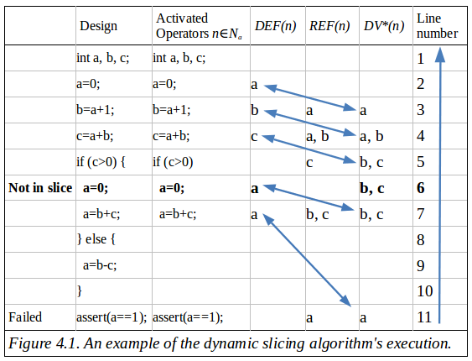
Dynamic Slicing Algorithm (2) *
Example
* Can be described in detail if will be asked

Slide 27
Outline
Introduction
Model-Based
Error
Localization
Algorithm
Mutation-Based
Error
Correction
Algorithm
Experimental
Results
Conclusion
Problem Formulation
Requirements for the tool
Contributions
The Model
Animation and Simulation
Algorithm
Rankings
Dynamic Slicing Algorithm
Related Work
The Model
Error Classes
Algorithm
Properties
Siemens Benchmarks
Error Localization
Dynamic Slicing
Error Correction
Contributions and Novel Approaches
Experimental Results
Future Extensions

Slide 28
Related Work
Four independent ranking algorithms were proposed in [1].
Program Spectrum
Rankings Definitions have same meaning, but different mathematical form
Experimental Results are Compared Later
[1] Abreu Rui, Zoeteweij Peter and van Gemund Arjan J.C. 2006. An Evaluation of Similarity Coefficients for Software Fault Localization. Dependable Computing, 2006. PRDC '06. 12th Pacific Rim International Symposium on, 39-46.

Slide 29
Outline
Introduction
Model-Based
Error
Localization
Algorithm
Mutation-Based
Error
Correction
Algorithm
Experimental
Results
Conclusion
Problem Formulation
Requirements for the tool
Contributions
The Model
Animation and Simulation
Algorithm
Rankings
Dynamic Slicing Algorithm
Related Work
The Model
Error Classes
Algorithm
Properties
Siemens Benchmarks
Error Localization
Dynamic Slicing
Error Correction
Contributions and Novel Approaches
Experimental Results
Future Extensions

Slide 30
The Model
Is Hammock Graph, where every node is parsed into Abstract Syntax Tree (AST)
  Mutations in the AST Nodes *
  Mutations in the edges of the hammock graph
  Mutations in the edges of AST
  * Implemented in the FORENSIC tool
Developed at the Graz University of Technology by Robert Könighofer and colleagues from the Institute for Applied Information Processing and Communications – IAIK.

Slide 31
Outline
Introduction
Model-Based
Error
Localization
Algorithm
Mutation-Based
Error
Correction
Algorithm
Experimental
Results
Conclusion
Problem Formulation
Requirements for the tool
Contributions
The Model
Animation and Simulation
Algorithm
Rankings
Dynamic Slicing Algorithm
Related Work
The Model
Error Classes
Algorithm
Properties
Siemens Benchmarks
Error Localization
Dynamic Slicing
Error Correction
Contributions and Novel Approaches
Experimental Results
Future Extensions

Slide 32
Error Classes
Errors, that can be discovered in the processed design
Algorithm should repair as much of them, as possible
Possible Errors in the Siemens Benchmarks are in the Dissertation

Slide 33
Outline
Introduction
Model-Based
Error
Localization
Algorithm
Mutation-Based
Error
Correction
Algorithm
Experimental
Results
Conclusion
Problem Formulation
Requirements for the tool
Contributions
The Model
Animation and Simulation
Algorithm
Rankings
Dynamic Slicing Algorithm
Related Work
The Model
Error Classes
Algorithm
Properties
Siemens Benchmarks
Error Localization
Dynamic Slicing
Error Correction
Contributions and Novel Approaches
Experimental Results
Future Extensions

Slide 34
Mutation-Based Error Correction Algorithm (1)
Implemented Mutations
  Operator mutations: Integer variable mutation (“I → I+1”), (“I → I-1”), (“I → -I”), Mutations of the variables of primitive types (“I → F()”), General mutations of constants (“C → C+1”), (“C → C-1”), (“C → 0”), (“C → -C”), (“C → C*2”), (“C → C/2”), Mutations in the digits of a numeric constant (“axb.c → ayb.c”), (“ab.c → xab.c”), Floating point number rounding mutations.
  Mutations in operators: Arithmetical operators (+), (-), (*), (/), (%), Assignment operators (=), (+=), (-=), (*=), (/=), (%=), Comparison operators (<), (>), (==), (!=), (<=), (>=), Logical operators and bit shift (&&), (||), (<<), (>>), (&), (|), (^), Bit shift with assignments operators (<<=), (>>=), (&=), (|=), (^=), Unary arithmetical operators (+), (-), Increment and decrement operators (++x), (x++), (--x), (x--), Unary logical operators (!), (~).

Slide 35
Mutation-Based Error Correction Algorithm (2)
One Error Assumption
Multiple Error Assumption
Error Classes Are Defined
Algorithm is fast, simple, reliable
Mathematical Definitions are in the Dissertation

Slide 36
Outline
Introduction
Model-Based
Error
Localization
Algorithm
Mutation-Based
Error
Correction
Algorithm
Experimental
Results
Conclusion
Problem Formulation
Requirements for the tool
Contributions
The Model
Animation and Simulation
Algorithm
Rankings
Dynamic Slicing Algorithm
Related Work
The Model
Error Classes
Algorithm
Properties
Siemens Benchmarks
Error Localization
Dynamic Slicing
Error Correction
Contributions and Novel Approaches
Experimental Results
Future Extensions

Slide 37
Properties*
Can be used for Measuring of the Error Localization Accuracy
Can Correct Error Using Alternative Mutation
If Correctional Mutation is found Depends on the entire Model Structure
* Examples can be shown is will be asked

Slide 38
Outline
Introduction
Model-Based
Error
Localization
Algorithm
Mutation-Based
Error
Correction
Algorithm
Experimental
Results
Conclusion
Problem Formulation
Requirements for the tool
Contributions
The Model
Animation and Simulation
Algorithm
Rankings
Dynamic Slicing Algorithm
Related Work
The Model
Error Classes
Algorithm
Properties
Siemens Benchmarks
Error Localization
Dynamic Slicing
Error Correction
Contributions and Novel Approaches
Experimental Results
Future Extensions

Slide 39
Siemens Benchmarks*
Design | Number of Lines of Code | Number of Inputs | Number of Designs with Errors
print_tokens | 569 | 4130 | 7
print_tokens2 | 515 | 4115 | 10
replace | 558 | 5543 | 31
schedule | 419 | 2650 | 9
schedule2 | 312 | 2710 | 10
tcas | 186 | 1605 | 41
tot_info | 413 | 1052 | 22
* Bug Aristotle Analysis System -- Siemens Programs, HR Variants <http://pleuma.cc.gatech.edu/aristotle/Tools/subjects/>

Slide 40
Outline
Introduction
Model-Based
Error
Localization
Algorithm
Mutation-Based
Error
Correction
Algorithm
Experimental
Results
Conclusion
Problem Formulation
Requirements for the tool
Contributions
The Model
Animation and Simulation
Algorithm
Rankings
Dynamic Slicing Algorithm
Related Work
The Model
Error Classes
Algorithm
Properties
Siemens Benchmarks
Error Localization
Dynamic Slicing
Error Correction
Contributions and Novel Approaches
Experimental Results
Future Extensions

Slide 41
Model-Based Error Localization (1)
In [1] a number of rankings for the model-based error localization are proposed
Design | Ample | Jaccard | Ochiai | Tarantula
print_tokens | 2 | 7,3 | 1 | 10,5
print_tokens2 | 16,4 | 17,5 | 13,9 | 20
replace | 12,7 | 11,6 | 7,6 | 12,2
schedule | 11,3 | 2,9 | 1,6 | 3
schedule2 | 34,7 | 31,1 | 25,1 | 31,3
tcas | 9,8 | 8,8 | 7,9 | 8,8
tot_info | 13,2 | 9,6 | 7,1 | 11
Mean | 14,3 | 12,69 | 9,17 | 12,69
Percentage of statements to be inspected to reach error.
[1] Abreu Rui, Zoeteweij Peter and van Gemund Arjan J.C. 2006. An Evaluation of Similarity Coefficients for Software Fault Localization. Dependable Computing, 2006. PRDC '06. 12th Pacific Rim International Symposium on, 39-46.

Slide 42
Model-Based Error Localization (2)
In FORENSIC tool
Design | Ochiai | Ample | Consecutive | Jaccard | Ochiai | Simple | Tarantula | *
print_tokens | 1 | 2 | 7,3 | 1 | 10,5 | 1 | 10,5 | 1
print_tokens2 | 13,9 | 16,4 | 17,5 | 13,9 | 20 | 13,9 | 20 | 13,9
replace | 7,6 | 12,7 | 11,6 | 7,6 | 12,2 | 7,6 | 12,2 | 7,6
schedule | 1,6 | 11,3 | 2,9 | 1,6 | 3 | 1,6 | 3 | 1,6
schedule2 | 25,1 | 34,7 | 31,1 | 25,1 | 31,3 | 25,1 | 31,3 | 25,1
tcas | 7,9 | 9,8 | 8,8 | 7,9 | 8,8 | 7,9 | 8,8 | 7,9
tot_info | 7,1 | 13,2 | 9,6 | 7,1 | 11 | 7,1 | 11 | 7,1
Mean | 9,17 | 14,3 | 12,69 | 9,17 | 12,69 | 9,17 | 12,69 | 9,17
* Number of Corrected Designs
Percentage of mutations to be applied to correct the error in the design.

Slide 43
Model-Based Error Localization (3)
Graphical representation of experiments in [1]
Percentage of statements to be inspected to reach error.
[1] Abreu Rui, Zoeteweij Peter and van Gemund Arjan J.C. 2006. An Evaluation of Similarity Coefficients for Software Fault Localization. Dependable Computing, 2006. PRDC '06. 12th Pacific Rim International Symposium on, 39-46.

Slide 44
Model-Based Error Localization (4)
Graphical representation FORENSIC experiments
Percentage of mutations to be applied to correct the error in the design.

Slide 45
Model-Based Error Localization (5)
Can be used for Measuring of the Error Localization Accuracy
In [1] Ochiai ranking decreases the percentage of blocks of code to be inspected by 5% comparing with worst case – the Ample tool ranking
In FORENSIC tool by 10%, that is much better
[1] Abreu Rui, Zoeteweij Peter and van Gemund Arjan J.C. 2006. An Evaluation of Similarity Coefficients for Software Fault Localization. Dependable Computing, 2006. PRDC '06. 12th Pacific Rim International Symposium on, 39-46.

Slide 46
Outline
Introduction
Model-Based
Error
Localization
Algorithm
Mutation-Based
Error
Correction
Algorithm
Experimental
Results
Conclusion
Problem Formulation
Requirements for the tool
Contributions
The Model
Animation and Simulation
Algorithm
Rankings
Dynamic Slicing Algorithm
Related Work
The Model
Error Classes
Algorithm
Properties
Siemens Benchmarks
Error Localization
Dynamic Slicing
Error Correction
Contributions and Novel Approaches
Experimental Results
Future Extensions

Slide 47
Dynamic Slicing (1)
In FORENSIC tool
Design | Number of Mutations, required to correct the error |  | Change,
 | (A) If Dynamic Slicing is used | (B) If Dynamic Slicing is not used
print_tokens | 1954,5 | 2106,0 | 7,75
print_tokens2 | 2141,14 | 2254,29 | 5,02
replace | 1635,88 | 1683,06 | 2,8
schedule | 564,0 | 715,33 | 21,16
schedule2 | 648,25 | 713,25 | 9,11
tcas | 304,0 | 553,71 | 45,1
tot_info | 1338,5 | 1363,94 | 1,87

Slide 48
Dynamic Slicing (2)
In [60] Experimental Evaluation of using Dynamic Slicing for same Benchmark Designs were performed
Design | # of Proc. Designs in FORENSIC | Change in FORENSIC | # of Proc. Designs in [60] | Change in [60]
print_tokens | 2 | 7,75 | 5 | 32
print_tokens2 | 7 | 5,02 | 8 | 49
replace | 16 | 2,8 | 19 | 42
schedule | 3 | 21,16 | 6 | 47
schedule2 | 4 | 9,11 | 3 | 53
tcas | 31 | 45,1 | - | -
tot_info | 18 | 1,87 | - | -
[60] Zhang Xiangyu, He Haifeng, Gupta Neelam, Gupta Rajiv. 2005. Experimental evaluation of using dynamic slices for fault location. ADEBUG - Proceedings of the Third International Workshop on Automatic Debugging, Linköping, Sweden, 33-42.

Slide 49
Outline
Introduction
Model-Based
Error
Localization
Algorithm
Mutation-Based
Error
Correction
Algorithm
Experimental
Results
Conclusion
Problem Formulation
Requirements for the tool
Contributions
The Model
Animation and Simulation
Algorithm
Rankings
Dynamic Slicing Algorithm
Related Work
The Model
Error Classes
Algorithm
Properties
Siemens Benchmarks
Error Localization
Dynamic Slicing
Error Correction
Contributions and Novel Approaches
Experimental Results
Future Extensions

Slide 50
Error Correction (1)
One Error Assumption
Dynamic Slicing is used for Model-Based Error Localization
Simple Ranking is used for Model-Based Error Localization
Design | % of Errors Corrected | # of Mutations to correct Error | Processing time, s (1000 inputs)
print_tokens | 2/7=28,57 | 1954,5 | 330
print_tokens2 | 7/10=70,0 | 2124,14 | 502
replace | 16/32=50,0 | 1635,88 | 342
schedule | 3/9=33,33 | 564 | 130
schedule2 | 4/10=40,0 | 648,25 | 184
tcas | 31/41=75,61 | 304 | 50
tot_info | 18/32=56,25 | 1338,5 | 312

Slide 51
Error Correction (2)
In [12] Mutation-Based Error Correction experiments on the same Siemens designs is presented
Design | # of Errors Corrected in [12] (A) | # Errors Corrected in FORENSIC (B) | Total Designs (C)
print_tokens | 0 | 2 | 7 | 28,57
print_tokens2 | 0 | 7 | 10 | 70,0
replace | 3 | 16 | 32 | 40,63
schedule | 0 | 3 | 9 | 33,33
schedule2 | 1 | 4 | 10 | 30,0
tcas | 9 | 31 | 43 | 53,66
tot_info | 8 | 18 | 23 | 43,48
[12] Debroy Vidroha, and Wong W. Eric. 2010. Using Mutation to Automatically Suggest Fixes for Faulty Programs. Software Testing, Verification and Validation (ICST), 2010 Third International Conference on, 65–74

Slide 52
Outline
Introduction
Model-Based
Error
Localization
Algorithm
Mutation-Based
Error
Correction
Algorithm
Experimental
Results
Conclusion
Problem Formulation
Requirements for the tool
Contributions
The Model
Animation and Simulation
Algorithm
Rankings
Dynamic Slicing Algorithm
Related Work
The Model
Error Classes
Algorithm
Properties
Siemens Benchmarks
Error Localization
Dynamic Slicing
Error Correction
Contributions and Novel Approaches
Experimental Results
Future Extensions

Slide 53
Contributions and Novel Approaches
Introduced two novel rankings for model-based error localization – Consecutive and Simple rankings.
Usage of the compiler functionality for the model simulation task, the specification animation and the implementation of the dynamic slicing algorithm.
Usage of the number of processed mutations instead of a number of statements required to reach the error as a measure of the error localization accuracy.

Slide 54
Contributions and Novel Approaches
Implementation of the model-based error localization, mutation-based error correction and dynamic slicing algorithms in the corresponding tool.
Definition of the specification format for simulation-based verification.
Finally, based on the development and evaluation performed during writing the dissertation, can be claimed that the FORENSIC tool can be utilized in a useful way in the process of software development.

Slide 55
Outline
Introduction
Model-Based
Error
Localization
Algorithm
Mutation-Based
Error
Correction
Algorithm
Experimental
Results
Conclusion
Problem Formulation
Requirements for the tool
Contributions
The Model
Animation and Simulation
Algorithm
Rankings
Dynamic Slicing Algorithm
Related Work
The Model
Error Classes
Algorithm
Properties
Siemens Benchmarks
Error Localization
Dynamic Slicing
Error Correction
Contributions and Novel Approaches
Experimental Results
Future Extensions

Slide 56
Experimental Results (1)
Simple ranking for the model-based error localization is more stable than other rankings
Ochiai ranking decreases the number of required mutations compared to the worst case Ample ranking by 10%
Consecutive ranking that is simple ranking plus some secondary ranking, for example Ochiai, results the best results, 1.25% better than Ochiai ranking.

Slide 57
Experimental Results (2)
For tcas design the dynamic slicing algorithm will reduce the number of required mutations for correction by 45,1% on average, for schedule – by 21,16%, for schedule2 by 9,11%, and for print_tokens by 7.19%, but less for replace, tot_info and print_tokens2 designs.
Mutation-based error correction algorithm can suggest corrections for significantly more designs than the approach presented in [12], 70% additionally corrected errors for print_tokens2 design, 54% additionally corrected for tcas design.

Slide 58
Outline
Introduction
Model-Based
Error
Localization
Algorithm
Mutation-Based
Error
Correction
Algorithm
Experimental
Results
Conclusion
Problem Formulation
Requirements for the tool
Contributions
The Model
Animation and Simulation
Algorithm
Rankings
Dynamic Slicing Algorithm
Related Work
The Model
Error Classes
Algorithm
Properties
Siemens Benchmarks
Error Localization
Dynamic Slicing
Error Correction
Contributions and Novel Approaches
Experimental Results
Future Extensions

Slide 59
Future Extensions
In the future, the FORENSIC tool can be extended with C++/SystemC support and the algorithms presented in the dissertation can be carried over for C++/SystemC error localization and error correction.
It is possible to implement an input generator for the tool while the reference outputs can be achieved by simulating the specification with the generated inputs.

Slide 60
Thank You

Slide 61
Siemens Benchmarks*
Design | Number of Lines of Code | Number of Inputs | Number of Designs with Errors
print_tokens | 569 | 4130 | 7
print_tokens2 | 515 | 4115 | 10
replace | 558 | 5543 | 31
schedule | 419 | 2650 | 9
schedule2 | 312 | 2710 | 10
tcas | 186 | 1605 | 41
tot_info | 413 | 1052 | 22
* Bug Aristotle Analysis System -- Siemens Programs, HR Variants <http://pleuma.cc.gatech.edu/aristotle/Tools/subjects/>

Slide 62
Example of a table
Design | Number of Lines of Code | Number of Inputs | Number of Designs with Errors
print_tokens | Data | Data | Data
print_tokens | Data | Data | Data
print_tokens | Data | Data | Data
print_tokens | Data | Data | Data
print_tokens | Data | Data | Data
Note: PowerPoint does not allow you to have nice default tables - but you can cut and paste this one

Slide 63
Example of a table
Title | Title | Title | Title
Data | Data | Data | Data
Note: PowerPoint does not allow you to have nice default tables - but you can cut and paste this one

Slide 64
Outline
Introduction
Model-Based
Error
Localization
Algorithm
Mutation-Based
Error
Correction
Algorithm
Experimental
Results
Conclusion
Problem Formulation
Requirements for the tool
Contributions
The Model
Animation and Simulation
Algorithm
Rankings
Dynamic Slicing Algorithm
Related Work
The Model
Error Classes
Algorithm
Properties
Correction using Alternative Mutation
Model Format
Siemens Benchmarks
Error Localization
Dynamic Slicing
Error Correction
Contributions and Novel Approaches
Experimental Results
Future Extensions

Slide 66
Bullet Slide
Bullet point
Bullet point
  Sub Bullet

Slide 67
Bullet Slide
Bullet point
Bullet point
  Sub Bullet
Bullet point
Bullet point
  Sub Bullet
Bullet point
Bullet point
  Sub Bullet

Slide 68
Colour scheme
Background
Text &
Lines
Shadows
Title
Text
Fills
Accent
Accent &
Hyperlink
Followed
Hyperlink

Slide 69
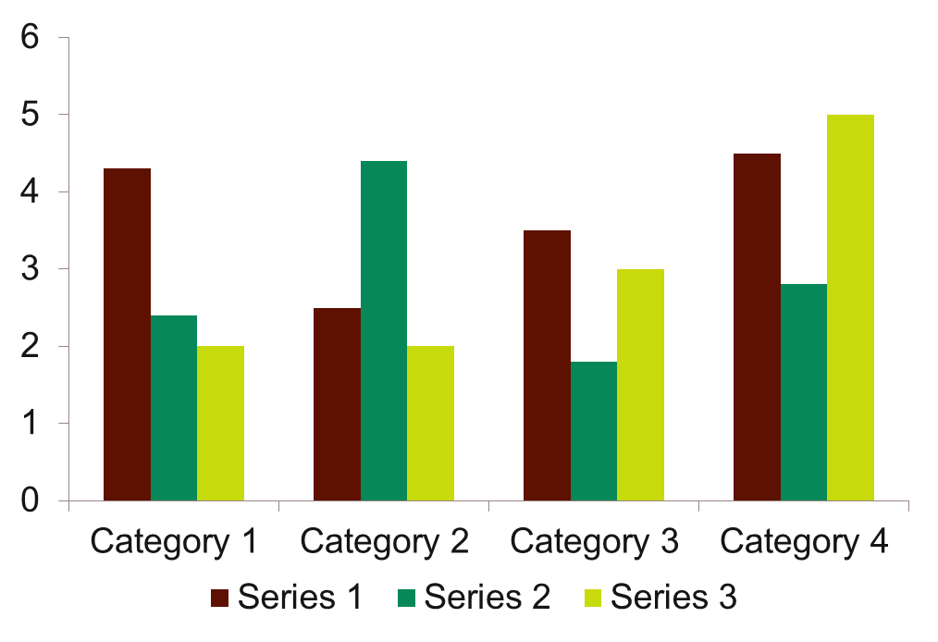
Sample Graph (3 colours)

Slide 70
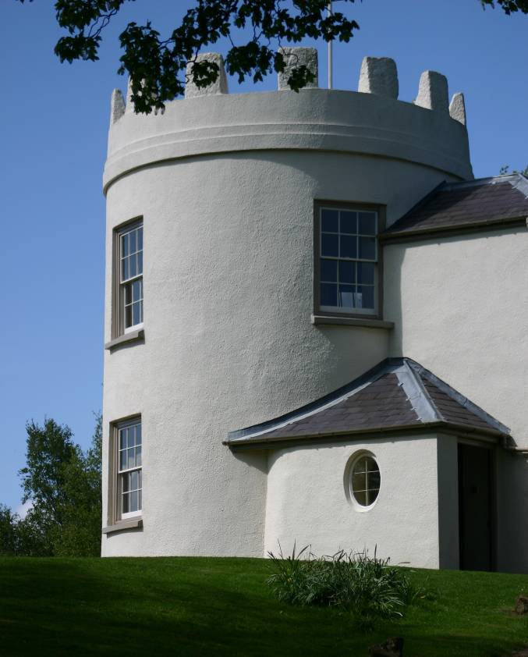
Picture slide
Bullet point
Bullet point
  Sub Bullet

Slide 71
Process Flow
Design
Plan
Build
Test
Evaluate
Bullet 1
Bullet 2
Bullet 3
Bullet 1
Bullet 2
Bullet 3
Bullet 1
Bullet 2
Bullet 3
Bullet 1
Bullet 2
Bullet 3
Bullet 1
Bullet 2
Bullet 3
Note:
Marbles and shadows can be moved

Slide 72
Example of a table
Title | Title
Data | Data
Note: PowerPoint does not allow you to have nice default tables - but you can cut and paste this one

Slide 73
Examples of default styles
Text box
Text box
With shadow
Table
Text and lines are like this
Hyperlinks like this
Visited hyperlinks like this

Slide 74
Use of templates
You are free to use these templates for your personal and business presentations.
We have put a lot of work into developing all these templates and retain the copyright in them. You can use them freely providing that you do not redistribute or sell them.
Do
Use these templates for your presentations
Display your presentation on a web site provided that it is not for the purpose of downloading the template.
If you like these templates, we would always appreciate a link back to our website. Many thanks.
Don’t
Resell or distribute these templates
Put these templates on a website for download. This includes uploading them onto file sharing networks like Slideshare, Myspace, Facebook, bit torrent etc
Pass off any of our created content as your own work
You can find many more free PowerPoint templates on the Presentation Magazine website
www.presentationmagazine.com

