Slide 1
RESEARCH REPORT · 2026
Elevator Vertical Distance Estimation
Predicting how far an elevator travelled — using only the sensors in your pocket.
Eyal Yakir · Uriya Cohen-Eliya
Smartphone Inertial & Pressure Sensing
April 2026

Slide 2
INTRODUCTION
The Problem
A phone in your pocket. An elevator ride. How far did you actually travel — vertically?
a
b
c
Detect the ride
Estimate Δh
Quantify uncertainty
Find when the elevator started and stopped — purely from the IMU.
Predict the signed vertical distance (up or down) in metres.
Return a calibrated 90 % confidence interval, not just a point estimate.
02

Slide 3
INTRODUCTION
End-to-End Pipeline
Two stages, one shared idea: model the physics, then quantify the noise.
Sensor stream
Segmentation
Quality filter
Prediction
Calibration
Accelerometer + pressure (~50–100 Hz)
Slice ride intervals up / down / outside
Per-segment σ reject low-SNR
Δh + 90 % CI 3 algorithms
Split-conformal coverage guarantee
OUTPUT
Per-ride signed Δh in metres with calibrated [Δh – δ , Δh + δ] interval.
03

Slide 4
INTRODUCTION
Data Collection
Multi-phone simultaneous recording across seven elevators in three cities.
7
6
3
4
397
Elevators
Buildings
Cities
Phones / ride
Labelled rides
Buildings
Protocol
Millenium Hotel — Internal
Ra'anana
All four phones recording in sync (one in each pocket).
Millenium — Outside elevator
Ra'anana
Ride pattern: full traversal up, then descent.
Acro
Ra'anana
Stationary windows before and after each ride for gravity calibration.
Beit Mansour
Ra'anana
Beit Yitzchaki
Ra'anana · held-out test
Barometer (where available) provides ground-truth altitude via ISA inversion.
BarIlan-2
Herzliya
Beit Yitzchaki withheld as test set — never seen during tuning.
Haari
Ramat Gan
04

Slide 5
INTRODUCTION
Storyline
Where this hour will take us.
01
Physics
02
Detection
Jerk-limited S-curves and what an elevator looks like to an IMU.
Matched-filter pair detection on the accelerometer; F1, IoU.
03
Prediction
04
Uncertainty
Three algorithms to predict Δh: barometer, ZUPT, trapezoid pulse-pair.
Per-segment σ, quality filter, split-conformal calibration.
05
Results
06
Product
Held-out: 89.4 % within ±1.5 m, MAE 1.49 m, median 0.30 m.
Boutique pipeline — a Streamlit wizard producing a Hebrew PDF report.
05

Slide 6
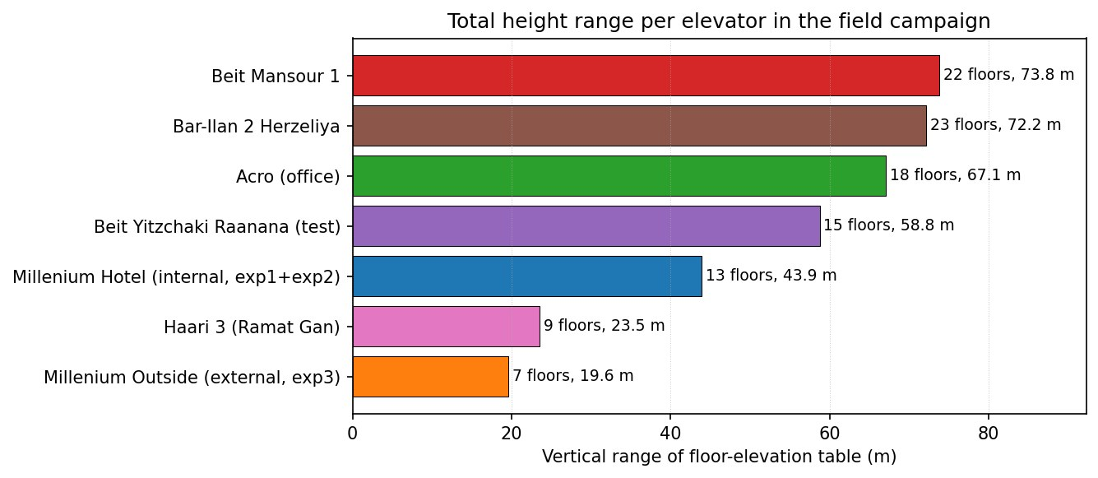
INTRODUCTION
Building Heights — Diversity of the Dataset
Total traversable height per elevator. Spans short residential to multi-storey hotel.
Fig. Sum of signed Δh across all rides per elevator.
06

Slide 7
Act II · Physics
How elevators look to an inertial sensor

Slide 8
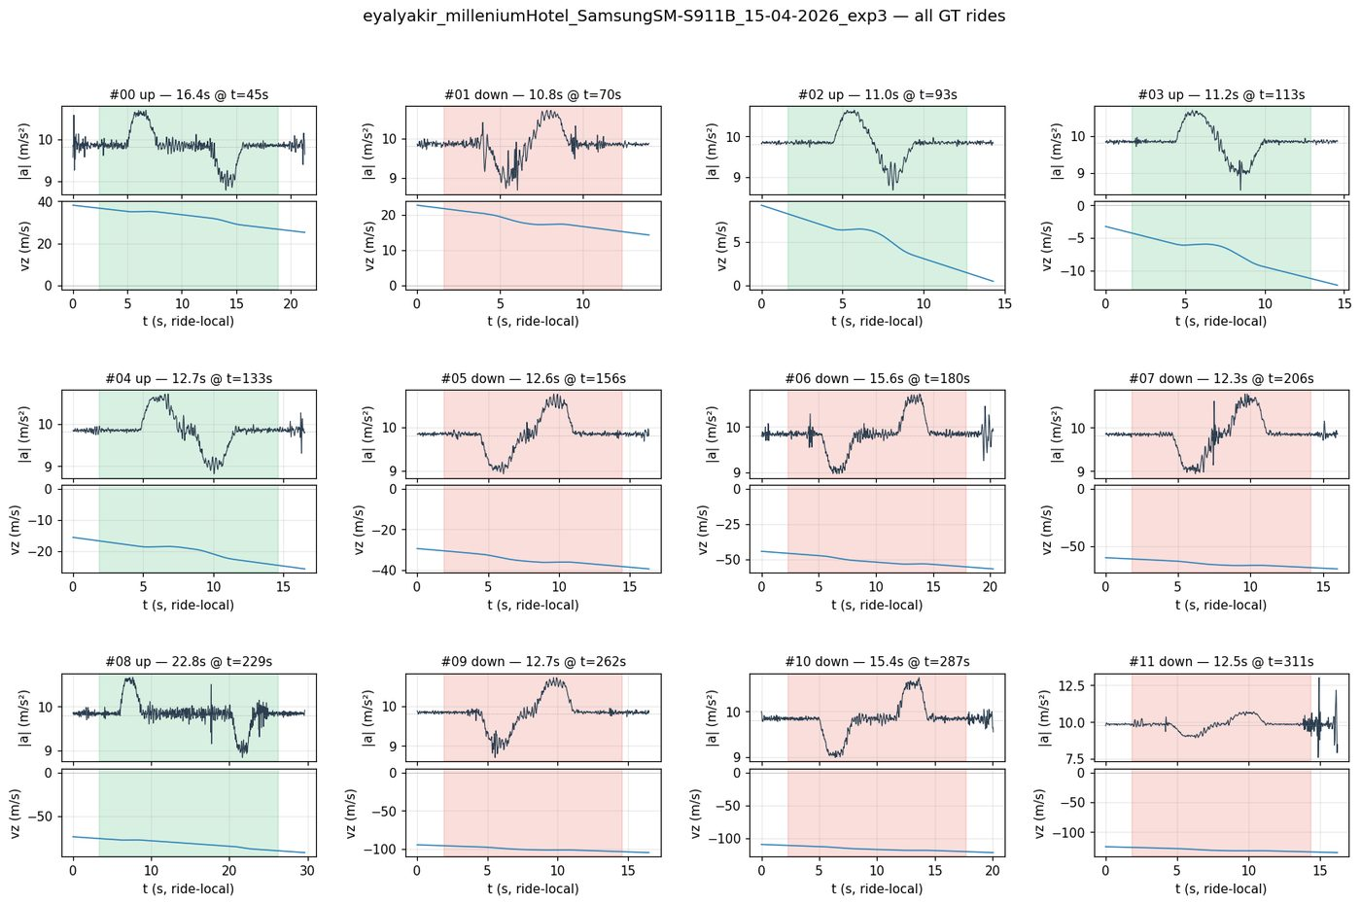
PHYSICS
Elevator Kinematics — A Jerk-Limited S-Curve
What the IMU sees
Velocity v(t)
Smooth S-curve — no kink at peak.
Acceleration a(t)
Two trapezoid lobes — one positive, one negative.
Jerk j(t) = ä
Bounded; this is what makes the ride comfortable.
Gravity dominates
|a| ≪ g. Subtract gravity carefully or estimates blow up.
07

Slide 9
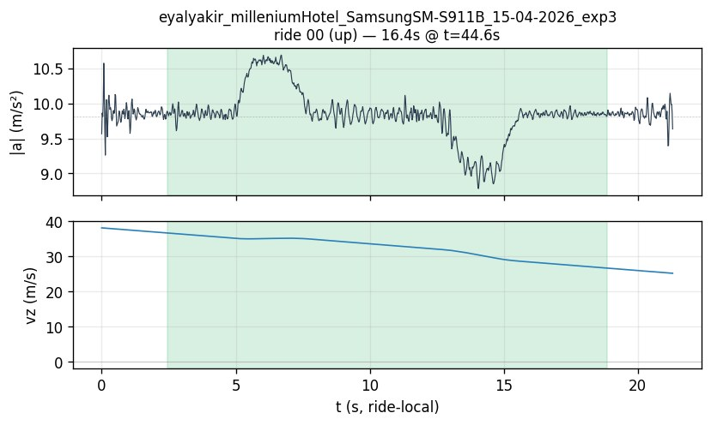
PHYSICS
Seven Phases of an Ideal Ride
Fig. Velocity (top) and acceleration (bottom) versus time. The seven phases mirror the jerk profile.
08

Slide 10
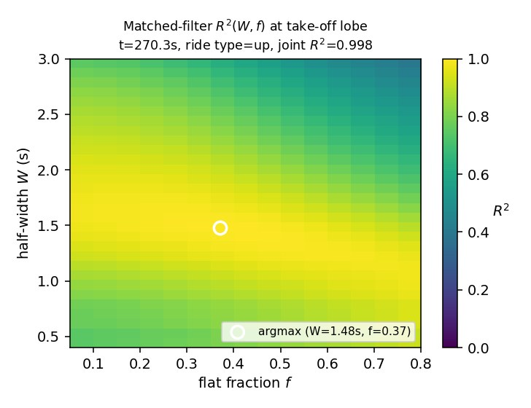
PHYSICS
The Trapezoid Template — What We Actually Fit
Why a trapezoid?
A perfect ride produces an acceleration profile composed of two trapezoid lobes: positive at start, negative at end. We replace the smooth S-curve with this idealised shape. Three free parameters per lobe:
a₀
plateau amplitude
τ_r
ramp duration
τ_p
plateau duration
09

Slide 11
Act III · Detection
Finding ride intervals on the IMU

Slide 12
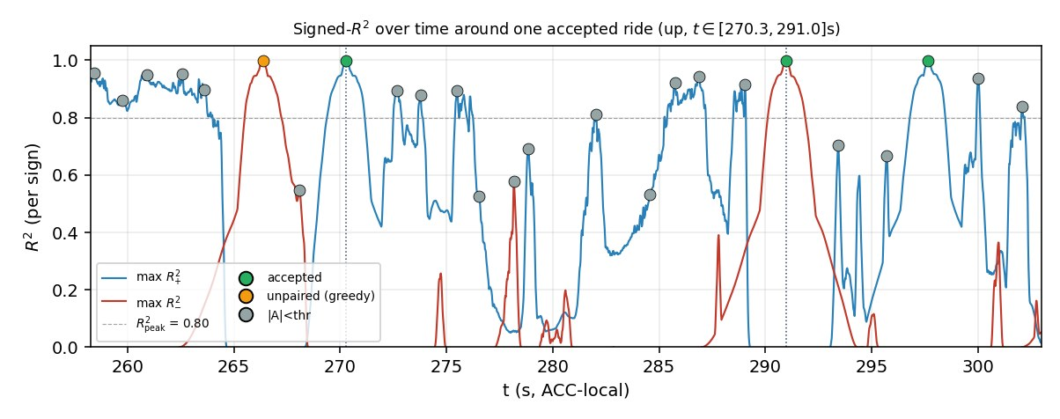
DETECTION
Matched-Filter Detection
Cross-correlate the ideal pulse with the measured signal.
Sweep a single trapezoid template across the time series.
Output: response score r(t) — high where the shape matches.
Adaptive threshold τ on r(t) yields candidate ride starts/ends.
Coarse first pass over a grid of τ_r, τ_p, a₀ values.
10

Slide 13
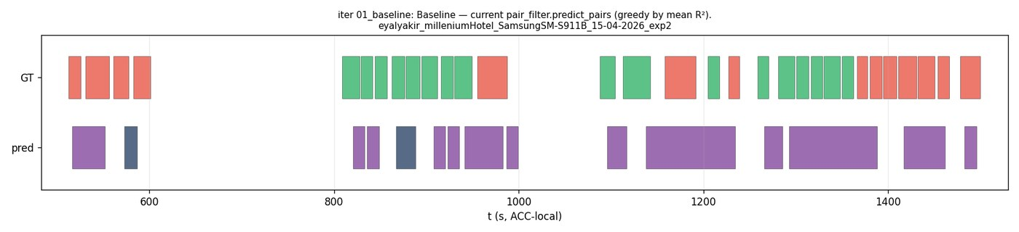
DETECTION
Pair Filter — Eliminating False Lobes
Each ride must have BOTH a positive and a negative lobe within a sensible time window.
Positive lobe
Plateau gap
Negative lobe
Acceleration phase — elevator speeds up
Coasting at constant speed — skipped by the filter
Deceleration phase — elevator slows down
11

Slide 14
DETECTION
Detection Headline
Stable across the held-out building. IoU-aware metrics confirm tight ride bounds.
TRAIN · 5 buildings
TEST · Beit Yitzchaki (held out)
0.813
0.875
F1* (best operating point)
F1*
0.642
0.830
IoU-F1 @ 0.5 — ride-bound quality
IoU-F1 @ 0.5
F1* is the F1 at the optimal threshold; IoU-F1@0.5 requires ≥ 0.5 overlap with the GT interval.
12

Slide 15
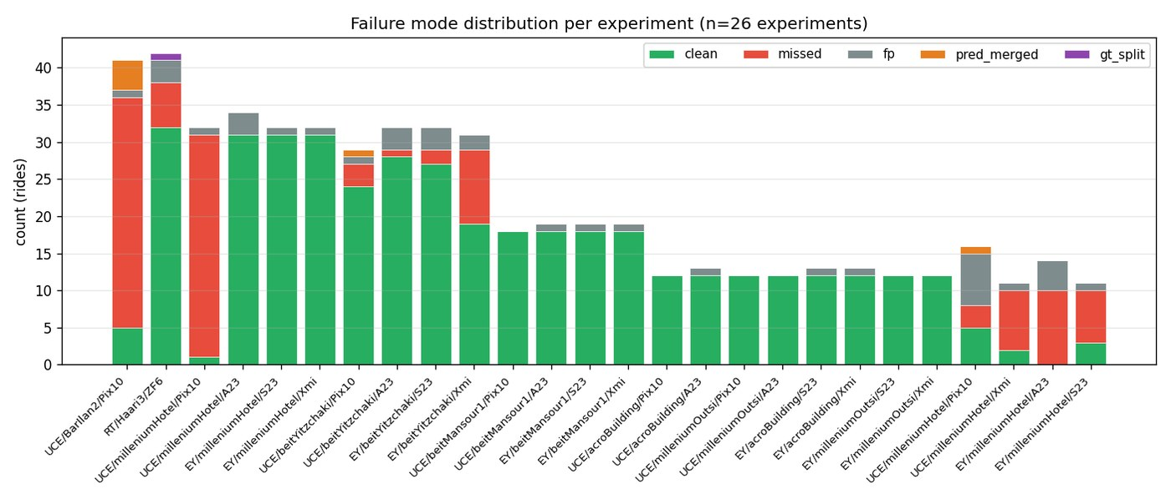
DETECTION
Failure Modes — Where Detection Slips
What goes wrong
Walking confusion
Steady gait amplitude can mimic an acceleration lobe.
Short rides
1–2 floor traversal: lobes overlap, no plateau.
Phone re-orientation
Pocket repositioning produces a transient impulse.
Building harmonics
Older shafts add 1–3 Hz oscillation atop the pulse.
13

Slide 16
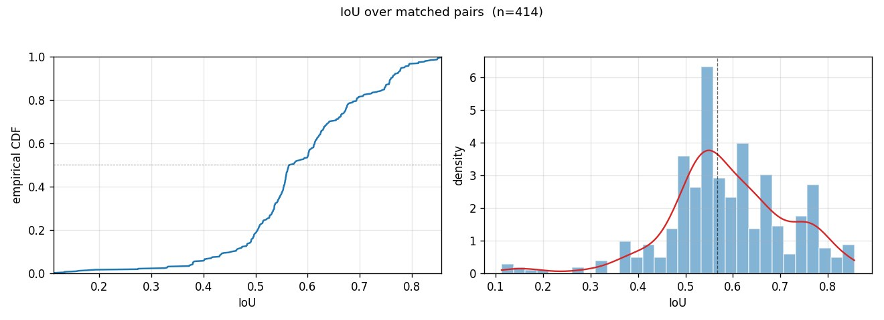
DETECTION
How Tight Are the Ride Bounds?
Distribution of IoU between detected and ground-truth ride intervals. Modes near 0.85 — bounds are tight.
14

Slide 17
Act IV · Prediction
Three algorithms for vertical distance

Slide 18
PREDICTION
Three Algorithms for Δh
Each leverages different physics. We use whichever the phone can support.
Barometric ISA
ZUPT integration
Trapezoid pulse-pair
Pressure → ISA altitude inversion. Needs a barometer (≈ 60 % of phones). Cleanest signal — used as ground truth where available.
Subtract gravity, integrate twice. Zero-velocity-update at start/end pins drift. Works on every phone but accumulates noise.
Fit the seven-segment trapezoid template to the measured acceleration. Closed-form Δh from plateau parameters; robust to baseline drift.
Δh = h_ISA(p₂) − h_ISA(p₁)
Δh = ∬ aᵥ(t) dt² , with ZUPT
Δh = a₀ τ_p (τ_r + τ_p)
15

Slide 19
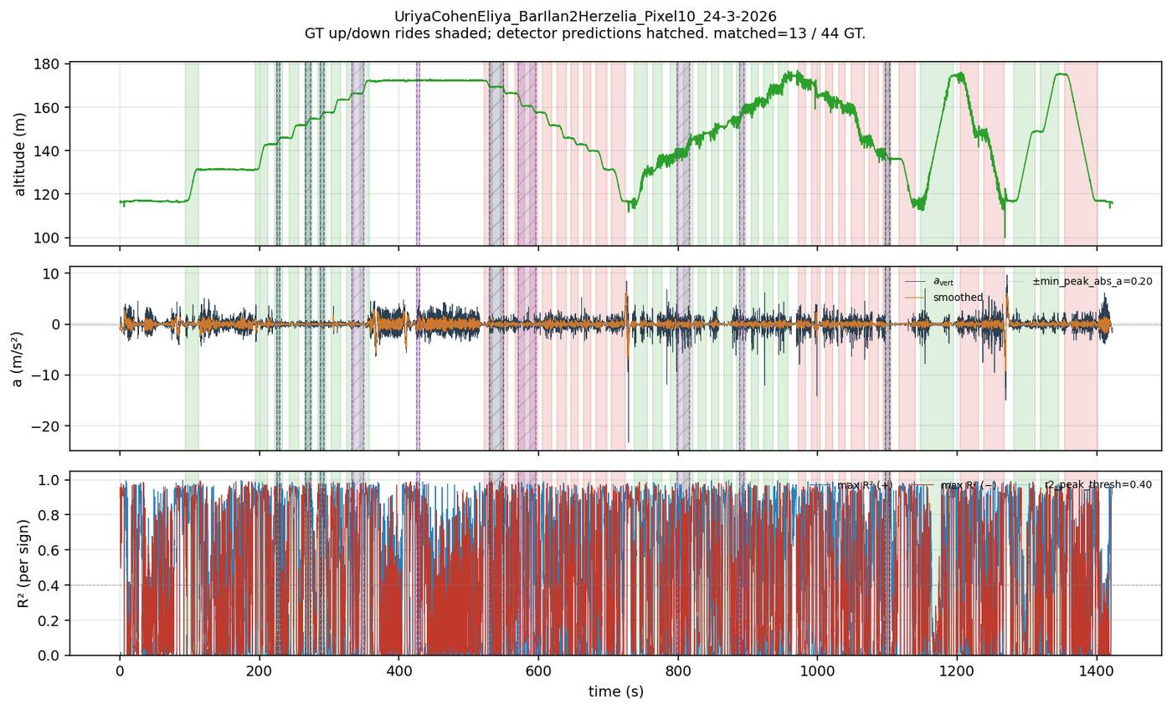
PREDICTION
ZUPT — Double Integration
Zero-Velocity Update
Step 1.
Subtract gravity using stationary pre/post windows.
Step 2.
Integrate vertical acceleration → velocity v(t).
Step 3.
Pin v(0) = v(T) = 0 — both endpoints are stationary.
Step 4.
Integrate v(t) → Δh.
Drift cancels at the endpoints; bias from any residual gravity error scales with T².
16

Slide 20
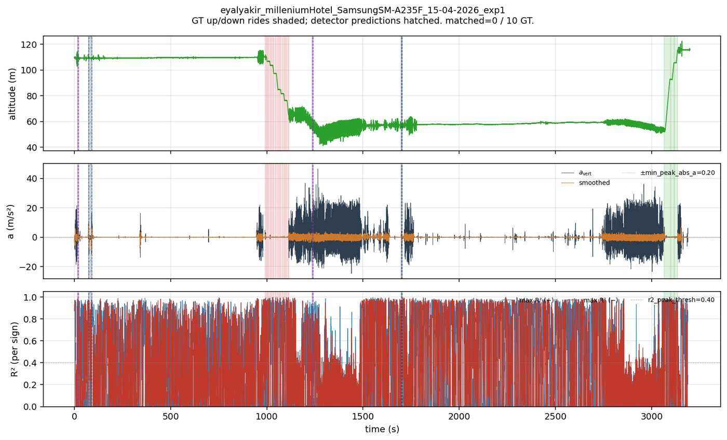
PREDICTION
Trapezoid Pulse-Pair — Shared-Shape Fit
Why share parameters?
A real elevator uses the same jerk profile to accelerate and to decelerate. So both lobes share τ_r and a₀, with sign-flipped polarity. Joint least-squares over the pair halves the parameter count and doubles the effective SNR.
Δh = a₀ · τ_p · (τ_r + τ_p)
17

Slide 21
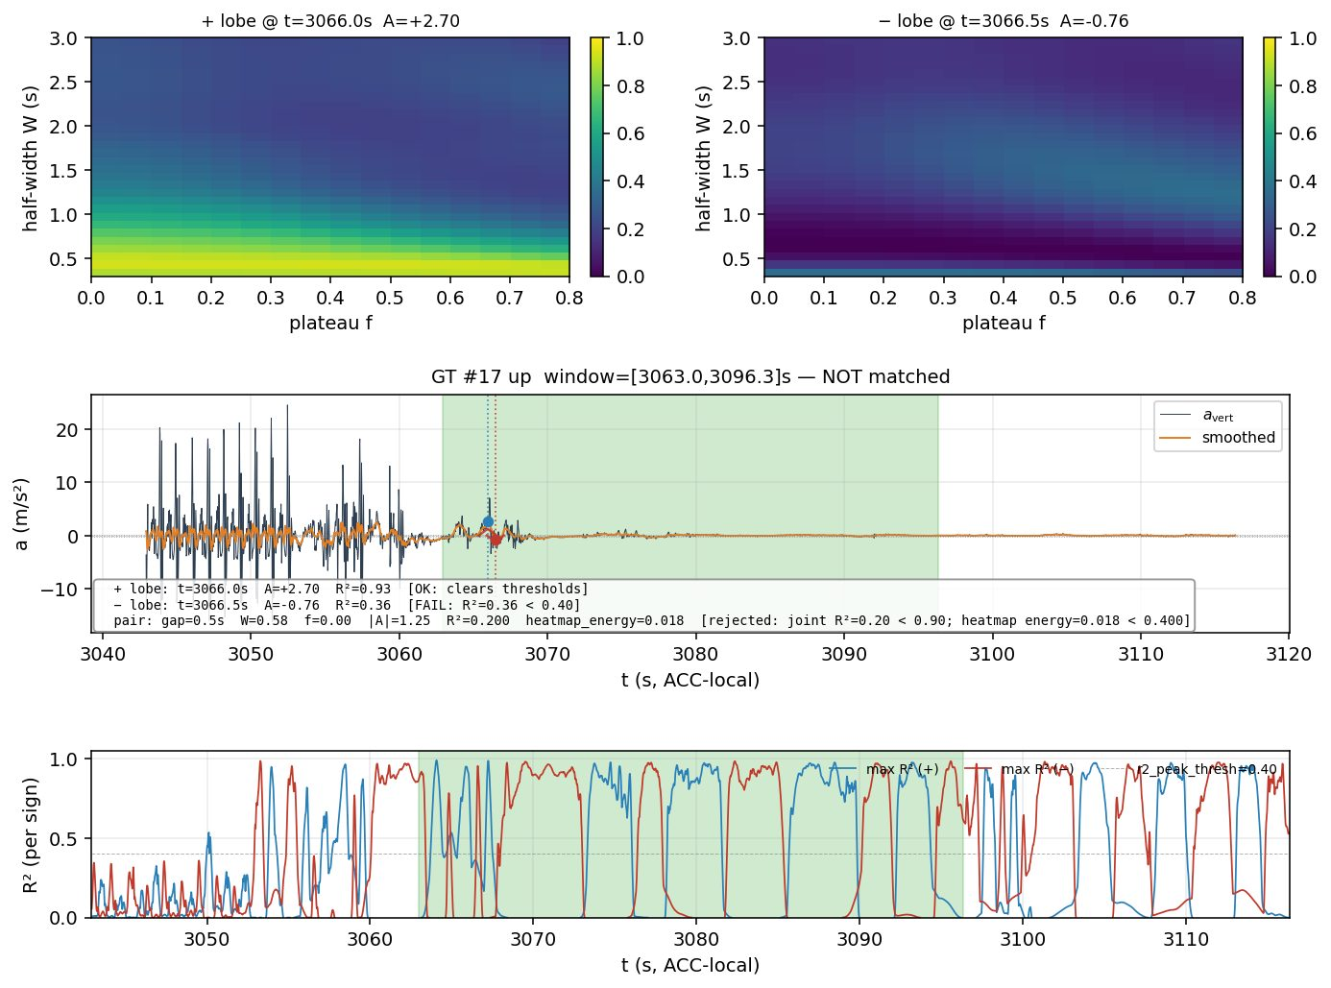
PREDICTION
Joined Pulse — When Rides Are Too Short
Short-ride regime
On 1–2 floor rides the cabin reaches maximum speed only briefly — or never reaches it at all. The two lobes overlap. We collapse to a single joined-pulse model with no plateau:
Δh = ½ · a₀ · τ_r²
Detection switches between the two automatically based on plateau length τ_p.
18

Slide 22
PREDICTION
Per-Segment σ and the Quality Filter
Not every ride is equally informative. We compute a closed-form noise estimate per segment and reject the worst.
Quality rule
Closed-form per-segment σ
σ_Δh² = σ_a² · ∂Δh/∂a₀ + σ_τr² · ∂Δh/∂τ_r + σ_τp² · ∂Δh/∂τ_p
Drop any prediction whose σ_Δh exceeds 1.5 m — these are rides where the model itself says “I'm uncertain”.
Each ∂Δh/∂θᵢ from the trapezoid Jacobian.
Sensor noise σ_a estimated from the pre-stationary window.
≈ 8%
≈ 25%
Geometry noise σ_τ from CRB on the matched-filter response.
of rides flagged & dropped
MAE reduction on the rest
19

Slide 23
PREDICTION
Split-Conformal Calibration
Per-segment σ gives a Gaussian-tail interval — but the residuals aren't Gaussian. We re-calibrate.
1. Hold-out
2. Score residuals
3. Pick quantile
Final interval
Reserve 20 % of training rides as a calibration split.
On the calibration split, compute |Δh − Δĥ| / σ̂.
Take the 90th-percentile of those scores → multiplier q.
Δĥ ± q · σ̂ ⟹ marginal coverage ≥ 90 %.
20

Slide 24
Act V · Results
Held-out performance

Slide 25
RESULTS
Headline Numbers — Held-Out Test
Pooled across both prediction algorithms with matched-segmenter; n = 397 rides.
89.4 %
1.49 m
0.30 m
within ± 1.5 m
MAE
median |error|
By algorithm
Algorithm
median |error|
coverage @ 90 %
ZUPT
0.19 m
94.4 %
Trapezoid pulse-pair
0.29 m
93.5 %
21

Slide 26
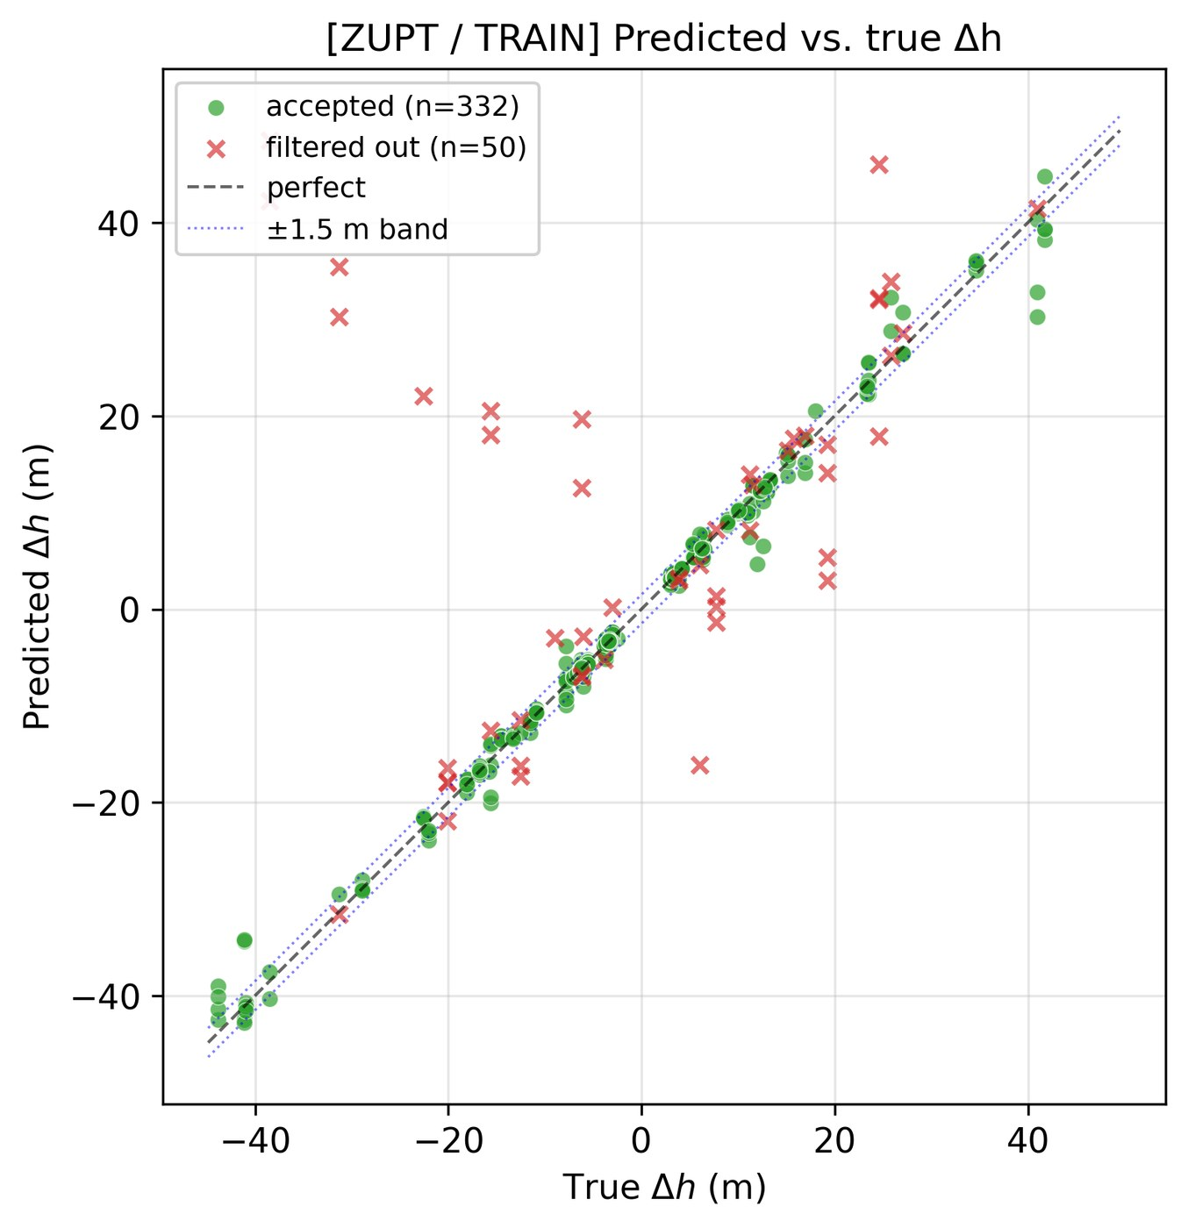
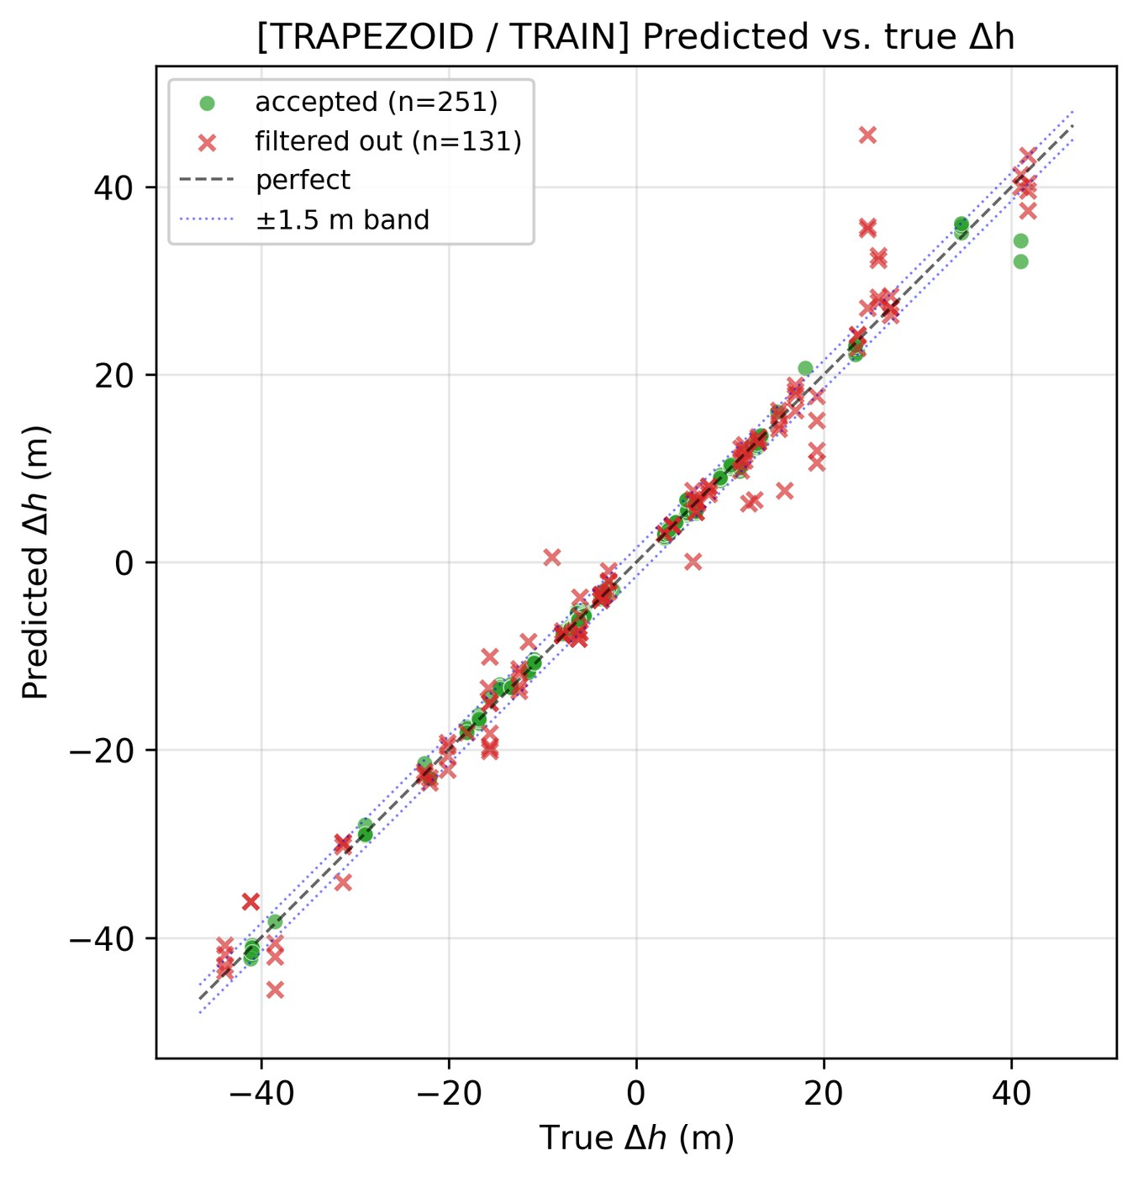
RESULTS
Predicted vs True Δh — Train
ZUPT (left) · Trapezoid pulse-pair (right). Closer to y = x is better.
22

Slide 27
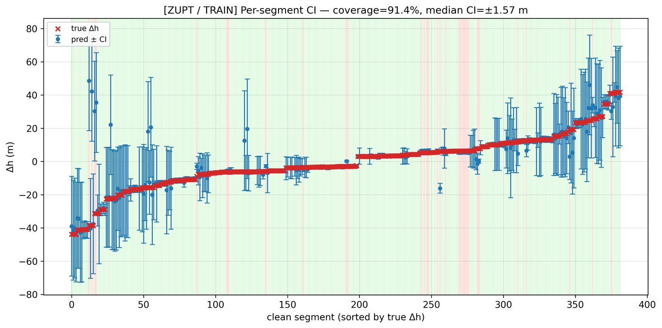
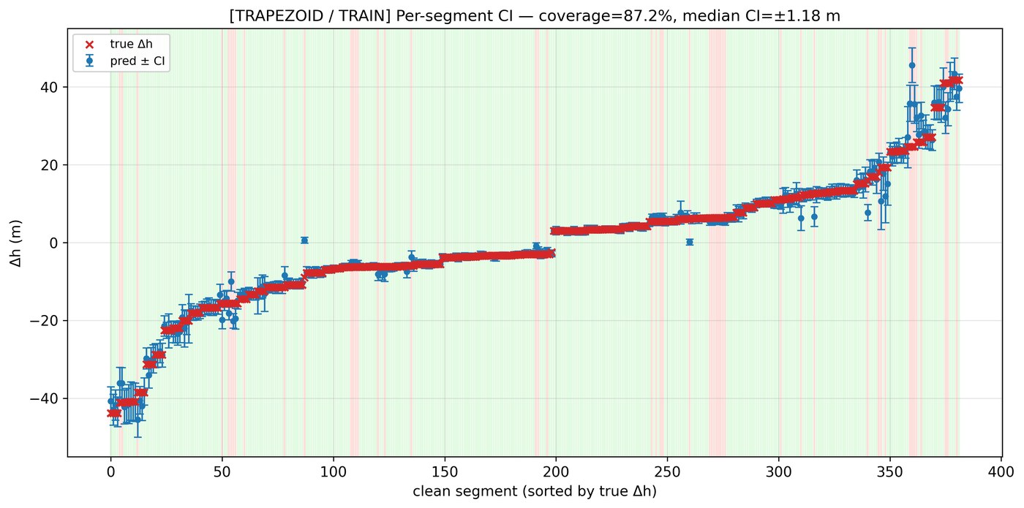
RESULTS
Error CDFs — Where Each Algorithm Lives
CDF of |Δh − Δĥ| on train (left) and test (right). Median error stays sub-half-metre on test.
23

Slide 28
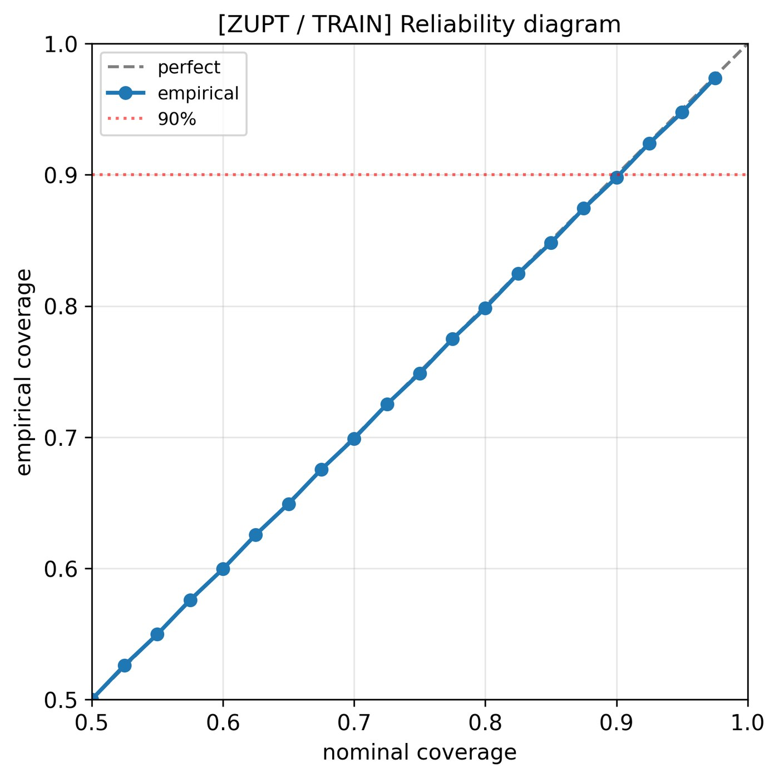

RESULTS
Per-Segment Confidence Intervals
Each ride: prediction ± 90 % CI plotted against true Δh. Bands widen on harder rides — exactly as designed.
24

Slide 29
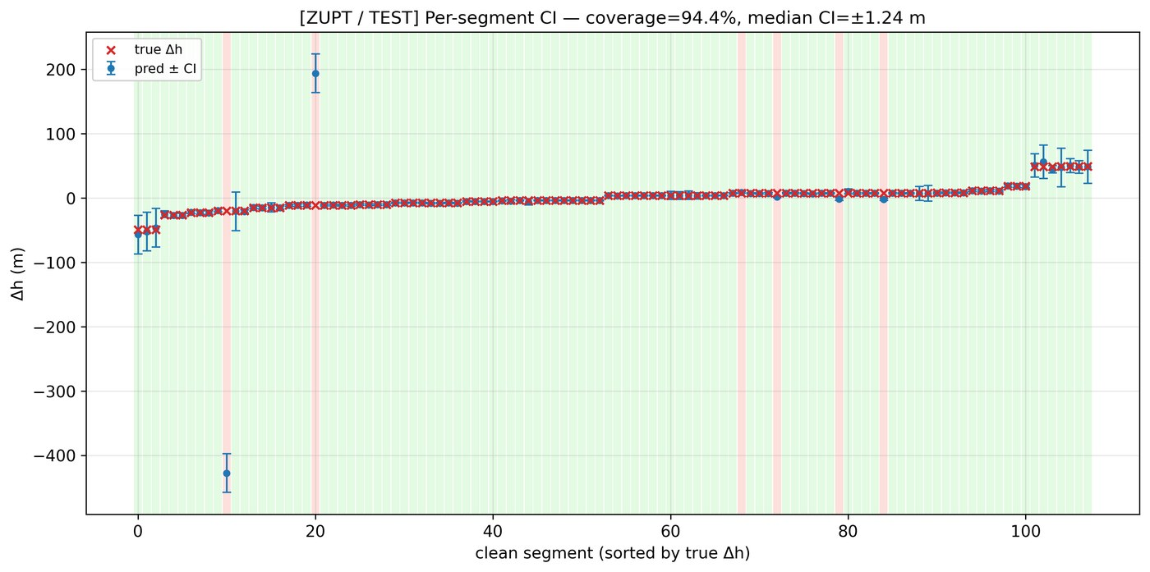
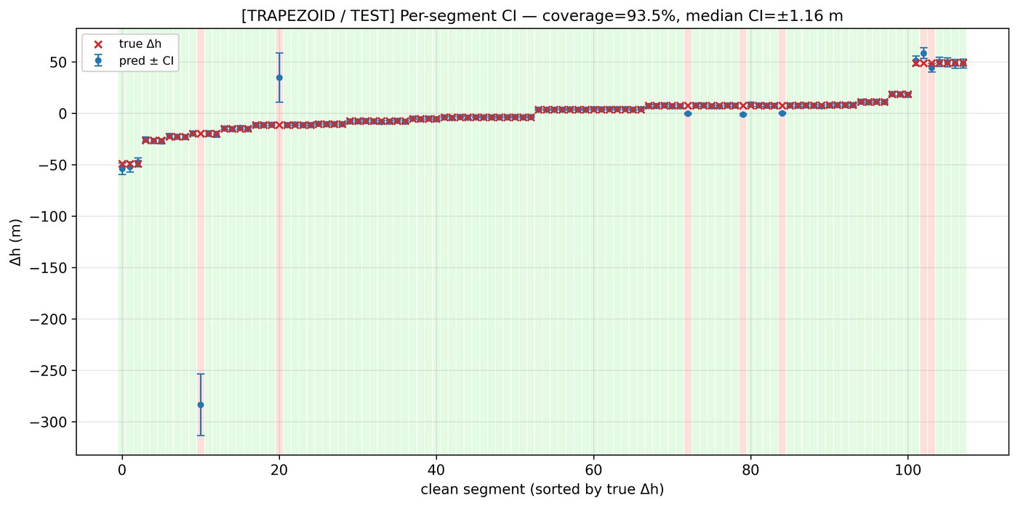
RESULTS
Coverage and MAE by Ride Length
Coverage holds at ≥ 90 % across short, medium, and tall rides. MAE scales sub-linearly with Δh.
25

Slide 30
Act VI · Product
From research to a deliverable

Slide 31
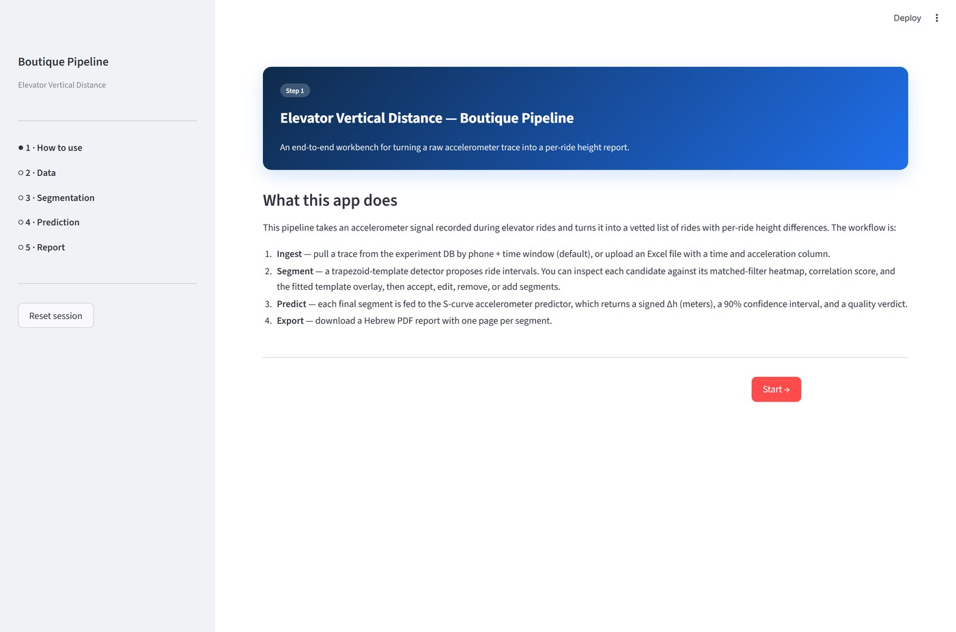
PRODUCT
Boutique Pipeline — End-to-End in 5 Steps
Streamlit wizard
1. Upload — drag & drop session zips.
2. Inspect — view raw signals + GT overlay.
3. Segment — edit detected ride bounds.
4. Predict — pick algorithm; see Δh + CI.
5. Report — generate Hebrew PDF deliverable.
26

Slide 32

PRODUCT
Step 3 — Segmentation Review
Detected ride intervals are editable. The user accepts, splits, or deletes any candidate before prediction.
27

Slide 33
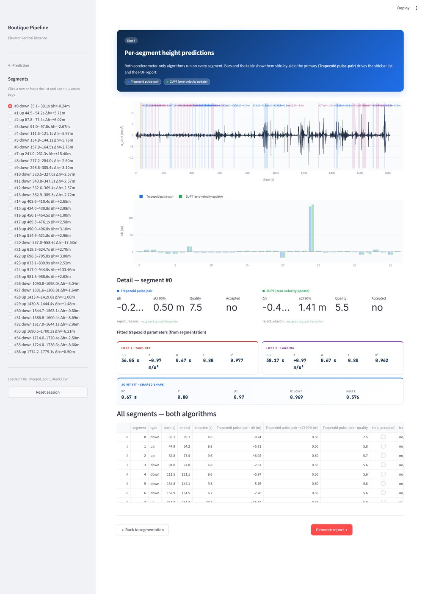
PRODUCT
The Hebrew PDF Deliverable
What it contains
Per-elevator summary table
All rides with predicted Δh + CI
Quality flags for low-SNR rides
Ground-truth overlay where available
Hebrew RTL layout, A4 portrait
28

Slide 34
Act VII · Closing

Slide 35
CLOSING
What We Learned
Three takeaways from a year of riding elevators with phones in our pockets.
Physics first, ML second
σ is a feature, not an output
Cross-phone is the real test
A tight kinematic prior — the trapezoid template — beat black-box alternatives at every stage. Detection AND prediction.
Letting the model report its own uncertainty unlocked the quality filter, the CI, and downstream calibration.
Numbers from a single phone are misleading. Four-phone simultaneous recording was decisive in catching biases.
29

Slide 36
Q & A
Thank you.
Eyal Yakir · Uriya Cohen-Eliya
30

Slide 37
APPENDIX · HIDDEN
Detector Hyperparameter Walkthrough
Coarse grid → refine. Defaults chosen on the train fold; never re-tuned on test.
Parameter
Search range
Default
Source
τ_r ramp duration
0.5 – 1.5 s
0.9 s
Ride dynamics
τ_p plateau duration
0.0 – 6.0 s
1.5 s
Lobe length
a₀ plateau amplitude
0.4 – 1.4 m/s²
0.9 m/s²
Cabin spec
τ_thr detection threshold
2 – 6 σ
3 σ
Adaptive
Δt_pair pair gap window
0.5 – 30 s
auto
Per-ride bound
31

Slide 38
APPENDIX · HIDDEN
Per-Experiment Detection Breakdown
Detection metrics by building. Beit Yitzchaki is the held-out test set.
Building
F1*
IoU-F1 @ 0.5
Millenium Hotel — Internal
0.84
0.69
Millenium — Outside
0.79
0.61
Acro
0.82
0.65
Beit Mansour
0.83
0.68
BarIlan-2 (Herzliya)
0.78
0.59
Haari (Ramat Gan)
0.81
0.64
Beit Yitzchaki (HOLD-OUT)
0.875
0.830
32

Slide 39
APPENDIX · HIDDEN
Trapezoid σ — CRB Derivation
We derive a Cramer-Rao lower bound on σ_Δh given the trapezoid Jacobian and white sensor noise.
y(t) = T(t; θ) + ε(t), ε ~ N(0, σ_a² I)
I(θ) = (1/σ_a²) · J(θ)ᵀ J(θ) Fisher information
Cov(θ̂) ≥ I⁻¹(θ) Cramer-Rao
σ_Δh² = ∇_θ Δh ᵀ · I⁻¹(θ) · ∇_θ Δh delta-method
with ∇_θ Δh = ( τ_p(τ_r+τ_p), a₀ τ_p, a₀(τ_r + 2τ_p) )
33

Slide 40
APPENDIX · HIDDEN
ZUPT — Noise Budget
Three error sources dominate ZUPT estimates. Each scales differently with ride duration T.
Sensor white noise
Gravity bias
Tilt error
σ_h ∝ σ_a · T^{1.5} / √(N)
σ_h ∝ Δg · T²
σ_h ∝ sin(δθ) · g · T²
Reduced by sampling rate ↑ and stationary calibration.
Worst at long rides. Mitigated by per-ride gravity estimate.
Mitigated by long stationary windows; pocket motion remains a risk.
34

Slide 41
APPENDIX · HIDDEN
Ground-Truth Audit — Four-Phone Cross-Check
Each ride is recorded by four phones simultaneously. We use the cross-phone disagreement as a GT noise floor.
0.08 m
99.2 %
12 / 397
median cross-phone σ
rides agree within ±0.5 m
manual edits required
Where the barometer agrees with the trapezoid+ZUPT cross-check across all four phones, we trust the GT to ±10 cm. The handful of edits address PRS dropouts.
35

Slide 42
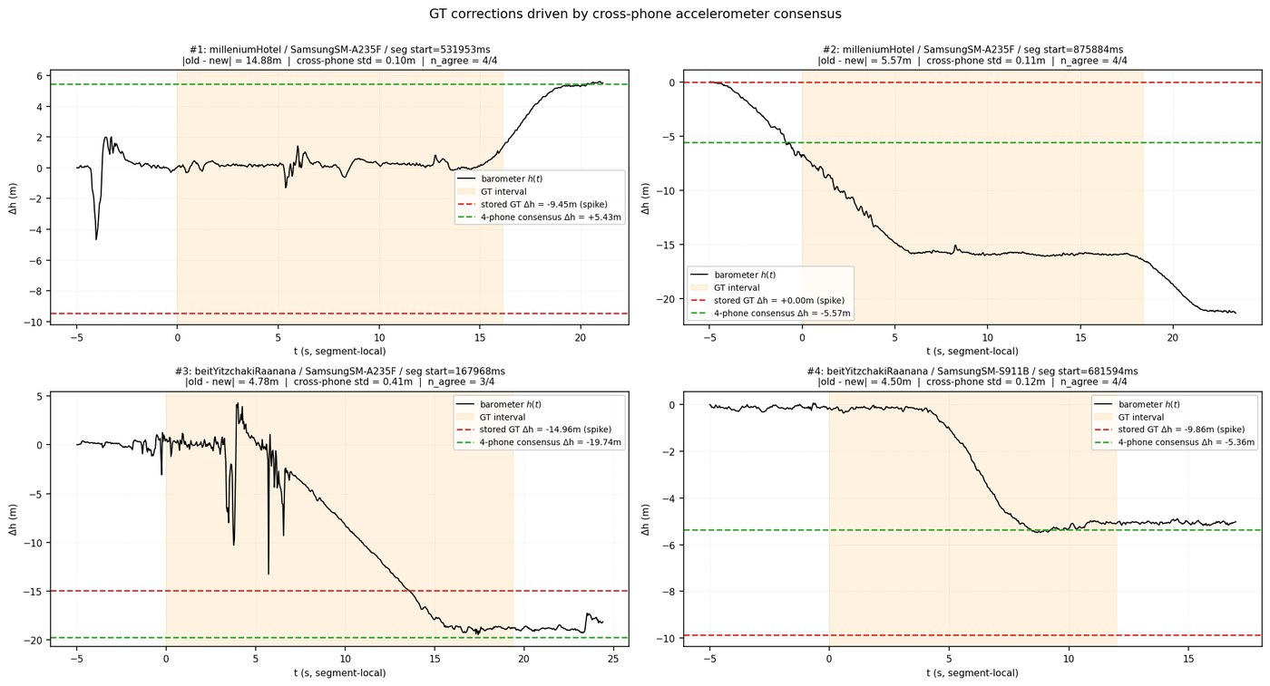
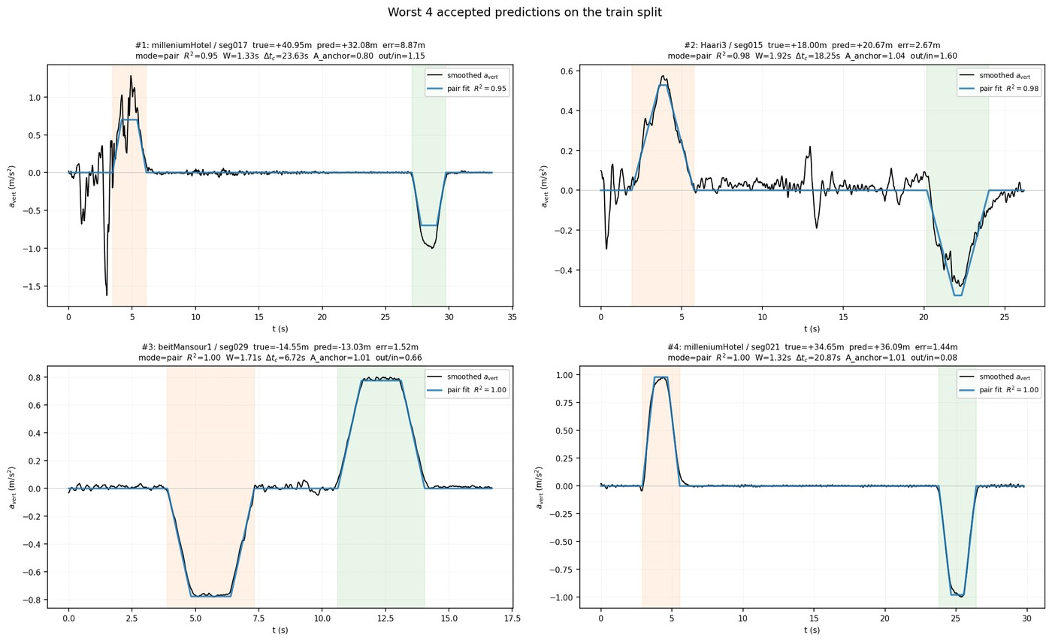
APPENDIX · HIDDEN
Worst-Prediction Case Studies
Two failure cases. Left: short ride with overlapping lobes. Right: pocket reorient mid-ride.
36

Slide 43
APPENDIX · HIDDEN
Architecture / File Layout
Two-stage pipeline; each stage is a Pydantic-configured dispatcher.
src/segmentation/
Stage 1 — Segmenter dispatcher; two algorithms (matched-filter, pressure-filter).
src/prediction/
Stage 2 — Predictor dispatcher; three algorithms (barometer, ZUPT, trapezoid).
src/utils/
Stage-agnostic helpers — gravity removal, conformal calibrator, pulse fits.
src/data/
Loaders, GT editor, dataset definitions.
src/pipelines/
End-to-end Streamlit Boutique Pipeline.
docs/latex/
This report; LaTeX source + figures.
37

