Slide 1
ISYE 6740_Thesis_Plan
Team member: Lingchao Mao Jintian Lyu

Slide 2
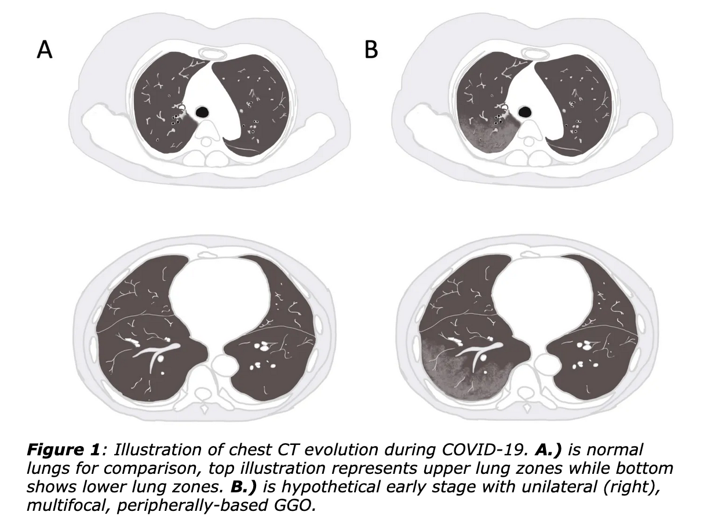
Proposed study 1 – COVID Severity Predection
Goal: Use area of infection, age, gender etc as markers to predict COVID severity development
Pattern: “Ground Glass Opacity”, white shadow etc
Proposed method
Infection area: ISOMAP+K-means
Regression
PCA to reduce dimension
Evaluation criteria
Dice similarity coefficient for segmentation

Slide 3
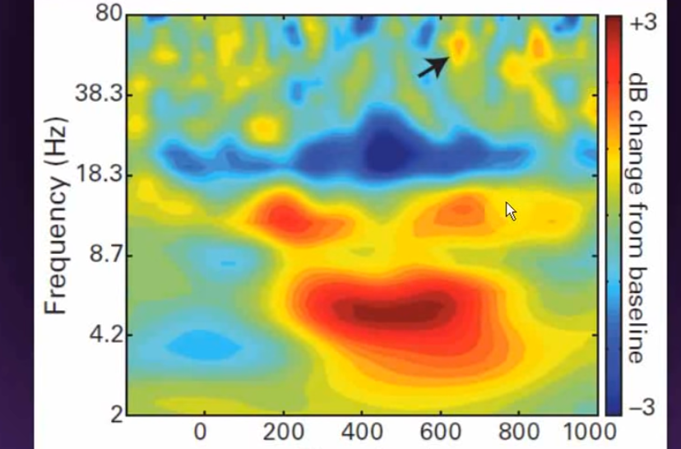
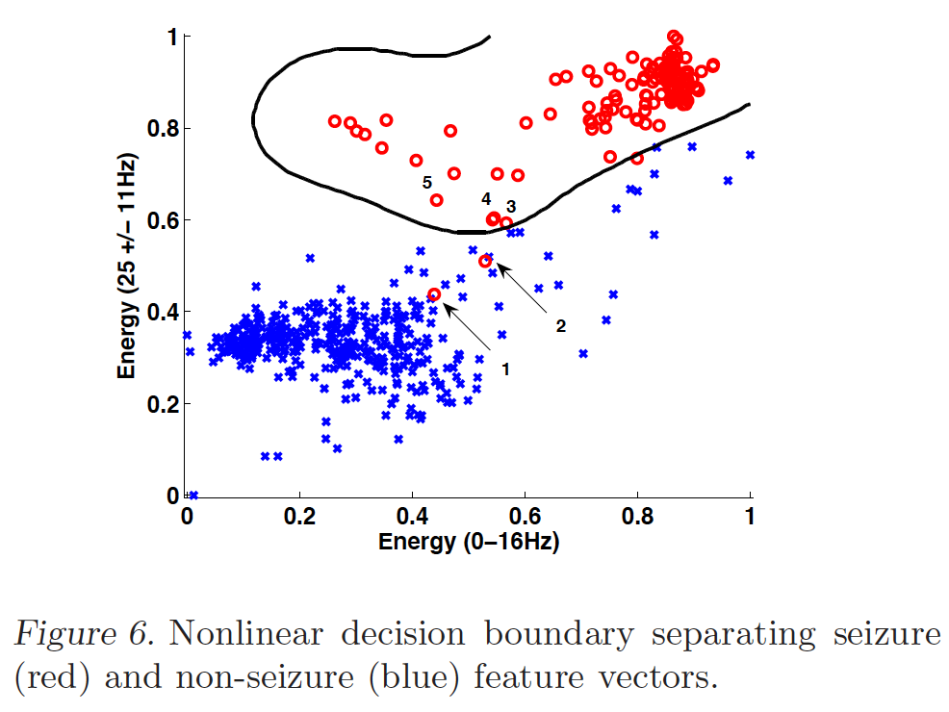
Proposed study2 – Seizure prediction
Goal: classification of epilepsy vs normal waves
Method
Classification across images: PCA to extract features, K-means etc
Classification within image: Spectral clustering?
Modeling seizure waves: Fourieri’s therorem, EM, density plot?

Slide 4
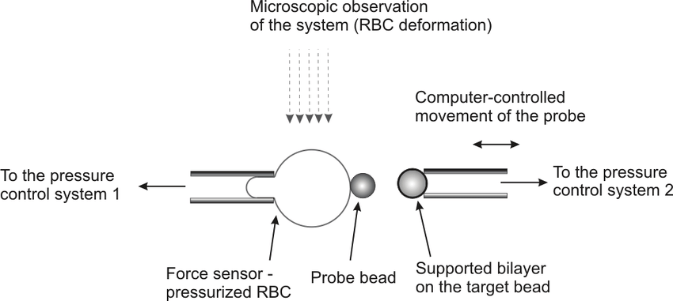
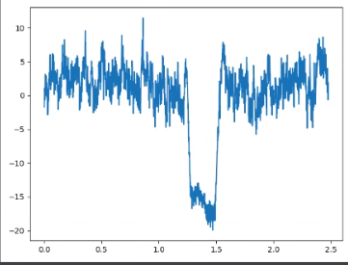
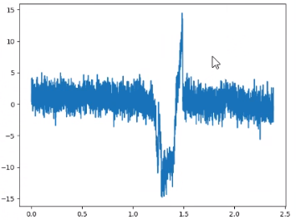
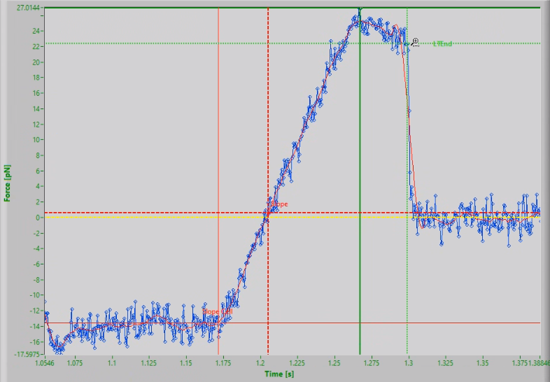
Proposed study2 – BFP data analysis
Biomembrane force probe (BFP) is a device to investigate ligand-receptor interaction
X – time Y – position
Goal: Distinguish lifetime(red circle) among series of binding events
Data pattern (from left to right)
No binding; Binding but rapture; Binding with lifetime (desired)

