Slide 1
CSE7301 - INTERNSHIP Review-3 Presentation TITLE OF THE PROJECT / WORK ASSIGNED / DOMAIN
Student Details
Name | Urja Rajesh Savalekar
Roll No | 20211CCS0044
Section | 08CCS02
Batch No.
Under the Supervision of,
Dr. Sharmasth Vali Y
Assistant Professor
School of Computer Science and Engineering
Presidency University
Name of the Program: PIP4004 INTERNSHIP
Name of the HoD: Dr. ANAND RAJ – HOD( CIT and CCS)
Name of the Program Project Coordinator: Dr Sharmasth Vali Y
Name of the School Internship/Project Coordinators: Mr. Md Ziaur Rahman /
Dr. Sampath A K / Dr. Abdul Khadar A

Slide 2
Content
About Company or Organization
Working domain or the technology
About your team and reporting Manager
Challenges Faced in Internship
Objectives of the work
Literature Review
Proposed System
Problem Statement
System Requirements
Advantages of Proposed System/Work
Internship Roadmap
Implementation
Design
Algorithm
Source Code

Slide 3
About Company or Organization
About Unacademy
India’s Largest Learning Platform – Founded in 2015, Unacademy provides high-quality educational content for competitive exams, school curriculums, and skill development.
Diverse Learning Solutions – Offers live classes, recorded lectures, interactive doubt-solving, and premium subscriptions like Unacademy Plus and Iconic Subscription.
Catering to Multiple Exams – Covers UPSC, IIT-JEE, NEET, CAT, GATE, and many more, ensuring comprehensive exam preparation.
Tech-Driven Education – Utilizes AI-driven personalized learning, real-time analytics, and a vast educator community to enhance learning experiences.
Strong Growth & Investments – Backed by investors like SoftBank, Sequoia Capital, and General Atlantic, Unacademy is headquartered in Bangalore and is revolutionizing the EdTech industry.

Slide 4
Working domain or the technology
1. RETOOL : low-code development platform
Features: database management , custom UI and Automation , Integration with APIs and Third-Party Services
Figma : UI/UX Design and Prototyping Tool
Features : cloud based collaboration, vector based editing and prototyping

Slide 5
About your team and reporting Manager
1. Reporting Manager : Mr. Meer Ali
2. Senior team lead : Ms. Vandana
3. Team lead : Mr. Shubham
4. Db Associate : Miss. Ankita (trainee)
5. Team :20+ interns for the the development of Airlear Application

Slide 6
Challenges Faced in Internship
Transitioning from Bootcamp to Work Environment – Adjusting to professional workflows and corporate expectations.
Learning real world application based technologies

Slide 7
Objectives of the work
Automation of Manual Processes – Streamlining the multilingual content entry process using Retool, eliminating manual data entry errors, and ensuring efficient content updates for the AirLearn mobile application.Development Enhancing data handling and automation in Retool to update, modify, and manage learning materials seamlessly for different languages like German, Spanish, and French.User Interface (UI) Development
Using Figma – Creating and optimizing Figma Slides for the AirLearn app,
Content Delivery & User Experience – Ensuring that all educational materials are accessible across different devices to provide a high-quality learning platform.

Slide 8
Literature Review
Open-source CMS solutions like WordPress and Drupal support multilingual content but require manual integration for Figma-based workflows.
Optical Character Recognition (OCR) for text extraction from images and design tools.
Language detection models, such as langdetect and fastText, to classify extracted content.
Text normalization techniques for formatting and preparing text for translation.

Slide 9
Proposed System / Work
Designing Multilingual Content Templates in Figma
Automated Content Extraction from Figma
Language Detection and Text Processing
Database Storage and Management
Content Review and Approval Using Retool
Real-Time Synchronization with Live Applications
System Testing and Performance Evaluation

Slide 10
Problem Statement
In the modern digital landscape, managing multilingual content efficiently remains a significant challenge, especially for educational and application-driven platforms. Figma, a popular design tool, lacks built-in automation for extracting, translating, and synchronizing multilingual content, leading to time-consuming manual processes. Designers and content managers must repeatedly extract text, translate it, store it in databases, and manually update applications, resulting in workflow inefficiencies, inconsistencies, and delays.
Current methods require extensive human intervention, making them prone to errors in extraction, translation, and deployment. Additionally, real-time updates across multiple platforms are difficult to achieve without an automated synchronization system. Without an integrated solution, organizations struggle to maintain accuracy, scalability, and efficiency in managing multilingual educational content.
This research aims to bridge the gap between design and deployment by automating the entire content management workflow—from extraction in Figma to translation, database storage, review, and real-time synchronization—thereby reducing manual effort and improving efficiency.

Slide 11
System Requirements
Programming Language: Python (for automation scripts)
Development Environment: Visual Studio Code / PyCharm / Jupyter Notebook
Database System:
PostgreSQL (for structured storage) or
Firebase Realtime Database (for real-time synchronization)
APIs & Libraries:
Figma API (for content extraction)
Google Translate API (for multilingual translation)
langdetect (for language identification)
Retool (for content review interface)
WebSocket / Firebase Realtime Database (for live synchronization)
3. Security & Access Control
Authentication: API keys for Figma and Google Translate
Data Encryption: HTTPS for secure data transmission

Slide 12
Advantages of Proposed System/Work
The proposed system automates multilingual content management, reducing manual effort and human errors in text extraction, translation, and synchronization. It ensures real-time updates across applications, enhancing efficiency and eliminating deployment delays. Additionally, the modular architecture allows scalability, supporting future expansions with minimal modifications.

Slide 13
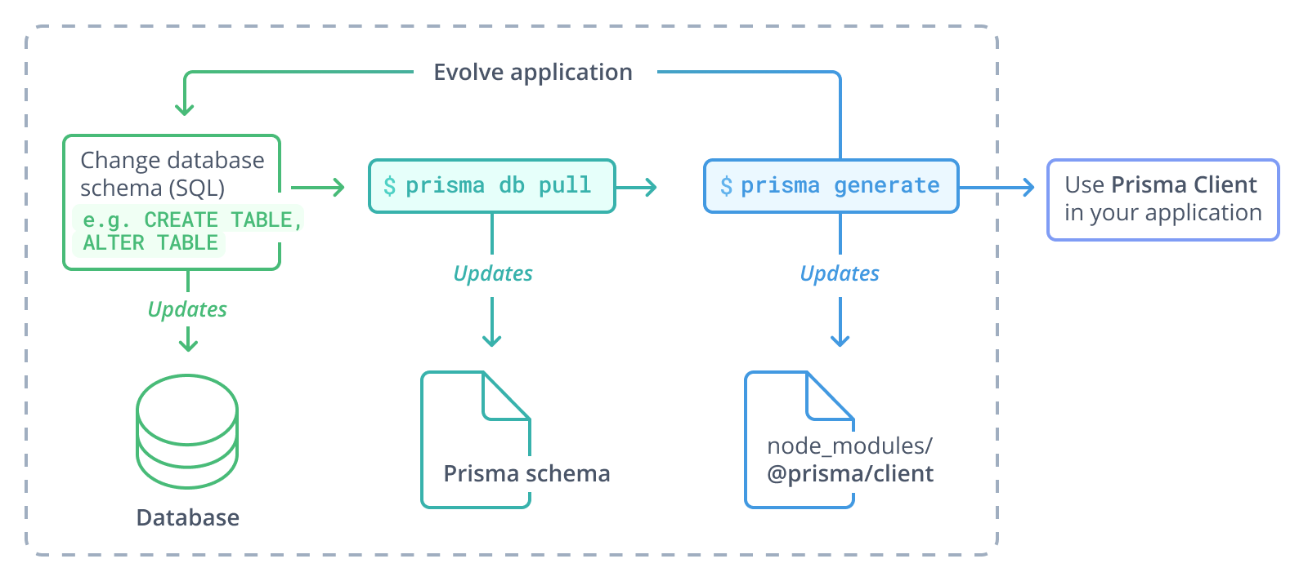
Design and Implementation – Prisma ORM

Slide 14
Methods and Tools Used
PRISMA ORM : is defined as a programming technique that allows data to be seamlessly mapped between a relational database management system (RDBMS) and an object-oriented programming language such as Java or Python. ORM systems serve as a bridge between the two different paradigms.
PostgreSQL : is an object-relational database management system (ORDMBS), which means that it has relational capabilities and an object-oriented design. piece of software designed to translate between the data representations used by databases and those used in object-oriented programming
JSON : or JavaScript Object Notation, is a standard format for storing and exchanging data. It's a text-based format that's easy for humans to read and for machines to parse.

Slide 15
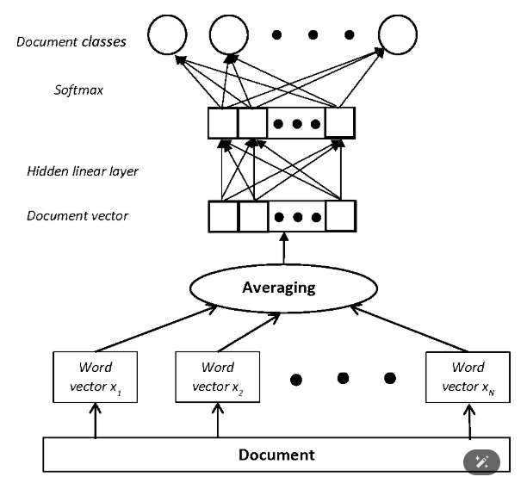
ALGORITHMS : ML MODELS
Language detection models, such as
1.langdetect
2.fastText

Slide 16
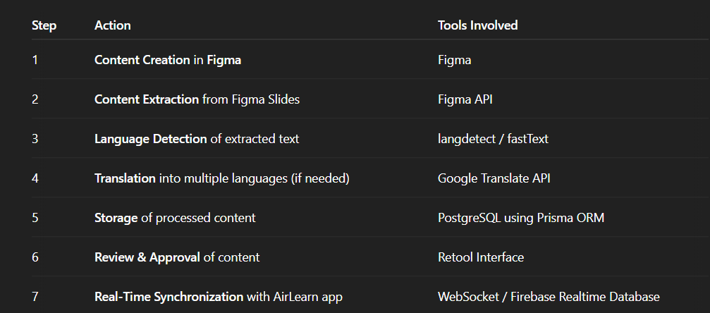
FLOW CASE :

Slide 17
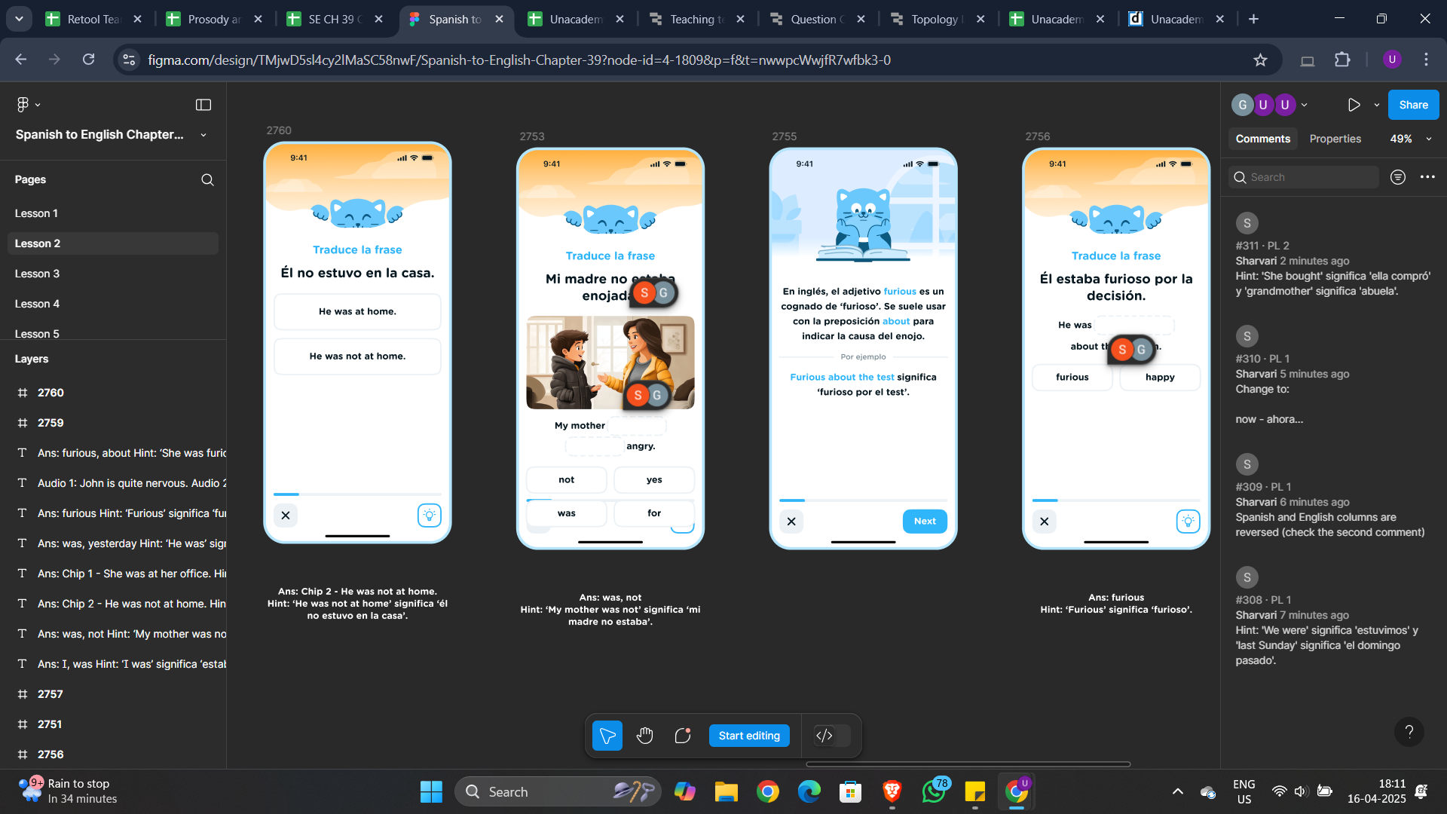
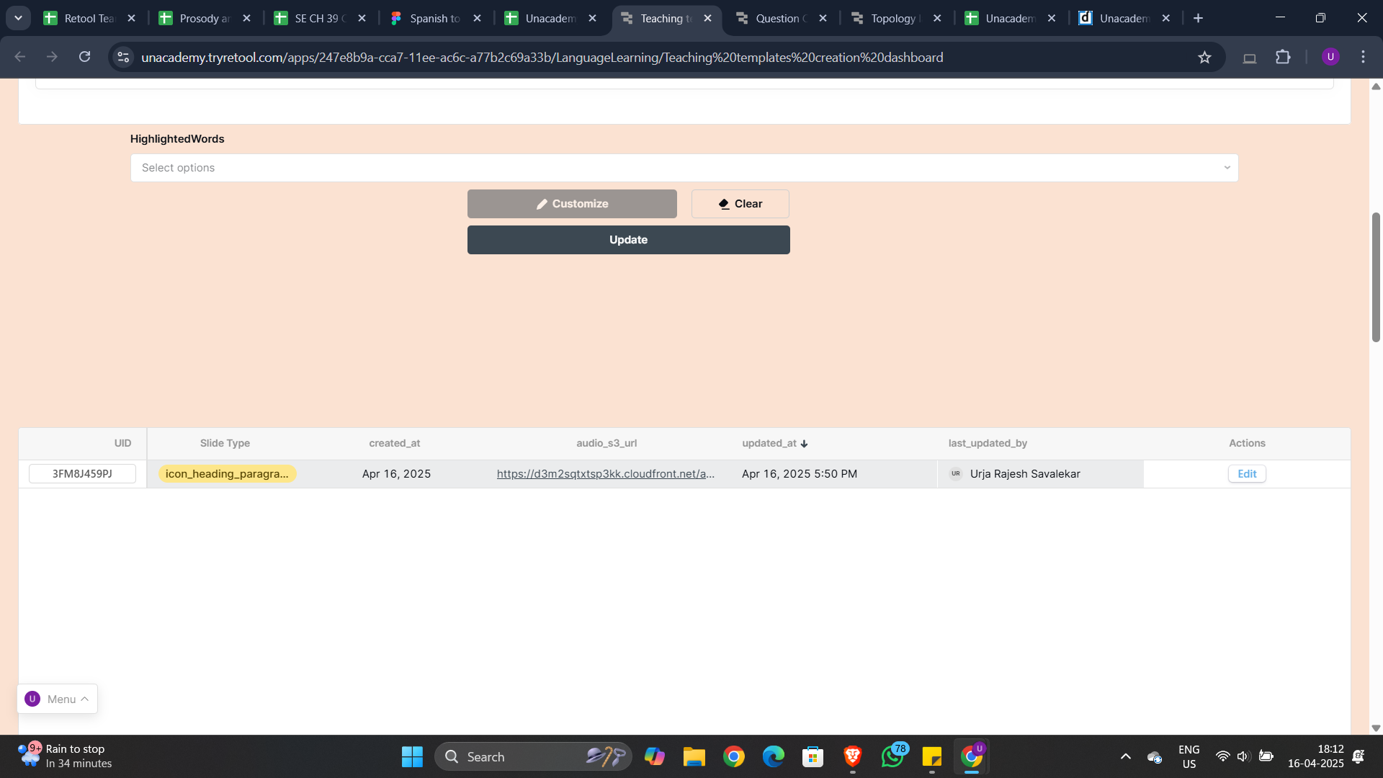
RETOOL - OUTPUTS

Slide 18
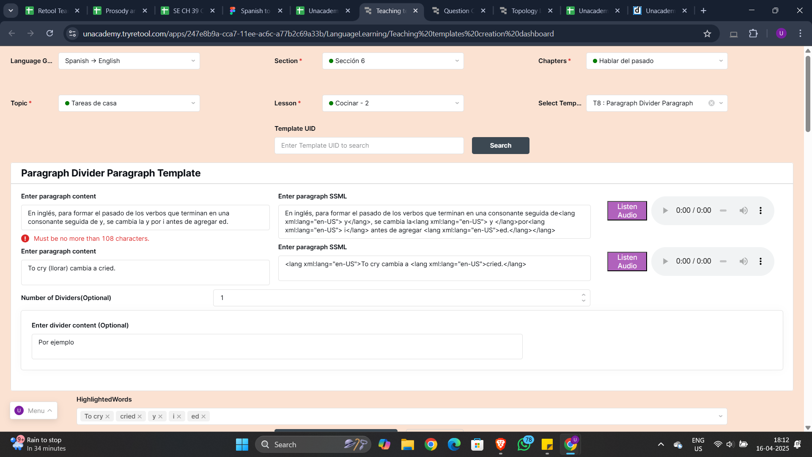

Slide 19
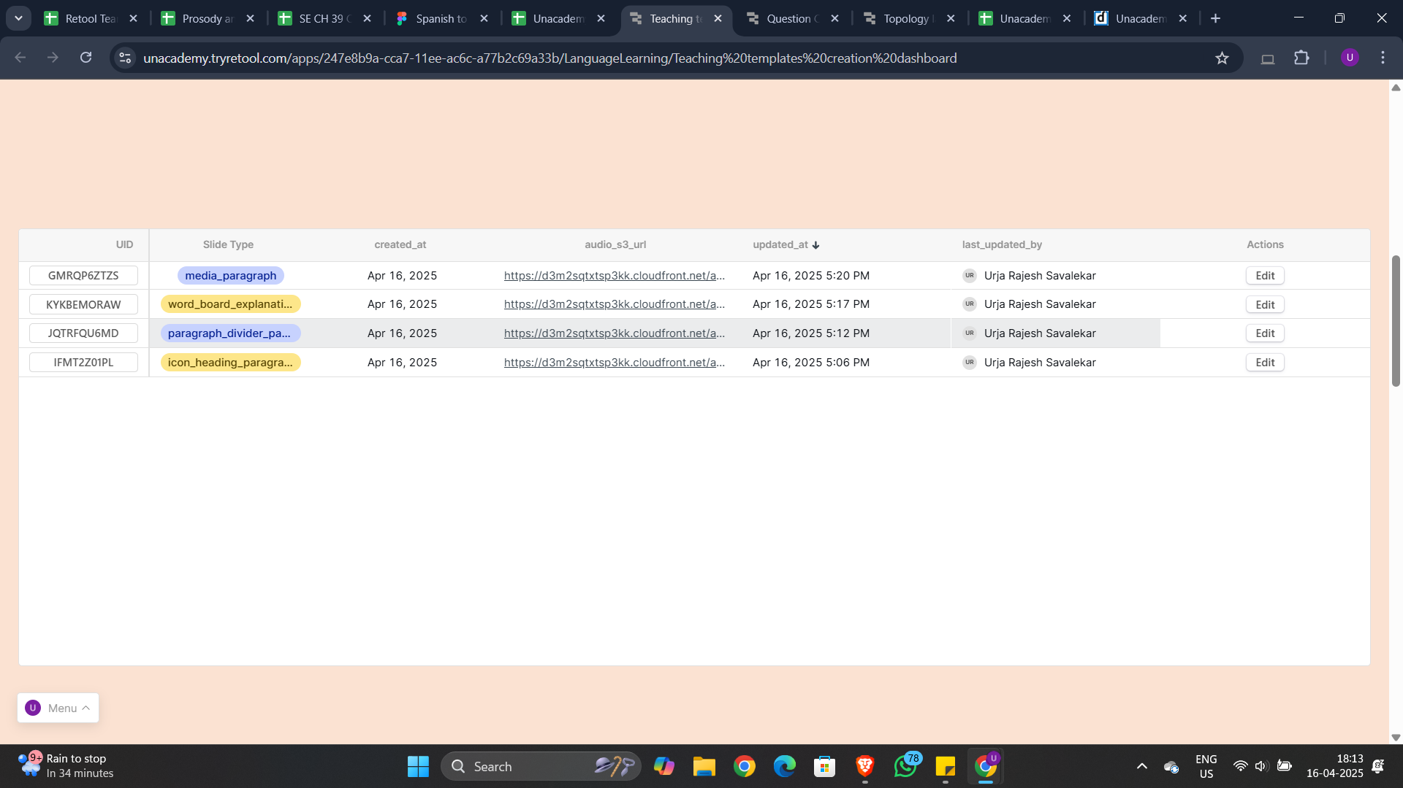

Slide 20
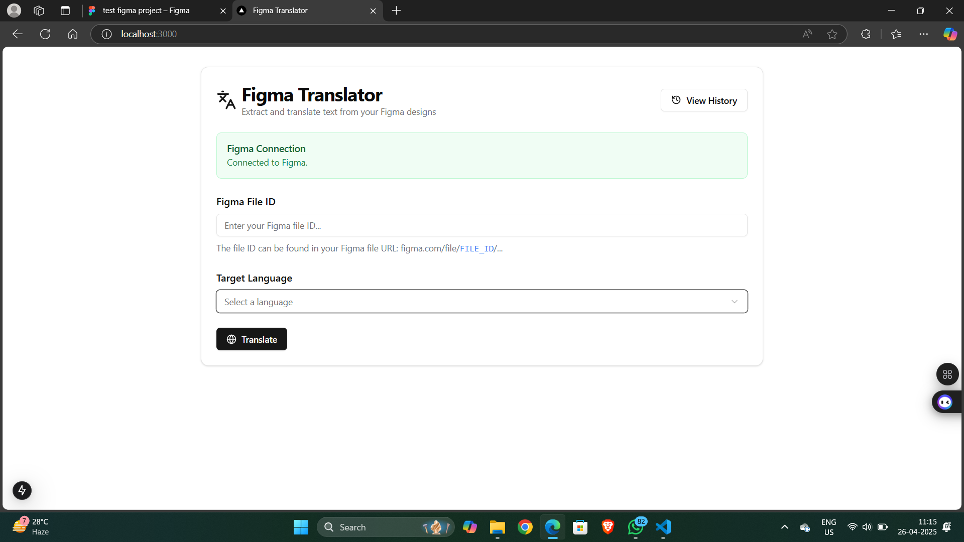
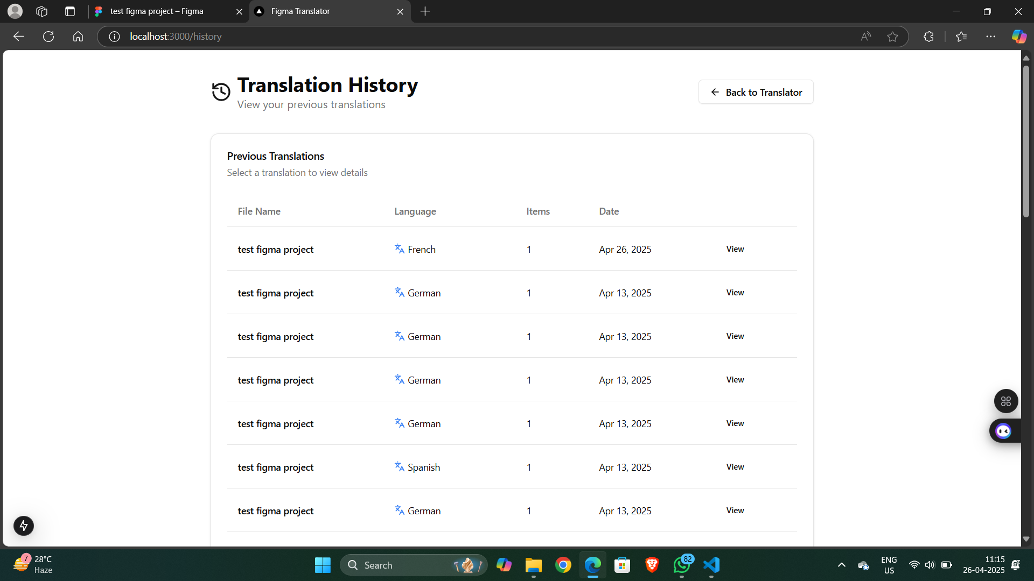

Slide 21
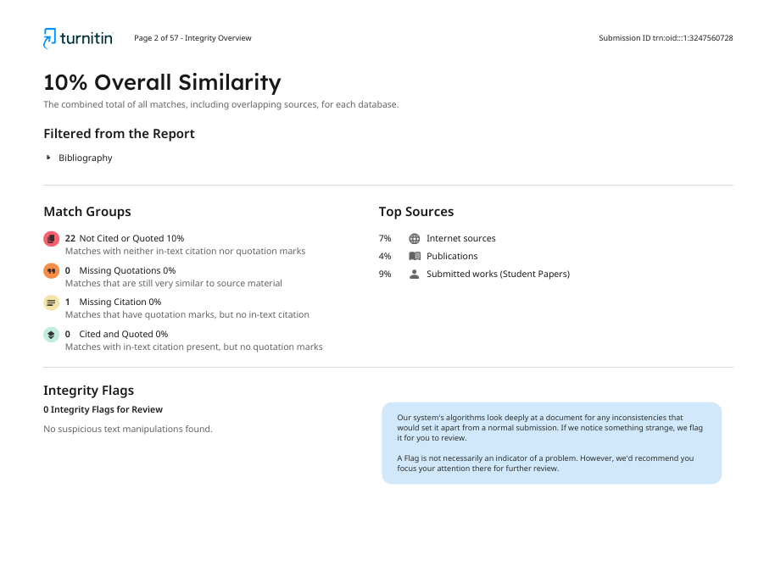
Plagiarism Report

Slide 22
Internship Road Map
Note: Write in the below table what u will be achieving in each review
Review 0
Initial planning and setup : exploring retool for backend automation and figma for ui design
Review 1
Development and implementation
Review 2
Testing and optimizing
Review 3
Final submission and deployment

Slide 23
Q&A

Slide 24
Thank you !!

