Slide 1
“Finding Target Audience using Geographic Segmentation”
Urjasvit Sinha
MS Data Analytics, Northeastern University
urjasvitsinha@gmail.com
www.linkedin.com/in/urjasvit-sinha-a34670159/

Slide 2
Case Study
“We have a client who wants to increase the number of people in Illinois with their, slightly more expensive/premium, private health insurance. They want to use personalized, omni-channel communication platform to send out messages to people across Illinois, but they don’t want to spam people who aren’t interested in their product.
What populations would you recommend they target first, and why?”
Columns of interest in the dataset:
Sex by Age (only the most aggregated column)
Race
Median Household Income In The Past 12 Months (In 2019 Inflation-Adjusted Dollars)
Total Population
Types Of Health Insurance Coverage By Age

Slide 3
Data Munging and Loading
Steps followed to get the required data:
Read the documentation given on the Census website (https://www2.census.gov/programs-surveys/acs/summary_file/2019/documentation/tech_docs/ACS_SF_Excel_Import_Tool.pdf)
Found and extracted relevant columns in excel files and exported it to Python.
Performed data loading, data wrangling and merged excel sheets into one data frame.
Exported data frame by saving it as Dataset_Consolidated.csv

Slide 4
Data Visualization
Imported the final dataset file Dataset_Consolidated.csv in Tableau Desktop.
Created worksheets, dashboards and storyboards to find the target audience for the company to sell their expensive insurance.
Divided Illinois state into counties and created zones/clusters using population density and median household income.
Explored Cook County (High population, significant income zone) further and narrowing the geography (Chicago City) for the target audience.
Analysed Chicago City to get population aged (19-64 years) with no/one type of insurance since possibility of them purchasing new health insurance is high.

Slide 5
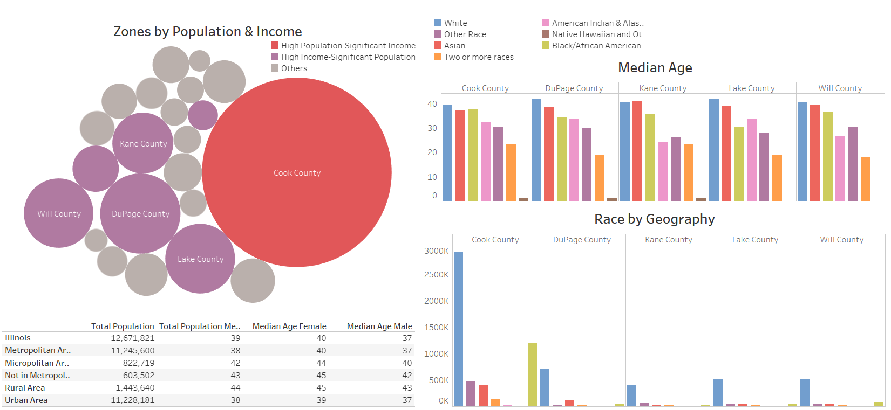
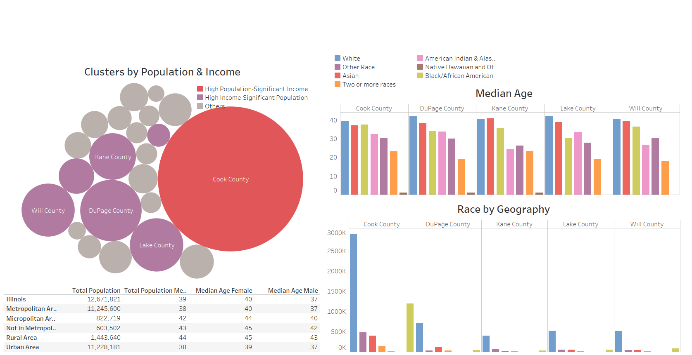
Understanding Customer Demographics in Illinois

Slide 6
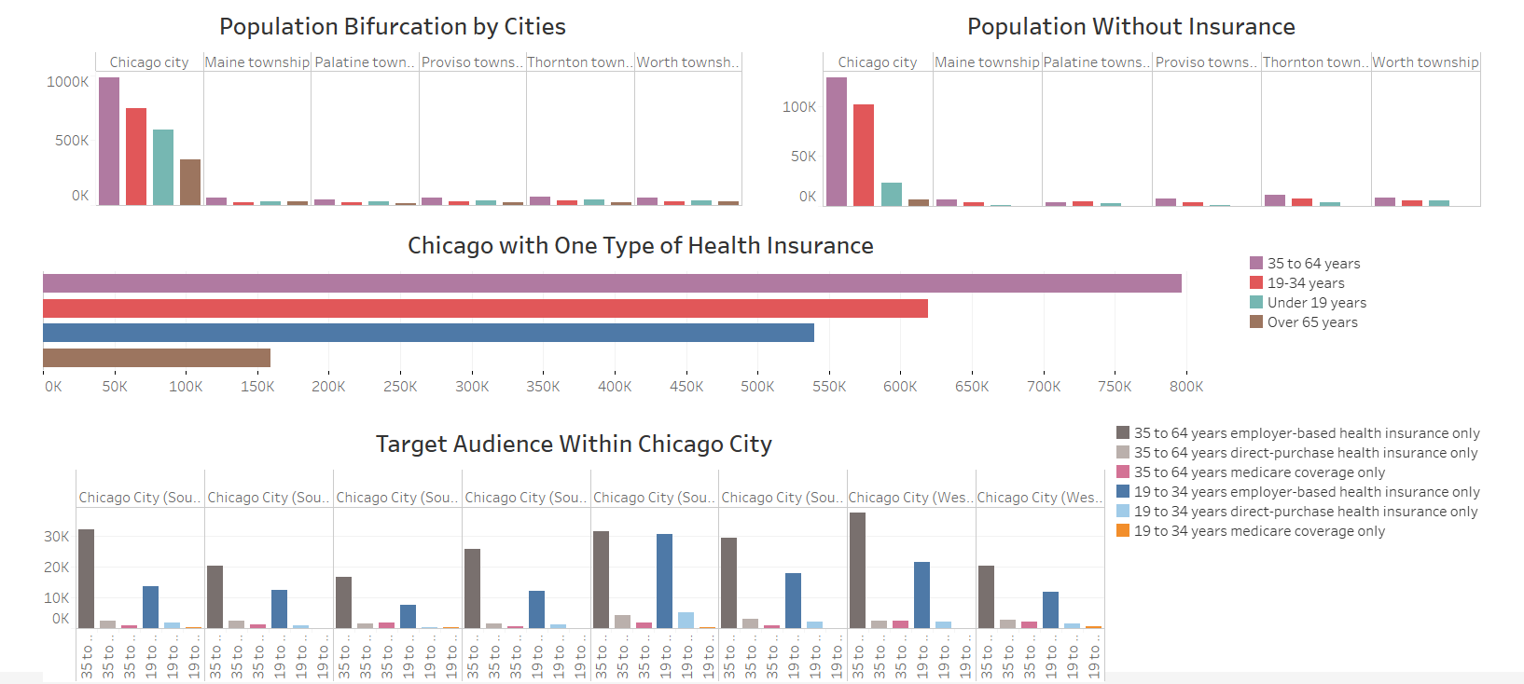
Analysis of High Population and Significant Income Zone (Cook County)

Slide 7
Conclusion
Division of Illinois into three zones can be used as a marketing strategy by client to rollout their product in phases by analysing and improving their product from feedback.
Cook County is initially chosen as it is most populous county with significant household income relatively low median age(<40).
Chicago City has high number of people who have no insurance and only one type (employer-based, directly purchased and Medicare) insurance. This group can be potential customer as they can afford premium of another insurance.
Among them, people aged between 19-64 are significant and more likely to buy insurance than others as they would like to insure themselves from incurring any health expenditures in future.

Slide 8
References
https://www.census.gov/programs-surveys/geography/guidance/geo-identifiers.html
https://www.census.gov/programs-surveys/acs/technical-documentation/summary-file-documentation.html
https://en.wikipedia.org/wiki/Illinois%27s_congressional_districts

