Slide 1

Capstone 2
2015 Flight Delays and Cancellations Data Analysis
Presented by: Romana Akter
6/10/2022

Slide 2
2015 Flight Delays & Cancellations in US
2015 Flight Delays and Cancellations | Kaggle
The flight delay and cancellation data was collected and published by the DOT's Bureau of Transportation Statistics which tracks the on-time performance of domestic flights operated by large Air Carriers. Summary information on the number of on-time, delayed, canceled, and diverted flights is published in DOT's monthly Air Travel Consumer Report and this dataset contains the information of 2015 flight delays and cancellations.

Slide 3
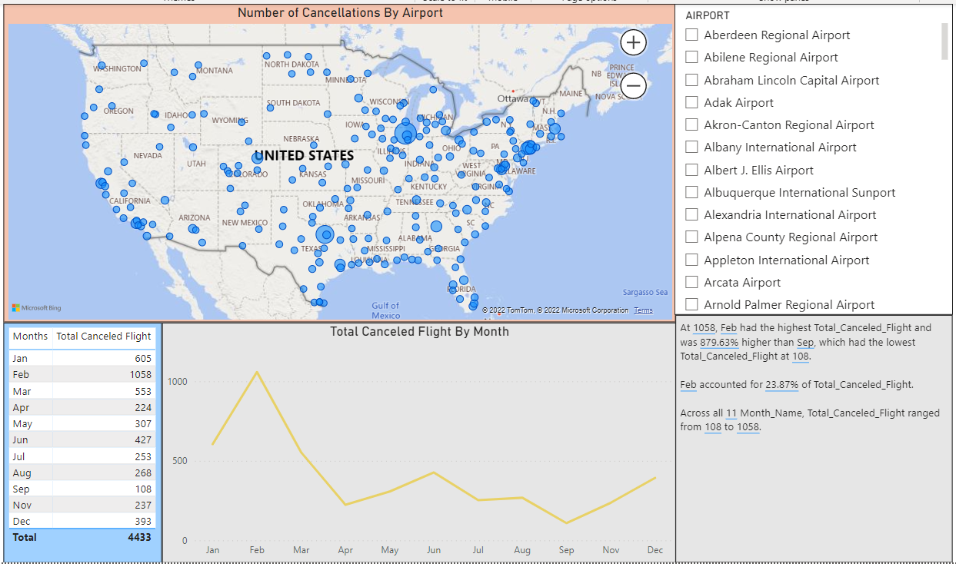
Flight Cancellations by Month and Airport

Slide 4
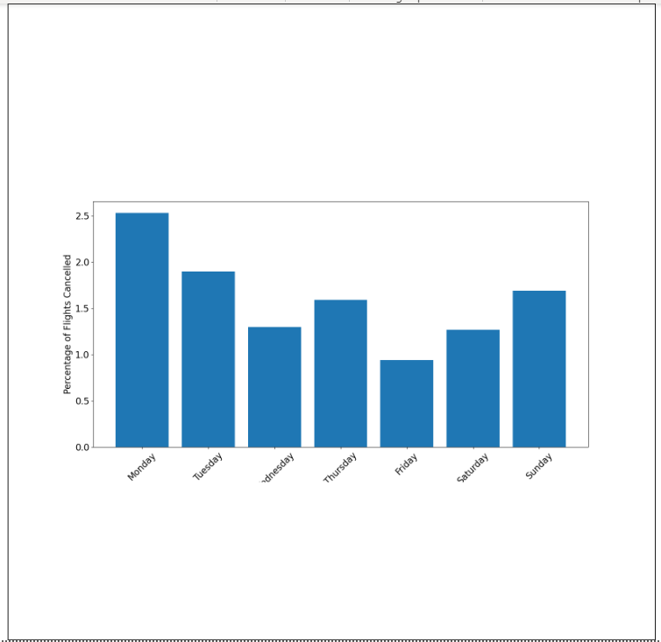
Python Integration

Slide 5
Thank You
This Subtitle is Arial in Medium Blue

