Slide 1



Campus problems get lost in group chats
Broken fans, leaking taps, dead street lights, dirty washrooms. Students report them on WhatsApp groups and paper registers, and that is where the trouble starts.
Complaints get lost
Same issue, many reports
Nobody knows what happened
Messages scroll away and paper registers are never read.
Nobody can see what has already been reported.
Students never learn whether any action was taken.
Team: Noushin Anamika Urmee, Arina Afrin, Tanjim Hasan
Notes:
Open with the pain. Today a broken fan is reported in a WhatsApp group or a paper register. The message scrolls away, five students report the same fan, and nobody ever hears back. Three problems: lost complaints, duplicates, and no feedback.

Slide 2
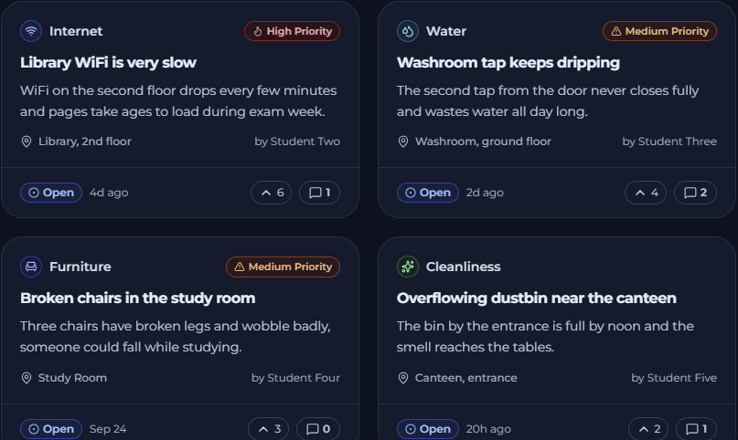




Report it. Upvote it. Track it. Fix it.
Report
Title, category, location and an optional photo. A duplicate warning shows similar open issues.
Upvote
One vote per student. The most urgent issues rise to the top.
Track
Open, In Progress or Resolved, with a full timeline and comments.
High: 5+ votes
Medium: 3-4
Low: 0-2
Resolve
Staff update the status with a note, so students see what was done.
Priority is computed from upvotes, so nobody can label their own issue High.
Notes:
Our answer is one simple loop. A student reports an issue. If it already exists we warn them and they upvote instead. Everyone can track the status and the timeline. Staff change the status and leave a note, so the student sees exactly what was done.

Slide 3
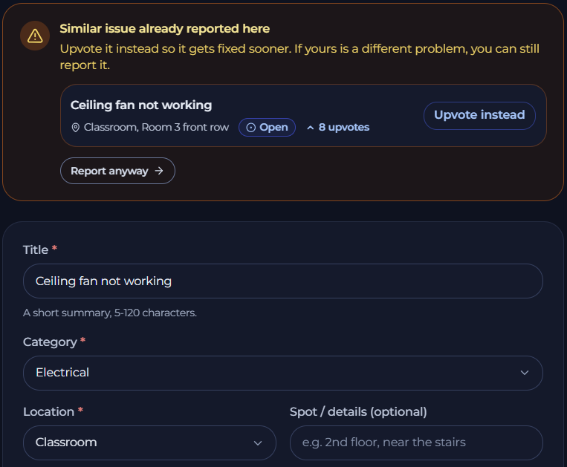




Everything students and staff need
Report with a photo
Category, location and an optional photo
Search and filter
Category, status, location, sort and pages
Upvote
One vote per user, urgent issues rise
Comments and timeline
Official staff replies and status history
Dashboards
My Reports for students, stats for admins
Duplicate and priority
Similar-issue warning and priority labels
Also: dark mode, mobile layout, role-based access
Notes:
Walk through the six cards quickly, then show the screenshot. The duplicate warning is the key idea: while typing a title, similar open issues in the same category and building are shown, and the student can upvote instead. Extras: dark mode, mobile layout and role-based access.

Slide 4



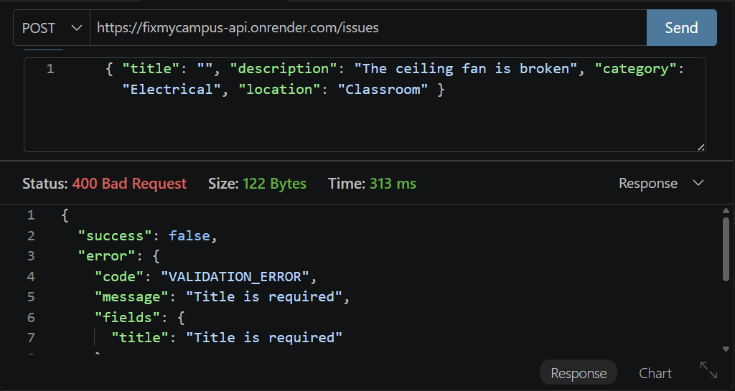
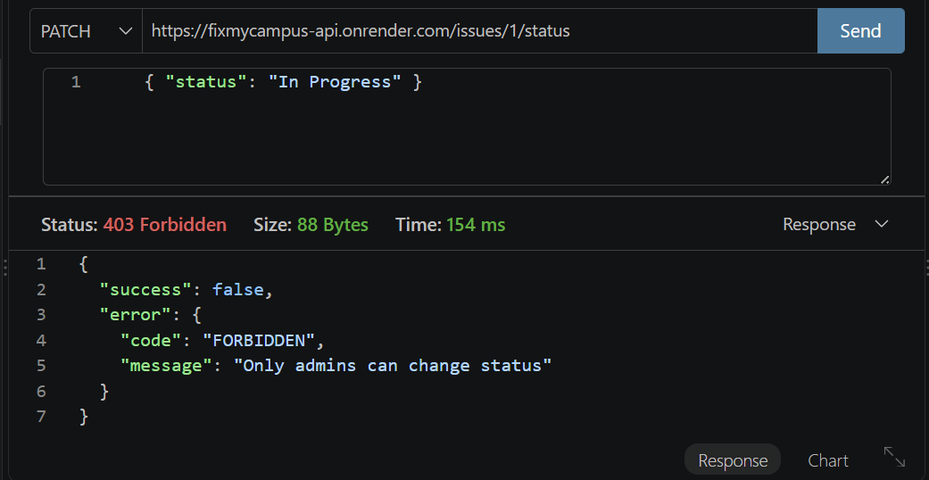
API and architecture
13 endpoints
2 roles
5 tables
React frontend
Express API
PostgreSQL
Hosted web app. Login, issue list, report form, dashboards
Render. JWT login check, role check, zod validation
Supabase. users, issues, comments, upvotes, status_history
Validation: an empty title returns 400
Role check: a student changing status gets 403
Notes:
Three layers. The React frontend talks to an Express API. Every request goes through a login check, a role check and validation before it reaches PostgreSQL. 13 endpoints, 2 roles, 5 tables. The two screenshots are the required demonstrations: an empty title is rejected with a clear 400 message, and a student who tries to change a status gets 403. The full endpoint table is in the README.

Slide 5
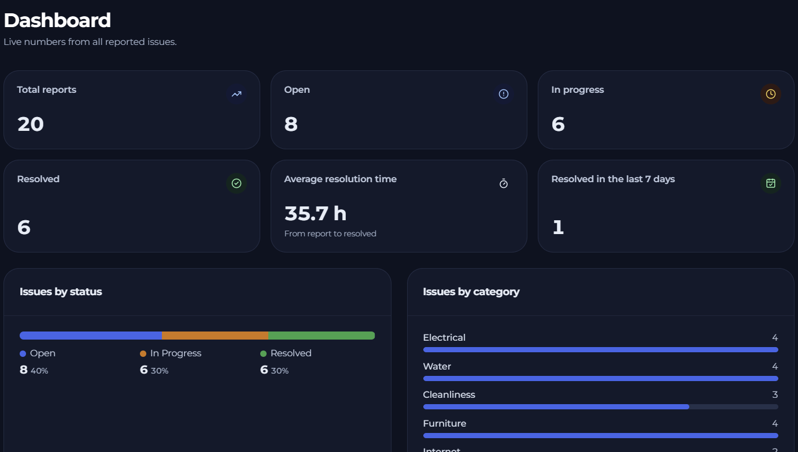






Impact and what is next
Students
See their report, the votes and what staff did.
Staff
One list sorted by urgency, with hotspots and average resolution time.
Campus
Fewer duplicate complaints and a visible record of every fix.
NEXT
Notifications when a status changes
A QR code per location for one-scan reporting
Maintenance trends and weekly reports
Notes:
Close on the value. Students finally see what happened to their report. Staff get one list sorted by urgency and hotspot data. The campus gets fewer duplicate complaints. Next steps: notifications, QR codes per location, and maintenance trends. Finish with the live link.

