Slide 1
KERNEL BUILD PROCESS

Slide 2
Kernel building
There are two main methods for building kernel
1.To cross compile
2.To build locally on a Raspberry Pi
First we will see cross compiling. For cross compiling we need to go through following steps:
Step1: Install required dependencies
To build the sources for cross-compilation, we have to make sure you have the dependencies needed on your machine by executing following instruction:
sudo apt install git bc bison flex libssl-dev make libc6-dev libncurses5-dev

Slide 3
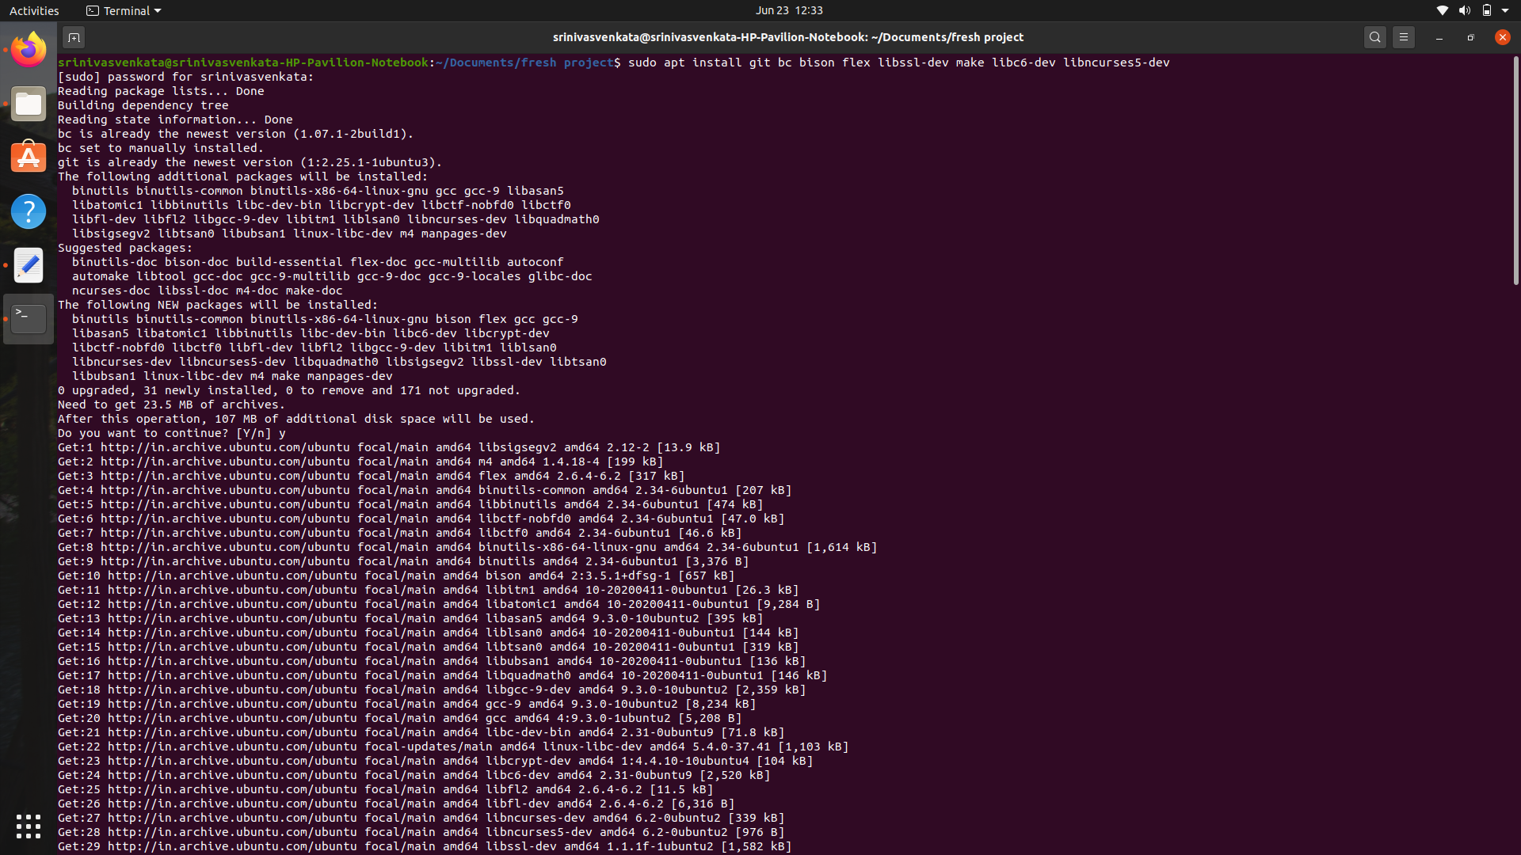

Slide 4
Step2: Install toolchain
We need to download the tool chain
git clone https://github.com/raspberrypi/tools ~/tools

Slide 5
Step3: We need to update the $PATH environment variable makes the system aware of file locations needed for cross-compilation.
echo PATH=\$PATH:~/tools/arm-bcm2708/arm-linux-gnueabihf/bin >>~/.bashrc
source ~/.bashrc

Slide 6
Step4: Downloading source code
To download the minimal source tree for the current branch we need to run following command:
git clone --depth=1 https://github.com/raspberrypi/linux

Slide 7
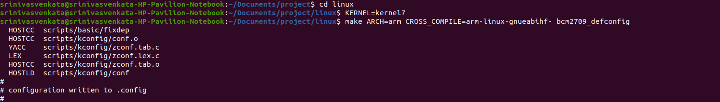
Step5: Build sources
We need to execute following commands to build the sources and Device Tree files:
cd linux
KERNEL=kernel7
make ARCH=arm CROSS_COMPILE=arm-linux-gnueabihf- bcm2709_defconfig

Slide 8
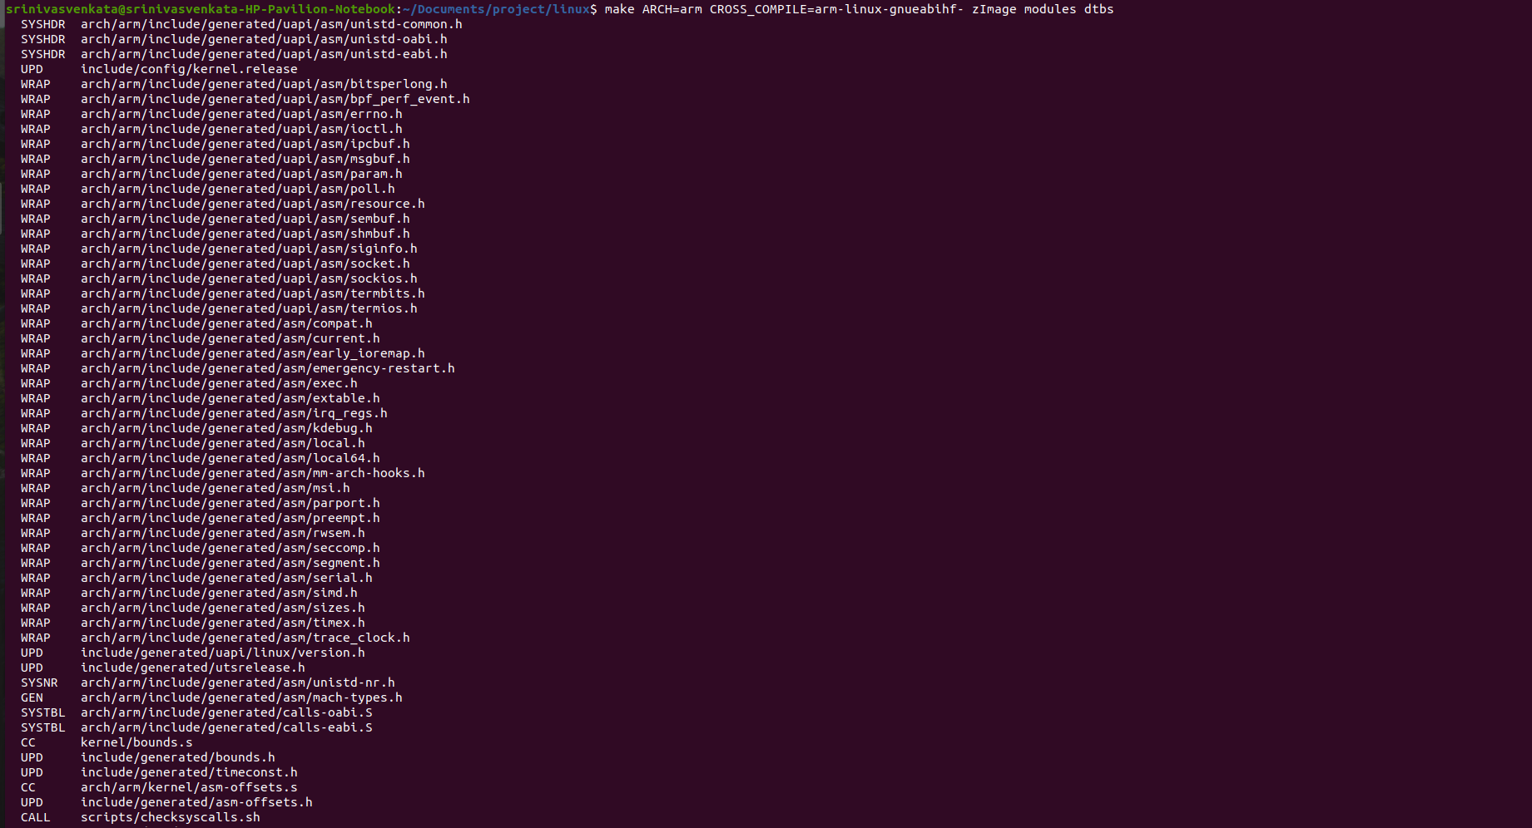
After above steps execute following command to build final image:
make ARCH=arm CROSS_COMPILE=arm-linux-gnueabihf- zImage modules dtbs

Slide 9
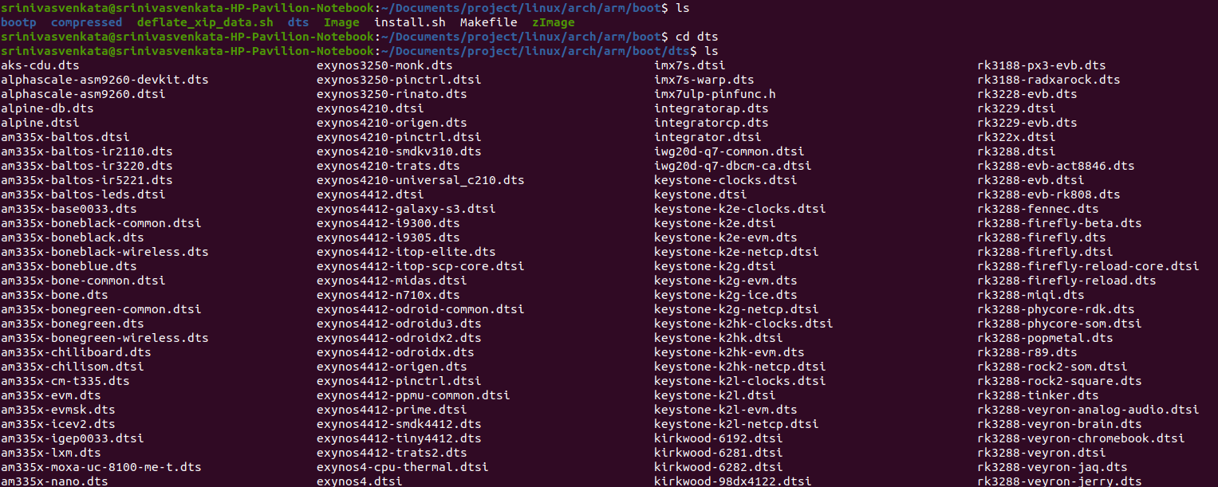
After build process has completed, we can observe a bootable zimage is created as you can observe in the below screenshot:

Slide 10
The other way is you can build locally on raspberry pi.
Step1: On a Raspberry Pi, first install the latest version of Raspberry Pi OS. Then boot your Pi, plug in Ethernet to give you access to the sources, and log in.
Step2: Install build dependencies
Install git and other build dependencies using following command :
sudo apt install git bc bison flex libssl-dev make
Step3: Download source code using following command:
git clone --depth=1 https://github.com/raspberrypi/linux

Slide 11
Step4:
Depending on the Raspberry pi first we need to prepare the default configuration by running the following commands:
cd linux
KERNEL=kernel7
make bcm2709_defconfig
Step5:
To build and install the kernel, modules, and Device Tree blobs:
make -j4 zImage modules dtbs
sudo make modules_install
sudo cp arch/arm/boot/dts/*.dtb /boot/
sudo cp arch/arm/boot/dts/overlays/*.dtb* /boot/overlays/
sudo cp arch/arm/boot/dts/overlays/README /boot/overlays/
sudo cp arch/arm/boot/zImage /boot/$KERNEL.img

Slide 12
Flashing Procedure for cross compilation method
Install directly onto the SD card:
First, use lsblk before and after plugging in your SD card to identify it. You should end up with something like this:
sdb
sdb1
sdb2
sdb5
sdb6
sdb7
mkdir mnt
mkdir mnt/fat32
mkdir mnt/ext4
sudo mount /dev/sdb6 mnt/fat32
sudo mount /dev/sdb7 mnt/ext4
Install the modules:
sudo env PATH=$PATH make ARCH=arm CROSS_COMPILE=arm-linux-gnueabihf- INSTALL_MOD_PATH=mnt/ext4 modules_install

Slide 13
Finally, copy the kernel and Device Tree blobs onto the SD card, making sure to back up your old kernel:
sudo cp mnt/fat32/$KERNEL.img mnt/fat32/$KERNEL-backup.img
sudo cp arch/arm/boot/zImage mnt/fat32/$KERNEL.img
sudo cp arch/arm/boot/dts/*.dtb mnt/fat32/
sudo cp arch/arm/boot/dts/overlays/*.dtb* mnt/fat32/overlays/
sudo cp arch/arm/boot/dts/overlays/README mnt/fat32/overlays/
sudo umount mnt/fat32 sudo umount mnt/ext4

Slide 14
GCC OLDER VERSION ERROR USE THIS BELOW COMMAND:
>sudo apt install crossbuild-essential-armhf
To fix errors in version 5.4.0-113-generic follow the below commands
sudo apt update
sudo apt install g++
sudo apt-get install libgmp-dev
sudo apt-get install libmpc-dev

Slide 15
THANK YOU

