Slide 1
Character driver
      - Presented by Urmila Lakade

Slide 2
Goal
Create device number
Create device files
Make a char device registration with the VFS (CDEV_ADD)
Implement the driver’s file operation methods for open, read, write,

Slide 3
Major and Minor Numbers
Major numbers
  Major number identifies the driver associated
  with the device
  Char drivers are identified by a c
    crw------- 1 root root 5, 1 Apr 12 1650
  Block drivers are identified by a b
    brw-rw---- 1 awang floppy 2, 0 Apr 12 1650
Minor numbers
  Minor number is used by the kernel to determine
  which device is being referred to

Slide 4
The Internal Representation of Device Numbers
dev_t type, defined in linux/kdev_t.h
12 bits for the major number
  Use MAJOR(dev_t dev) to obtain the major number
20 bits for the minor number
  Use MINOR(dev_t dev) to obtain the minor number
Use MKDEV(int major, int minor) to turn them into a dev_t

Slide 5
Statically Allocating Device Numbers
To obtain one or more device numbers, use
int register_chrdev_region(dev_t first, unsigned int count, char name)
Returns 0 on success, error code on failure
first
  Beginning device number
  Minor device number is often 0
count
  Requested number of contiguous device numbers
name
  Name of the device

Slide 6
Dynamically Allocating Device Numbers
Kernel can allocate a major number on the fly
int alloc_chrdev_region(dev_t dev, unsigned int firstminor, unsigned int count, char name)
dev
  Output-only parameter that holds the first number on success
firstminor
  Requested first minor number often 0

Slide 7
Freeing Device Numbers
To free your device numbers, use
int unregister_chrdev_region(dev_t first,unsigned int count)
first
  Beginning device number
  Minor device number is often 0
Count
  Requested number of contiguous device numbers

Slide 8
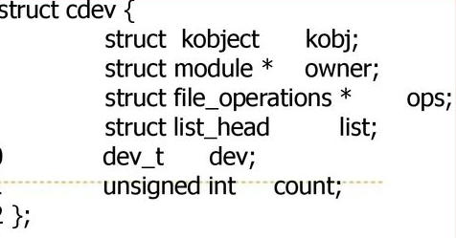
Char Device Registration
Need to allocate struct cdev to represent char devices
include linux/cdev.h
Need to initialize file_operations and
set owner to THIS_MODULE
Runtime
  struct cdev * my_cdev = cdev_alloc()
  my_cdev-> &my_fops (fops:struct file_operations )
Own allocation
  void cdev_init(struct cdev *cdev, struct file_operations *fops)

Slide 9
Char Device Registration
Inform the kernel by calling
int cdev_add(struct cdev cdev, dev_t num,unsigned int count)
  Cdev : struct cdev variable
  Num : first device number
  Count : number of device numbers
After this function call, the kernel knows the association between the
major/minor numbers and the file operation.your device is ready to be used
Remove a char device, call this function
  void cdev_del(struct cdev dev)
    Cdev : struct cdev variable

Slide 10
Device File Creation
Manually device file creation
  Mknod -m <permission> <name> <device type> <major > <minor>
  Eg . Mknod -m 666 /dev/char_device c 250 2
Dynamic device file creation
  Include the header file linux/device.h and linux/kdev_t.h
  Create the struct Class
  Create Device with the class which is created by the above step
Create the class
Create a directory in sysfs : /sys/class/<your_class_name>
struct class * class_create(struct module *owner, const char *name);
  owner – pointer to the module that is to “own” this struct class
  name – pointer to a string for the name of this class
the pointer created here is to be destroyed when finished by making a call to class_destroy.
  void class_destroy (struct class * cls);

Slide 11
Device File Creation
Create Device
This function creates a subdirectory under /sys/class/<your_class_name> with your device name.
This function also populates sysfs entry with dev file which consists of the major and minor numbers, separated by a : character
  /sys/class/your_class_name/your_device_name/dev
struct device *device_create(struct *class, struct device *parent, dev_t dev, void * drvdata, const char *fmt, ...);
class – pointer to the struct class that this device should be registered to
parent – pointer to the parent struct device of this new device, if any
devt – the dev_t for the char device to be added
drvdata – the data to be added to the device for callbacks
fmt – string for the device’s name
... – variable arguments

Slide 12
File Operations
The file_operation structure ste up operation that applies to the reserved device number
It is defined in <linux/fs.h>
A collection of function pointer.
In this character driver we will give support to handle the below user level system calls
  open
  close
  read
  Write

Slide 13
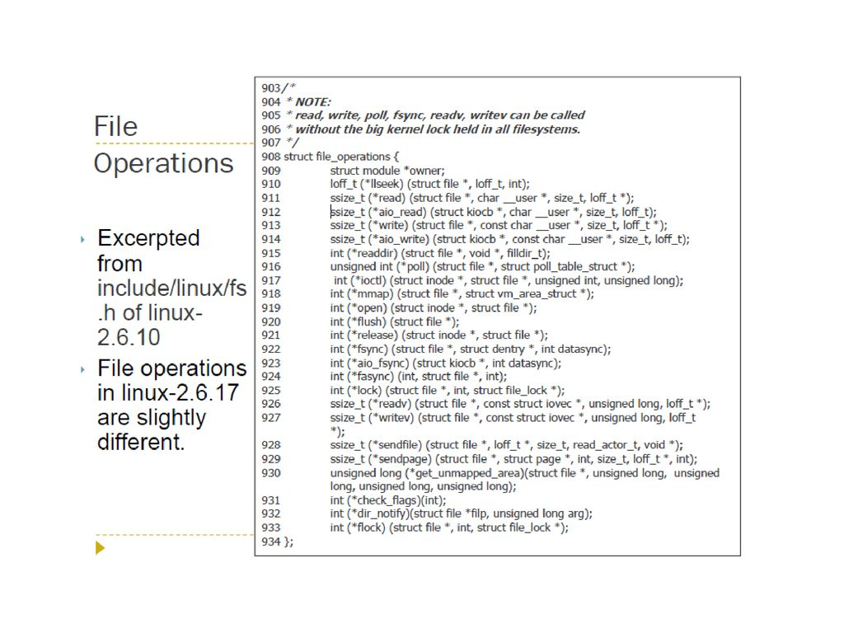
File Operations

Slide 14
File Operations
int (open) (struct inode *inode, struct file *file);
  Return :0 if open is successful Negative error code if open fails
first operation performed on the device file
int (release) (struct inode *inode, struct file *file);
  Return :0 if open is successful Negative error code if open fails
ssize_t (read) (struct file * file, char __user * buff, size_t count, loff_t * f_pos )
  returns the number of bytes read, or anegative value/
  appropiate error code on errors
  File : Pointer of file object
  Buff : Pointer of user buffer
  Count : Read count given by user
  f_pos : Pointer of current file position from which theread has to begin

Slide 15
File Operations
ssize_t (write) (struct file *, const char _ _user *, size_t, loff_t *);
  returns the number of bytes read, or anegative value/
  appropiate error code on errors
  File : Pointer of file object
  Buff : Pointer of user buffer
  Count : Read count given by user
  f_pos : Pointer of current file position from which theread has to begin
File operation defination example
  static struct file_operations fops ={
  .owner = THIS_MODULE,
  .read = etx_read,
  .write = etx_write,
  .open = etx_open,
  .release = etx_release,
  };

Slide 17
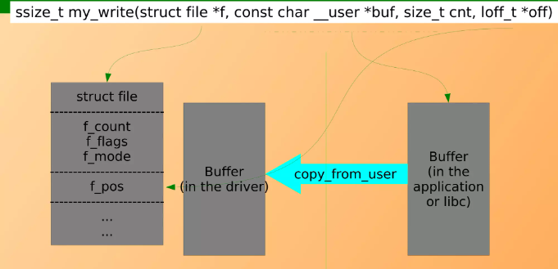
Copy data between user space and kernel space.
Using this driver we can send strings or data to the kernel device driver using the write function. It will store that string in the kernel space.

Slide 18
copy_from_user
unsigned long copy_from_user (void *to, const void *from, unsigned long count);
  to – Destination address, in the kernel space
  from – The source address in the user space
  count – Number of bytes to copy

Slide 19
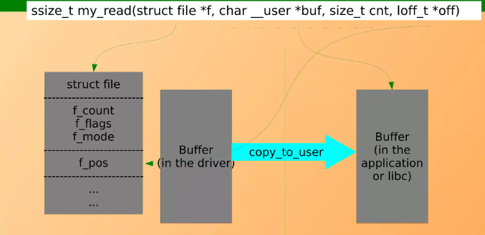
Copy data between user space and kernel space
Then when I read the device file, it will send the data which is written by write by function to the userspace application.

Slide 20
copy_to_user
unsigned long copy_to_user (void *to, const void *from, unsigned long count);
  to – Destination address, in the user space
  from – The source address in the kernel space
  count – Number of bytes to copy

Slide 21
Memory created and deleted for kernel buffer
kmalloc function is used to allocate the memory in kernel space
The function is fast and doesn’t clear the memory it obtains.
#include <linux/slab.h>
void *kmalloc(size_t size, gfp_t flags);
  size– how many bytes of memory are required.
  flags– the type of memory to allocate.
The flags argument may be one of:
  GFP_KERNEL – Allocate normal kernel ram. May sleep.
  GFP_NOIO – Do not do any I/O at all while trying to get memory.
  GFP_NOFS – Do not make any fs calls while trying to get memory.
  _GFP_HIGH – This allocation has high priority and may use emergency pools.
  __GFP_NOFAIL – Indicate that this allocation is in no way allowed to fail (think twice before using).
  __GFP_NORETRY – If memory is not immediately available, then give up at once.
  __GFP_NOWARN – If allocation fails, don’t issue any warnings.
  __GFP_REPEAT – If allocation fails initially, try once more before failing.

Slide 22
Memory created and deleted for kernel buffer
This is like a free() function in the userspace. This is used to free the previously allocated memory.
void kfree(const void *objp)
  *objp – pointer returned by kmalloc

Slide 23
Thank you !

