Slide 1
BANKING & FINANCIAL SERVICES | CUSTOMER CHURN ANALYTICS
Bank Customer Relationship
Management (CRM) Data Analysis
Customer Churn & Retention — Project Submission
Prepared by Urmila Palwal
Tools Used MySQL • Microsoft Power BI
Domain: Banking & Financial Services | Focus: Customer Churn Analytics

Slide 2











ROADMAP
Agenda
Problem Statement
Regional & Demographic Analysis
Business objective behind the churn study
Geography, gender & credit-score patterns
Data Schema
Product & Behavioral Analysis
Entity relationships across 7 CRM tables
Product usage, tenure & loyalty patterns
Data Cleaning & Preparation
Key Insights & Churn Drivers
Quality checks and consistency fixes
What predicts and drives attrition
Analytical Approach
Recommendations
SQL, DAX & Power BI methodology
Retention strategy for the bank
Live Dashboard Reports
Conclusion
BANK CRM CHURN ANALYSIS
02
Churn, demographics & product report pages
Summary of outcomes and impact

Slide 3
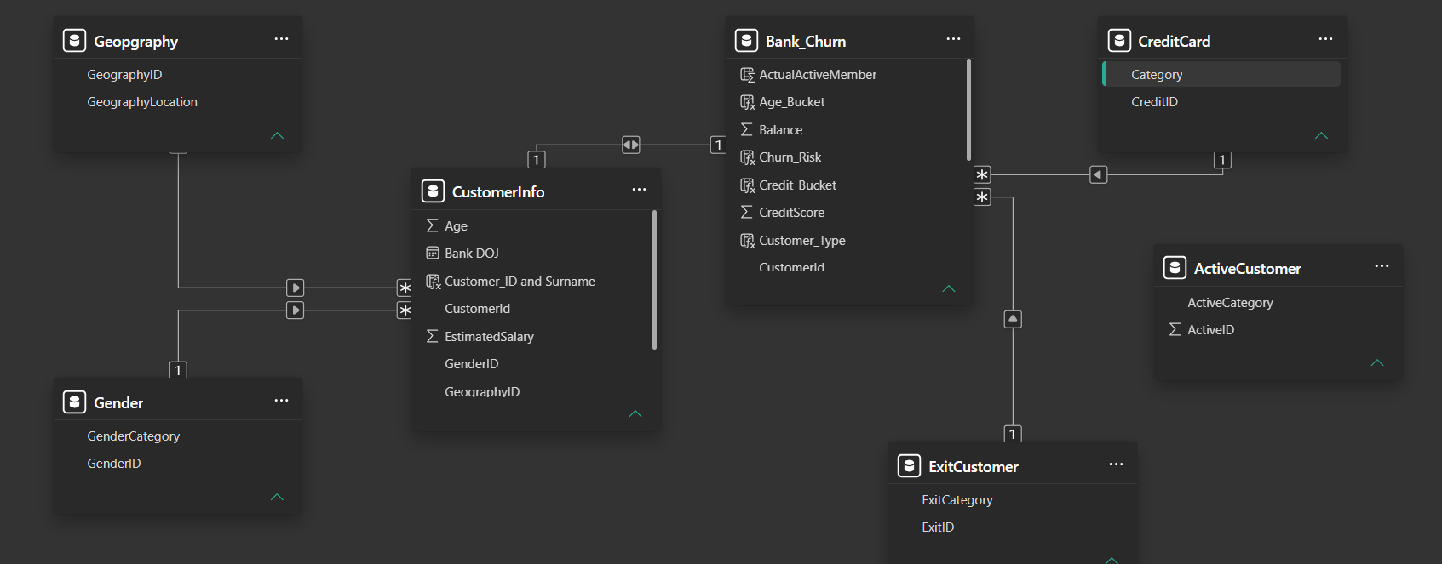
DATA MODEL
Data Schema — Entity Relationships
CORE TABLES
Bank_Churn — credit score, balance, churn risk (fact table, one row per CustomerId)
CustomerInfo — age, salary, tenure & the CustomerId/GenderId/GeographyId keys
Geography & Gender — lookup dimensions joined back to CustomerInfo
SUPPORTING TABLES
CreditCard — card category, linked by CreditID
ActiveCustomer — active vs. inactive flag
ExitCustomer — retain vs. exit outcome
RELATIONSHIP TYPE
One-to-many joins on CustomerId and CreditID keep the model in a clean, query-friendly star schema
Power BI data model — relationships across the 7 CRM tables (star-schema style joins)
BANK CRM CHURN ANALYSIS
03

Slide 4

BUSINESS CONTEXT
Problem Statement
WHY THIS ANALYSIS MATTERS
The bank is losing a meaningful share of its customer base each year. Leadership needs a data-driven view of who is leaving, why, and where to intervene first.
Reduce overall customer churn and protect the bank's deposit base
Analyse customer behaviour, engagement and product usage patterns
Identify high-risk customers by geography, credit tier and product mix
Build an interactive Power BI dashboard with KPIs and slicers
Translate analytical findings into actionable retention strategies
Baseline churn snapshot (≈10,000 customer accounts)
20.4%
7
3
Overall Churn Rate
Relational Tables
Geographic Markets
Goal: pinpoint the customer segments most likely to churn, and design retention actions the bank can act on immediately.
BANK CRM CHURN ANALYSIS
04

Slide 5

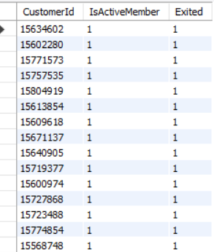
DATA QUALITY
Data Cleaning & Preprocessing
APPROACH
Imported the dataset into Power Query Editor (Power BI) to profile every column for null or blank values
No major missing values were found across the dataset
Built active relationships between the 7 tables to support cross-table analysis
Standardized naming — e.g. renamed HasCrCard to Has_creditcard for schema clarity
Discrepancy Uncovered
Records exist where a customer is marked Exited = 1 while still flagged IsActiveMember = 1 — a logical contradiction, since Exited is treated as the accurate field.
Root cause: the ETL pipeline fails to downgrade IsActiveMember to 0 when an account is closed — inflating "active member" counts unless corrected before reporting.
DATA QUALITY CHECKS AVAILABLE
Deletion — remove rows with negligible missing values
Statistical imputation — fill nulls with mean / median
Default imputation — placeholder for missing categories
Sequential fill — forward/backward fill for time-series
SQL output — flagged conflicting records
BANK CRM CHURN ANALYSIS
05

Slide 6
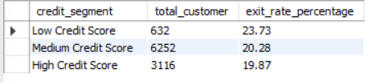
METHODOLOGY
Analytical Approach
SQL (MYSQL)
SAMPLE — Credit score segment vs. exit rate
Multi-table JOINs across CustomerInfo, Geography, Gender and Bank_Churn
CASE-based segmentation: credit-score tiers, age brackets, balance tiers
Aggregations (AVG, SUM, COUNT) for churn rate, salary and product usage
Window functions — RANK() OVER() to rank gender income by region
CTEs and correlated subqueries for tenure and active-customer filters
select case
when CreditScore < 500 then "Low Credit Score"
when CreditScore between 500 and 700
then "Medium Credit Score"
else "High Credit Score" end as segment,
count(CustomerId) as total_customer,
round(sum(Exited)*100/count(*),2) as exit_rate
from bank_churn
group by segment
order by exit_rate desc;
POWER BI & DAX
DAX calculated columns (e.g. composite CustomerID_Surname key)
Interactive dashboard with KPI cards, bar/column/donut visuals
Slicers for Geography, Gender, Active Status and Credit Card
Conditional formatting to flag high-risk customers
Result: the Low Credit Score segment shows the highest exit rate (23.60%), followed by Medium (20.66%) and High (19.35%) — credit health correlates with retention.
BANK CRM CHURN ANALYSIS
06

Slide 7
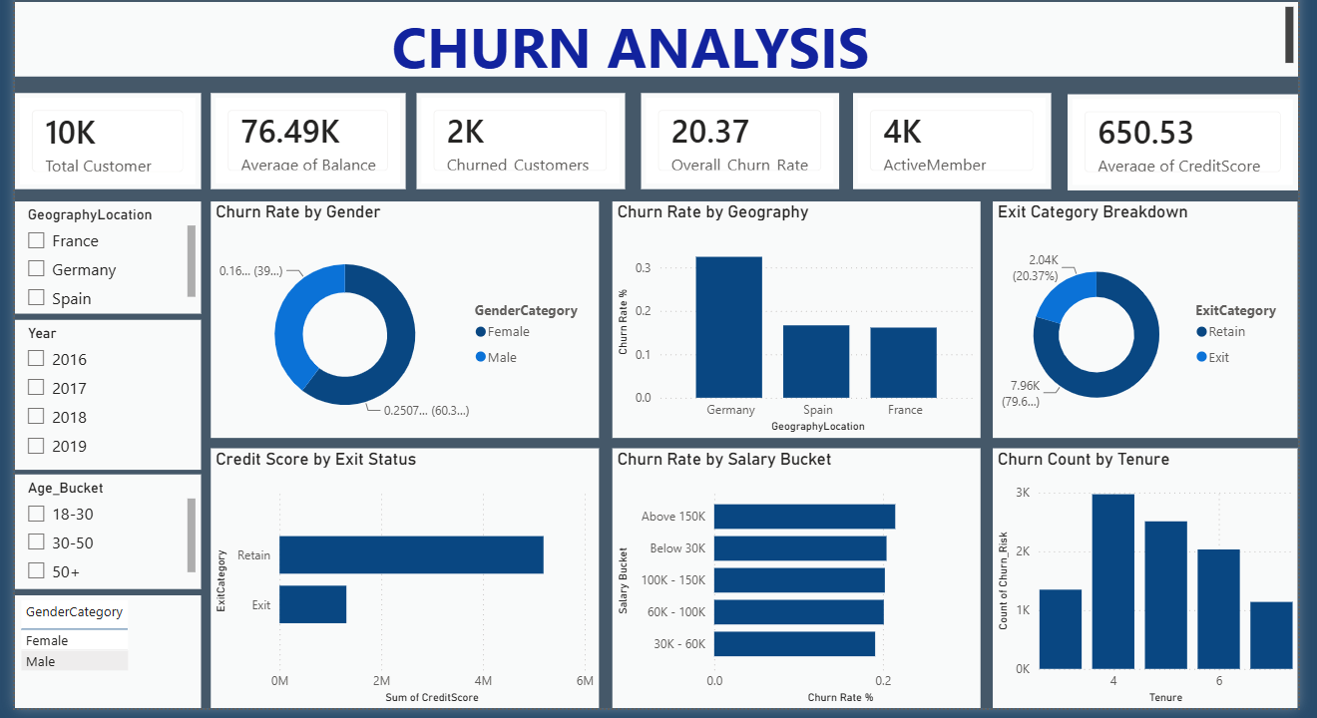
POWER BI
Churn Analysis
KPI CARDS (TOP ROW)
Total Customer
Average of Balance
Churned Customers
Overall Churn Rate
ActiveMember
Average of CreditScore
KEY VISUALS
Churn % by gender, geography & salary
Exit category: retain vs. exit
Credit score by exit status & tenure
FILTERS AVAILABLE
GeographyLocation • Year • Age_Bucket • GenderCategory
Full churn-analysis report page — churn rate by gender, geography & salary, exit breakdown and tenure
BANK CRM CHURN ANALYSIS
07

Slide 8
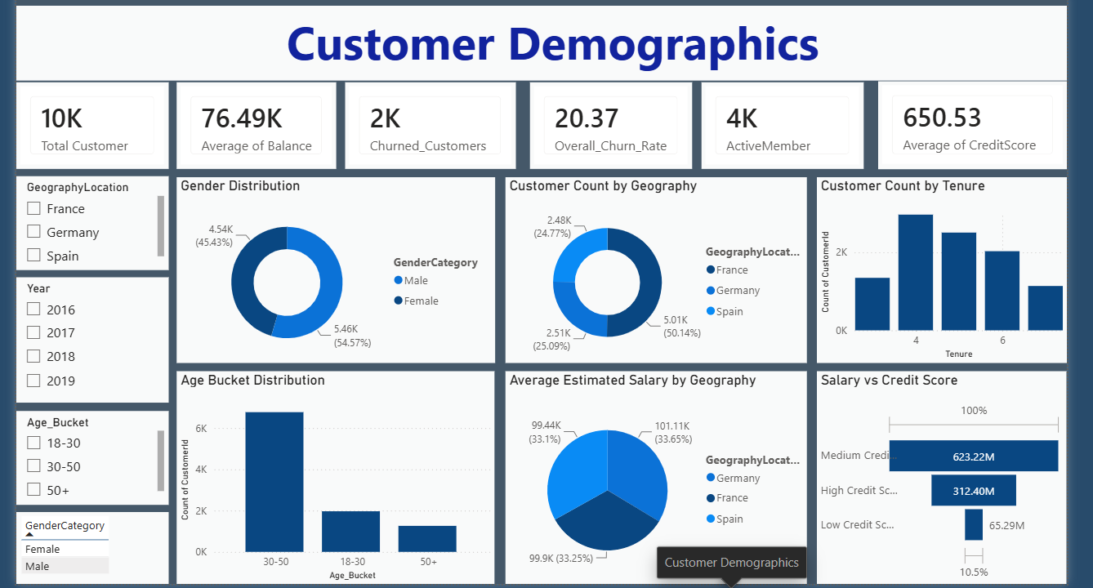
POWER BI
Customer Demographics
KPI CARDS (TOP ROW)
Total Customer
Average of Balance
Churned Customers
Overall Churn Rate
ActiveMember
Average of CreditScore
KEY VISUALS
Gender split & customers by geography
Age bucket & tenure distribution
Avg. salary & credit score by region
FILTERS AVAILABLE
GeographyLocation • Year • Age_Bucket • GenderCategory
Full demographics report page — gender split, geography mix, age & tenure distribution, salary and credit-score cuts
BANK CRM CHURN ANALYSIS
08

Slide 9
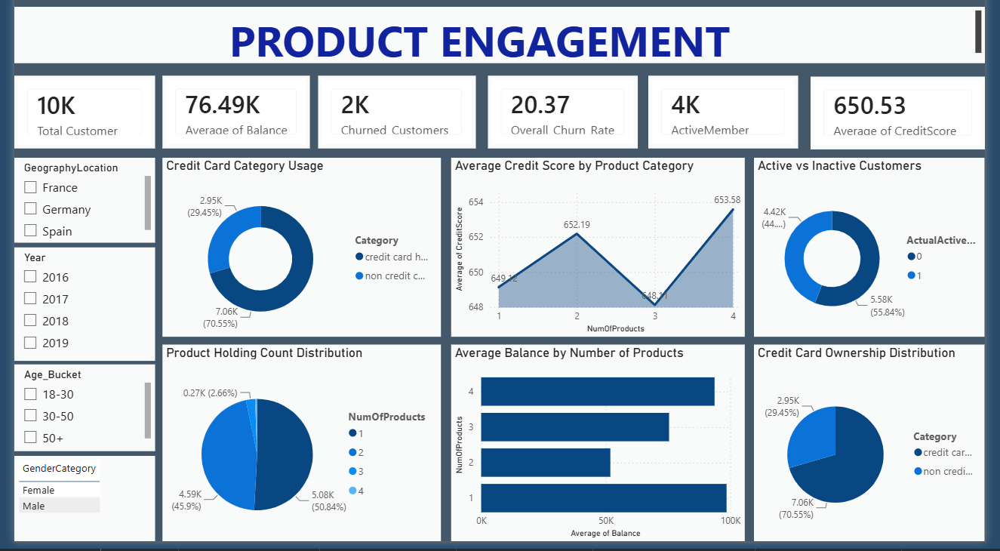
POWER BI
Product Engagement
KPI CARDS (TOP ROW)
Total Customer
Average of Balance
Churned Customers
Overall Churn Rate
ActiveMember
Average of CreditScore
KEY VISUALS
Credit-card usage & ownership mix
Avg. credit score & balance by products
Active vs. inactive customer split
FILTERS AVAILABLE
GeographyLocation • Year • Age_Bucket • GenderCategory
Full product-engagement report page — credit-card usage, product holding mix, and active vs. inactive customers
BANK CRM CHURN ANALYSIS
09

Slide 10
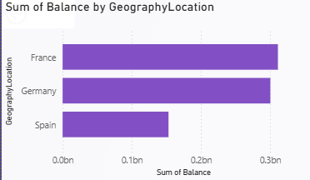
REGIONAL ANALYSIS
Regional Balance Distribution
INSIGHT
France holds the highest total account balance at ≈€0.31 billion, leading all regions
Germany follows closely at ≈€0.30 billion, showing strong balance retention
Spain reports significantly lower balances (≈€0.15bn) — roughly half of France or Germany
Customer balances are heavily concentrated in France and Germany
Total account balance by geography (France, Germany, Spain)
€0.31bn
€0.30bn
€0.15bn
France — Highest
Germany — Close 2nd
Spain — ~Half
BANK CRM CHURN ANALYSIS
10

Slide 11

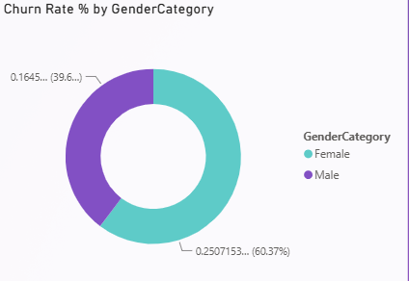
DEMOGRAPHIC ANALYSIS
Churn by Gender
25.07%
16.45%
Female Churn Rate
Male Churn Rate
INSIGHT
Female customers churn at a significantly higher rate (25.07%) than male customers (16.45%)
Female attrition accounts for over 60% of the relative churn proportion between genders
Female-focused engagement is a primary lever to reduce total customer loss
Churn rate by gender, most recent year in the dataset
BANK CRM CHURN ANALYSIS
11

Slide 12


RISK ANALYSIS
Credit Score & Retention
EXIT RATE BY CREDIT-SCORE SEGMENT
INSIGHT
Low Credit Score customers exit at the highest rate — 23.60%, vs. 20.66% (Medium) and 19.35% (High)
Retained customers carry a slightly higher average credit score (651.85) than churned customers (645.35)
The gap is modest (~6.5 points), suggesting credit health is a mild — not dominant — churn signal
Medium Credit Score customers still drive the highest absolute churn volume simply due to segment size
AVERAGE CREDIT SCORE: RETAINED VS. EXITED
651.85
645.35
Avg. Score — Retained
Avg. Score — Exited
BANK CRM CHURN ANALYSIS
12

Slide 13
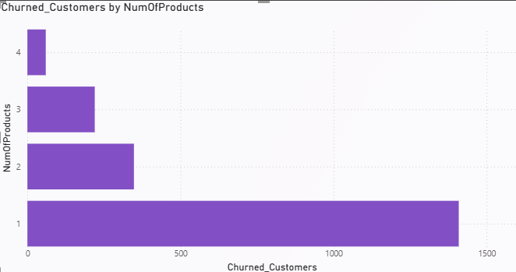
BEHAVIORAL ANALYSIS
Product Usage & Churn
~1,400
1.53
Churned w/ 1 Product
Avg. Products (CC holders)
INSIGHT
The vast majority of churned customers (≈1,400) held only 1 product at the time of exit
Churn volume drops sharply for customers holding 2+ products
Very few customers with 3 or 4 products ever churned
Cross-selling a second product to single-product customers is the clearest lever to cut churn
Number of products held by customers who exited
BANK CRM CHURN ANALYSIS
13

Slide 14
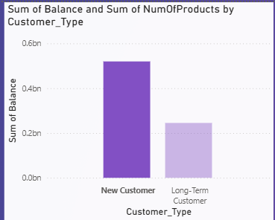
BEHAVIORAL ANALYSIS
Customer Tenure & Loyalty Patterns
INSIGHT
New customers (0–2 years) typically hold only 1 product — still "testing the waters" with the bank
Long-term customers (5+ years) commonly hold 2+ products — a strong indicator of loyalty
Average balances stabilise and grow with tenure, as customers shift from transactional to loyal, high-value clients
RECOMMENDATION
Push targeted cross-selling within the first 12–24 months to build multi-product loyalty early
Reward customers who reach the 5-year tenure mark with milestone loyalty perks
Product holding & balance behaviour by tenure band
BANK CRM CHURN ANALYSIS
14

Slide 15

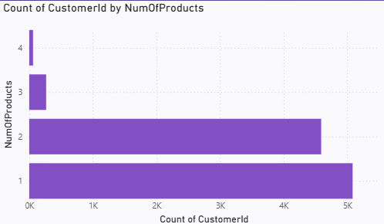
BEHAVIORAL ANALYSIS
Product Affinity & Cross-Sell
INSIGHT
Account + credit card is the bank's strongest natural product pairing
Customers holding exactly 2 products show the lowest churn — the ideal loyalty "sweet spot"
3–4 product combinations are rare and correlate with markedly higher churn, suggesting fee or complexity friction
RECOMMENDATION
Focus cross-selling on credit-card offers for single-product customers
Avoid pushing a 3rd/4th product onto stable 2-product customers
Customer distribution by number of products & credit-card ownership
BANK CRM CHURN ANALYSIS
15

Slide 16

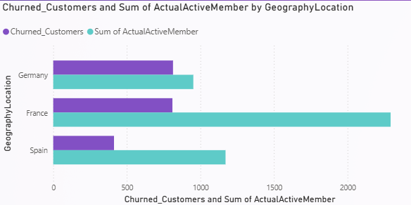
MARKET ANALYSIS
Geographic Market Trends
INSIGHT — THE GERMAN WEALTH PARADOX
Germany holds nearly double the average balance of France or Spain, but shows higher sensitivity to churn among high-net-worth customers
France is the most stable market — moderate balances, but the highest volume of active, long-tenured customers (705 vs. 393 in Spain and 307 in Germany)
Spain mirrors France's balance profile but with a smaller active-account footprint
Average balance & churn by geography
€120K
€62K
€61K
Germany Avg. Balance
France Avg. Balance
Spain Avg. Balance
BANK CRM CHURN ANALYSIS
16

Slide 17

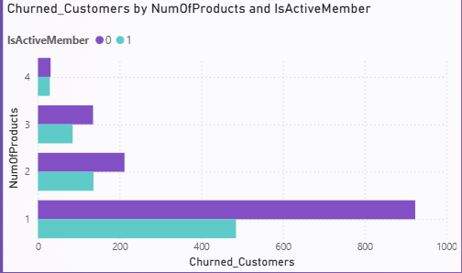
PREDICTIVE VIEW
Key Churn Drivers & Predictors
STRONG PREDICTORS
NumOfProducts & IsActiveMember — the two strongest behavioural predictors of churn
Tenure — moderate, contextual signal (churn clusters around the 5-year mark)
WEAK / NON-PREDICTORS
EstimatedSalary — virtually zero predictive value; high earners churn as often as low earners
No meaningful correlation found between salary and balance, or salary and credit score
Model guidance: weight NumOfProducts & IsActiveMember heavily; de-emphasise EstimatedSalary.
Relative importance of customer attributes in predicting churn
BANK CRM CHURN ANALYSIS
17

Slide 18
SYNTHESIS
Key Insights
Gender gap
Product entanglement
Geography
Female customers churn at 25.07% vs. 16.45% for male customers.
Single-product customers are the single biggest churn & capital-loss group (~€0.5bn lost balance).
France leads in stable, long-tenured active customers; Germany carries the highest capital risk per churn.
Credit health
Tenure
Predictors
Low credit-score customers churn at the highest rate (23.60%), though the effect is moderate.
Average tenure at exit is consistent (~4.8–5 years) across all age groups.
NumOfProducts and IsActiveMember drive churn risk; salary has almost no predictive value.
BANK CRM CHURN ANALYSIS
18

Slide 19
STRATEGY
Recommendations
Drive the second-product strategy
Automate early-warning triggers
Cross-sell credit cards or savings products to single-product customers within their first 12 months — the strongest churn lever available.
Flag customers the moment IsActiveMember shifts to inactive — intervene before formal churn, not after.
Target female-customer retention
Support low credit-score segments
Investigate and address the drivers behind the higher female churn rate with tailored engagement programs.
Offer financial-education and credit-building perks to reduce the elevated churn rate in this tier.
Protect high-value German accounts
Audit the multi-product journey
Deploy premium wealth-management and dedicated relationship managers for Germany's high-balance, high-flight-risk customers.
Review fees and UX for 3–4 product customers, whose churn spikes despite deep entanglement.
BANK CRM CHURN ANALYSIS
19

Slide 20
WRAP-UP
Conclusion
This CRM analysis combined SQL-based data modelling with an interactive Power BI dashboard to explain and predict customer churn across the bank's three core markets.
Identified single-product ownership and inactivity as the leading churn signals
Quantified regional risk — France stable & loyal, Germany high-value but flight-prone
Delivered an interactive dashboard with KPIs and slicers for ongoing monitoring
Translated findings into targeted, actionable retention recommendations
20.4%
€0.5bn
Overall Churn Rate
At-Risk Single-Product Balance
BANK CRM CHURN ANALYSIS
20

Slide 21
Thank You
Presented by Urmila Palwal
Tools Used MySQL • Microsoft Power BI

