Slide 1
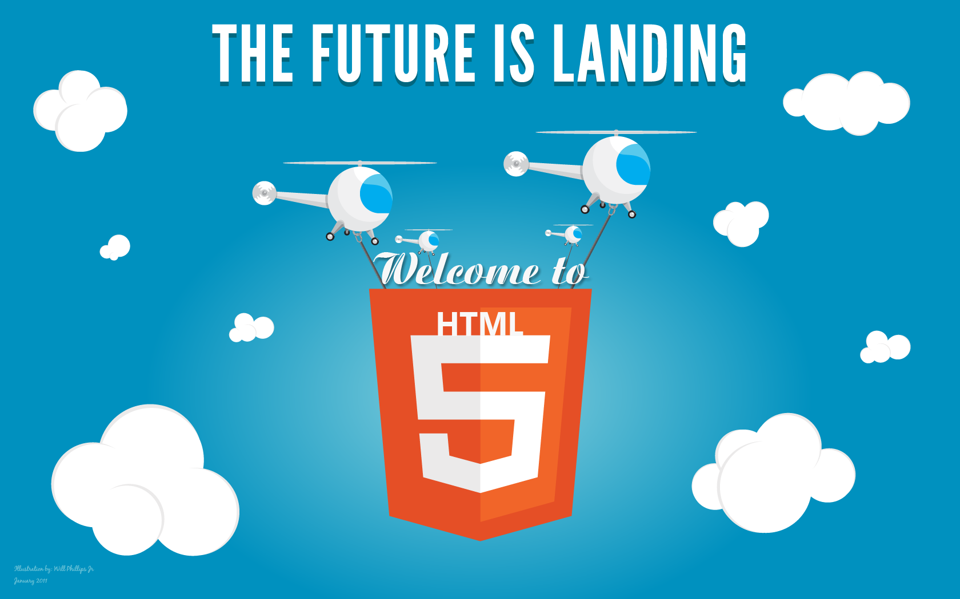
Welcome to

Slide 2

What is HTML5?
HTML5 is the New standards for HTML.
Previous standard that is still in practice is. . . . HTML4 / XHTML1.0.
HTML5 is still a work in progress. However, the major browsers support many of the new HTML5 elements and APIs.
Browser Support for HTML5
HTML5 is not yet an official standard, and no browsers have full HTML5 support.
But all major browsers (Safari, Chrome, Firefox, Opera, Internet Explorer) continue to add new HTML5 features to their latest versions.

Slide 3
What’s New in HTML5?
New Semantic/Structural Elements
Video and Audio
2D/3D Graphics
New Input Types
New Attributes
New Form Elements
Local Storage
Local SQL Database
Drag and Drop
Geolocation
Web Workers

Slide 4
How Did HTML5 Get Started?
Minimum HTML5 Document
<!DOCTYPE html>
<html>
<head>
<title>Title of the document</title>
<!--[if IE]>
<script type="text/javascript" src="js/html5.js"></script>
<![endif]-->
</head>
<body>
The content of the document......
</body>
</html>

Slide 5
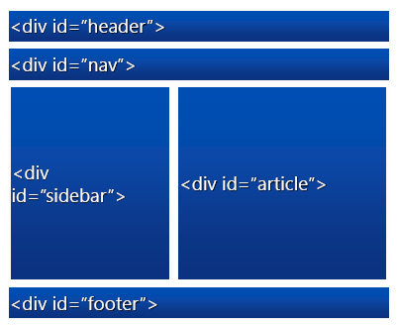
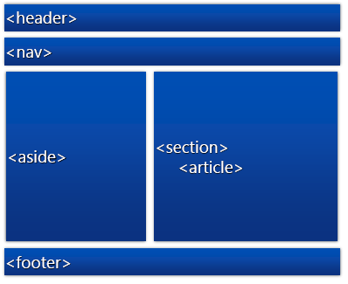
New Semantic/Structural Elements
HTML Tags
New Semantic HTML Elements

Slide 6
New Semantic/Structural Elements
<header> | Defines a header for a document or section
<nav> | Defines navigation links
<section> | Defines a section in a document
<article> | Defines an article
<aside> | Defines content aside from the page content
<details> | Defines additional details that the user can view or hide
<dialog> | Defines a dialog box or window
<summary> | Defines a visible heading for a <details> element
<footer> | Defines a footer for a document or section

Slide 7
New Semantic/Structural Elements
<mark> | Defines marked/highlighted text
<meter> | Defines a scalar measurement within a known range (a gauge)
<progress> | Represents the progress of a task
<time> | Defines a date/time
<figure> | Specifies self-contained content, like illustrations, diagrams, photos, code listings, etc.
<figcaption> | Defines a caption for a <figure> element
<wbr> | Defines a possible line-break

Slide 8
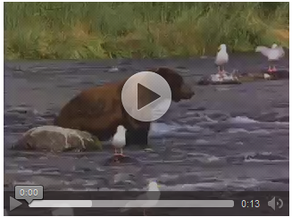
Video and Audio
Video Element
Today, most videos are shown through a plug-in (like flash). However, different browsers may have different plug-ins.
HTML5 defines a new element which specifies a standard way to embed a video/movie on a web page: the <video> element.
How It Works
<video width="320" height="240" controls>
<source src="movie.mp4" type="video/mp4">
<source src="movie.ogg" type="video/ogg">
Your browser does not support the video tag.
</video>
For more info: http://www.w3schools.com/html/html5_video.asp

Slide 9

Video and Audio
Audio Element
Today, most audio files are played through a plug-in (like flash). However, different browsers may have different plug-ins.
HTML5 defines a new element which specifies a standard way to embed an audio file on a web page: the <audio> element.
How It Works
<audio controls>
<source src="horse.ogg" type="audio/ogg">
<source src="horse.mp3" type="audio/mpeg">
Your browser does not support the audio element.
</audio>
For more info: http://www.w3schools.com/html/html5_audio.asp

Slide 10

2D/3D Graphics
Using Canvas?
The HTML5 <canvas> element is used to draw graphics, on the fly, via scripting (usually JavaScript).
The <canvas> element is only a container for graphics. You must use a script to actually draw the graphics.
How It Works
<canvas id="myCanvas" width="200" height="100" style="border:1px solid #c3c3c3;">
Your browser does not support the HTML5 canvas tag.
</canvas>
<script>
var c=document.getElementById("myCanvas");
var ctx=c.getContext("2d");
ctx.fillStyle="#FF0000";
ctx.fillRect(0,0,150,75);
</script>
For more info: http://www.w3schools.com/html/html5_canvas.asp

Slide 11
2D/3D Graphics
Using SVG
SVG stands for Scalable Vector Graphics
SVG is used to define vector-based graphics for the Web
SVG defines the graphics in XML format
SVG graphics do NOT lose any quality if they are zoomed or resized
Every element and every attribute in SVG files can be animated
SVG is a W3C recommendation
SVG Advantages
SVG images can be created and edited with any text editor
SVG images can be searched, indexed, scripted, and compressed
SVG images are scalable
SVG images can be printed with high quality at any resolution
SVG images are zoomable (and the image can be zoomed without degradation)
For more info: http://www.w3schools.com/html/html5_svg.asp

Slide 12

2D/3D Graphics
Example
<svg xmlns="http://www.w3.org/2000/svg" version="1.1" height="190">
<polygon points="100,10 40,180 190,60 10,60 160,180"
style="fill:lime;stroke:purple;stroke-width:5;fill-rule:evenodd;">
</svg>
For more info: http://www.w3schools.com/html/html5_svg.asp

Slide 13



New Input Types
Color | Gives the end user a native color picker to choose a color.
Color <input type="color" name="color">
Date | Offers a datepicker.
Date <input type="date" name="date">
datetime | An element to choose both date and time.
datetime-local | An element to choose both date and time, with local timezone.
Date time-local <input type="datetime-local" name="datetime-local">

Slide 14




New Input Types
email | A field for entering e-mail address(es).
Email <input type="email" name="email">
month | Choose a full month.
Month <input type="month" name="month">
number | Picking a number user can select max and min value.
Number <input type="number" name="number">
range | Offers a slider to select the value.
Range <input type="range" id="range" name="range">

Slide 15



New Input Types
search | An input type for search field used for site search.
Search <input type="search" name="search" results="5" >
tel | Choosing a telephone number.
Tel <input type="tel" name="usrtel">
time | Input a certain time.
Time <input type="time" name="time">
url | Entering a URL.
Url <input type="url" name="url">

Slide 16

New Input Types
week | Picking a specific week.
Week <input type="week" name="week">

Slide 17


New Attributes
autocomplete | An option to turn off automatic form completion of values for a field. Possible values are “on” and “off”.
Autocomplete <input type="text" name="autocomplete" autocomplete="on">
autofocus | Whether focus should be set to this field as soon as it has loaded.
Autofocus <input type="text" name="autofocus" autofocus>
formaction | Formaction attribute specify the url of the file,when the form is submitted it will redirect to that url.
Formaction <input type="submit" formaction="http://www.google.com/" value="Save">

Slide 18
New Attributes
formenctype | The formenctype attribute specify the encoding type of the form data when the form is submitted.
Formenctype <input type="submit" formenctype="application/x-www-form-urlencoded" value="Save">
formmethod | It specify the HTTP method to send the form data to server.
Formmethod <input type="submit" formmethod="POST" value="Send as POST">
formnovalidate | Append to a submit button to bypass form validation.
Formnovalidate <input type="submit" formnovalidate value="Don't validate">

Slide 19


New Attributes
formtarget | For buttons that submit a form to be able to override the form’s target attribute.It specify where to display response that is received.
Formtarget <input type="submit" formtarget="_blank" value="Post to new tab/window">
max | Maximum value for the value that can be put in.
Max <input type="range" id="range3" max="90">
min | Minimum value for the value that can be put in.
Min <input type="range" id="range4" min="10">

Slide 20

New Attributes
multiple | Allows for selection of multiple files for <input type=”file”> elements, and for multiple e-mail addresses separated by a comma.
Multiple <input type="file" multiple>
novalidate | Applies only to the <form> element, bypass all the validation before submitted.
novalidate <form action="demo_form.asp" novalidate>
pattern | It specify the custom validation pattern.
Pattern <input type="text" pattern="[A-Z]*">

Slide 21

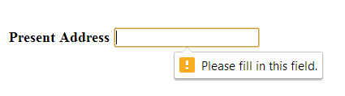
New Attributes
placeholder | Meant to be able to display a hint to the end user what to input. (Side note: I wrote a blog post discussing the desired behavior of the placeholder attribute)
Placeholder <input type="text" name="placeholder" placeholder="Enter your Designation">
readonly | If a field should be readonly.
Readonly <input type="text" readonly>
required | For required field validation.
Required <input type="text" name="required" required>
spellcheck | It is boolean property when it is on browser will perfom spellcheck for the input
Spellcheck <input type="text" spellcheck="true">

Slide 22
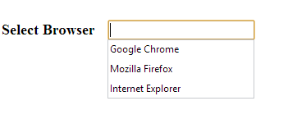
New elements
datalist | Contains a number of <option> elements with values that can be used as suggestions for other form elements through the usage of the list attribute on them.
DataList <input type="text" name="characters" list="data-list"> <datalist id="data-list"> <option value="Google Chrome"> <option value="Mozilla Firefox"> <option value="Internet Explorer"> </datalist>
keygen | Offers a way to create a public/private key pair.The private key is stored locally and public key is sent to the server.
keygen <keygen name="key"></keygen>

Slide 23



New elements
meter | The meter element is for displaying values on a bar, where you can custom control min, max and assigned value.
Meter <meter min="0" max="10" value="4"></meter>
output | It is used to show output of a calculation in the page
Output <input id="a" type="number" value="1" /> <input id="b" type="number" value="1" /> <output for="a b" id="output"></output>
progress | It is used to indicate progress of any kind in a web page, for instance file upload progress.
Progress <progress max="100" value="70"></progress>

Slide 24
Web Storage
In HTML5 web pages can store data locally within user's browser.
Earlier this was done with cookies.However webstore is more secure and faster.
The data is stored in key/value pairs.
There are two new objects for storing data on the client.
localStorage- It stores data with no expiration date
sessionStorage -stores data for one session.
For more info: https://developer.mozilla.org/en-US/docs/Web/Guide/HTML/HTML5

Slide 25
Web Storage
Local Storage
Set value in Local Storage
localStorage.lastname='Patel';
Get value from Local storage
Var Lastname=localStorage.lastname;
Session Storage
Set data to session :
  sessionStorage.Firstname ='Abhishek';
Get data from session :
  var strFirstName= sessionStorage.Firstname;
For more info: https://developer.mozilla.org/en-US/docs/Web/Guide/HTML/HTML5

Slide 26
Web Sql Storage
Web Sql storage allows user to create database and perform sql query at clientside.
There are three methods
  openDatabase:This method creates the database.
  var db = openDatabase('mydb', '1.0', 'Test DB', 2 * 1024 * 1024);
  This method took following parameters
  Databasename,Version,Description and Size of database
  transaction:This method gives ability to control a transaction and performing the either commit or rollback depending on the situation.
  executesql:This method is used to execute actual sql query.
  db.transaction(function (tx) {
  tx.executeSql('CREATE TABLE IF NOT EXISTS Employee (id unique, Name)');
tx.executeSql('INSERT INTO Employee (id, log) VALUES (1, "Abhishek")');
  });
For more info: https://developer.mozilla.org/en-US/docs/Web/Guide/HTML/HTML5

Slide 27
Drag and Drop
HTML5 supports drag and drop function.
To make an element draggable, set draggable attribute true.
<img draggable="true">
Drag and drop functionality is achieved by handling the following methods
ondragstart :This event fire when the element is dragged
ondragover:This event specifies where the dragged data to be dropped.
ondrop:This event fires when the element is dropped.
For more info: https://developer.mozilla.org/en-US/docs/Web/Guide/HTML/HTML5

Slide 28
Geolocation
The HTML5 Geolocation API is used to get the geographical position of the user.
Due to privacy the geographical position of the user isnot available until the user approves it.
getCurrentPosition() method is used to get user's current position
position.coords.latitude attribute is used to get latitude
position.coords.longitude attribute is used to get longitude
Example:
<script>
function getLocation() {
if (navigator.geolocation) {
navigator.geolocation.getCurrentPosition(showPosition);
}
return false;
}
function showPosition(position) {
alert(position.coords.latitude);
alert(position.coords.longitude);
}
</script>
For more info: https://developer.mozilla.org/en-US/docs/Web/Guide/HTML/HTML5

Slide 29
Web Workers
A web worker is a javascript running in the background, without affecting the performance of the page.
Currently when executing the script in HTML page,the page becomes unresponsive until the script is finished.
A webworker is the javascript that runs in the background independently of other scripts without affecting the performance of the page.
Syntax:
  For Start
  var w=new Worker(“Your javascript path”);
  For Stop
  w.terminate();
For more info: https://developer.mozilla.org/en-US/docs/Web/Guide/HTML/HTML5

Slide 30
Useful Links
http://www.w3schools.com/html/html5_intro.asp
https://developer.mozilla.org/en-US/docs/Web/Guide/HTML/HTML5
http://robertnyman.com/2011/08/16/html5-forms-input-types-attributes-and-new-elements-demos-tips-and-tricks/
http://mobilehtml5.org/
http://html5please.com/#showall
For check browser support
http://fmbip.com/litmus/
http://html5test.com/index.html
http://caniuse.com/

