Slide 1
MIALab Project – Group 2
Cyril Albrecht, Quentin Savary, Valerio Mollet

Slide 2
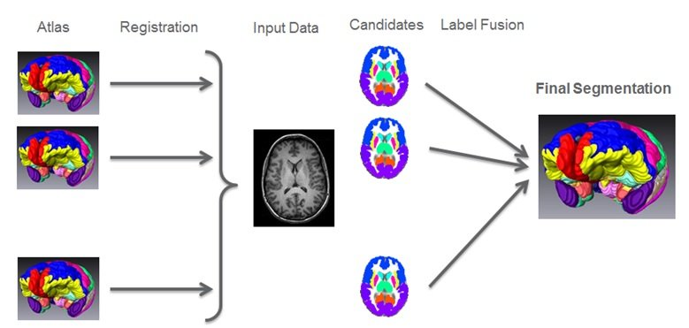
Global Weighted Voting
Principle is similar to majority voting
Weighting by similarity Measurement with target
Mean square difference as similarity Measurement

Slide 3
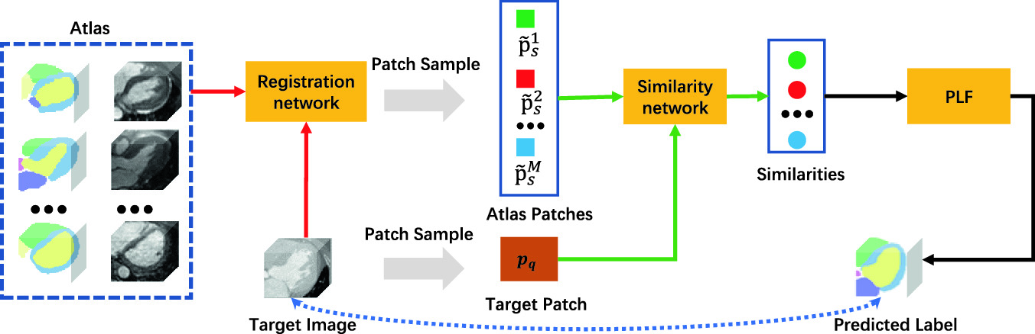
Local Weighted Voting
Principle is similar to global voting
Weighting by similarity Measurement with target
Square difference as similarity Measurement
LWV

Slide 4
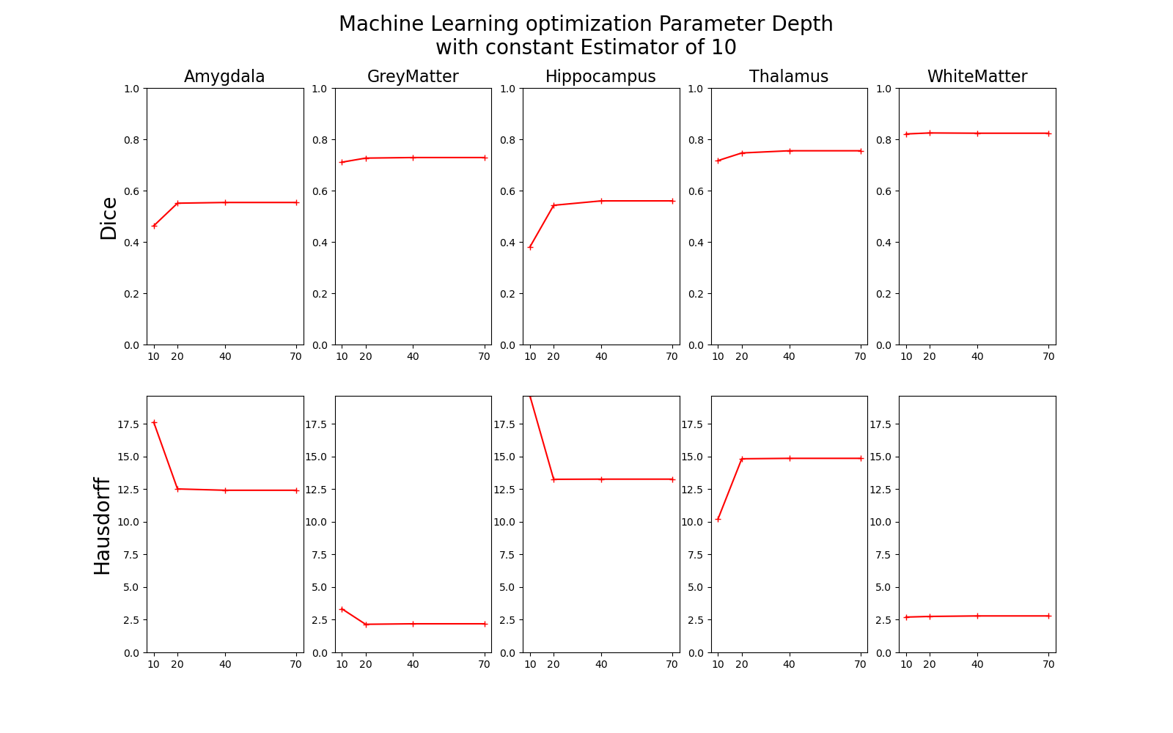
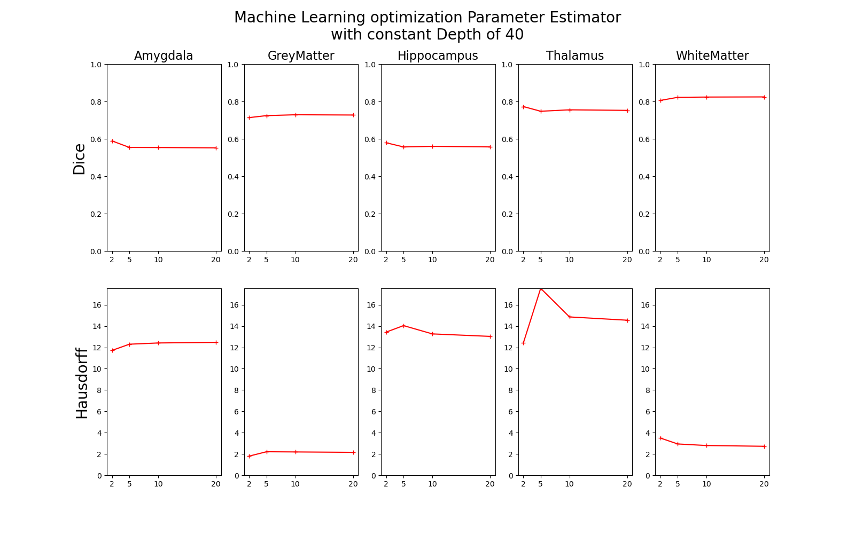
Machine Learning
Machine learning based on random forest decision tree
Optimization of Parameters depth and estimator

Slide 5
Registration
Affine
Rotation, Translation and Scaling
Already existed
Non-rigid
Compensate free form deformation
B-Spline Registration
SimpleElastix Library

Slide 6
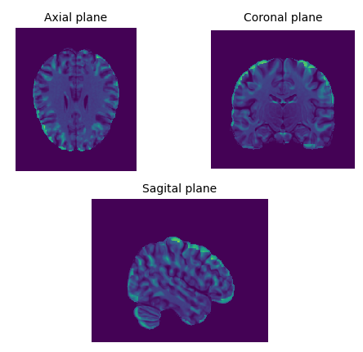
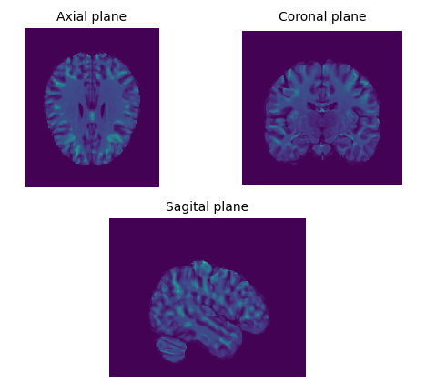
Registration
Affine Registration
Non-Rigid Registration

