Slide 1
MIALab Project – Group 2
Cyril Albrecht, Quentin Savary, Valerio Mollet

Slide 2
Table of content
Hypothesis
Segmentation
Registration
Results
Conclusion
Questions

Slide 3
Hypothesis
“Atlas based segmentation consists of a powerful baseline for brain tissue segmentation when compared to a ML based approach”
Main focus on segmentation types
Segmentation depends on registration

Slide 4
Segmentation
Atlas-based
Multi-atlas
Majority voting
Shape-based averaging
Global/local weighted voting
Machine learning
Random forest (estimators=10, depth=40)

Slide 5
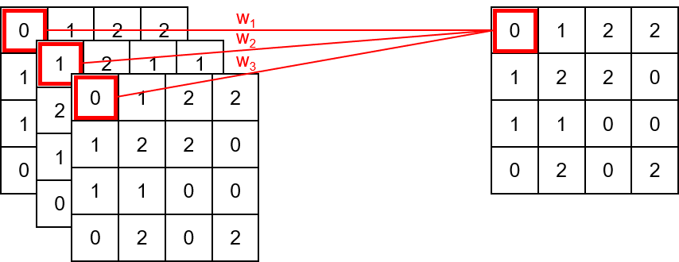
Segmentation (Majority Voting)
w_{i} = 1
Multiple atlas
Atlas fusion

Slide 6
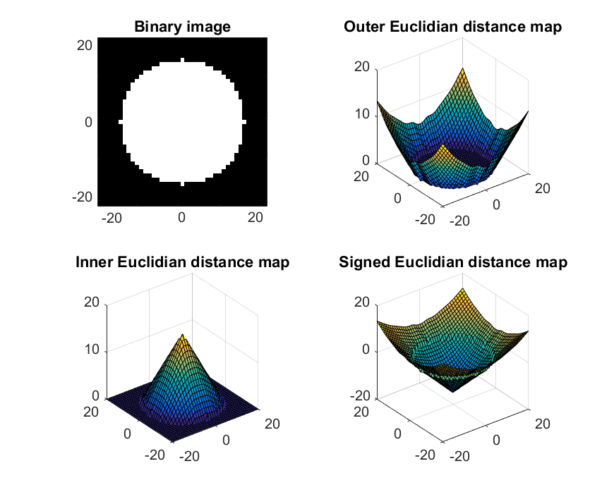
Segmentation (Shape-based Averaging)
Assign for each pixel the label that minimize the sum of signed Euclidian distance map (SED).
Less fragmented result.
(Adapted from Rohlfin and al, 2007)

Slide 7
Segmentation (Global Weighted Voting)
Principle is similar to majority voting
Weighting by similarity Measurement with target
Mean square difference as similarity Measurement
0
1
2
2
W₁=0.2
1
2
1
1
W₂=0.6
1
1
2
1
1
W₃=0.2
2
2
2
2
0
2
1
2
0
1
2
2
1
1
0
2
0
0
0
1
1
0
0
1
1
2
2
0
0
2
1
0
0
2
0
0
2
0
2
0
1
1
0
0
2
0
2
0
2
0
2
Similarity Measurment T1w and T2w with target

Slide 8
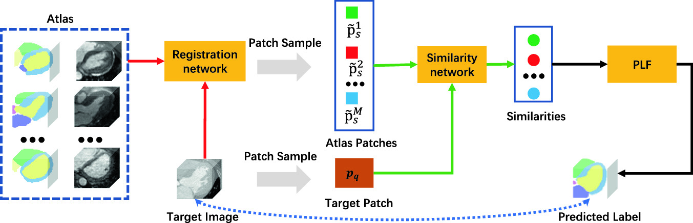
Segmentation (Local Weighted Voting)
Principle is similar to global voting
Weighting by similarity Measurement with target
Square difference as similarity Measurement
LWV

Slide 9
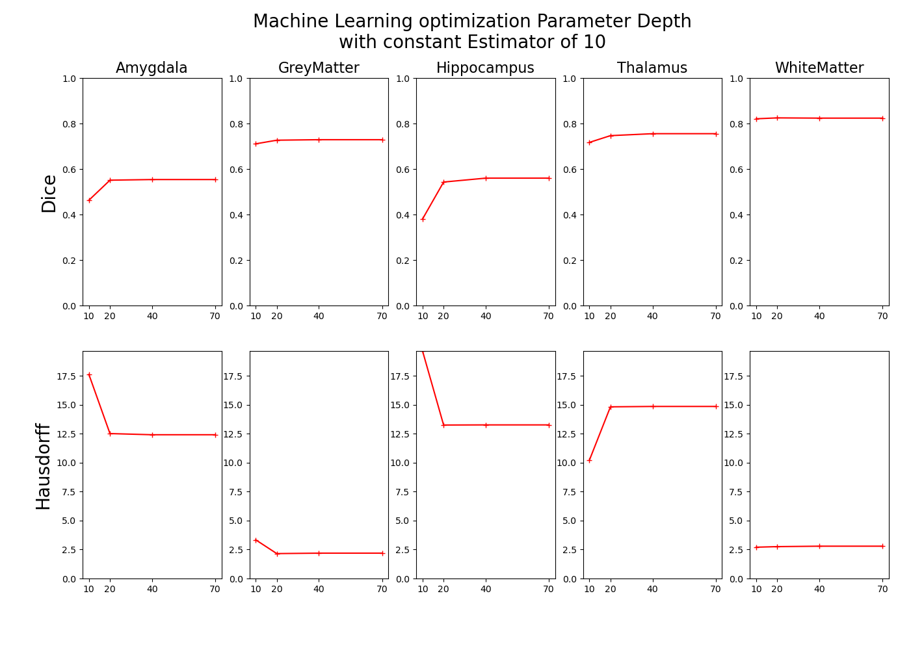
Machine Learning
Machine learning based on random forest
Optimization of Parameters depth and estimator

Slide 10
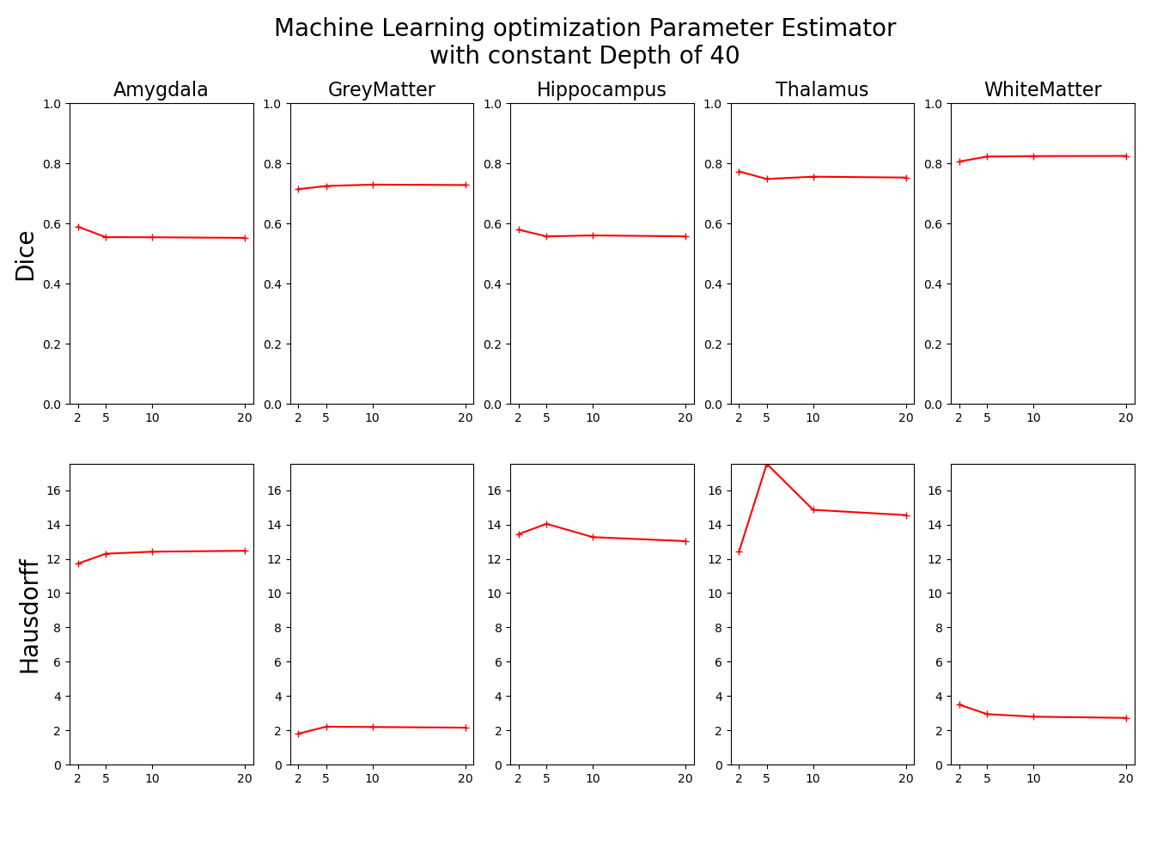
Machine Learning
Machine learning based on random forest
Optimization of Parameters depth and estimator

Slide 11
Registration
Affine
Rotation, Translation and Scaling
Already existed
Non-rigid
Compensate free form deformation
B-Spline Registration
SimpleElastix Library

Slide 12
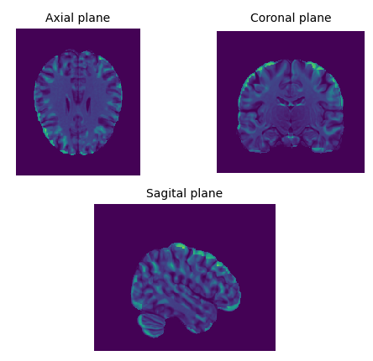
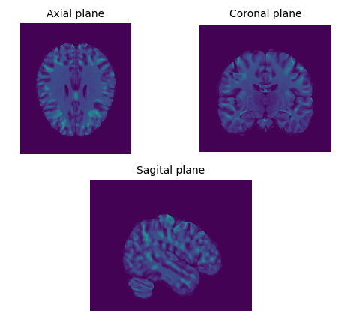
Registration
Affine Registration
Non-Rigid Registration

Slide 13
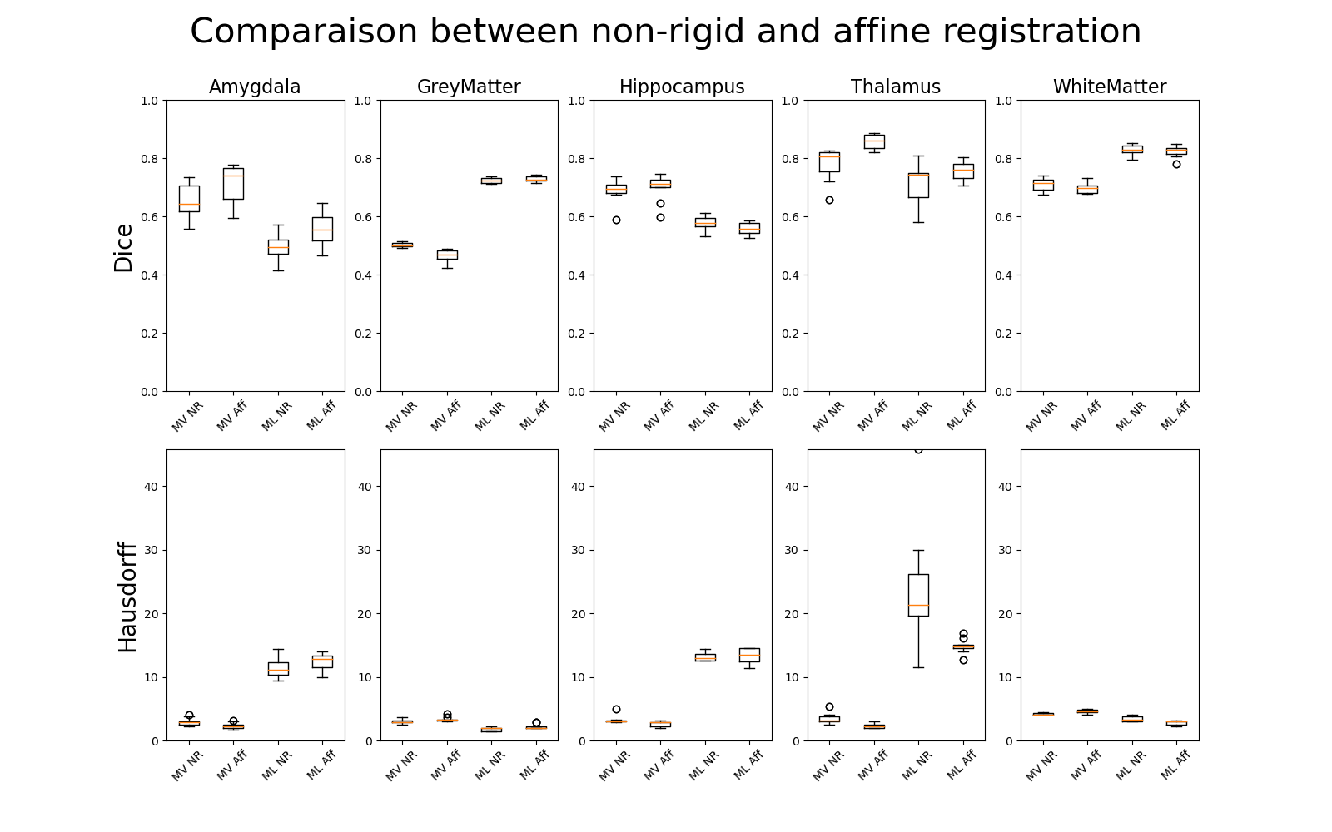
Results – Non-rigid vs affine
MV: majority voting
ML: machine learning
NR: non-rigid
Aff: affine

Slide 14
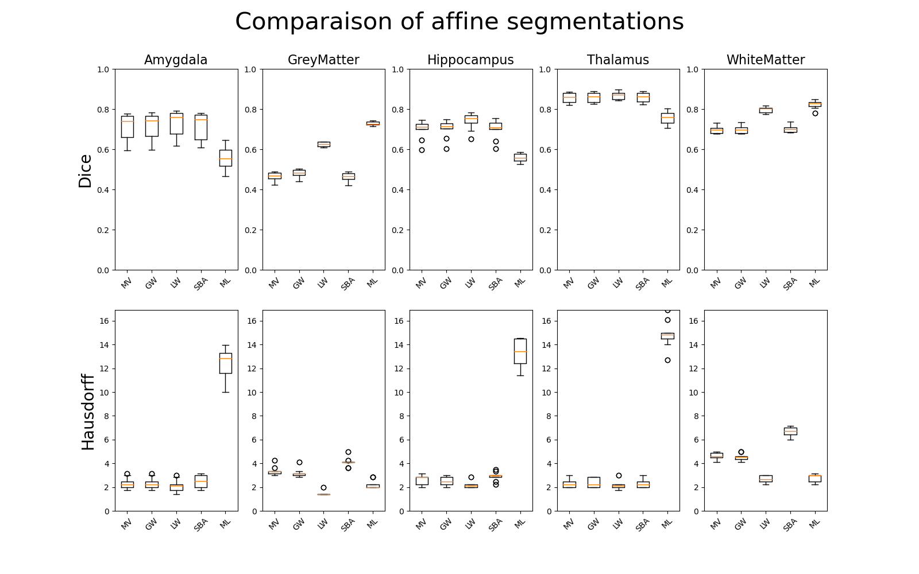
Results – Affine registration
MV: majority voting
GW: global weights
LW: local weights
SBA: shape based averaging
ML: machine learning

Slide 15
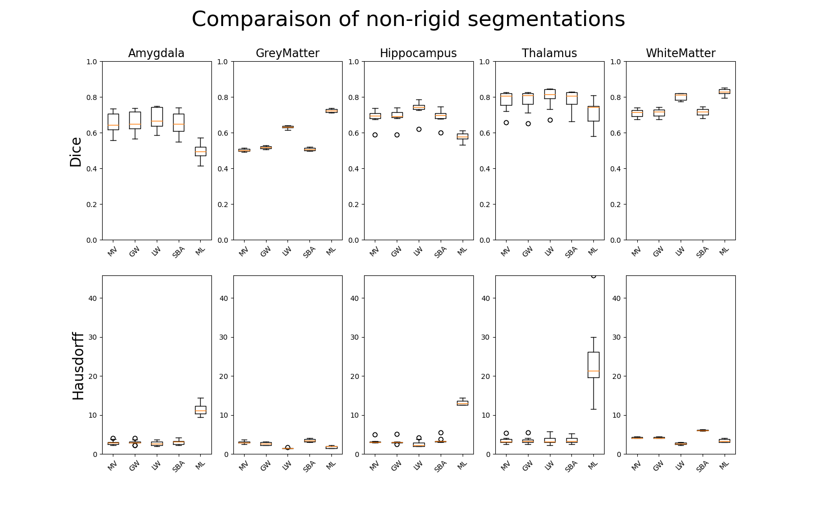
Results – Non-rigid registration
MV: majority voting
GW: global weights
LW: local weights
SBA: shape based averaging
ML: machine learning

Slide 16
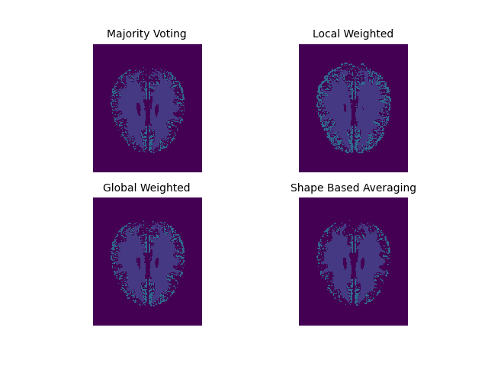
Conclusion
Minor difference between non-rigid and affine registration
Machine learning struggles with small brain parts
Atlas-based segmentation with local weights works best

Slide 17
Outlook
Final report redaction
Clean source code
Hybrid solution:
Machine learning for grey and white matter
Atlas-based for amygdala, hippocampus and thalamus
Further machine learning algorithms

Slide 18

Questions

