Slide 1
MIALab Project – Group 2
Cyril Albrecht, Quentin Savary, Valerio Mollet

Slide 2
Table of content
Hypothesis
Segmentation
Registration
Preliminary results
Current state
Outlook
Questions

Slide 3
Hypothesis
“Atlas based segmentation consists of a powerful baseline for brain tissue segmentation when compared to an ML based approach”
Main focus on segmentation types
Segmentation depends on registration

Slide 4
Segmentation
Machine learning
Random forest (estimators=10, depth=40)
Atlas-based
Single atlas
Multi-atlas
Majority voting
Shape-based averaging
Global/local weighted voting

Slide 5
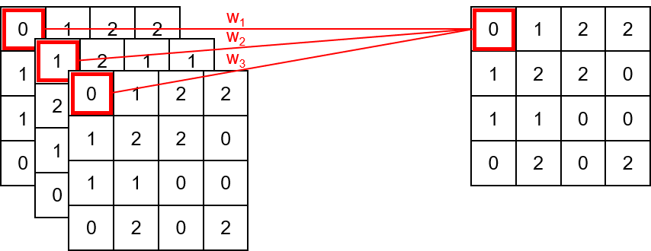
Multi-atlas fusion (Majority Voting)
w_{i} = 1
Multiple atlas
Atlas fusion

Slide 6
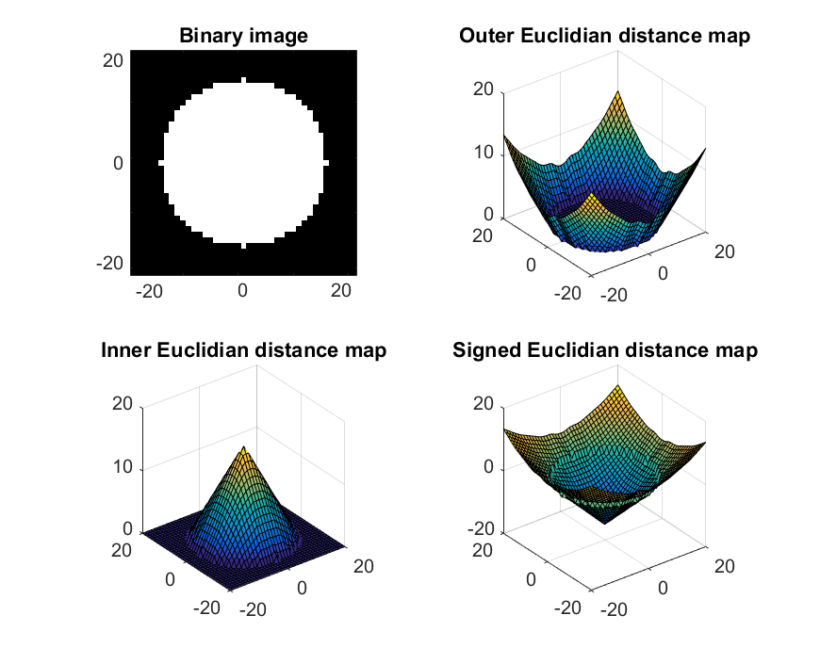
Multi-atlas fusion (Shape-based Averaging)
Assign for each pixel the label that minimize the sum of signed Euclidian distance map (SED).
Less fragmented result.
(Adapted from Rohlfin and al, 2007)

Slide 7
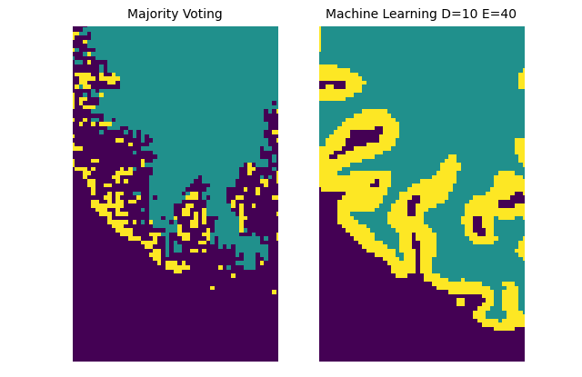
Machine Learning vs Majority Voting

