Slide 1
MIALab Project – Group 2
Cyril Albrecht, Quentin Savary, Valerio Mollet

Slide 2
Table of content
Hypothesis
Segmentation
Registration
Preliminary results
Current state
Outlook
Questions

Slide 3
Hypothesis
“Atlas based segmentation consists of a powerful baseline for brain tissue segmentation when compared to an ML based approach”
Main focus on segmentation types
Segmentation depends on registration

Slide 4
Segmentation
Machine learning
Decision forest
Atlas-based
Single atlas
Multi-atlas
Majority voting
Global/local weighted voting
Shape-based averaging

Slide 5
Registration
Affine
Rotation, Translation and Scaling
Already existed
Non-rigid
Compensate free form deformation
B-Spline Registration
SimpleElastix Library

Slide 6
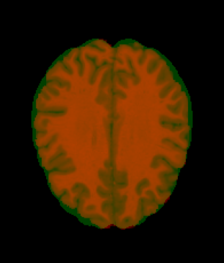
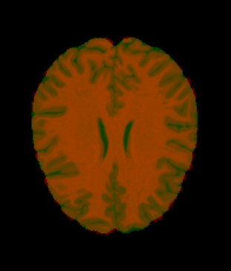
Registration
Affine Registration
Non-Rigid Registration

Slide 7
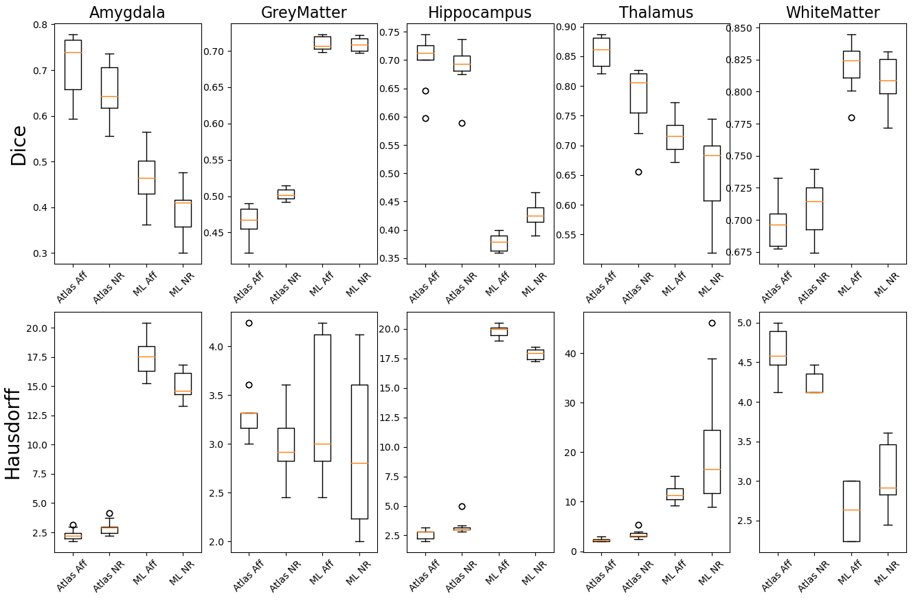
Preliminary results

Slide 8
Current state
Implementation of non-rigid registration
Implementation of majority voting atlas-based segmentation
Comparison of the four different solution
ML-based segmentation with affine registration
ML-based segmentation with non-rigid registration
Atlas-based segmentation with affine registration
Atlas-based segmentation with non-rigid registration

Slide 9
Outlook
More altas building techniques
More ML segmentation types
Uniformize result plot
Eventually hybrid solution
ML for grey and white matter
Atlas for amygdala, hippocampus and thalamus

Slide 10

Questions

