Slide 1
MIALab Project – Group 2
Cyril Albrecht, Quentin Savary, Valerio Mollet

Slide 2
Table of content
Hypothesis
Segmentation
Registration
Results
Conclusion
Questions

Slide 3
Hypothesis
“Atlas based segmentation consists of a powerful baseline for brain tissue segmentation when compared to a ML based approach”
Main focus on segmentation types
Segmentation depends on registration

Slide 4
Segmentation
Atlas-based
Multi-atlas
Majority voting
Shape-based averaging
Global/local weighted voting
Machine learning
Random forest (estimators=10, depth=40)

Slide 5
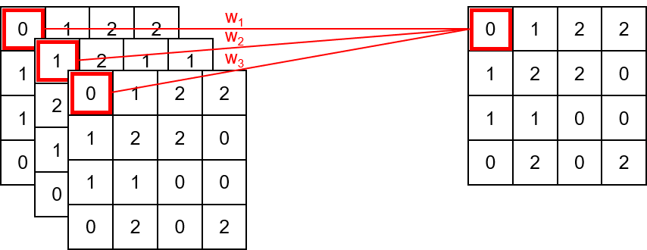
Segmentation - Majority Voting
w_{i} = 1
Multiple atlas
Atlas fusion

Slide 6
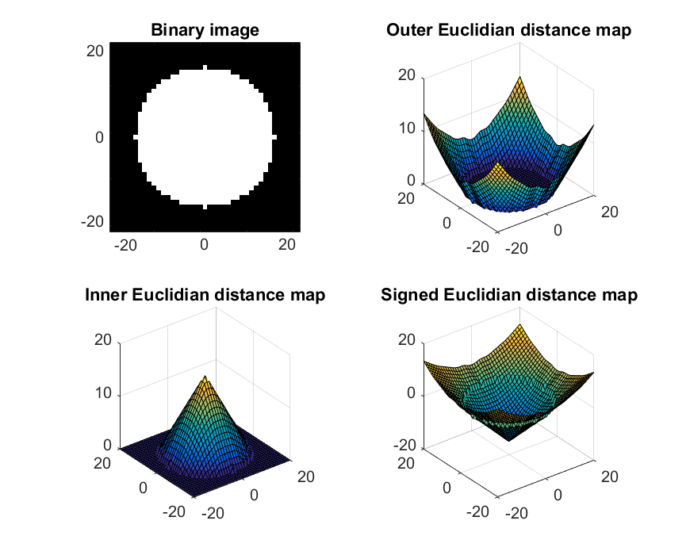
Segmentation - Shape-based Averaging
Assign for each pixel the label that minimize the sum of signed Euclidian distance map (SED).
Less fragmented result.
(Adapted from Rohlfin and al, 2007)

Slide 7
Segmentation - Global Weighted Voting
Principle is similar to majority voting
Weighting by similarity Measurement with target
Mean square difference as similarity Measurement
0
1
2
2
W₁=0.2
1
2
1
1
W₂=0.6
1
1
2
1
1
W₃=0.2
2
2
2
2
0
2
1
2
0
1
2
2
1
1
0
2
0
0
0
1
1
0
0
1
1
2
2
0
0
2
1
0
0
2
0
0
2
0
2
0
1
1
0
0
2
0
2
0
2
0
2
Similarity Measurment T1w and T2w with target

Slide 8
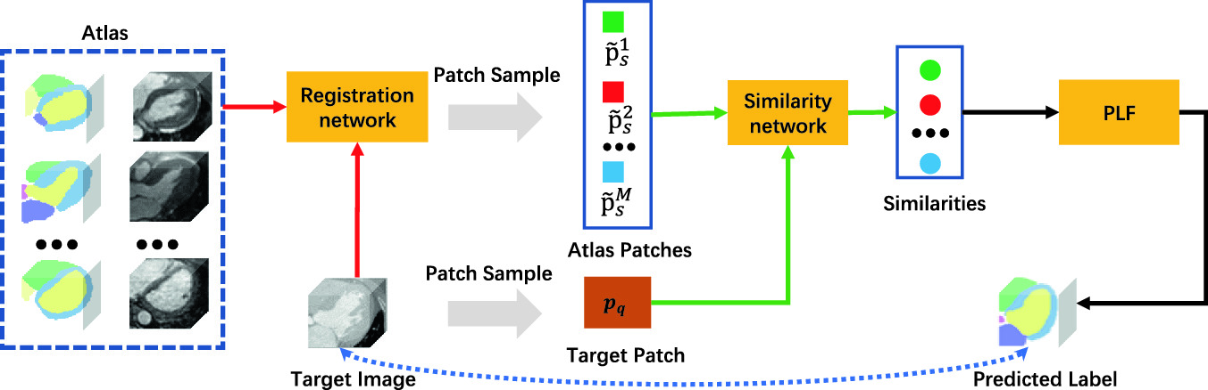
Segmentation - Local Weighted Voting
Principle is similar to global voting
Weighting by similarity Measurement with target
Square difference as similarity Measurement
LWV
(https://link.springer.com/chapter/10.1007%2F978-3-030-59716-0_23)

Slide 9
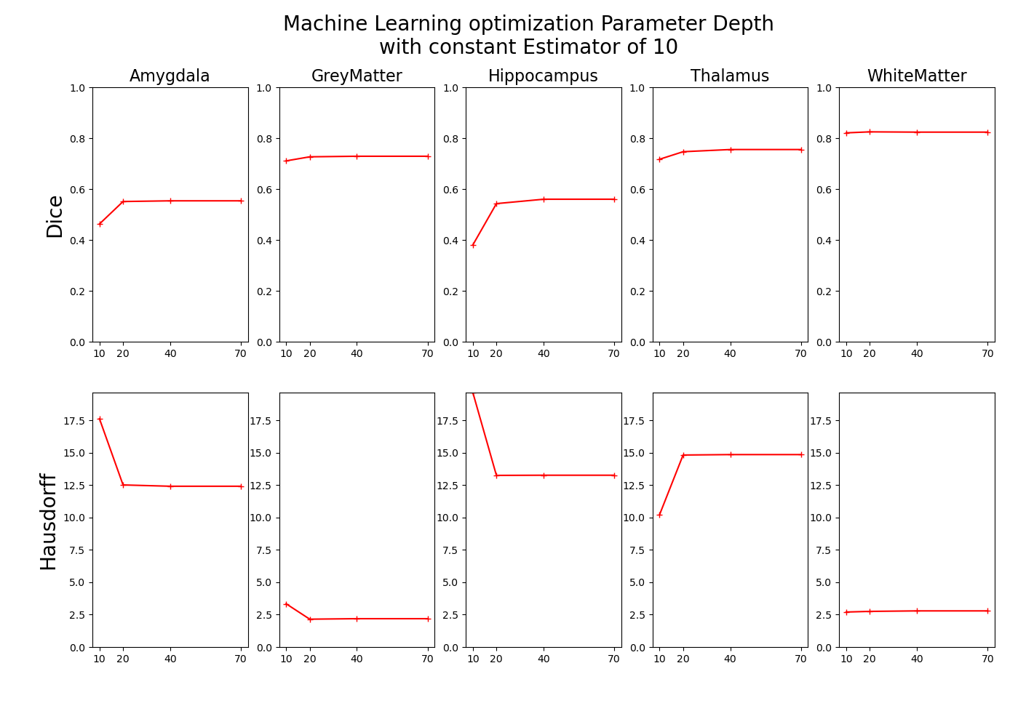
Segmentation - Machine Learning
Machine learning based on random forest
Optimization of Parameters depth and estimator

Slide 10
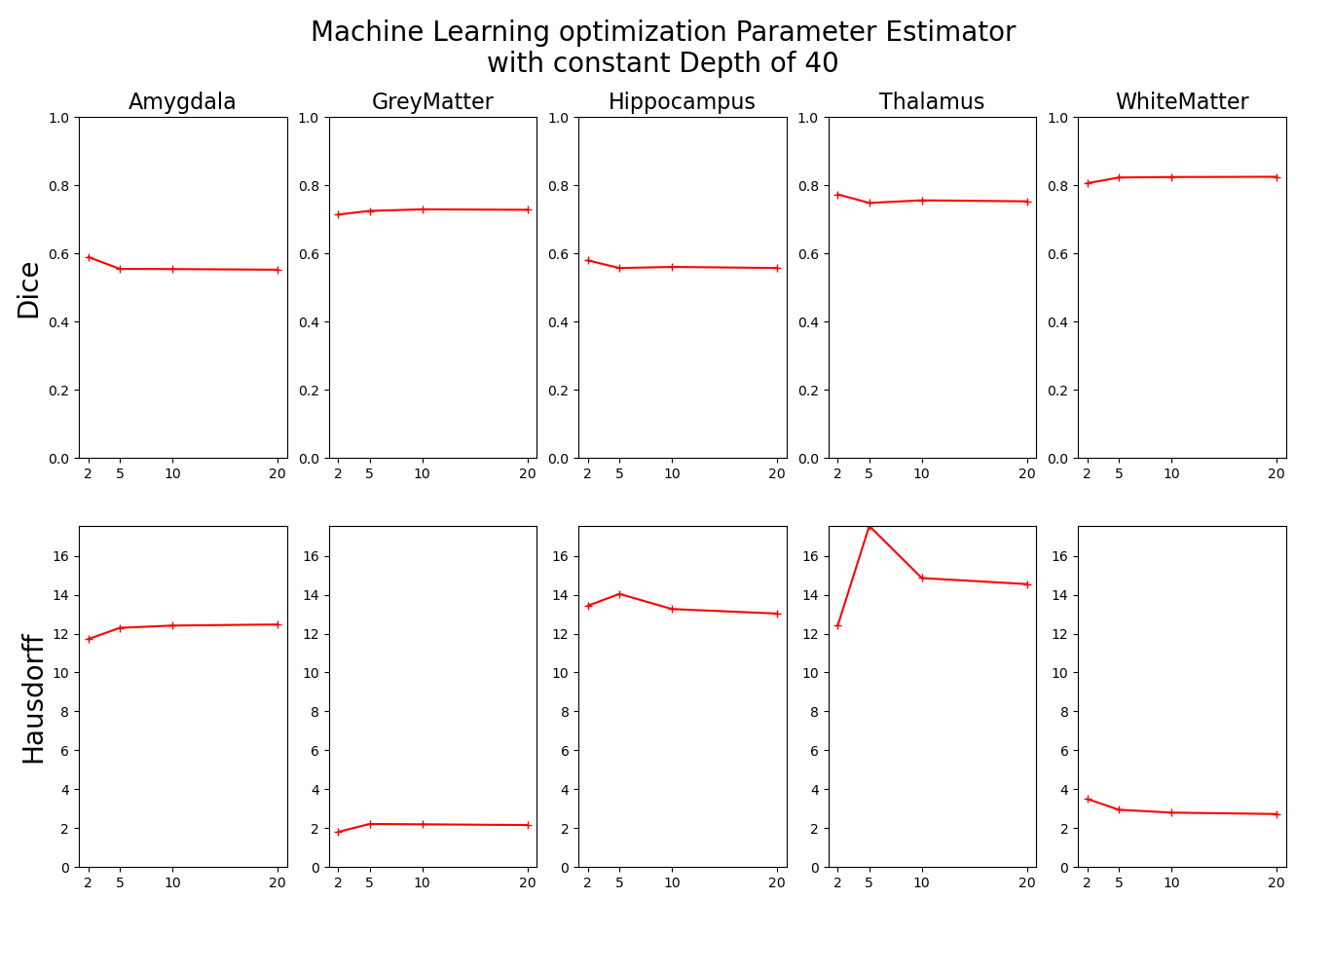
Segmentation - Machine Learning
Machine learning based on random forest
Optimization of Parameters depth and estimator

Slide 11
Registration
Affine
Rotation, Translation and Scaling
Already existed
Non-rigid
Compensate free form deformation
B-Spline Registration
SimpleElastix Library

Slide 12
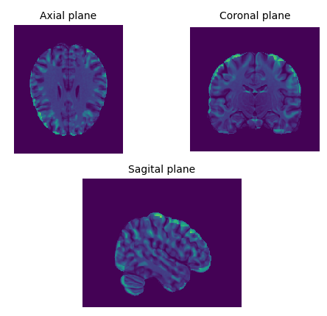
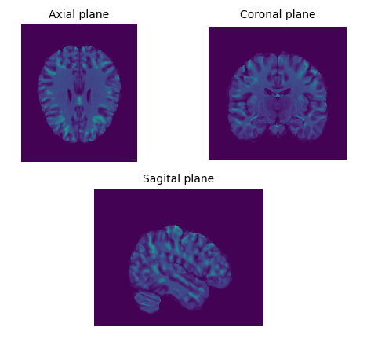
Registration
Affine Registration
Non-Rigid Registration

Slide 13
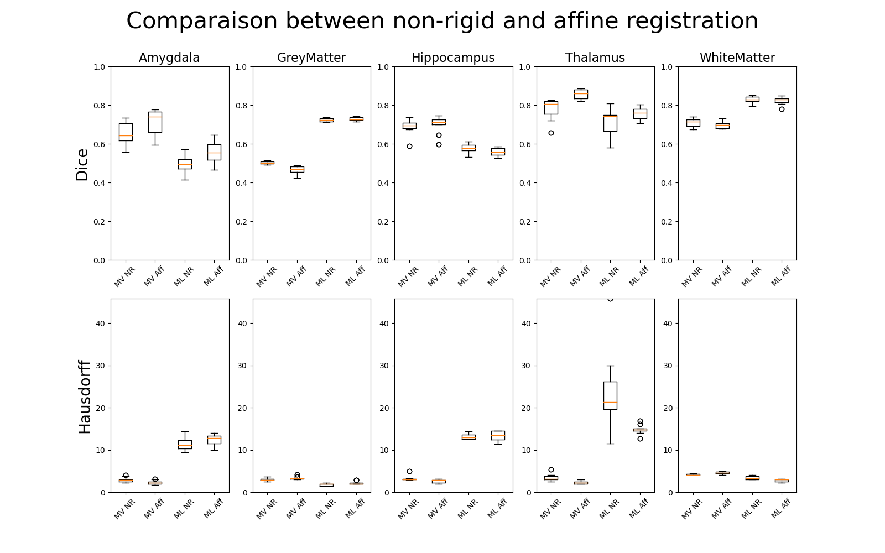
Results – Non-rigid vs affine
MV: majority voting
ML: machine learning
NR: non-rigid
Aff: affine

Slide 14
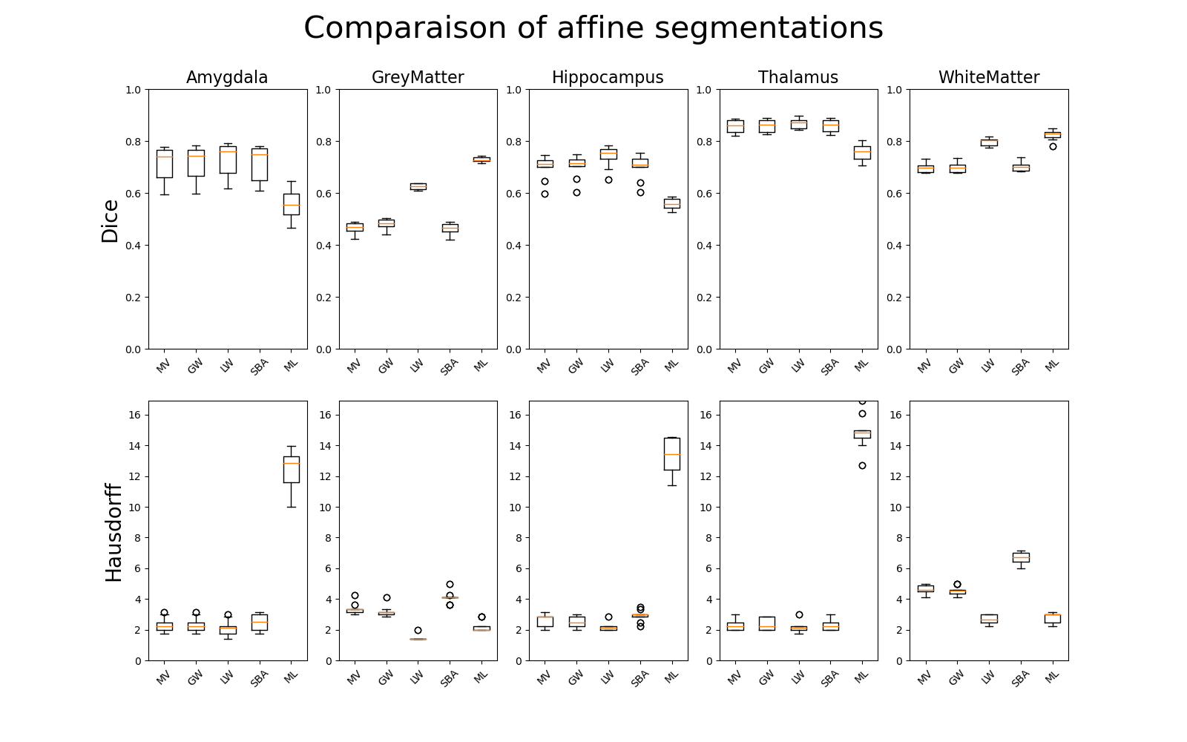
Results – Affine registration
MV: majority voting
GW: global weights
LW: local weights
SBA: shape based averaging
ML: machine learning

Slide 15
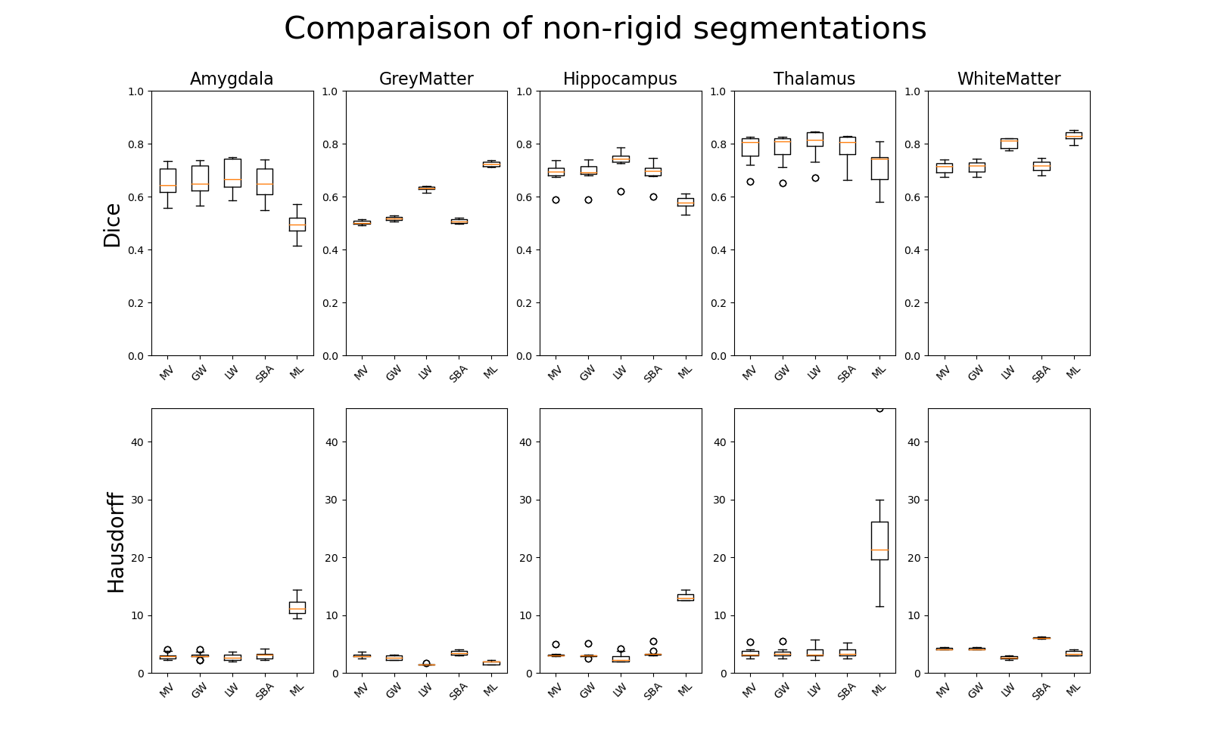
Results – Non-rigid registration
MV: majority voting
GW: global weights
LW: local weights
SBA: shape based averaging
ML: machine learning

Slide 16
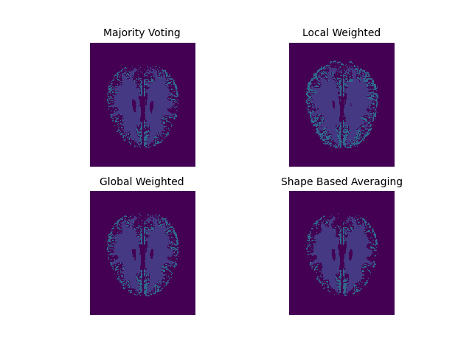
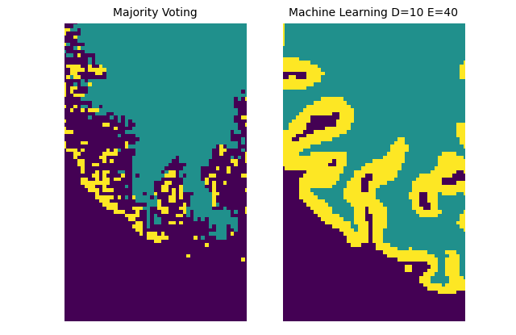
Conclusion
Minor difference between non-rigid and affine registration
Machine learning struggles with small brain parts
Atlas-based segmentation with local weights works best

Slide 17
Outlook
Final report redaction
Clean source code
Hybrid solution:
Machine learning for grey and white matter
Atlas-based for amygdala, hippocampus and thalamus
Further machine learning algorithms

Slide 18

Questions

