Slide 1
MIALab Project – Group 2
Cyril Albrecht, Quentin Savary, Valerio Mollet

Slide 2
Global Weighted Voting
Principle is similar to majority voting
Weighting by similarity Measurement with target
Mean square difference as similarity Measurement
0
1
2
2
W₁=0.2
1
2
1
1
W₂=0.6
1
1
2
1
1
W₃=0.2
2
2
2
2
0
2
1
2
0
1
2
2
1
1
0
2
0
0
0
1
1
0
0
1
1
2
2
0
0
2
1
0
0
2
0
0
2
0
2
0
1
1
0
0
2
0
2
0
2
0
2
Similarity Measurment T1w and T2w with target

Slide 3
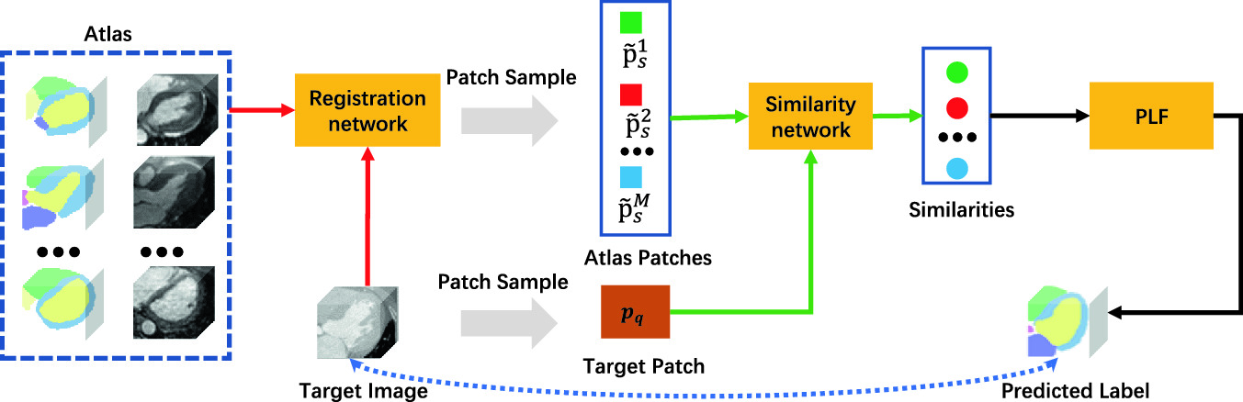
Local Weighted Voting
Principle is similar to global voting
Weighting by similarity Measurement with target
Square difference as similarity Measurement
LWV

Slide 4
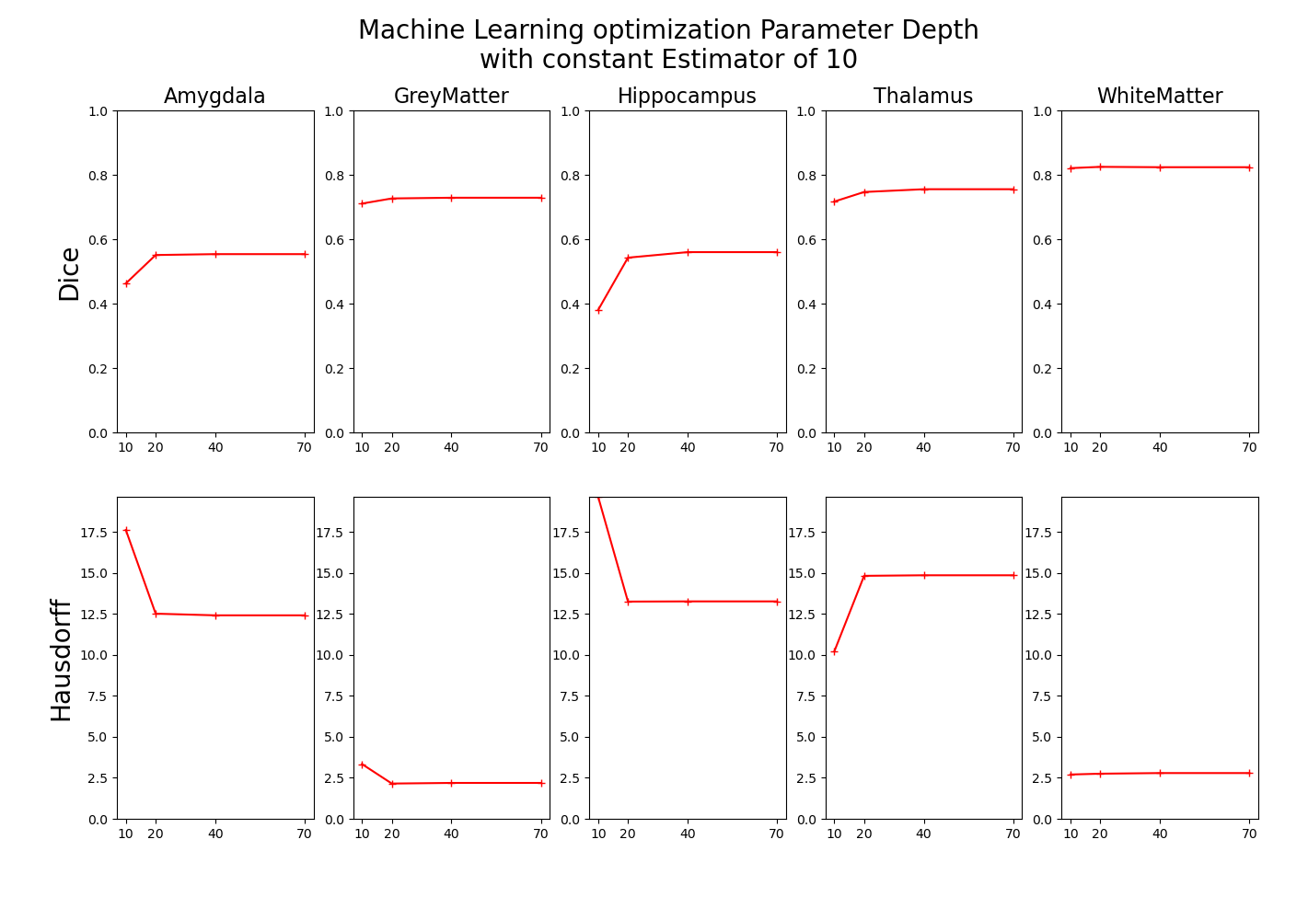
Machine Learning
Machine learning based on random forest
Optimization of Parameters depth and estimator

Slide 5
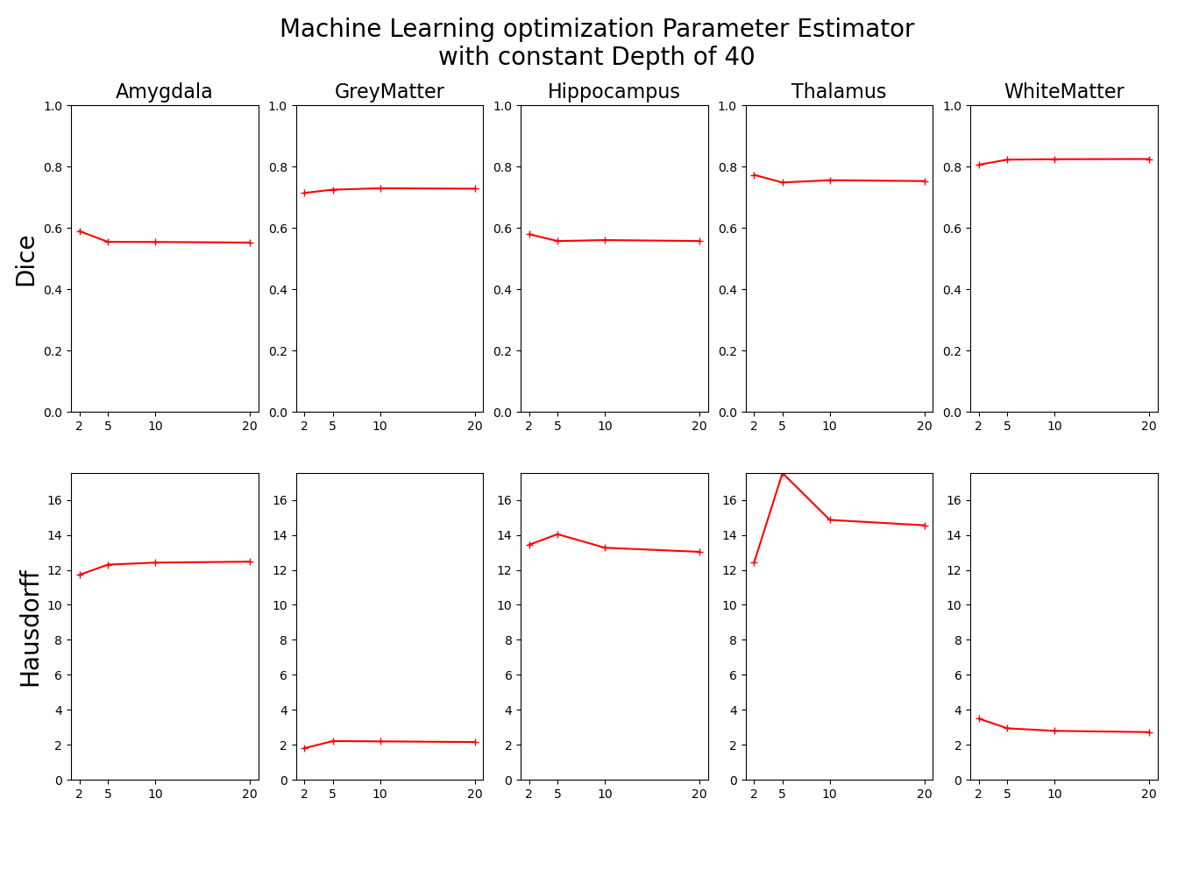
Machine Learning
Machine learning based on random forest
Optimization of Parameters depth and estimator

Slide 6
Registration
Affine
Rotation, Translation and Scaling
Already existed
Non-rigid
Compensate free form deformation
B-Spline Registration
SimpleElastix Library

Slide 7
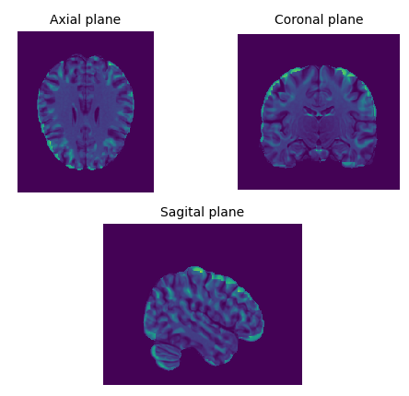
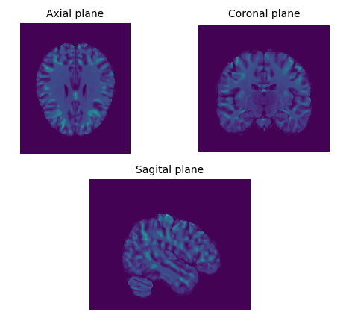
Registration
Affine Registration
Non-Rigid Registration

