Slide 1
MIALab Project – Group 2
Cyril Albrecht, Quentin Savary, Valerio Mollet

Slide 2
Table of content
Hypothesis
Segmentation
Registration
Results
Conclusion
Outlook
Questions

Slide 3
Hypothesis
“Atlas based segmentation consists of a powerful baseline for brain tissue segmentation when compared to an ML based approach”
Main focus on segmentation types
Segmentation depends on registration

Slide 4
Segmentation
Machine learning
Decision forest
Atlas-based
Single atlas
Multi-atlas
Majority voting
Global/local weighted voting
Shape-based averaging

Slide 5
Registration
Affine
Rotation, Translation and Scaling
Already existed
Non-rigid
Compensate free form deformation
B-Spline Registration
SimpleElastix Library

Slide 6
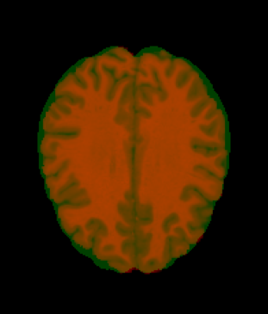
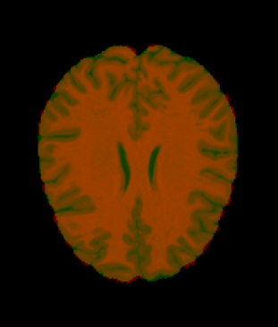
Registration
Affine Registration
Non-Rigid Registration

Slide 7
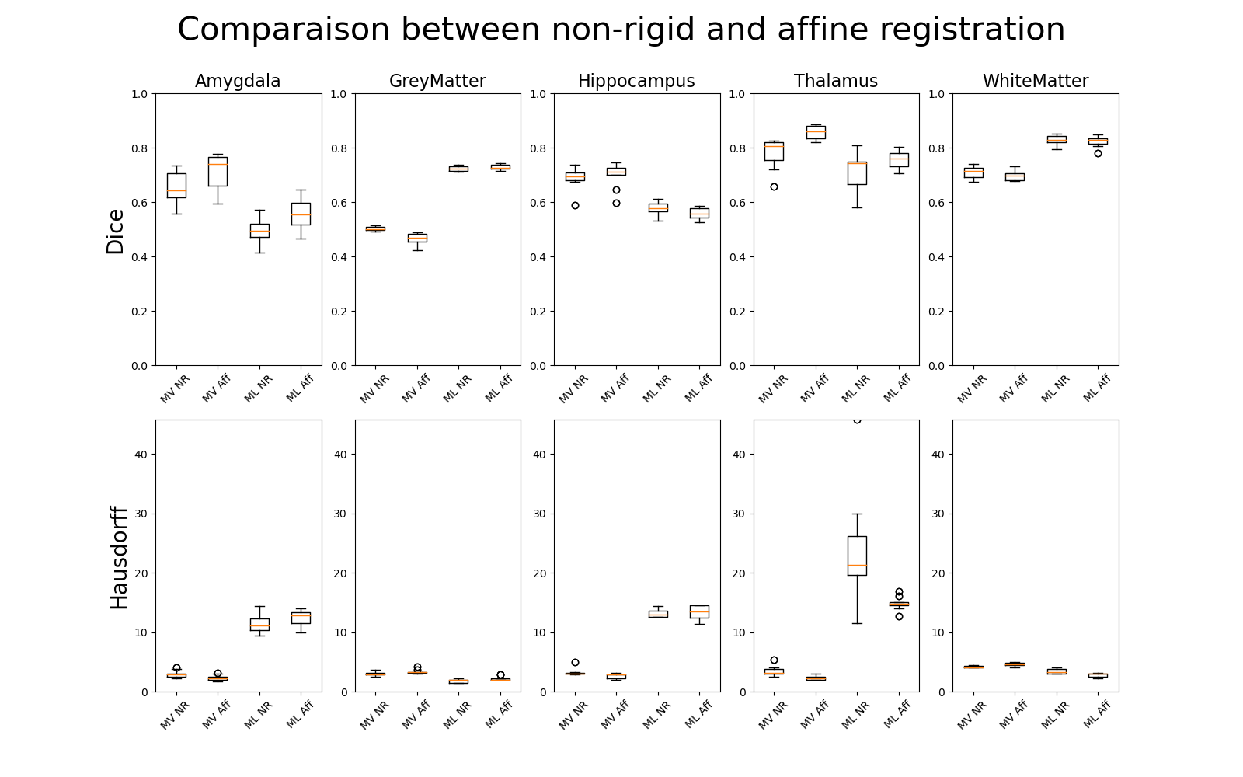
Results – Non-rigid vs affine
MV: majority voting
ML: machine learning
NR: non-rigid
Aff: affine

Slide 8
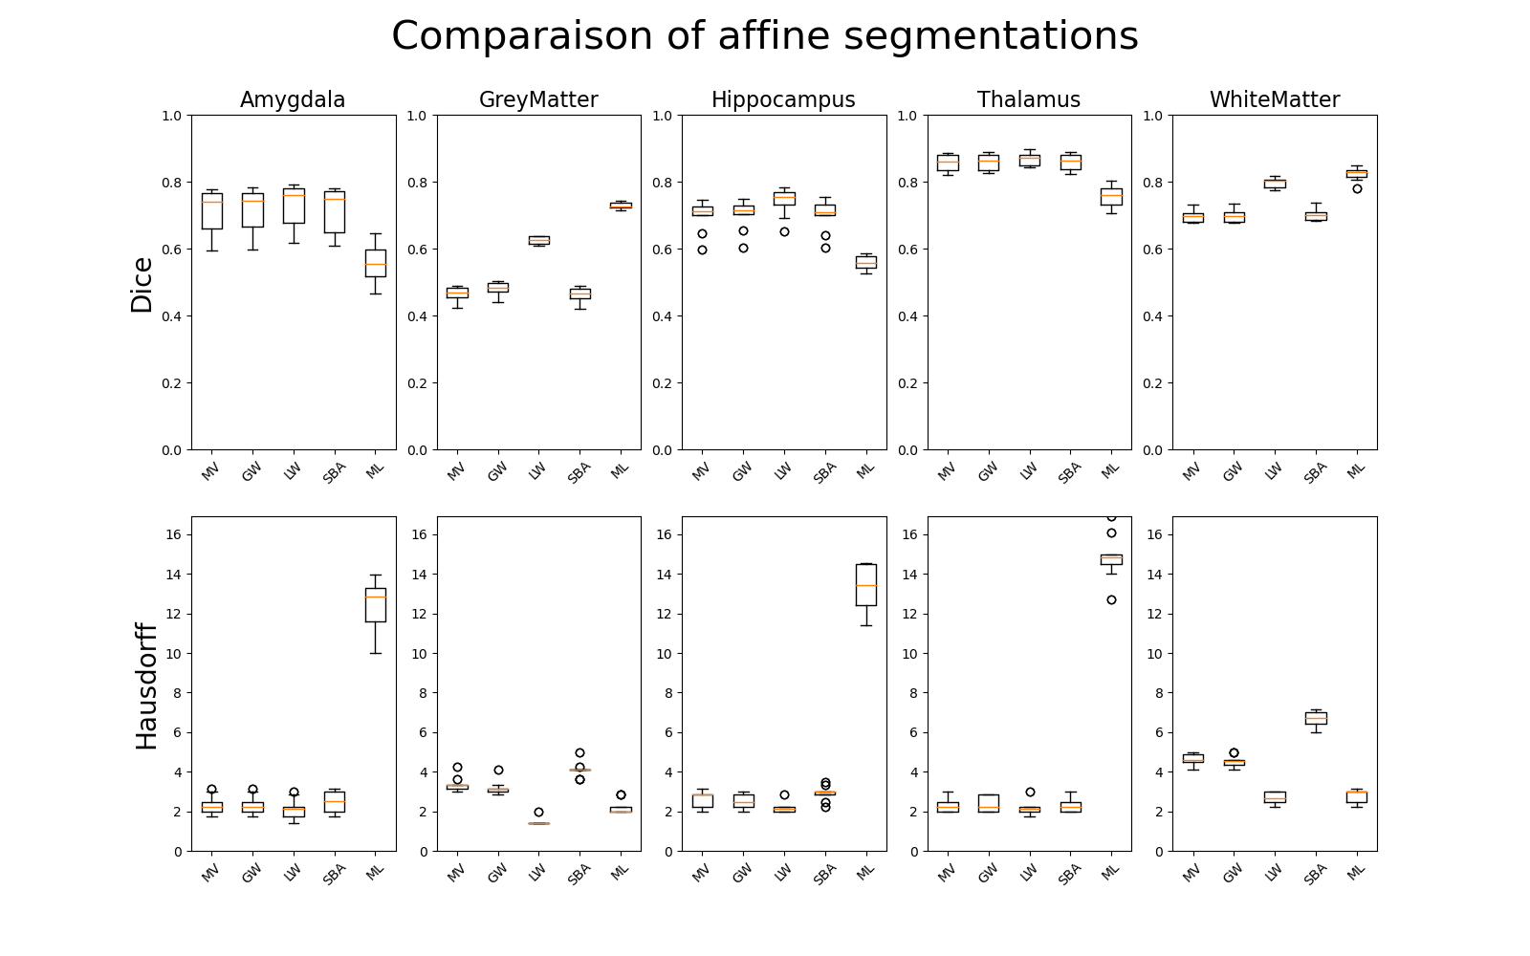
Results – Affine registration
MV: majority voting
GW: global weights
LW: local weights
SBA: shape based averaging
ML: machine learning

Slide 9
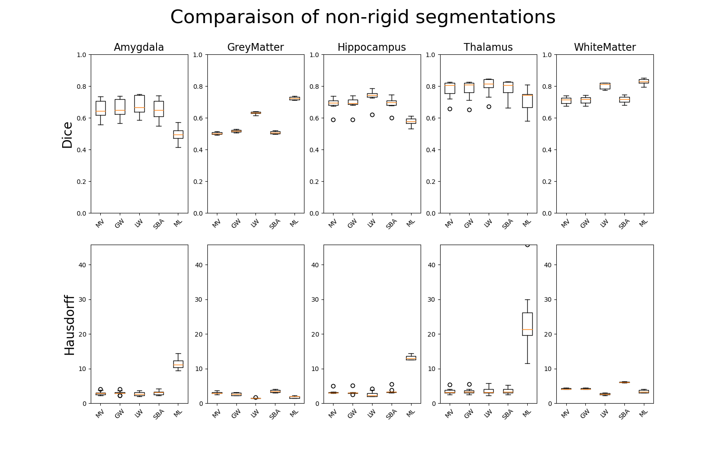
Results – Non-rigid registration
MV: majority voting
GW: global weights
LW: local weights
SBA: shape based averaging
ML: machine learning

Slide 10
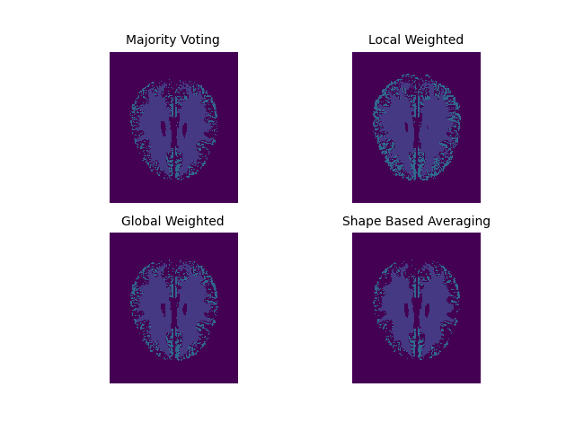
Conclusion
Minor difference between non-rigid and affine registration
Machine learning struggles with small brain parts
Atlas-based segmentation with local weights works best

Slide 11
Outlook
Final report redaction
Clean source code
Hybrid solution:
Machine learning for grey and white matter
Atlas-based for amygdala, hippocampus and thalamus
Further machine learning algorithms

Slide 12

Questions

