Slide 1
MIALab Projekt – Group 2
Cyril Albrecht, Quentin Savary, Valerio Mollet

Slide 2
Table of content
Hypothesis
Current state
Segmentation
Registration
Preliminary results
Outlook
Questions

Slide 3
Hypothesis
“Atlas based segmentation consists of a powerful baseline for brain tissue segmentation when compared to an ML based approach”
Main focus on segmentation types
Segmentation depends on registration

Slide 4
Current state
2 types of registration
2 types of segmentation
What else?

Slide 5
Segmentation
Machine learning
…
Atlas-based
…

Slide 6
Registration
Affine
Rotation, Translation and Scaling
Already existed
Non-rigid
Compansate free form deformation
B-Spline Registration
SimpleElastix Library

Slide 7
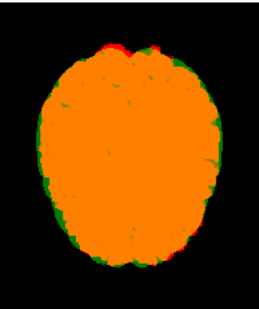
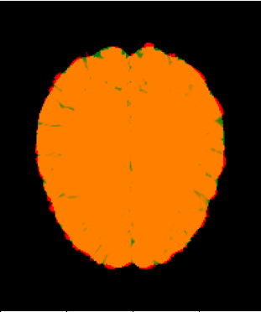
Registration
Affine Registration
Non-Rigid Registration

Slide 8
Preliminary results
Boxplot graph + short discussion

Slide 9
Outlook
More Altas building techniques
More ML segmentation types

Slide 10

Questions

