Slide 1
Uroflowmetry Android App Manual

Slide 2
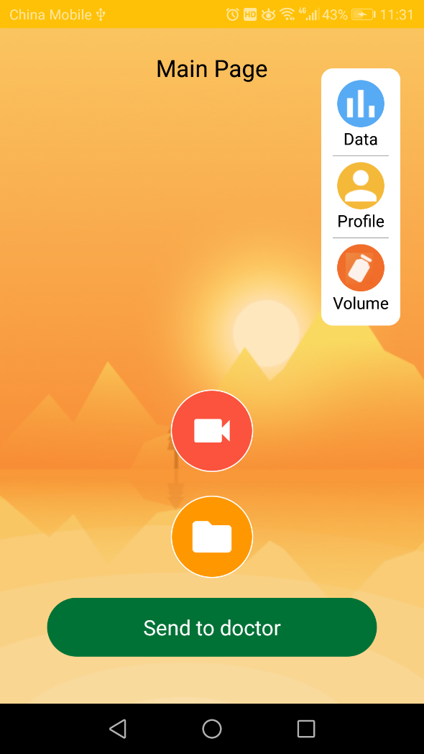
Main Page
This is home page of app. It contains six buttons regarding on features of app.
You can see the measured data in both table format and chart graph.
You can set/get your profile information
You can select/see volume of bottle
You can measure the flow with camera.
You can measure from pre-taken video file.
You can send the measured data to server.

Slide 3
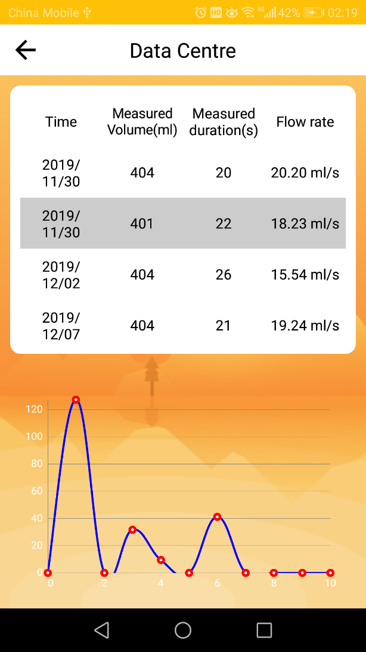
Main -> Data Page
In this page, you can see whole data measured by camera (or from video files)

Slide 4
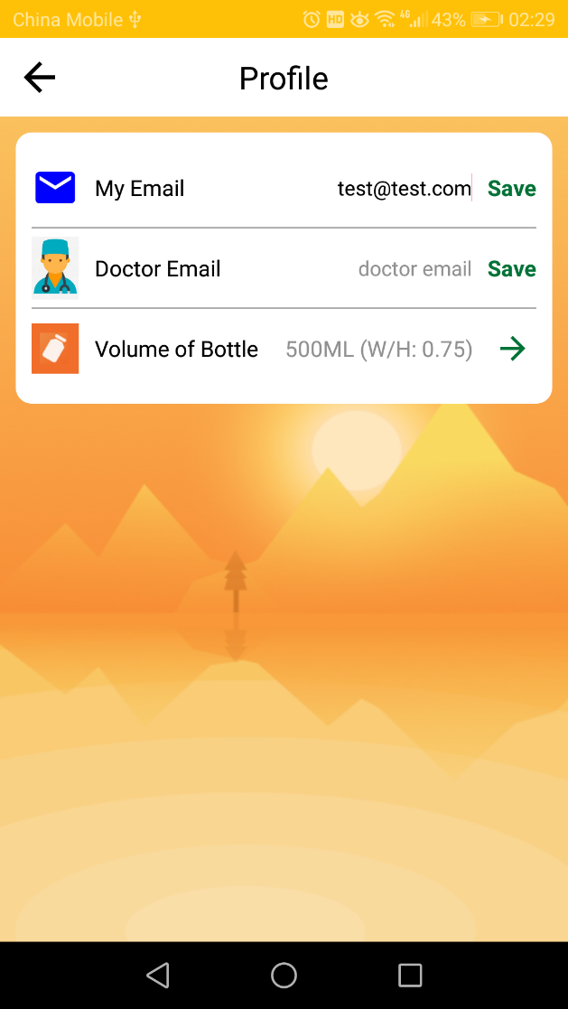
Main -> Profile Page
In this page, you can set your email, doctor email and volume information.

Slide 5
Main -> Profile Page
In this page, you can set your email, doctor email and volume information.

Slide 6
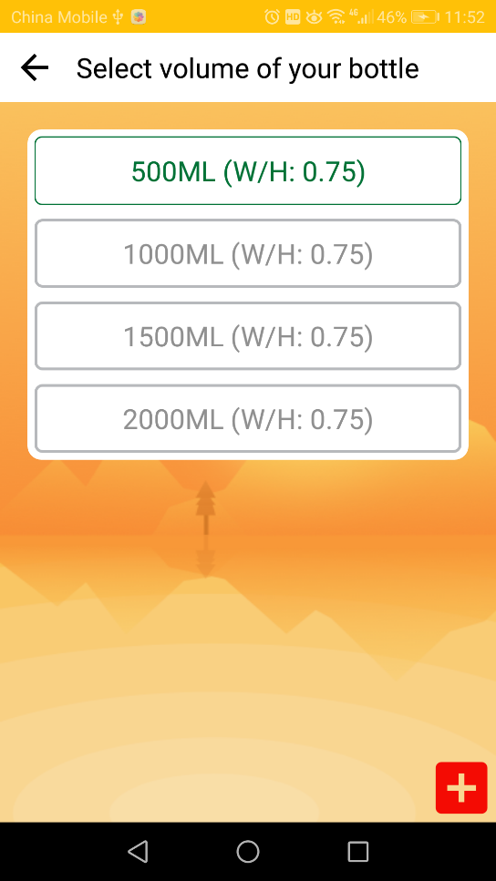
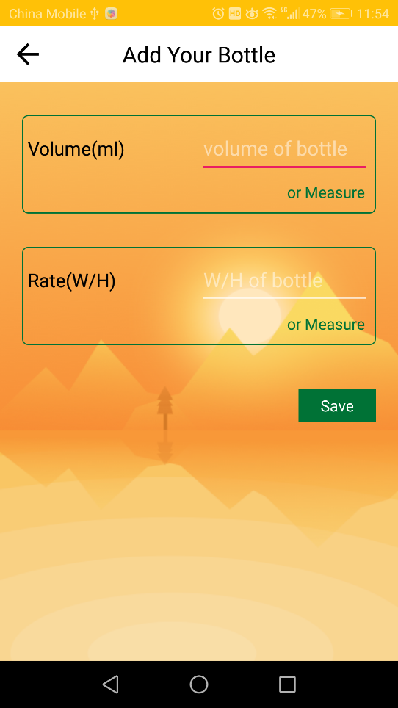
Main -> Volume Page
In this page, you can select the volume of bottle. And also you can add new customized bottle.

Slide 7
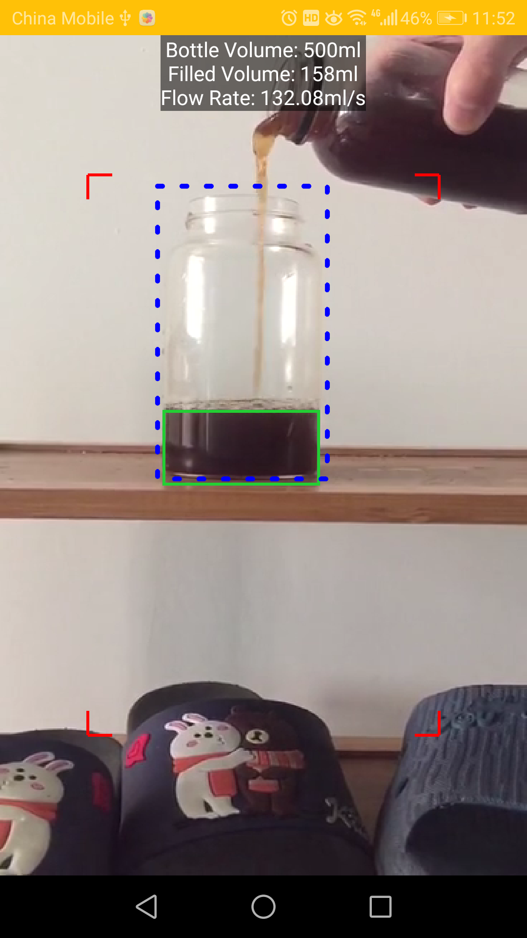
Main -> Measure Page (Camera and File)
You can measure the flow with camera. (or from pre-captured video file)

Slide 8
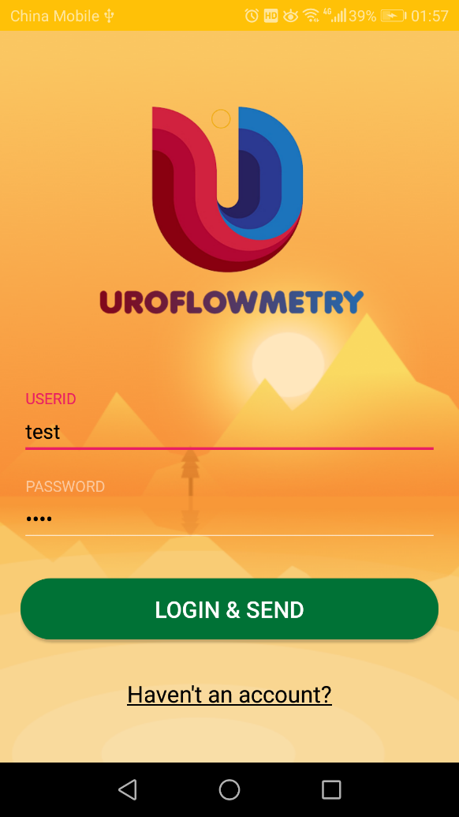
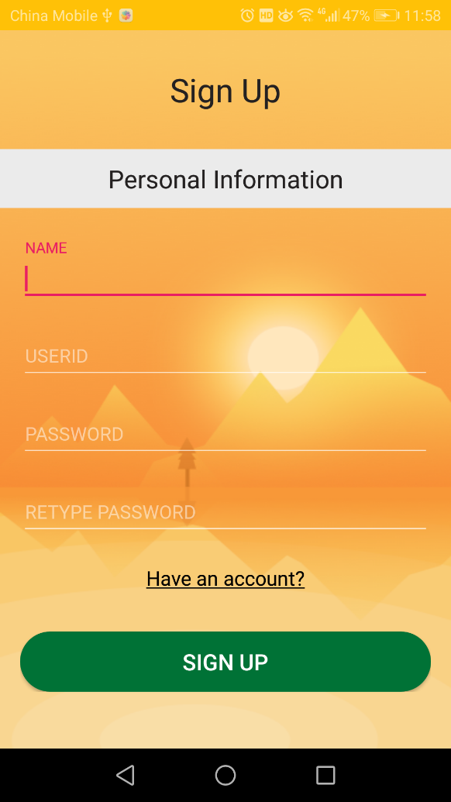
Main -> Send To Doctor
In this page, you can send the measured data to server. If you don’t have account in server, you can signup from app.

