Slide 1
Uroflowmetry Web App Manual

Slide 2
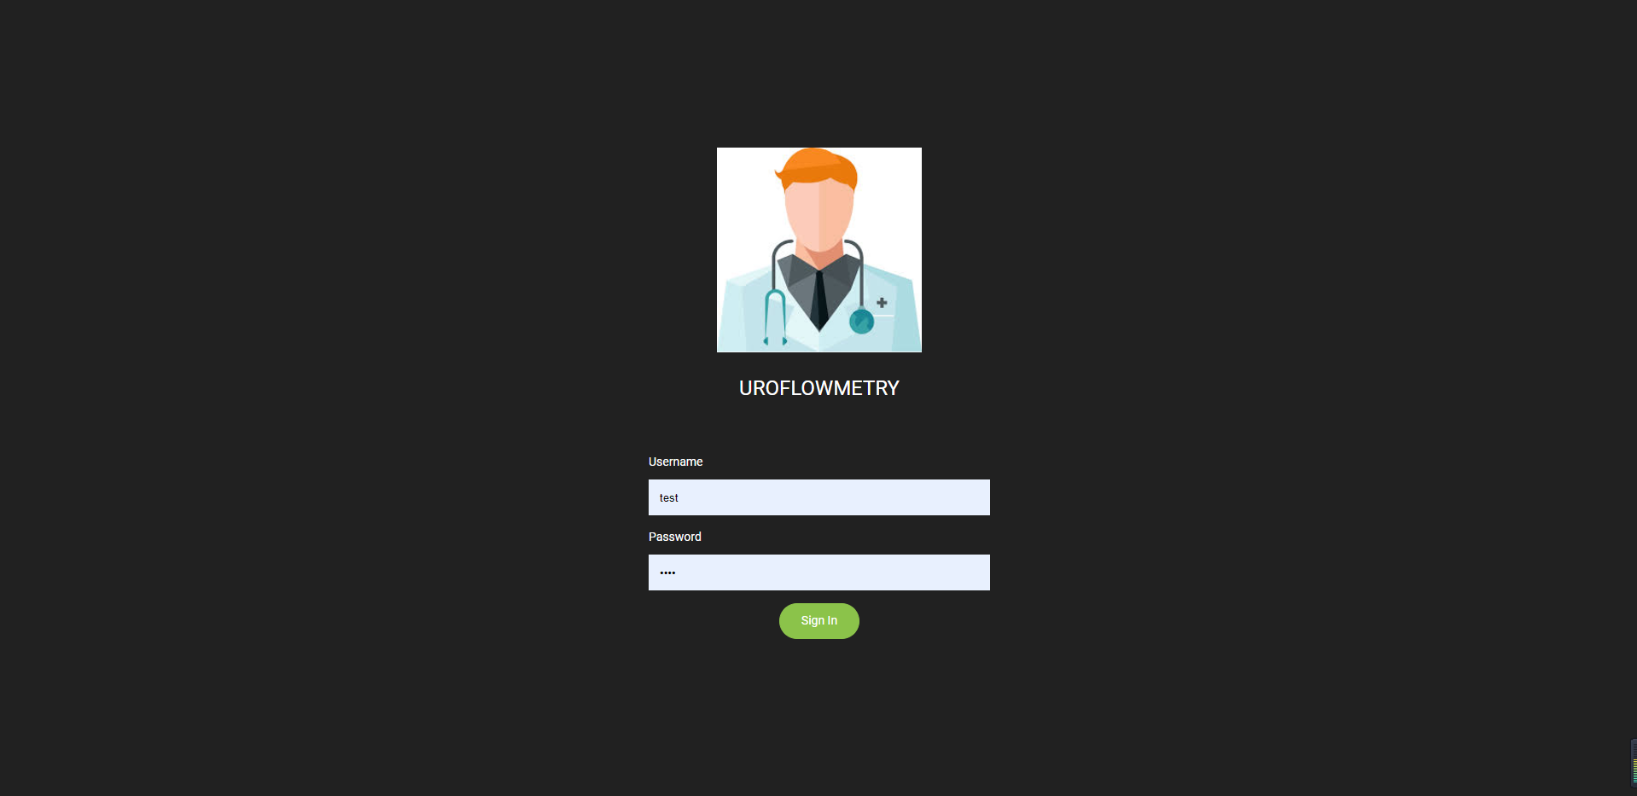
Login Page
You can login with the account registered from android app.

Slide 3
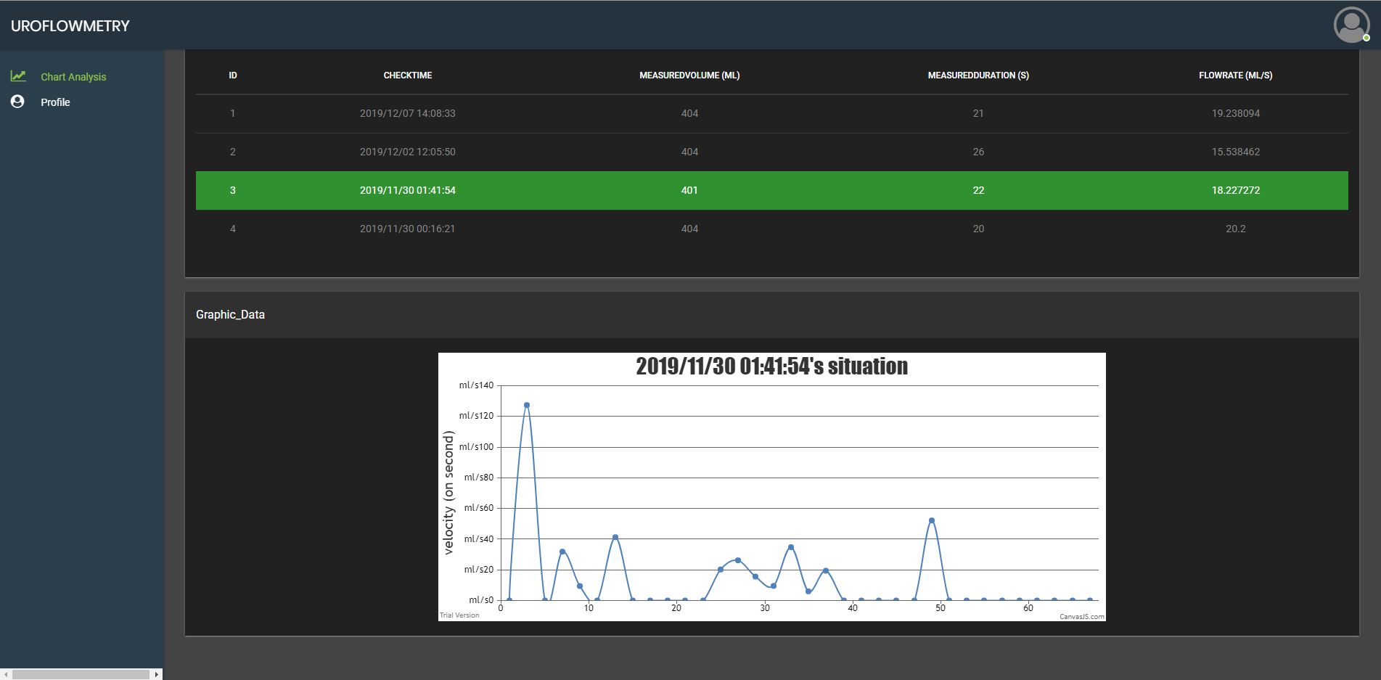
Main Page
This page shows same one with “Data Centre” page of android app

Slide 4
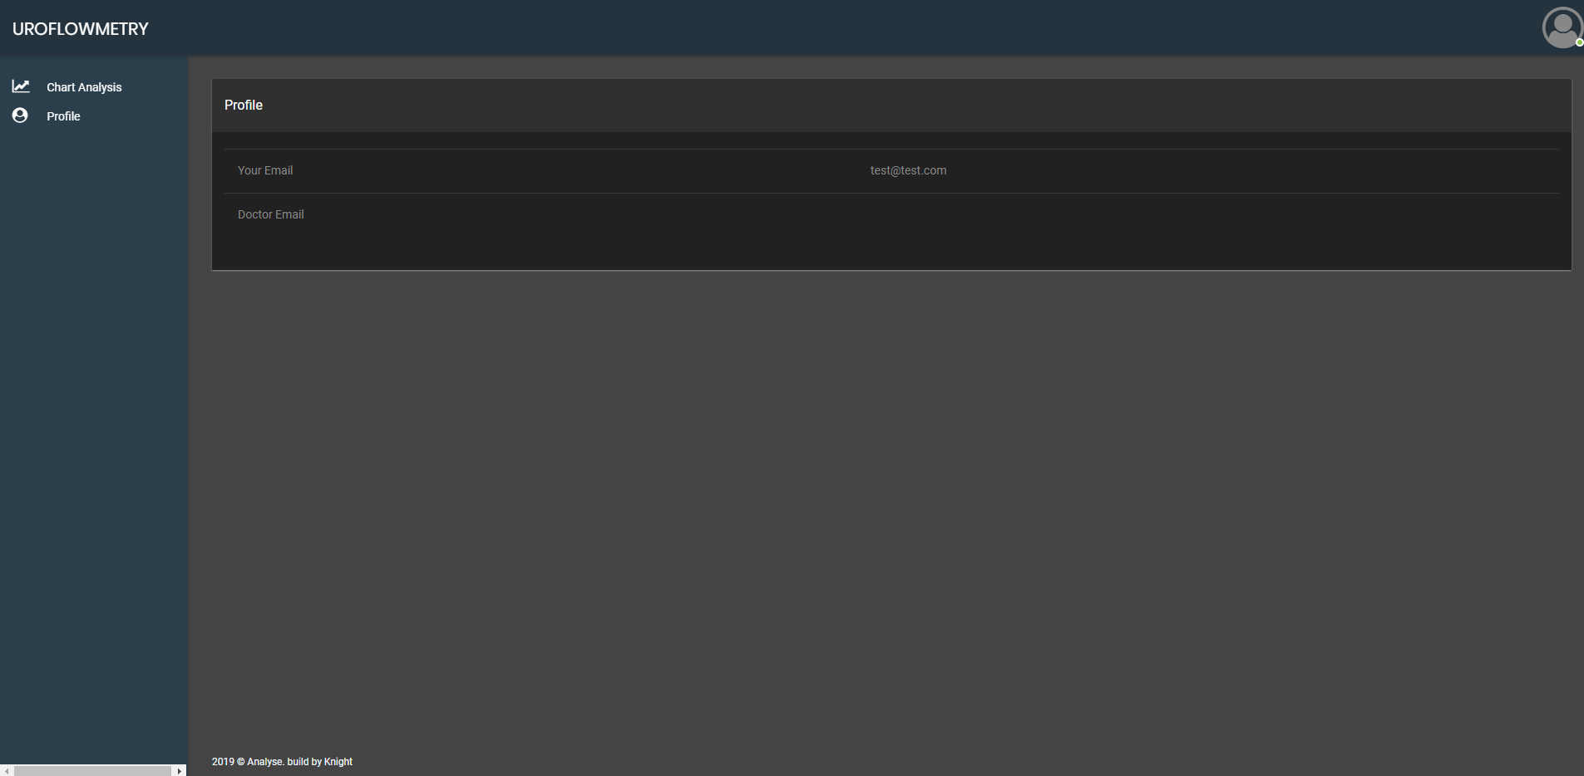
Profile Page
This page shows the profile information.

