Slide 1
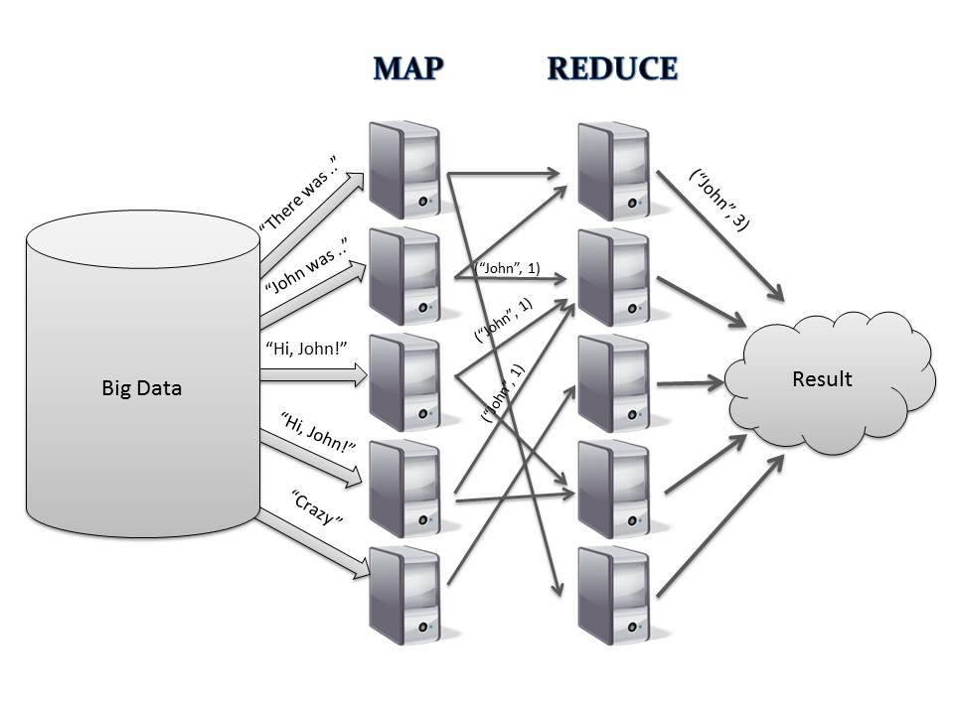
MapReduce
Peter Wad Sackett

Slide 2
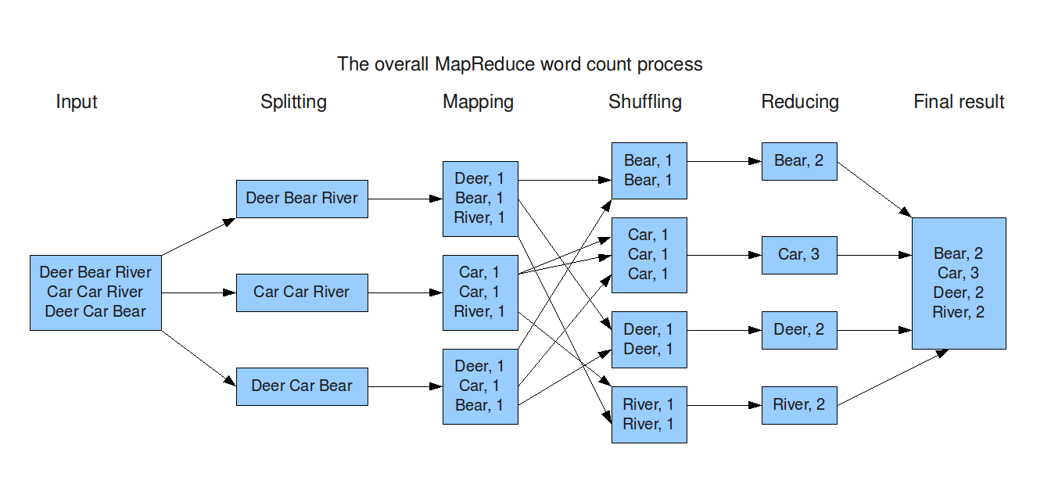
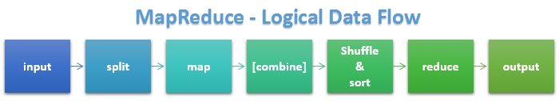
MapReduce example
Big input data is split up between several nodes, which starts the mapping process. The mapped data is shuffled (sent) to the appropriate reduce node. The reduced results are collected.

Slide 3
MapReduce
MapReduce is a programming framework, where you are designing the map function and the reduce function. The framework will take care of the distribution of data/tasks.
https://en.wikipedia.org/wiki/MapReduce
Computerome does not have MapReduce functionality, but some supercomputers on DTU have.
Queueing Systems and MapReduce are kind of competitors and don’t live easily together as they both want control over the nodes in the supercomputer grid.
Make your own MapReduce system with MPI – or don’t.
Hadoop is a free implementation of MapReduce.
http://hadoop.apache.org/
Disco is a python-based MapReduce implementation.
http://discoproject.org/

Slide 4
Complete subject break
Now to something different

Slide 5
Charsets in Python
A byte is 8 bits. One bit represents 0 or 1. Thus a byte can represent 256 different combinations. If you assign a letter to each combination then you will have combinations to spare. Even when assigning the numbers, special chars !”#¤%&//())=, capital letters, you will have surplus combinations.
The americans did that in the 60’es and created the ASCII charset, which utilises one byte per char.
However, if you want to represent all chars in all languages, then 256 is far too little – think arabic, russian, chinese.
Many different solutions to this problem has been made, and the current trend is to use the UTF-8 charset, where ”normal” latin chars take up one byte, and the national (non-american) char take up 2 or more bytes, using special codes to differentiate between single and multiple byte chars.
The consequence is that the length of a string is not necessarily the same as the number of bytes, and that processing the chars is more difficult since they have varying length. Every file opened and every string created is done using a given charset (normally UTF-8) and Python will handle this for you.

Slide 6
Binary and hex
The natural numbers for a computer are in binary or hex, so we must understand those numbering systems.
Decimal is easy to understand for humans. We have the digits from 0 to 9 and we can represent larger numbers by the position of the digit. In all numbering systems the positioning of the digits is important for the size of the number.
243 in decimal is 3 ones, 4 tens, and 2 hundreds. Add it all together and we have 243.
Binary only have two digits, 0 & 1. 111110011 in binary is 1 one, 1 two, 0 four, 0 eight, 1 sixteen, 1 thirtytwo, 1 sixtyfour and 1 hundredtwentyeights. Added together we have again 243.
The hexadecimal system has 16 digits, meaning we need to represent the numbers 10, 11, 12, 13, 14 & 15 with a single char. We use A, B, C, D, E and F.
F3 is 15 sixteens and 3 ones. Added together: again decimal 243.
Binary and hex have a direct correspondance; 4 bits (4 digits) equals 1 hex digit.

Slide 7
Why is binary and hex important?
Data is stored in some fashion in the computer. Dicts (Python) are pretty memory consuming data structures. If you can manage to represent your data in another way, you might be able to solve larger problems. Since binary data is also quick to access, you might gain a performance increase.
Python have data types; bytes and bytearray for dealing with binary data. Data manipulation with these are faster than normal string methods.
Imagine the DNA sequence: ATCG
This will use 4 bytes in memory when using the most efficient charset ASCII. However, since there are only 4 possible chars, then 2 bits is enough information to know which base is used.
Given that A = 00, T = 11, C= 10, G = 01
Then ATCG is in binary 00111001, hex 0x39, and takes up 1 byte.
Memory reduction: 75%

Slide 8
Working with binary in Python
All integers are naturally stored in binary. If you want a textual representation of an integer (here 10) in binary, do
bin(10) which gives ’0b1010’
”{:b}”.format(10) which gives 1010
To write an integer in binary in f.ex. an assignment, do
x = 0b1010
Perhaps look into the binascii module.
Since numbers can be seen as decimal, hex or binary then
x = 3 x = 0x3 x = 0b11 are equal.
The bits in a number can be manipulated in various ways.
Moving (shifting) left or right. Flipping or masking.

Slide 9
Bit manipulation
no = 0b1010
Leftshifting bits in an integer. Zeroes are added at the right end.
no << 2 leftshifts 2 bits giving 0b101000 which is 40.
Rightshifting bits in an integer. Bits ”fall off” at the right end.
no >> 2 rightshifts 2 bits giving 0b10 which is 2.
Or-ing bits together. Boolean operation.
no | 0b1100 gives 0b1110.
And-ing bits together. Boolean operation.
no & 0b1100 gives 0b1000.
Xor-ing bits together. Boolean operation. Bit flip.
no ^ 0b1100 gives 0b0110.
Inverting bits in an integer (32/64 bit).
~no gives 0b11111111111111111111111111110101.

Slide 10
Size of data structures in Python
The sys library contains a function getsizeof which will return the size in bytes of simple objects.
It does not work for f.ex. a dicts of dicts, but it will work for a simple dict, list or string.
import sys
testdict = {’A’:4, ’B’:34, ’C’:10, ’X’:’Bladder’}
totalsize = sys.getsizeof(testdict)
If you want to know more try this in Google:
Python3 memory used by object

