Slide 1
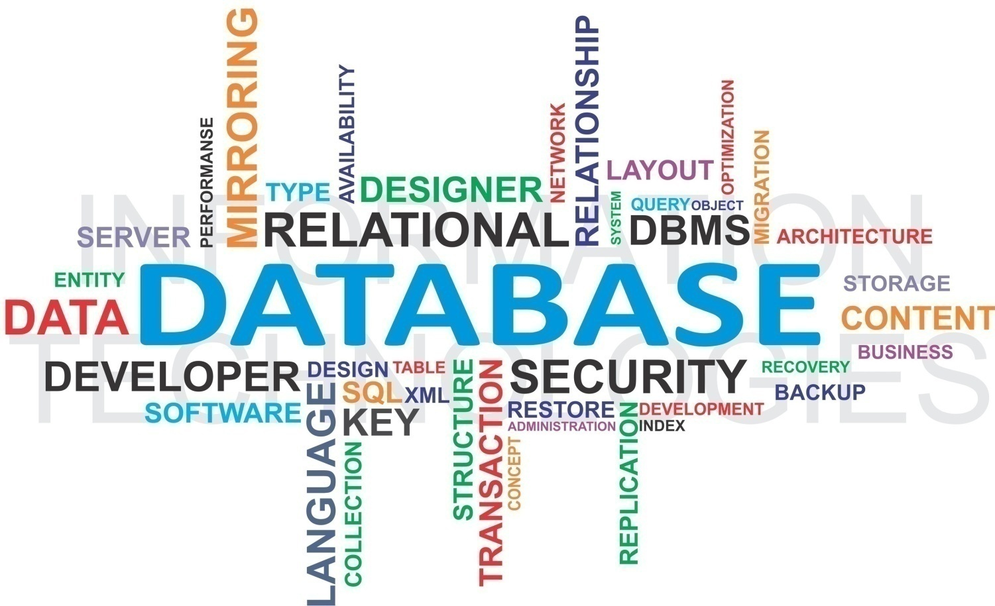
Databases
Peter Wad Sackett

Slide 2
What is a database
Organized collection of data which models aspects of reality
Examples are many: bank records, CPR register, uniprot
Access to the database (collection of data) is facilitated by a DBMS, database management system. Often ’database’ is used to refer to both the data and the system.
A DBMS provides functions to do with:
Data definition – Creation, modification and removal of definitions that describe the organization of the data.
Update – Insertion, modification, and deletion of the actual data.
Retrieval – Access to the data in a form directly usable, according to selection criteria.
Administration – User administration, enforcing data security, monitoring performance and users, maintaining data integrity.

Slide 3
Types of databases
There are many different types of database systems and they have different uses. Database systems have been developed to target both general use and specialized use.
Think of examples like; your shopping list, address book on your phone, a companys records of employees, bank transactions, indexing the internet.
Types differ on many properties, like size, speed, distributed data, complexity, design philosophy.
ACID transactions – high level databases
Atomicity – a transaction either fails or succeeds
Consistency – any transaction brings the database from one valid state to another according to the data definition rules
Isolation – Any set of transactions end in the same state whether executed concurrently or serially
Durability – When an transaction is committed, it will remain so

Slide 4
Why use databases (seems like a lot of work)?
Data persists across application runs.
Data can be used by many different applications and programming languages.
The DBMS itself can make the applications easier to make, both in less time used for development and correctness.
Databases are fast – well, they are slow, but faster than anything you could make even in unreasonable time.
Databases (some of them) can store a HUGE amount of data. Most databases can store much more data, than you can comfortably juggle in computer memory. This is scalability.
Databases makes it easy to search, retrieve, store and modify data.
The DBMS can address security concerns.
The DBMS handles concurrency. You and your mom accesses it at the same time. You make a change – this is immediately reflected in your mom’s queries.
Remember ACID; durability is important.

Slide 5
When not to use databases
The alternative to using a database for ”data storage” is usually just to use flat files perhaps in some hierarchical directory structure in the file system, where the data is stored as simple text, or perhaps JSON format or similar.
CPR: 121215-2968
First name: Sanne
Last name: Lind
Height: 187
Weight: 74
Eye color: Green
Blood type: B+
This can be done, when the data is small and simple, or perhaps unstructured in a way that does not fit a database.
You have to say goodbye to everything a database system offers. Everything has to be programmed/handled by you.

Slide 6
Main database types
Hierarchcal database model
Data are organized in a tree-like structure – outdated.
Relational database model
Data are organized in tables with common keys showing relations.
Popular, uses SQL as query language
Oracle, MySQL, PostGress, Microsoft SQL Server
NoSQL – a mix of models, catch-all
Key-value organisation, document organisation (XML), etc
Designed to scale and be fast. Targetted to special use.
Query language can be simple or similar to SQL.
MongoDB, Cassandra

Slide 7
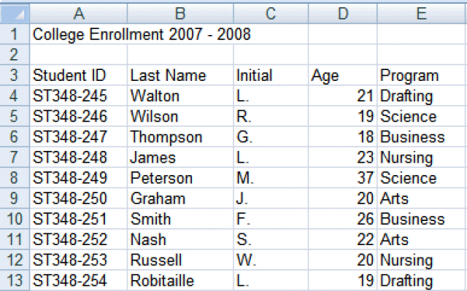
Relational Databases simplified
When thinking about relational databases, think spreadsheet.
This is obviously a gross simplification, but a good start for understanding.
A relational database is a set of tables, rather similar to spreadsheets.
A basic table has rows of data entries. Every column/field is of a specific data type of your choosing; The standard types like strings, integers, floats can be any length you specify. More special types like date fields are of a set size. The standard types also come in different flavours . Choose appropiately.
The really important part is the first field is a primary key. This MUST be a unique key for the entire table.

Slide 8
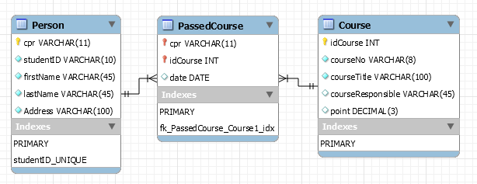
Tables - relations
Candidate keys
Foreign keys
Primary key
Attributes/fields
Relations between data (tables) are established via the unique primary key. In this example the primary key is cpr in the Person table, and an autogenerated primary key, idCourse, in the Course table. The courseNo is not primary key because course numbers can be reused.
The table PassedCourse shows which students passed which courses at what date. The fields cpr and idCourse in PassedCourse are foreign keys that together constitutes a combined primary key for the table.

Slide 9
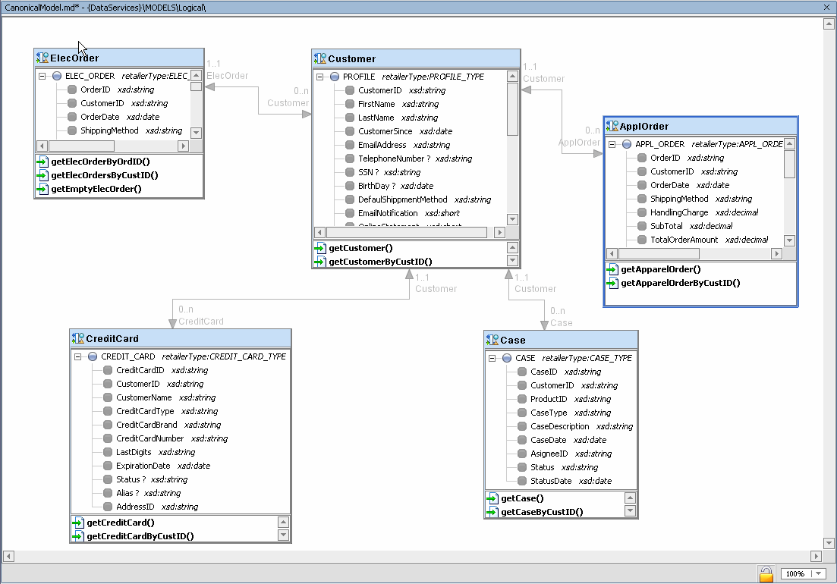
More complex example

Slide 10
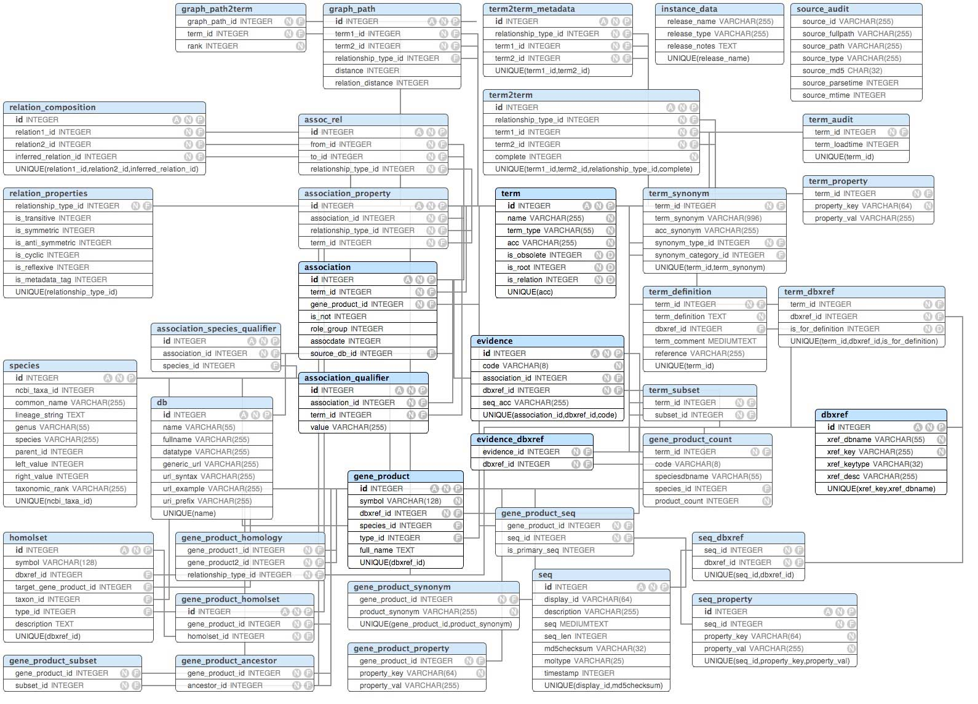
Relational Databases data schema

Slide 11
Normalization
The object of normalization is to arrange the data in tables in such form that data redundancy is avoided, updates (insertions, deletions, changes) are simple, i.e. single operation, and integrity preserved.
To achieve this goal 6 normal forms have been defined. In order to meet a normal form you must meet it’s predecessor.
Some simple rules will get you far when normalizing the database:
A crude approximation, but good for beginners, is to differentiate between ”fact” tables, and ”relation” tables. A fact table should contain simple facts about the primary key, which is not a combined key. A relation table is a table, which primary key is a combined key that tells about the relations between two or more fact tables.
No attribute (field) can be used as a list or repeated; make two tables.
Every non-key attribute must provide a fact about the key, the whole key, and nothing but the key, so help me Codd.

Slide 12
First normal form
A relation is in 1NF if and only if the domain of each attribute contains only atomic values, and the value of each attribute contains only a single value from that domain.
First normal form enforces these criteria:
Eliminate repeating groups in individual tables.
Create a separate table for each set of related data.
Identify each set of related data with a primary key.
Wrong
Right, 2 tables
sprotID | Length | Accession
SP96_DICDI | 600 | P14328;
ASM_HUMAN | 629 | P17405; P17406; Q13811; Q16837; Q16841;
AGI_URTDI | 372 | P11218;
sprotID | Length
SP96_DICDI | 600
ASM_HUMAN | 629
AGI_URTDI | 372
sprotID | Accession
SP96_DICDI | P14328
ASM_HUMAN | P17405
ASM_HUMAN | P17406
ASM_HUMAN | Q13811
ASM_HUMAN | Q16837
ASM_HUMAN | Q16841
AGI_URTDI | P11218

Slide 13
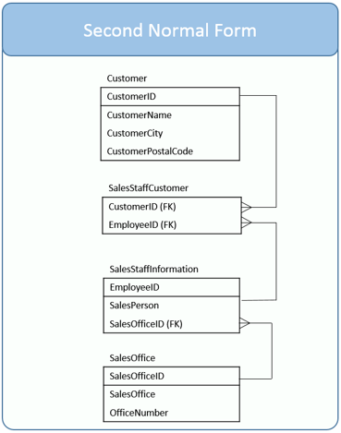
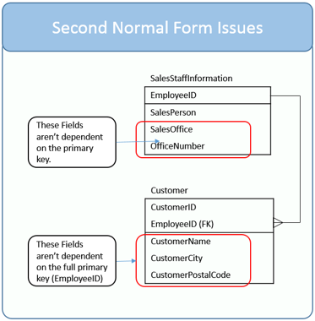
Second normal form
A table is in 2NF if it is in 1NF and no non-key attribute is dependent on any subset of any candidate key of the table. A non-key attribute of a table is an attribute that is not a part of any candidate key of the table. A candidate key can be a combined key.
In other words: Every non-key attribute of the table is dependent on the whole of every candidate key.

Slide 14
Third normal form
A table is in 3NF, if it is in 2NF and every non-key attribute is non-transitively dependent on every key in the table.
Basically it means that any non-key attributes are independent of each other.
Sport | Year | Winner
Fussball | 2015 | Hans
Pong | 2015 | Hannah
Tennis | 2015 | Poul
Fussball | 2016 | Hans
Pong | 2016 | Hilde
Tennis | 2016 | Poul
Combined primary key
Attributes are dependant
Sport | Year | Winner | Country
Fussball | 2015 | Hans | Germany
Pong | 2015 | Hannah | USA
Tennis | 2015 | Poul | Denmark
Fussball | 2016 | Hans | Germany
Pong | 2016 | Hilde | Germany
Tennis | 2016 | Poul | Denmark
Winner | Country
Hans | Germany
Hannah | USA
Poul | Denmark
Hilde | Germany
Wrong
Right

Slide 15
Fourth normal form
The previous normal forms have been concerned about single attribute dependecies to the key. 4NF is concerned about multi-value dependencies in a relation. There must be none. A multi-value dependency exists if there are 3 attributes (A, B & C) in a relation, such that for each value of A there is a set of values for B and C, but the value set for B & C are independent of each other.
Combined primary key
Student | Skill
Moe | Acting
Larry | Acting
Larry | Cooking
Student | Skill | Hobby
Moe | Acting | Paintball
Moe | Acting | Sewing
Larry | Acting | Painting
Larry | Acting | Swimming
Larry | Cooking | Painting
Larry | Cooking | Swimming
Student | Hobby
Moe | Paintball
Moe | Sewing
Larry | Painting
Larry | Swimming
Wrong
Right

Slide 16
Fifth and sixth normal form
If you can get a relational database to 4NF, it is usually also 5NF and 6NF compliant. Getting this far is excellent. Many professional database designers stop already at 3NF.
If you want to read more:
A very practical guide
http://www.essentialsql.com/get-ready-to-learn-sql-database-normalization-explained-in-simple-english/
https://en.wikipedia.org/wiki/Database_normalization
https://en.wikipedia.org/wiki/First_normal_form
https://en.wikipedia.org/wiki/Second_normal_form
https://en.wikipedia.org/wiki/Third_normal_form
https://en.wikipedia.org/wiki/Fourth_normal_form
https://en.wikipedia.org/wiki/Fifth_normal_form
https://en.wikipedia.org/wiki/Sixth_normal_form

