Slide 1

Super computers
Peter Wad Sackett

Slide 2
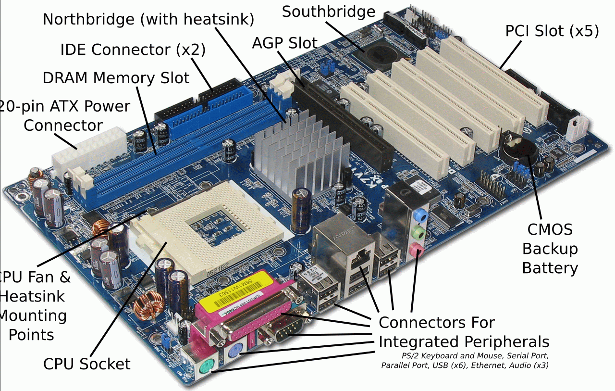
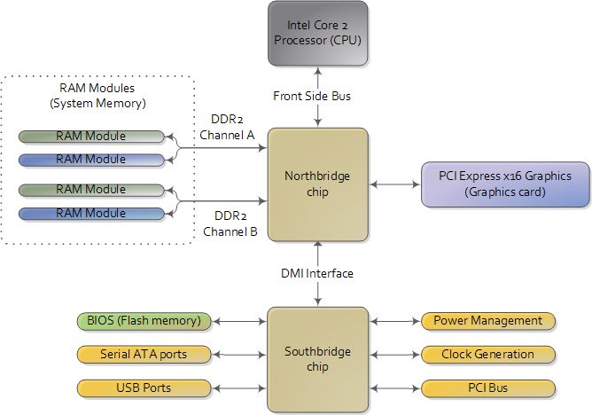
How a computer works – do we care ?
? ?
Who cares !
You just need to use it

Slide 3
How a computer works – WE CARE
We have to care because if our laptop is not big enough, then stupidly throwing a super computer after the problem is not going to help.
EX: Your laptop can handle a toy problem of size X which scales O(n²) in a day. The SC is 100 times more powerful, but your real problem is 100 times bigger. Result; You wait 100 days for the SC to finish.

Slide 4
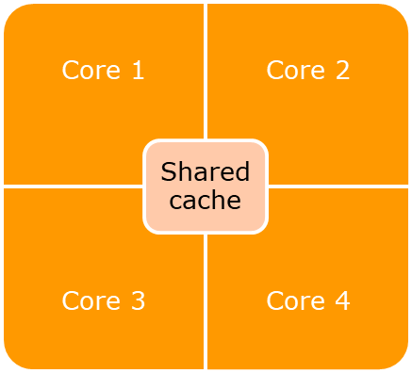
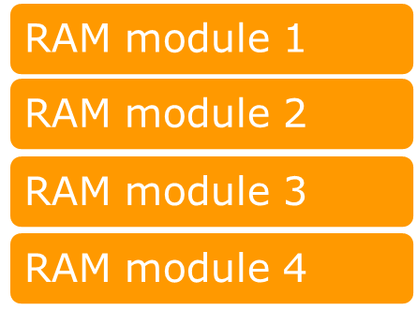
Simplified diagram of desktop computer
Motherboard
CPU
Performance and control layer
Memory
IO control
Bus
Graphics Adapter
CUDA
massive parallel floating
point operations (matrix)
Hard Disk

Slide 5
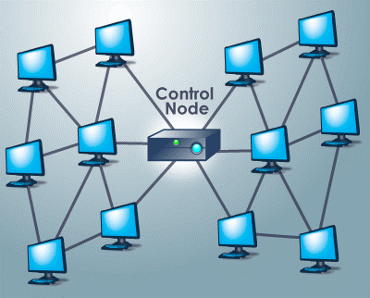
Computer grid
CLUSTER:
1-2 login and control nodes
Lots of slave nodes
Some nodes have more RAM
RAM is not shared
Cheap
SHARED MEMORY MACHINE:
Many cores - seems like one entity
Expensive
Challenges:
Parallelism
CUDA
Locality vs. Communication
IO access – file systems

Slide 6
How to use the power of the Super Computer
Using it raw:
You design everything, the programs, algorithms, IO, interprocess communication.
It will never happen – too much work, too much specialization, too expensive, too great a risk of breakdown.
Using a queueing system, sharing the SC:
Usage limitations will be placed on you; time, cores, RAM, storage.
Primitive parallelization using the queue.
Easy way to scale up some types of tasks.
Other types demands much more work before effective scaling occurs.
Systematic approach is necessary for success (to avoid confusion).

Slide 7
Falling asleep?
On to something
practical

Slide 8
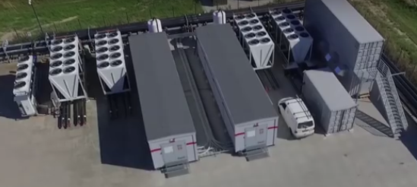
Computerome2
During the course you will work on Computerome2, which is the Danish National Supercomputer for Life Sciences. Be nice to it.
Computerome2 is a Unix cluster. NP - you know Unix already.
The course has a place set aside on Computerome2 /home/projects/pr_course where you can find all the files necessary for the exercises during the course.
You will create your own place in /home/projects/pr_course/people where you put all the programs and data you create during the course. The Unix group must have read permission to your files if you want me to read or evaluate your programs.

Slide 9
Computerome2 access tools
Windows
PuTTY http://www.putty.org SSH client
Xming https://sourceforge.net/projects/xming/ X server
WinSCP https://winscp.net/ file transfer
MobaXterm can be made to work – with trouble.
Mac
XQuartz https://www.xquartz.org/ X server
Cyberduck https://cyberduck.io/ file transfer
Linux
FileZilla https://filezilla-project.org/ file transfer
Some of the tools can be used on more platforms. Depending on your OS there are also native tools, like ssh and scp.
If you are on Windows, consider virtualising Linux or using WSL.
http://www.computerome.dk/

Slide 10
Modules on Computerome2
When you start out on Computerome2, the machine is practically an empty shell. You can then add functionality to it via the module system. For example you can add Perl or Python to its capabilities.
There is a somewhat big limit to how many modules you can have added at the same time, and some modules conflicts with other modules and can’t be added at the same time. For example it makes no sense to have several versions of the same tool loaded at the same time, therefore this is a ”natural” conflict.
It has been discovered that some modules silently interfere with other modules without the knowledge of the Computerome2 operators, who installed them. It is seldom, but has happened.
Hence, it is a good idea to only use the modules you need at any given time.
For example; to use R, perl, python3 you write
module load tools R/3.2.5 perl/5.20.2 anaconda3/4.0.0

Slide 11
More on modules
Some useful module commands:
module avail See available modules
module list See your loaded modules
module load <some_module> Load (use) a module
module unload <some_module> Remove a module (functionality)
module display <some_module> See more info about the module
All modules added this way are only available in your session. There are a few collections of module that becomes visible/available when
module load tools ngs
If you want to find modules which give you a certain tool you could perhaps use this command, which will list just the module names that matches your search term.
module avail |& grep –i <search_term>

Slide 12
Modules and environment
Practical hint: type env on command line to see your environment.
You can add modules to your environment, i.e. automatically load certain modules on login. This is important for the Queueing System as jobs are executed with your environment. So – if python is automatically available to you, then it is also available to your job.
This is done by editing the .bashrc file in your home.
Use you favorite editor;
gedit .bashrc
Add/change/delete lines like
module load <some module list>
You basically put in unix commands that you want executed upon login in this file.
More about modules here
http://wiki.bio.dtu.dk/computerome/index.php/Installed_Software

Slide 13
How modules work and their limitations
When a module is loaded, what really happens is that several environment variables are changed – added to. Most important are PATH and LD_LIBRARY_PATH, which controls where to look for programs and where to find libraries. So loading a module is really just telling where to find the necessary programs/libraries.
Since a module is an instance of a program with all dependencies (libraries, other programs) compiled in, then it happens that program A needs library X version 1.2, but another program B needs the same library X, but version 1.5. Module/program A and B have a conflict in what library to use, because libraries are found by looking at the path in LD_LIBRARY_PATH, and the first library X found is the one chosen.
Some modules are big. The Python module is an Anaconda including BioPython. It was dicovered that samtools is part of BioPython, but samtools are also available as modules in several different versions. When Python and samtools are/were loaded, then when using samtools, the wrong Python version was chosen, due it being first in the path. This conflict was unknown to Computerome2 operators.

Slide 14
What affects the speed of your program ?
Any programs speed is limited by either IO and/or CPU. The limitations can change during the execution of the program, f. ex. the start phase can be IO-bound while the end phase is CPU-bound.
The reason for a program being slow is often due to the authors unawareness of how IO works, both on the file system level and on the programming language level.
Slowness due to CPU is often caused by unawareness of how to make efficient algorithms, or how the programming language works ”behind the scene”.
Both these issues will be addressed during the course.
It is important to realize that a slow program on your personal computer only affects yourself, but a slow program on a super computer affects everyone negatively, because the slowness scales up. You are likely used to hear the the speed scales, which is true, but if your program could run 10 times faster with the right modifications...
Most people pay for compute time on a super computer. This only accentuates the speed issue.

Slide 15
Python and IO
A very normal wellknown way to read and write a file in python is
infile = open(’myin.txt’, ’r’)
outfile = open(’myout.txt’, ’w’)
for line in infile:
outfile.write(line)
infile.close()
outfile.close()
The for-loop could have been replaced with
line = infile.readline()
while line != ’’:
outfile.write(line)
line = infile.readline()
if this would fit the specific purposes of the program better.
Both input and output files have been opened in text mode. This means that Python investigates the file to see which charset it is written in – meaning if it contained Chineese it would have been understood, too. This imposes a translational burden on Python.
It needs to deal with Unicode (wide chars) instead of just bytes.

Slide 16
Python – binary reading
Changing the opening mode of the files to binary mode.
infile = open(’myin.txt’, ’rb’)
outfile = open(’myout.txt’, ’wb’)
for line in infile:
outfile.write(line)
infile.close()
outfile.close()
Now the conversion to the right charset is no longer a burden for Python. The lines are simply read as bytes – not strings. This may add difficulty for the programmer since she now have to deal with bytes and not strings. However all string methods in Python also works for bytes.
bytesline = b’I am a line in bytes’
# Converting bytes to string – normal chars
stringline = bytesline.decode(’ascii’)
# Converting bytes to string – national chars
stringline = bytesline.decode(’utf-8’)
# Converting string to bytes
bytesline = stringline.encode(’utf-8’)

Slide 17
Python – block reading
It is a possibility to read/write a file one chunck of bytes at a time instead of line-based reading.
infile = open(’myin.txt’, ’rb’)
outfile = open(’myout.txt’, ’wb’)
while True:
chunck = infile.read(10000)
outfile.write(chunck)
if len(chunck) < 10000:
break
infile.close()
outfile.close()
When trying to read a chunck of a certain size, you either succeed at reading a ”right-sized” chunck, or fail in which case you have reached the end of the file.

Slide 18
File buffers
Early research in computers showed a) that some files are read very often and b) a read (f.ex. a line) in a file is often followed by another read continuing where the first read stopped. We do that all the time when we read a file line by line.
I/O operations are expensive in time, and the fewer there are, the better performance. It has also been shown that few large I/O operations are generally better than many small.
These observations led to the idea of file buffers. A program will read a file – actually requesting the OS to read the file. The OS will upon beginning to read the file, read a large chunk of the file into memory – the file buffer. As the program requests lines or other small reads from the file, this is given out by the OS from the file buffer. The OS keeps track of how much has been read. When the file buffer is empty, the OS reads a new chunk into a new file buffer and continues supplying the program with the reads it wants.
There is a similar situation with writes.
Most OS’es have some form of implementation of file buffers as they give a very sizable I/O performance increase. Exceptions are very specialized OS’es.

Slide 19
File buffers - consequences
The standard operation procedure for file buffers in Linux, is to fill all the ”unused” memory with file buffers. Unused means not reserved for other programs or purposes and since the memory is a rescource the OS might as well use it for file buffers. If a program suddenly needs more memory the oldest file buffers are just discarded and the memory freed up hereby is given to the program.
This behaviour is good, because if you read a file again/often the content is already in memory and no I/O access is needed.
Computers are limited in memory, so there is a limit to how much file data the OS will cache as file buffer, but there is also a minimum.
Reading a 3 GB file on a Computerome2 node with 128 GB will cache the entire file in file buffers. This means the second time you read the file, you won’t be accessing the disk, just the memory.
If you are measuring the time it takes to run a program repeatedly, the time is different from the first and the subsequent runs.
This will not happen if you read a 3 GB file on your 4 GB laptop.

