Slide 1
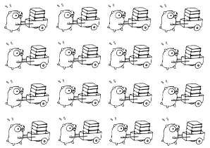
Distributed Computing
Peter Wad Sackett

Slide 2
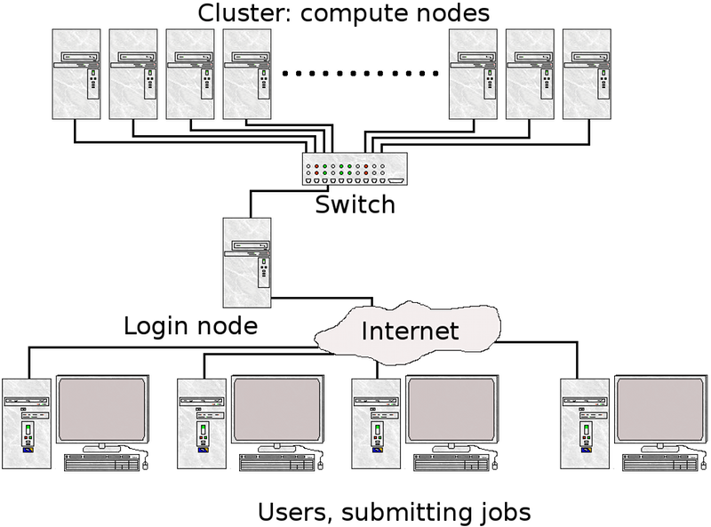
Recap of Super Computer cluster
The Super Computer is shared among the users. You are all competing for the available resources. This means CPU, RAM, storage and bandwidth.
The Queueing System will help you assign resources for your job. How you use the resources is up to you.
Storage
Your job
You
Keep the picture in mind for the following slides.

Slide 3
Distributed computing – the easy way
Some problems can be split up in several independent parts or subtasks. They can be recognized by realizing you can solve them on your laptop – one part at a time.
Examples:
The training af 1000 neural networks for identifying the best.
Sending 1000 proteins through a program or a pipeline.
This type of problems all have in common that the subtasks are repetitions of the same compute and the subtasks have little or no communication with each other. Often the dataset can be split up, analysed and results put together again. The success/failure of one subtask does not influence the other subtasks.
Problems with these properties are called embarrasingly parallel problems, as they are so easy to recognize and compute on in a distributed way.

Slide 4
Queueing Systems (ab)used
Any problem should first be analysed to which degree it is embarrasingly parallel, since a Queueing System will simply handle most of the problem for you in such case.
Task 1
Splitting data/jobs
Task 2
Collecting results
Submit to queue
Task 3
Pick up results
Task 4
For any/all sub tasks consider
1) Memory usage
2) Time usage
3) IO access
Submit appropiately

Slide 5
QS excels at embarrassingly parallel problems
A common way of structuring distributed compute of embarrassingly parallel problems. The problem is mostly administration of subtasks.
Administrator program
Split the dataset
Submit a number of workers to the QS
Worker program
Perform compute on part of the dataset
Save subresults
Collector program
Combine all subresults
Make final conclusion
The Administrator and the Collector can be combined if a way can be found to wait for all Workers to finish. That was a hint.
https://en.wikipedia.org/wiki/Parallel_computing
https://en.wikipedia.org/wiki/Embarrassingly_parallel

Slide 6
Estimating required RAM, CPU and time for a job
First of all – you learn by experience and guestimation.
RAM: Think about how large your input files are and how much of them you use in the program. Multiply by 4. Does your input explode inside the program? Think about the two largest data collections in your program.
CPU: If you made the program you know how many cores you use. Other standard programs like blast have an option deciding how many cores to use. If you don’t know; 1 core is a good bet.
Time: Better give it too much than too little. Keep an eye on time taking for all programs and you will learn.
The standard unix program ’top’ will show what processes are running and how much CPU and RAM they are using. Quite good for seeing actual figures. This requires that you do your run on an interactive node. This is fine in the development phase.
top –u pwsa

Slide 7
Distributed computing – the hard way
The problem can not be easily split into smaller task, which can be done independently – well, think hard once more.
The reasons for distributing the compute to several nodes can be:
RAM You need more RAM than one node holds.
IO The program is slow due to read/write of files.
CPU The program runs for too long, speed it up.
There are ways to distribute the compute even when we face non-embarrasingly parallel problems. The ways are of varying diffficulty and which you can use depends on the nature of the problem. It is often an art to do it well. More about this later.
The easiest way to speed up your program is to refactor it. Code the same problem in a new way – know your language and optimize.
You can easily gain RAM, IO and CPU by optimizing and thinking out of the box.

Slide 8
Extra explanation – apparently a difficult point to get
As taught in last week qsub requires a jobscript in order to submit a job to the Queueing System. The jobscipt is a file describing the job.
When you want Python (or another programming language) to submit to the QS, then Python must first create a jobscript, i.e. write a file with the jobscript content, before using qsub via subprocess.
This dynamic jobscript file creation is good to make systematic to minimize confusion and increase reproducability. It will also get easier to see what went wrong.
An interesting twist on this is that qsub can also run a job by getting the jobscript on STDIN. This means that the jobscript does not have to be a file. A simple useless example is:
echo ”ls –l” | qsub

Slide 9
Profiling
Profiling is the act of measuring the time the various parts of a program takes to complete. A program ususally spends more than 80% of the time in less than 20% of the code. The effort of optimizing should be spent the right place.
Simple time mesurements can be done with the time module.
import time
starttime = time.time()
# Here you insert some
# perhaps complicated code
# to be timed
endtime = time.time()
print ”This code took”, timeend-timestart, ”seconds”)
This method is often fine if you have an idea about where the time is spent in the code or if you want to measure several places. The time showed is actual wall clock time.

Slide 10
Real profiling
Python contains methods to profile code in more detail. Time spent in the various functions of the program is compiled and can be shown.
https://docs.python.org/3/library/profile.html
The standard profiler is rather confusing to use at least for a beginner and I can not really recommend it.
A quick test could be
python –m cProfile MyScript.py
When optimizing you must be prepared to spend time to test various ideas (in vain). Design your program from the beginning, so testing ideas are easy. You should also consider if your effort in making your program effecient is worth the trouble, if you only are going to run it a few times. However, you always learn from it.
Here is a nice post on performance analysis
https://www.huyng.com/posts/python-performance-analysis

Slide 11
Python – subprocess
https://docs.python.org/3/library/subprocess.html
Calling other programs from within Python is very powerful and is used for connecting programs/functions to your script without having to do a lot of coding yourself. Use the run convenience function for Python 3.5 or above, else the more complex Popen function for older Python or advanced use. Don’t give or get big data from your external program using the run function. It doesn’t scale.
import subprocess
# Just run a command, output appears on the screen
job = subprocess.run([’ls’])
# Run the job quietly – no output
job = subprocess.run([’ls’, ’-l’], stdout=subprocess.DEVNULL)
# Catch the output to be processed
job = subprocess.run([’ls’, ’-l’], stdout=subprocess.PIPE, universal_newlines=True)
lines = job.stdout.split(’\n’)
# Give input (entire input as string)
st = ’1,2\n3,4\nfive,six\n’
job = subprocess.run([’wc’], input=st, universal_newlines=True)

Slide 12
Python – subprocess and QS
The subprocess library can easily be used for submitting a job to the Queueing System. It can also catch the output, hence get the job id of the submitted job. Writing a function that uses qsub to submit the job with all the right options will be very useful. Since you have to write a jobscript as part of the function, put the option in the script, and find a way to uniquely identify them – perhaps a number.
The return value of such a function should be the job id.
It could also be useful to write a function, which uses subprocess (calling showq) to poll (query) the QS for finished jobs.
Polling the QS constantly is not a good idea, it can break down due to too much activity.
Introducing the python library time.
import time
# sleep/wait/do nothing for 1 second
time.sleep(1)
# sleep for ½ minute
time.sleep(30)
It is a good idea to wait 30 seconds between polls.

