Slide 1
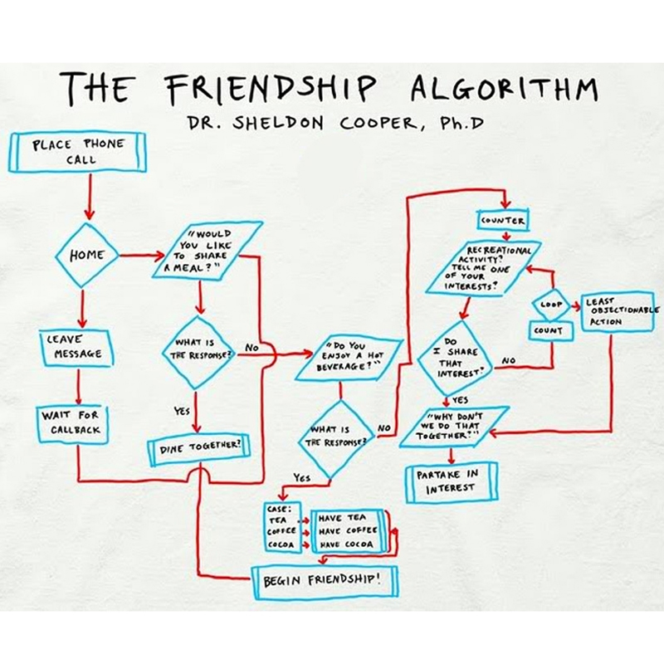
Algorithms ?
Peter Wad Sackett

Slide 2
The bulk work of HPC
A bioinformatician using a queueing system on a cluster spends most of the time making a pipeline or transforms data in simple ways, like splitting it in job-sized chunks, or formats output from one program to be used in another program. Sometimes harder decisions has to be made, like how many cores should be assigned to this program made by someone else.
This is all fairly simple and straight-forward work and can mostly only be optimized with regards to IO.
OK, the course is done.

Slide 3
Ideas to improve simple parallel execution
As already discussed, an easy way to improve the parallel execution of a job is to split the data up, perform the analysis on all chunks, and gather all results. Another easy way is to perform different analysis on the same data simultaneously, like neural network optimization. These two methods can of course be mixed.
How can the main programs (which you did not make) used in the analysis/pipeline be made to run faster using parallelism?
Some have options to use several cores (on the same node). Read the documentation and test it. Think about how it will affect the resources your job requires and submit accordingly.
Other programs has some base data they use for the analysis. Tailor the base to fit your needs.
Example; blast uses a generated database to blast your sequence against. Make the database as small as possible. Split the database up in 4 parts, make 4 parallel blast runs using 4 cores for each blast and aggregate the result. This way you have actually been using 16 cores for most of the work instead of the standard 1 core.

Slide 4
Why algorithms?
Any major new programming project benefits immensely from knowing about various general algorithms. One can simply look at a problem and see how a certain method/algorithm can apply, if you have a broad knowledge about algorithms.
Imagine not knowing about sorting and having to eliminate doublets in a list/array.
Sorting and searching are two ultra common techniques, and over time a great many algorithms have been developed for this for special purposes, or under certain circumstances. There is no need to invent your own.
Wikipedia is a good source for algorithms and their descriptions.
https://en.wikipedia.org/wiki/Sorting_algorithm
https://en.wikipedia.org/wiki/Category:Search_algorithms
https://en.wikipedia.org/wiki/Category:Algorithms

Slide 5
Divide and Conquer paradigm
Divide and Conquer is an algorithm design paradigm based on multi-branched recursion. A divide and conquer algorithm works by recursively breaking down a problem into two or more sub-problems of the same or related type, until these become simple enough to be solved directly. The solutions to the sub-problems are then combined to give a solution to the original problem.
Algorithms based on D&C are usually both efficient and easy to parallelize.
D&C are naturally recursive, but can also be implemented with an explicit stack (data structure).
It can be difficult to create a good D&C algorithm for a problem.
Example: binary search (special), mergesort, knapsack, sudoku.
https://en.wikipedia.org/wiki/Divide_and_conquer_algorithms

Slide 6
Optimization algorithms – difficult by nature
When you have a problem with many valid solutions and ask the question; ”Which is the best solution?” then it is an optimization problem.
It can be difficult to find an analytical best solution – meaning that the best solution can not be found from solving a set of equations.
Optimization problem example: Alignment of two sequences.
There a many ways to align two sequences, but the Needleman-Wunsch algorithm finds the best using an optimization strategy called dynamic programming.
The matrix used ensures that all possible combinations have been calculated and the right alignment can be followed through the matrix.
Other optimization problems can be much harder to solve, so what to do?
Sometimes you compromise and settle for ”good enough” instead of best.
If you want a more scientific explanation:
https://en.wikipedia.org/wiki/Optimization_problem

Slide 7
Heuristic algorithms – greedy by nature
Definition: A heuristic (algorithm) is a class of algorithms, which solves an optimization problem ”good enough”. Depending on the use/need, it results in one of
a good solution (not necessarily the best).
an estimate value not smaller than the value of the best solution.
an estimate value not larger than the value of the best solution.
It is usually much easier to make a heuristic than a true optimization algorithm.
Understand that any idea/algorithm that behaves like this, is a heuristic – it is not something specific you need to learn how to do.
An extremely common property of a heuristic is that the method is greedy. This means that the method when faced with a choice ALWAYS takes the best choice where most is immediately gained, disregarding eventual bad consequences that may follow.
Seems like some people we know.

Slide 8
Knapsack problem – the example heuristic
Indiana Jones have found treasure in the Temple of Doom. Unfortunately there is not enough space in his knapsack for all of it, so he must choose what to bring out, before Hell breaks loose.
A classic optimization problem.
Dr Jones knows the value and the size of all items in the treasure and his purpose is to bring out what he can carry that gives the biggest value together.
It is clear that he should take the items that gives him the best value for the size (greedy).
Dr Jones simply lines up (sorts) all the items after their value/size ratio, and starts putting the items from the expensive end into his knapsack until there can be no more. There will likely be some unused space, so he looks down the line for the last item he can stuff in.
This is a heuristic. It finds a good solution fast using a greedy method.
However, it may not be the best solution, as the method does not guarentee that.

Slide 9
Knapsack problem – the example optimization
If Dr Jones had more time, he could try all combinations of items, to see what would fit best in his knapsack. One of these combinations is guaranteed to be the best solution and it is easy enough to calculate the total value of his chosen items.
How to test all combinations?
Enter Divide and Conquer and the search tree: Initially the problem is that it has not been decided for any of the items if it should be chosen or not. This problem can be split in two subproblems, which are easier (less complex) to solve; a subproblem where item A is chosen to go into the knapsack, and a subproblem where item A is discarded. Now Dr Jones is only undecided on X-1 items for the two subproblems – much easier. One subproblem is put aside on a stack (list) of subproblems, while he works on the other.
By repeating this mechanism, eventually he will reach a subproblem where a decision has been made for all items if they have been chosen or not. He can now calculate the value and the total size.
The solution can be remembered if it is the best value seen so far, and the total size is no bigger than the space in the knapsack.
Now take an unsolved subproblem from the stack and continue the process. Eventually the best combination will be found.

Slide 10
Knapsack problem – the example improved
If Dr Jones calculates the size of the chosen items in a unresolved subproblem in the process, he can early on see the if the capacity of the knapsack has been exceeded, thus being able to throw the subproblem away as it is obvious that a solution will never be found in any of the choices this subproblem represents, no matter which items he later picks or not.
In a subproblem some decisions has been made about including some items and excluding other items. If Dr Jones could (over)estimate how good a solution it is possible to achieve based on these decisions, he might be able to throw the subproblem away, if it is clear that the choices made so far leads to a solution which can never be better than one already found.
Ahh, Dr Jones made a heuristic for that problem some slides ago. A slight change is needed. Calculating the total value and size for the already chosen items is easy. Now add the undecided items to the knapsack according to the heuristic, keeping track of total size and value. When he can not add more items due to size overflow, then cut the next item into a piece that fits the leftover space and add the appropriately reduced value. This is an overestimate – perfect.

Slide 11
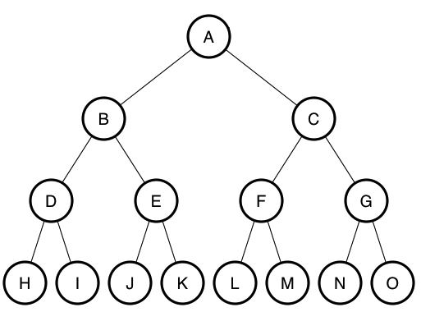
Branch and Bound
Dr Jones just used a Branch and Bound algorithm on the knapsack problem. He maximized one parameter (value) with a constraint on another (size).
Branch and Bound is a powerful Divide and Conquer method suitable for solving difficult (i.e. NP-complete) combinatorial optimization problems. Any number of constraints are possible, but only one (possibly compound) value can be optimized.
https://en.wikipedia.org/wiki/Branch_and_bound
The name comes from branching out in
subproblems in a search tree and when
constraints are violated or the estimate
(the upper bound in this case) show any
solutions in this part of the tree are bad
then the branch is cut, i.e. subproblem is thrown away.
It is important to be able to calculate a good bound as that enables the method to cut of branches high in the search tree, thus increasing performance.
The next slide will show pseudo code that explains the workings of Branch and Bound.

Slide 12
Branch and bound basic idea
Vectorize your problem (0=out, 1=in, x=undecided)
Put it on the stack, initialise bounds
whille problems on the stack
pop problem
calculate bound based on problem (heuristic)
if bound is worse than best_bound
continue
if problem is not solved
set a x to 1 and push subproblem to stack
set same x to 0 and push subproblem to stack
else if problem bound is better than best_bound
set new best_bound and best_solution

Slide 13
Practical example of different algorithmic ideas
MaxAlign
A tool to remove sequences (taxa) with many gaps in the post-process of alignments in order to improve the alignment area.
The presence of gaps in an alignment of nucleotide or protein sequences is often an inconvenience for bioinformatical studies. In phylogenetic analyses, for instance, gapped columns are often discarded entirely from the alignment.
MaxAlign is a program that optimizes the alignment prior to such analyses. Specifically, it maximizes the number of characters that are present in gap-free columns - alignment area - by selecting an optimal subset of sequences. MaxAlign can be used prior to any phylogenetic analysis as well as in other situations where this form of alignment clean up is useful, such as the presence of badly aligned or truncated sequences.

