Slide 1
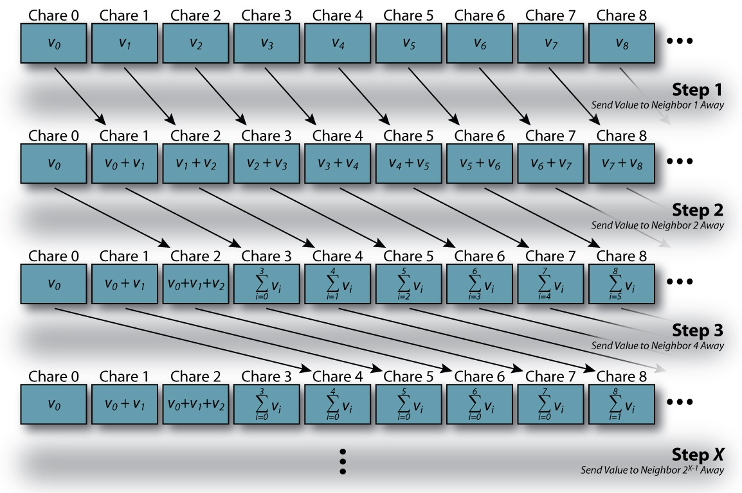
Programming in Parallel
Peter Wad Sackett

Slide 2
CPU-bound problems – no easy solution
When a problem is not embarrasingly parallel:
It is far easier to optimize your code than it is to parallelize it.
It is far easier to parallelize using the cores on a single node, than using many nodes (and their cores).
When parallelizing on many nodes, MPI is very often used or the MapReduce framework.
Python has a large collection of libraries to help you, including MPI.
https://wiki.python.org/moin/ParallelProcessing
Perl has a smaller collection, these 2 are well developed.
https://metacpan.org/module/MCE
http://search.cpan.org/~rcaputo/POE-1.367/lib/POE.pm
MPI is mainly available in C, C++, Fortran. You can find a Perl interface to the C MPI library.

Slide 3
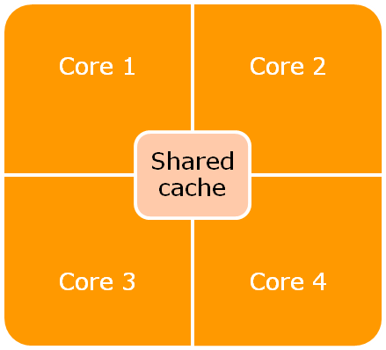
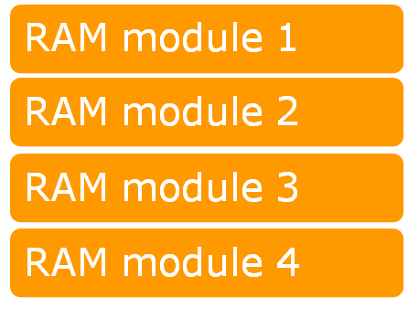
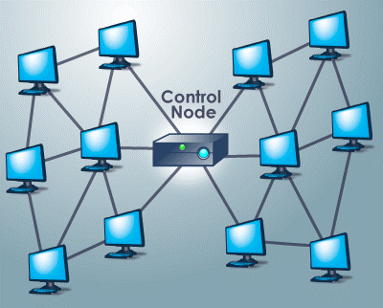
Explaining problems in parallelism
Performance and control layer

Slide 4
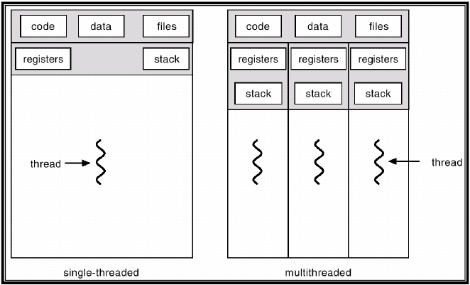
Single node parallel computation
Processes (forking) versus Threads
Threads generally have less overhead and faster communication
Processes are more robust and quite fast to create in linux

Slide 5
It does not matter
Enough theory – 95% do not use threads.
Threads do not work well with Python or Perl.
Python has the Global Interpreter Lock, which actually prevents threads from parallel execution.
Perl threads are just poorly implemented.
To make ”real” parallel programs with threads, use C, C++ or Java.
The rest will be about simple calling of external programs in Python and how to make simple embarrasing parallel jobs also in Python, but outside the Queueing System, on a node or just your laptop.
3 Python modules will be used; subprocess, multiprocessing and joblib. Only the last have to be separately installed (or use Anaconda).
pip install joblib

Slide 6
Python – subprocess refresher
https://docs.python.org/3/library/subprocess.html
Calling other programs from within Python is very powerful and is used for connecting programs/functions to your script without having to do a lot of coding yourself. It can even be used for simple parallelizing. Use the run convenience function for Python 3.5 or above, else the more complex Popen function for older Python or advanced use. Don’t give or get big data from your external program using the run function. It does not scale well.
import subprocess
# Just run a command, output appears on the screen
job = subprocess.run([’ls’])
# Catch the output to be processed
job = subprocess.run([’ls’, ’-l’], stdout=subprocess.PIPE, universal_newlines=True)
lines = job.stdout.split(’\n’)
# Give input (entire input as string)
st = ’1,2\n3,4\nfive,six\n’
job = subprocess.run([’wc’], input=st, universal_newlines=True)

Slide 7
Python – subprocess with Popen
Using the Popen function you can give or get huge amounts of data to your external program in the form of a data stream.
import subprocess
# Reading a gzipped file, offloading the CPU burden to external program
gzproc = subprocess.Popen([’/usr/bin/gunzip’ ,’-c’, ’ngs.gz’], stdout=subprocess.PIPE)
for line in gzproc.stdout:
# Compute on line
# Writing a gzipped file, offloading the CPU burden to external program
outfile = open(’/path/to/my/gzfile’, ’wb’)
gzproc = subprocess.Popen([’/usr/bin/gzip’ ,’-c’], stdin=subprocess.PIPE, stdout=outfile)
while loop is True:
gzproc.stdin.write(somedata)
gzproc.stdin.flush()
gzproc.stdin.close()
gzproc.wait()
outfile.close()
Here gzip is used as an example - use Python’s gzlib in real life.

Slide 8
Python - multiprocessing
https://docs.python.org/3/library/multiprocessing.html
This module contains the basic functionality necessary to
Start new processes – several ways
Manage a pool of workers
Communicate between processes – queues and pipes
Syncronize processes – semaphores
Share state – share memory
The module is actually great with a lot of valuable functionality. Anyone looking to make parallel programs in Python, like divide and conquer algorithms, should understand the module well.
The downside is that it is not easy to understand for the casual user and the programming API requires a very good understanding of the mechanisms of processes and Inter Process Communication (IPC).

Slide 9
Python - joblib
https://pythonhosted.org/joblib/index.html
Most user-made programs use parallelism in the embarrasing parallel way. It is the easiest to understand and to implement in any language.
This is where joblib steps in. It uses multiprocessing to create a simple and limited API that covers the common use. Here is an example using subprocess to call several external programs in parallel.
#!/usr/bin/env python
from joblib import Parallel, delayed
import subprocess
def syscall(command):
job = subprocess.run(command.split(),
stdout=subprocess.PIPE, universal_newlines=True)
result = job.stdout.split('\n')
return result
if __name__ == '__main__':
jobs = ['ls', 'ls -l', 'cat jobtest.py']
result = Parallel(n_jobs=3)(delayed(syscall)(x) for x in jobs)
print(result)

Slide 10
Python – joblib 2
joblib is perhaps better used for calling internal worker functions in Python.
#!/usr/bin/env python
from joblib import Parallel, delayed
def calc(x, y):
# Big calculation
result = x*y[0]/y[1]
return result
if __name__ == '__main__':
pairs = [ (x, y) for x in range(1,10) for y in range(6,37) ]
result = Parallel(n_jobs=4)(delayed(calc)(5, z) for z in pairs))
for res in result:
print(res)
print(”Sum:”, sum(result))
Functions that has to be called many times and takes a while for each call and are independent are great for this simple parallel execution.

Slide 11
Perl – Parallel::ChildManager
I have created a Perl module, that is similar to Python’s joblib, i.e. a simple interface to running several jobs in parallel.
It is installed on Computerome and can be used by
module load tools cbsperltools/1.0.0
Consult the man pages for details.
man Parallel::ChildManager

Slide 12
Parent/child relationship
When you fork - that is – create a new process which is a clone of your program, it is important to understand that you have two copies of the same program running. The copies do not share any data. There is a way for the program to know if you are the original/parent or the copy/child, and copies can act differently based on that.
Imagine that you have a data structure, say a list. When you have forked then both the parent and the child has their own copy of the list. If the child updates the list, this change is not reflected in the parent’s list and vice versa.
Any changes in the data structures must be communicated between parent and child. This is cumbersome and most parallel code is made so this communication is minimized.
Python’s joblib and Perl’s ChildManager both handle this by giving back results from the child to the parent in a way that is hidden from the users. The parent can then incorporate the results in it’s own data structures, and perhaps fork new children with new/more knowledge.

Slide 13
Parent/child relationship - warnings
Open file handles do not carry over well to children, when forking.
If you want to avoid problems, close your files before forking - reopen afterwards.
This is also relevant when using joblib or multiprocessing module.
This problem is indicated by getting ”pickle” errors.
When using joblib or other systems that transfers data between parent and children, remember to estimate the data transferred. The worker function in joblib transfers data back to the parent with the return call and the parent collect all the data from the children. The computer/node must be able to allocate all the memory required to do this..

