Slide 1
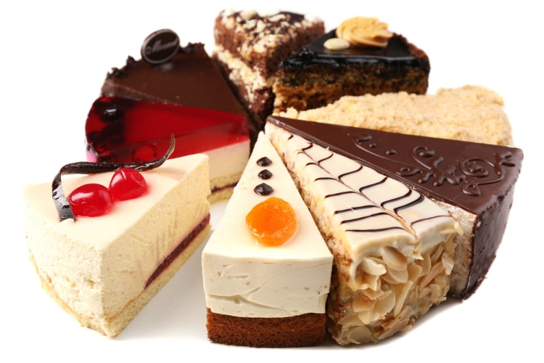
Fair distribution
Peter Wad Sackett

Slide 2
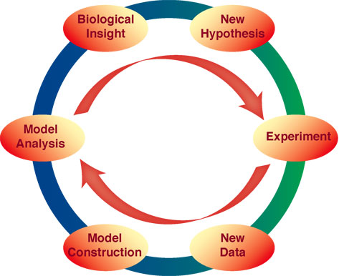
Methods are important in science
Bioinformatics uses computers to solve problems.
Requirements for a bioinformatician:
Biological knowledge (obvious)
Statistics
Analyzing problems
Designing methods

Slide 3
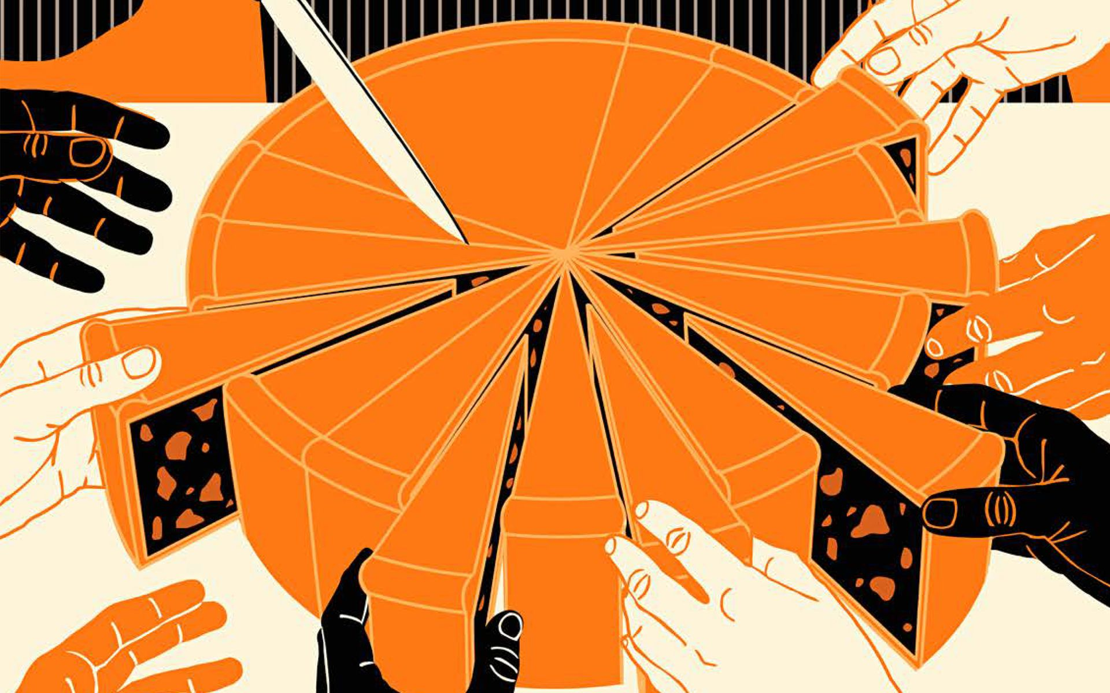
Methods for sharing a cake
Given a number of people and given a cake cut out in different sizes.
How do you share the cake equally?

Slide 4
Making a concrete problem
We have a cake cut in pieces. This is the size of the 20 pieces:
35.3 33.3 22.8 44.9 78.5 16.2 87.0
74.2 37.8 12.2 79.2 7.1 45.3 42.9
17.3 68.8 46.4 69.9 28.2 60.8
The size of the pieces are completely random and not designed for this thought experiment.
How do we distribute the pieces, so Alex, Brit, Carol and Denis get approximately the same amount? There is no extra cutting of cake.
What is the method ?
Group discussion

Slide 5
The importance of sharing cake equally
Why is this important?
Because the equal sharing of cake is the same problem as:
Having 20 computer jobs with different running times, that need to done as fast as possible on 4 different nodes on a supercomputer.
Having 20 office tasks that need to be shared among 4 office workers so they leave at the same time.
A more general formulation of the problem: Having X tasks that needs to be done by Y workers with an equal load on each worker.
This problem is known as a load balancing problem.

Slide 6
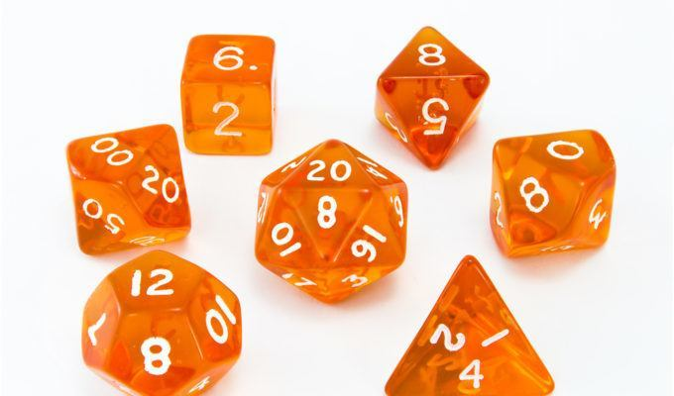
Method: Random Assignment
We distribute the cake randomly.
This means picking a random person to get a random piece of cake left. Some might get a lot of pieces, some might get few.
Requires a lot of luck to distribute the cake evenly.
In other words, some will likely get much more cake than others.

Slide 7
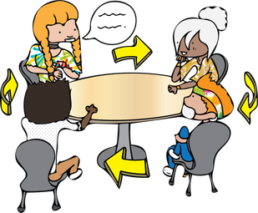
Method: Round Robin
Everybody takes a turn in order to pick a piece of cake. The round is over when everybody got a turn. If there is more cake left, you start a new round of cake picking in the same turn order.
An important part of this idea is: what piece do you pick when it is your turn.
It is assumed that when it is your turn to pick, you are greedy and pick the largest piece.
Notice that an initial turn order is made at random and kept through the entire process.
A problem in this strategy is that the first person will always get more than the rest.
Also note that as part of the solution we sorted the cake pieces according to size.

Slide 8
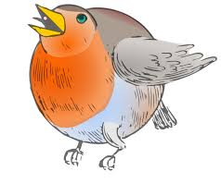
Method: Max-Min Round Robin
Very similar to Round Robin. In the first round everybody pick the largest piece left when it is their turn. The following round everybody picks the smallest piece left. The round after everybody picks the largest piece and so forth. Repeat until no more cake.
As can be seen, the method also requires an initial sorting of the cake pieces.
Notice that the same turn order is kept through the rounds.
The method is not bad as some care has been taken to distribute the cake evenly. However strange distributions can make the method go awry.

Slide 9

Method: Reverse Round Robin
Also similar to Round Robin, but when everybody has taken a piece and the round is over, the the turn order is reversed for the next round. Repeat until no more cake.
The basic idea is that the person who got the smallest piece in the previous round get the largest piece in the next round.
So Alex, Brit, Carol and Denis take cake pieces in this order:
A, B, C, D, D, C, B, A, A, B, C, D, D, C, B, A, A, B, C, D and so on.
The different Round Robin methods are turn based approaches that requires a sorting. Everybody gets a turn to take a piece of cake.
Everybody gets approximately the same amount of pieces, but the size of the pieces is not taken into consideration, except for the initial sorting.

Slide 10

Method: Least Load
Give to those who have the least.
We sort the pieces according to size - biggest piece first. Now give cake pieces (the biggest left) to the one who have the least, until no more cake.
Quite good strategy. Giving a big piece to anybody tends to unbalance the situation. By giving the biggest pieces away first, then the small pieces in the end are given to those who need it the most. This gives a fairly good/even distribution.
A significant change from the Robin methods is that we go away from a turn based approach.

Slide 11
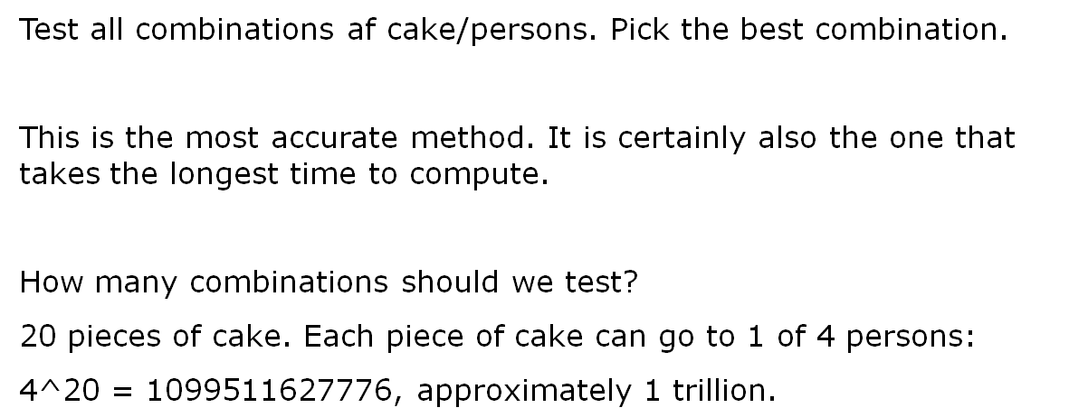
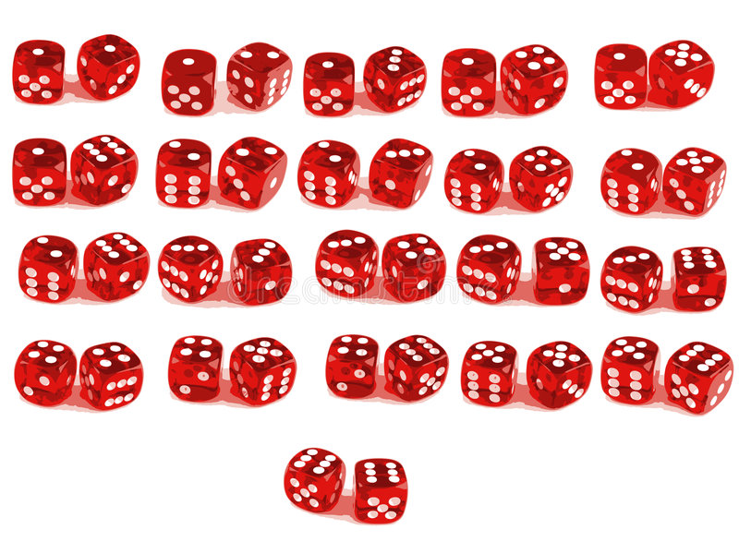
Method: All Combinations

Slide 12
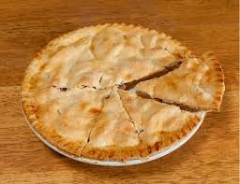
Evaluation of the methods
How to decide which method is good?
After trying the methods on our data set, we look at the range of the results. The difference between the person who got most cake and the person with least cake should be as small as possible.

Slide 13
Results: Random Assignment
Range: 132.1 - 302.1 Difference: 170
Alex Brit Carol Denis
69.9 79.2 78.5 87.0
44.9 60.8 74.2 68.8
17.3 45.3 46.4 42.9
33.3 37.8 28.2
16.2 35.3 12.2
22.8
7.1
132.1 234.8 302.1 239.1

Slide 14
Results: Round Robin
Range: 188.3 – 254.8 Difference: 66.5
Alex Brit Carol Denis
87.0 79.2 78.5 74.2
69.9 68.8 60.8 46.4
45.3 44.9 42.9 37.8
35.3 33.3 28.2 22.8
17.3 16.2 12.2 7.1
254.8 242.4 222.6 188.3

Slide 15
Results: Max-Min Round Robin
Range: 211.0 – 233.3 Difference: 22.3
Alex Brit Carol Denis
87.0 79.2 78.5 74.2
7.1 12.2 16.2 17.3
69.9 68.8 60.8 46.4
22.8 28.2 33.3 35.3
45.3 44.9 42.9 37.8
232.1 233.3 231.7 211.0

Slide 16
Results: Reverse Round Robin
Range: 218.8 - 235.7 Difference: 16.9
Alex Brit Carol Denis
87.0 79.2 78.5 74.2
46.4 60.8 68.8 69.9
45.3 44.9 42.9 37.8
22.8 28.2 33.3 35.3
17.3 16.2 12.2 7.1
218.8 229.3 235.7 224.3

Slide 17
Results: Least Load
Range: 225.3 – 229.5 Difference: 4.2
Alex Brit Carol Denis
87.0 79.2 78.5 74.2
46.4 60.8 68.8 69.9
45.3 44.9 37.8 42.9
35.3 33.3 28.2 22.8
12.2 7.1 16.2 17.3
226.2 225.3 229.5 227.1

Slide 18
Results: All Combinations
Range: 226.9 – 227.1 Difference: 0.2
Alex Brit Carol Denis
46.4 69.9 78.5 87.0
37.8 68.8 74.2 79.2
35.3 45.3 44.9 60.8
33.3 42.9 17.3
28.2 12.2
22.8
16.2
7.1
227.1 226.9 227.1 227.0

Slide 19
Conclusion
Alex Brit Carol Denis DIFF
Random Assignment 132.1 234.8 302.1 239.1 170.0
Round Robin 254.8 242.4 222.6 188.3 66.5
Max-Min Round Robin 232.1 233.3 231.7 211.0 22.3
Reverse Round Robin 218.8 229.3 235.7 224.3 16.9
Least Load 226.2 225.3 229.5 227.1 4.2
All Combinations 227.1 226.9 227.1 227.0 0.2

