Slide 1
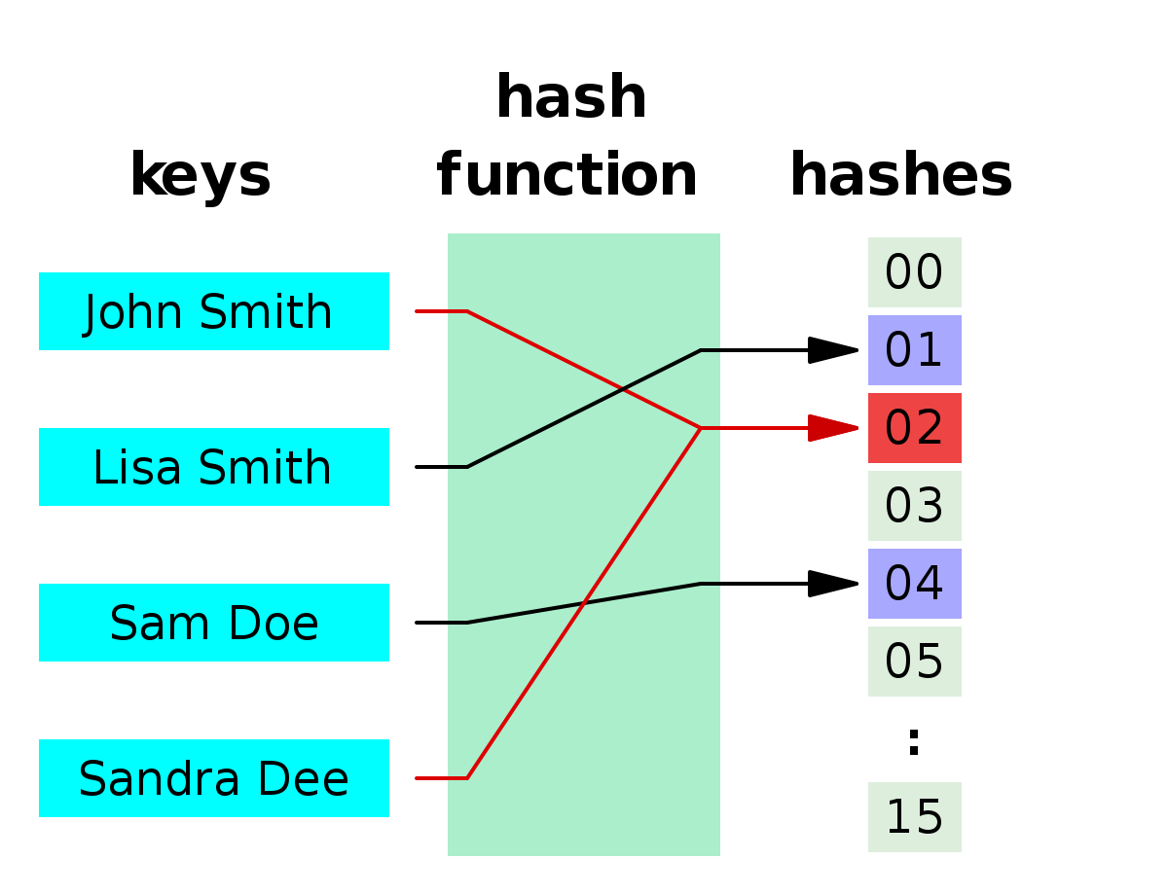
The use of hash
Peter Wad Sackett

Slide 2
Hash function - hashes
A hash function is a function that takes an arbitrary large input and gives an output of fixed size. An example input could be a sequence, a mail, a document, a program, a name and the output could be 2/4/8/16/32 bytes. It is essential that the function is deterministic, i.e. the same input gives the same output.
An example of a simple hash function is the cyclic redundancy check. Given a any sequence of bytes, you perform the XOR operation on subsequent byte pairs. Using a protein sequence: MVSFKLPA
MV in bits: 0100110101010110
SF in bits: 0101001101000110
xored together: 0001111000010000
KL in bits: 0100101101001100
xored: 0101010101011100
PA in bits: 0101000001000001
xored: 0000010100011101
The result is the last byte pair which in hex is 051D. This is the hash of the sequence. There are 20^8 different input combinations of 8 AA squashed down to 2^16 output combinations – and the input sequence could easily be longer.

Slide 3
Generally desired properties of hash functions
Collision resistance:
Since the possible input space is much larger than the possible output space, then obviously some input must generate the same output. This is called a collision. A hash function is generally desired to be collision resistant, i.e. it is hard to find two input that gives the same output.
Uniformity:
The input should map evenly to the entire output space. Every output should be generated with roughly the same probability.
Non-invertible:
It is not realistic to reconstruct the input from knowing the output.
Continuity – or not:
Two input that differ little is mapped to output that differ little. Bad for cryptographic hash, good for certain applications.
There are other less significant properties that might be desired depending on the use of the hash function.

Slide 4
Use of hash functions
A hash function is used in Python for dicts and sets. The key is hashed to give an index number in a list.
Hash functions are very much used in the field of cryptographics, where the properties collision resistance, uniformity, non-invertiveness and non-continuity are mandatory. The SHA family are great, if somewhat expensive hash functions in this field.
Hash functions are often used with big data. Sometimes to reduce dimensionality, other times to fingerprint data/sequences.
As an example the primary key in a database of sequences can be the MD5 sum (wellknown hash function) of the sequence.
Generally you should not design your own hash function (difficult and performance poor in python). Use instead a library in your language of choice. Python uses hashlib.

Slide 5
Hash function tricks
The MD5 hash function gives a 128 bit (16 bytes) hash of the input (any size). If less bits, like 20 bits are needed, they can be taken from anywhere of the 128 bits.
In some algorithms/methods more than one hash function result is needed for the same input. In such cases it is OK to use several non-overlapping slices of the hash. As an example an MD5 hash will support 6 20-bit hashes.
It is also possible to use the same hash function to generate different hashes from the input. Just add a constant to the input.
H(input + K1), H(input + K2), H(input + K3), etc.
These tricks only work due to the properties; collision resistance and uniformity and non-continuity.
Note that if a non-power-of-two range of numbers are needed from the hash - say a number between 0 and 10000 – then it can be gotten by dividing the hash value with 10001 and using the remainder. However, if slices are desired, then the slice size must be at least 5 bits wider than strictly necessary, due to the effects of the modulo division on the uniformity property.

Slide 6
Bloom filter
The bloom filter is a very fast and memory efficient probabilistic data structure that tests if an input is a member of a set. The answers are ”definitely not” or ”in set with a false positive rate”.
It works with a bit array of m bits and k different hash functions. In Python a bytearray is used with appropriate indexing.
When entering an element in the filter, the k hashes of the element/input are calculated and the k bits that the hash values point to in the bit array are set to 1.
When querying the filter, the k hashes are calculated and the k bit positions are checked. If one (or more) bits are 0, the element is not in the filter.
Elements can not be removed from the filter.
Two filters using the same size and hash functions can combine perfectly as a union with bitwise OR. Intersection can be done with bitwise AND, but the false positive probability rate is no better then the worst of the original filters.

Slide 7
Bloom filter calculations
The size of the bit array, m, and the number of hash functions, k, can be calculated, given the desired false positive rate, p, and the number of elements in the filter/set, n. These formulas assume optimal information content in the filter, i.e. half the bits are set.
m = (-n*ln(p)) / (ln(2)^2)
k = ⌈ -ln(p) / ln(2) ⌉
Often m is increased so it hits a power of 2 as that fits well with a bit field from a hash function.
Given that m, k and n are known, p can be calculated:
p = (1-e^(-k*n/m))^k
Example: 1000 elements in set, desired false positive rate of 1%.
m = (-1000 * ln(0.01)) / ln(2)^2 = 9585 ~ 16384 bits. In a bytearray, this is 16384/8 = 2048 bytes. In order to represent 16384 different positions 14 bits are needed from the hash function.
k = -ln(0.01)/ln(2) = 6.64 ~ 7 different hash functions.
p = (1-e^(-7*1000/16384))^7 = 0.06%
Due to the power-of-two increase of m, k can be decreased to 3 while still having a p below 0.5%.

Slide 8
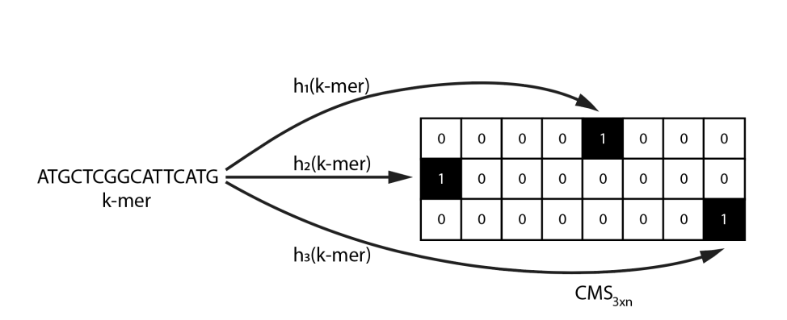
Count-min sketch
Method for continuous estimated frequency calculation. Requires a matrix (called a sketch) with w columns and d rows. With each of the d rows is an associated hash function.
Example of using a count-min sketch to count k-mers.
Figure by Kosai Al-nakeeb
For each new input, calculate the d hashes to obtain a column number and increment the number indicated by 1.
When querying the sketch for a count, calculate the d hashes to obtain the column numbers and pick the smallest number indicated by the columns. The true count is never larger than the number.
Input can continuously be added to the sketch in a stream, and can be queried at any time.
A problem is that a count-min sketch is a biased estimator; it will never underestimate, but may overestimate the true count of the input.

Slide 9
Count-min sketch formulas
Determining the number of columns, w, and rows/hash functions, d, is done by choosing a small number close to 0, ε, which is an additive error rate, and a probability for error, δ, such that
w = ⌈e/ε⌉
d = ⌈ln 1/δ⌉
Denoting the estimated count, â, the true count, a, and number of input, N, it is guaranteed that â <= a + ε*N, with probability 1 – δ.
Hence, ε is determining an upper limit for the overestimation - the tolerable error, and δ is determining the probability of the estimate exceeding that limit.
Note that two sketches using the same w, d and hash functions can be combined by simple addition. This enables scaling by splitting up the data set, and distributing the sketching to several nodes.

Slide 10
Count min sketch – handling bias
There are some techniques to minimize the overestimation of a standard count-min sketch. The best is conservative update.
When updating the sketch with new input, first query the sketch for the smallest number. Then increment only the columns in the rows that has this smallest number.
Thus the noise from collisions are minimized – leading to better estimates. The theoretical limits are not changed by this technique, but in practice the results are better.

Slide 11
MinHash
The Jaccard similarity coefficient is often used to show the similarity between two sets A and B. It is a number between 0 and 1.
J(A,B) = |intersection(A,B)| / |union(A,B)|
Calculating the intersection and union of two large sets is costly both in cpu time and memory.
Instead the signature of the sets are calculated and compared. A signature is created by hashing all elements of a set, and picking the k lowest hashes, so the signature is simply a list of k numbers.
Let sig(A), sig(B) be the signatures of set A and B. A Jaccard estimate is calculated from two signatures by picking the lowest k hashes from union(sig(A), sig(B)), denoted X. Now calculate intersection(X, sig(A), sig(B)), denoted Y. The estimate is |Y|/k.
Because the hash function maps ”randomly” then X is a random sample of union(A,B), hence standard Chernoff bounds are used, leading to the estimate is unbiased and has an expected error of 1/sqrt(k).
Note that signatures can be calculated on different nodes and stored for later use => scalability.

Slide 12
Links
https://en.wikipedia.org/wiki/Hash_function
https://en.wikipedia.org/wiki/Bloom_filter
https://en.wikipedia.org/wiki/Count-min_sketch
https://en.wikipedia.org/wiki/MinHash
https://genomebiology.biomedcentral.com/articles/10.1186/s13059-016-0997-x

