Slide 1

ASSOCIATION RULE MINING
Diabetes Hospital Readmission Patterns
Healthcare Pattern Discovery Using Orange Canvas
Rakshan Urooj Syed
Data Mining and Predictive Analytics
Piotr Szczurek
Notes:
Welcome the audience. Introduce yourself, the course, and the project title. State in one sentence what the project is about: using association rule mining to discover patterns linked to early hospital readmission in diabetic patients. Mention this is a 15-minute walkthrough of the dataset, method, and findings.

Slide 2




Project Goal
Find patterns linked to 30-day readmission
Use association rule mining
Not prediction.
Not causation.
Pattern discovery.
Focus on interpretable healthcare insights
Notes:
Explain that the goal is not prediction or causation, but discovering useful patterns. We are not building a model to predict who gets readmitted — we are mining the data to find which combinations of factors tend to occur together with early readmission.

Slide 3






Dataset Overview
SOURCE
Data Domains Covered
UCI Machine Learning Repository
DATASET
Hospital
Lab
Diabetes 130-US Hospitals (1999–2008)
RECORDS
Diabetic patient hospital encounters
Medication
Readmission
Notes:
Introduce the dataset: Diabetes 130-US Hospitals, covering ten years of diabetic patient encounters across many U.S. hospitals, from the UCI Machine Learning Repository. Each row is one hospital encounter. The dataset includes hospital stay details, lab results, medications, and readmission outcomes.

Slide 4


Basket-and-Item Setup
Basket
Items
Outcome
One hospital encounter
Patient / hospital attributes
readmitted = <30
Example: number_inpatient high + A1C missing → early readmission
Notes:
Explain the market-basket analogy: each hospital encounter is treated as one basket. The items inside that basket are categorized patient and hospital attributes. The outcome we focus on is whether the patient was readmitted within 30 days. Walk through the example: a high number of prior inpatient visits combined with a missing A1C result tends to co-occur with early readmission.

Slide 5




Preprocessing
Selected meaningful healthcare variables
Moved IDs / code-heavy fields out of mining
Removed noisy rare medication columns
Discretized numeric variables
Notes:
Walk through preprocessing briefly. We kept healthcare-relevant variables, set identifiers and code-heavy fields aside as meta data, removed rare individual medication columns because they created unhelpful 'no medication' rules, and discretized numeric fields into three equal-frequency categories so they could be mined as items.

Slide 6
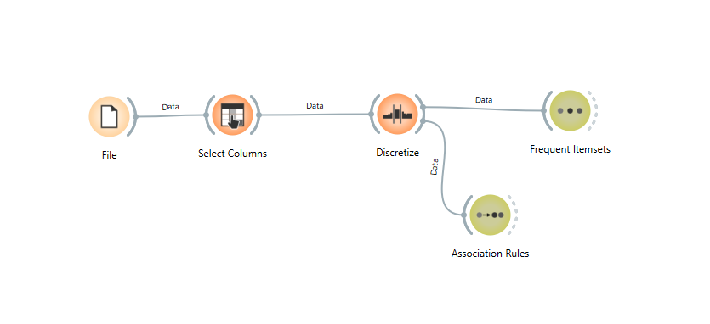

Orange Workflow
PASTE HERE: Orange Canvas workflow screenshot
(File → Select Columns → Discretize → Frequent Itemsets / Association Rules)
Notes:
Walk through the Orange Canvas pipeline shown in the screenshot. The File widget loaded the dataset. Select Columns kept the useful healthcare variables. Discretize converted numeric variables into categories. From there the workflow branched: Frequent Itemsets was used to explore common item combinations, while Association Rules generated the final if-then rules tied to early readmission. [PRESENTER NOTE: Replace the placeholder box on this slide with your actual Orange Canvas workflow screenshot before presenting.]

Slide 7



Rule Mining Metrics
Support
How often the rule appears in the dataset
Confidence
How often early readmission appears
Lift
How much stronger the rule is vs. random chance
Notes:
Briefly define the three metrics used to evaluate rules. Support tells us how common the pattern is. Confidence tells us how reliable the rule is — when the left side is true, how often does early readmission follow. Lift tells us how much stronger this association is compared to what we'd expect by random chance.

Slide 8
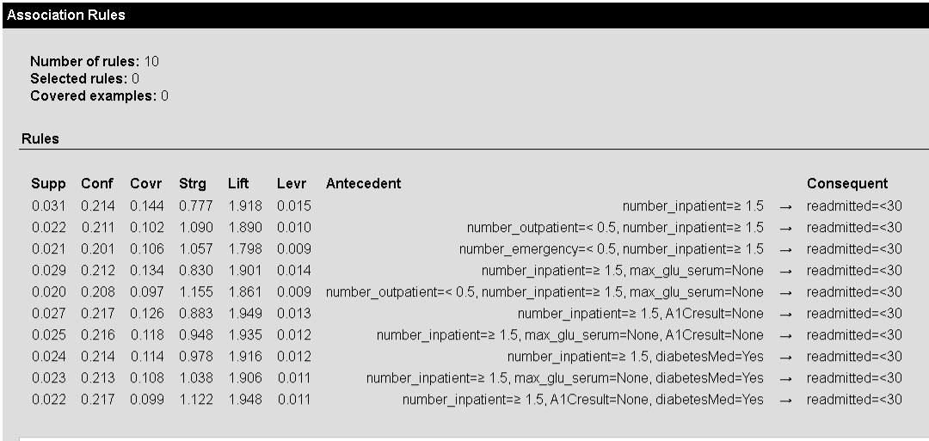
Final Rule Settings
readmitted=<30
2%
20%
3
10
OUTCOME
MIN. SUPPORT
MIN. CONFIDENCE
ANTECEDENT MAX
RULES FOUND
PASTE HERE: Association Rules screenshot
(readmitted=<30, support 2%, confidence 20%, 10 rules found)
Notes:
Explain that these settings gave a small, interpretable rule set. Stricter support and confidence thresholds did not return useful early-readmission rules, so we settled on 2% minimum support and 20% minimum confidence, with up to three antecedent items, which produced ten focused, explainable rules. [PRESENTER NOTE: Replace the placeholder box on this slide with a small cropped screenshot of the Association Rules widget showing these settings and the 10 results.]

Slide 9
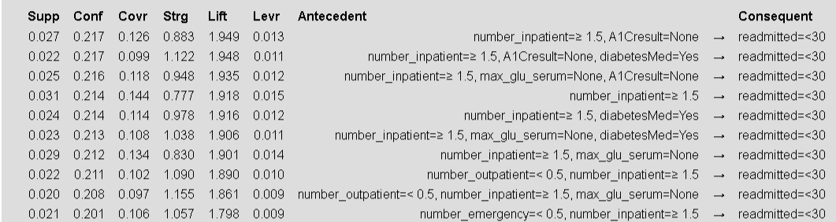

Top Rules by Lift
# | Rule (→ readmitted = <30) | Lift
1 | number_inpatient ≥ 1.5, A1Cresult = None | 1.949
2 | number_inpatient ≥ 1.5, A1Cresult = None, diabetesMed = Yes | 1.948
3 | number_inpatient ≥ 1.5, max_glu_serum = None, A1Cresult = None | 1.935
Higher lift = stronger association than random chance, these are the strongest patterns found
PASTE HERE: Lift-sorted Orange results
(cropped to top rules)
Notes:
Present the three rules with the highest lift, meaning the strongest association relative to chance. All three center on patients with one and a half or more prior inpatient visits, combined with a missing A1C result, and in the second rule, also being on diabetes medication. [PRESENTER NOTE: Replace the placeholder box with a cropped screenshot of the Orange results sorted by Lift, showing just the top rules.]

Slide 10
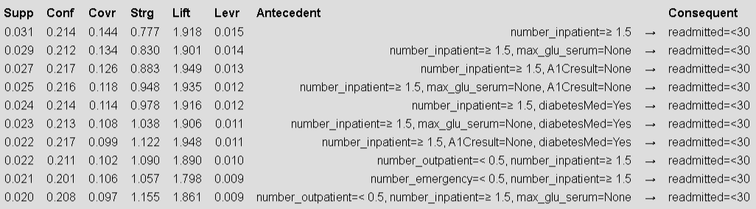
Top Rules by Support
Rule (→ readmitted = <30) | Support
number_inpatient ≥ 1.5 | 0.031
number_inpatient ≥ 1.5, max_glu_serum = None | 0.029
number_inpatient ≥ 1.5, A1Cresult = None | 0.027
Higher support = pattern appears more often in the dataset; these are the most common early-readmission patterns found.
OPTIONAL: small Support-sorted Orange screenshot
Notes:
These rules balance support and confidence — they are common enough to matter and reliable enough to trust. Note the consistency: every top rule includes a high count of prior inpatient visits, sometimes paired with a missing glucose or A1C result. [PRESENTER NOTE: If space allows, add a small cropped screenshot of the Orange results sorted by Support/Confidence below the table — keep it small so the table stays the focus.]

Slide 11
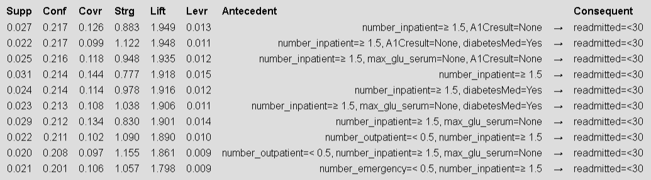
Top Rules by Confidence
Rule (→ readmitted = <30) | Confidence
number_inpatient ≥ 1.5, A1Cresult = None | 0.217
number_inpatient ≥ 1.5 | 0.214
number_inpatient ≥ 1.5, max_glu_serum = None | 0.212
Higher confidence = early readmission happens more often when the pattern appears These rules are ranked by confidence, meaning they show the patterns where early readmission appeared most often when the left-side conditions were present.
Notes:
These rules balance support and confidence — they are common enough to matter and reliable enough to trust. Note the consistency: every top rule includes a high count of prior inpatient visits, sometimes paired with a missing glucose or A1C result. [PRESENTER NOTE: If space allows, add a small cropped screenshot of the Orange results sorted by Support/Confidence below the table — keep it small so the table stays the focus.]

Slide 12

Best Overall Rules
Rule 1
Rule 2
Rule 3
Prior inpatient visits → early readmission
Prior inpatient visits + missing A1C → early readmission
Prior inpatient visits + missing A1C + diabetes medication → early readmission
Notes:
Highlight why these three were selected as the best overall rules: they are simple, interpretable, statistically meaningful, and clinically sensible. Each builds on the last — starting from prior inpatient visits alone, then adding a missing A1C result, then adding active diabetes medication.

Slide 13





Practical Healthcare Value
Where the statistics become decision-support
Flag patients for follow-up
Support discharge planning
Encourage medication review
Improve diabetes monitoring
Guide care coordination
Notes:
This is the practical value slide. Explain that the value of these rules is not just statistical — hospitals could use these patterns as decision-support signals to identify patients who may need extra follow-up, medication review, diabetes education, or care coordination before or after discharge.

Slide 14

Limitations
Association, not causation
Historical dataset
Missing values need caution
Clinical validation required
Notes:
Be upfront about limitations. These rules show association, not medical causation. The dataset is historical, from 1999 to 2008. Missing lab results may reflect documentation gaps rather than lack of care. These rules should support clinical decision-making, not replace it, and more validation would be needed before real clinical use.

Slide 15



Conclusion
Prior inpatient history was the strongest pattern
Missing A1C / glucose results added useful context
Rules can support follow-up and discharge planning
Best rules were simple, interpretable, and actionable
Notes:
Summarize the project. The strongest pattern was prior inpatient history. Missing A1C or glucose serum results added useful context, possibly pointing to monitoring gaps. These rules can support follow-up and discharge planning, and the best rules we found were simple, interpretable, and actionable — exactly what's needed for real hospital decision-support.

Slide 16

References
DATASET
Strack, B., DeShazo, J.P., et al. Diabetes 130-US Hospitals for Years 1999–2008. UCI Machine Learning Repository.
SOFTWARE
Demšar, J., et al. Orange: Data Mining Toolbox in Python. Orange Data Mining documentation.
METHODOLOGY
Agrawal, R., Imieliński, T., & Swami, A. Mining association rules between sets of items in large databases.
Notes:
Thank the audience and offer to answer any questions about the dataset, methodology, or findings.

Slide 17
Thank You
Notes:
Summarize the project. The strongest pattern was prior inpatient history. Missing A1C or glucose serum results added useful context, possibly pointing to monitoring gaps. These rules can support follow-up and discharge planning, and the best rules we found were simple, interpretable, and actionable — exactly what's needed for real hospital decision-support.

